Slide 1
Parallelization of K-means Clustering Model for chest X-Ray images using CUDA and OpenMP
By: Juhi Checker
Rohnie Baskar
Piyush Kulkarni

Slide 2
Problem Statement
Image classification algorithms such as K-means used for classifying large image datasets takes a lot of time to perform operations, thus increasing the computational demand of image processing. In this project, patients' X-Ray images are taken as a dataset and classified as having Pneumonia or not. The K-means algorithm is used for this classification. In a large dataset serial K-means require a lot of time for computation of centroids. Instead, this whole algorithm can be parallelised using the OpenMP and CUDA framework and also improve data locality which will optimise the computational process. Additionally, the comparison between the performance of the two is also analysed.
Notes:
It is seen that A global population of 7% is affected by pneumonia, which kills around billions of people a year. Even a trained radiologist can find examining chest X-rays challenging. in our project to improve the accuracy and speed of the diagnostic process, we have taken these patients' X-Ray images and classified them into Normal X-ray or X-ray with Pneumonia. The K-means algorithm was used for this classification. In a large dataset usually serial K-means require a lot of time for computation of centroids. Instead, this whole algorithm can be parallelised using the OpenMP and CUDA framework. Additionally, the comparison between the performance of the two is analysed.

Slide 3
Dataset
Training
Used dataset available on Kaggle.
Consists of 10 images each of Normal X-Ray and X-ray with Pneumonia.
Dataset consists of 31.6M datapoints.
Dataset is unlabelled data.
Testing
Used the 3 images of to test the model individually.
Classes
Normal
Pneumonia
Notes:
We downloaded dataset from kaggle named chest-xray-pneumonia
The Dataset was in Jpeg format
For training the model using K-means we took around 10 images from normal X-ray and X-ray with pneumonia. There were a total of 31.6M data points. Whereas, for testing the model with a new dataset we took 3 images.

Slide 4
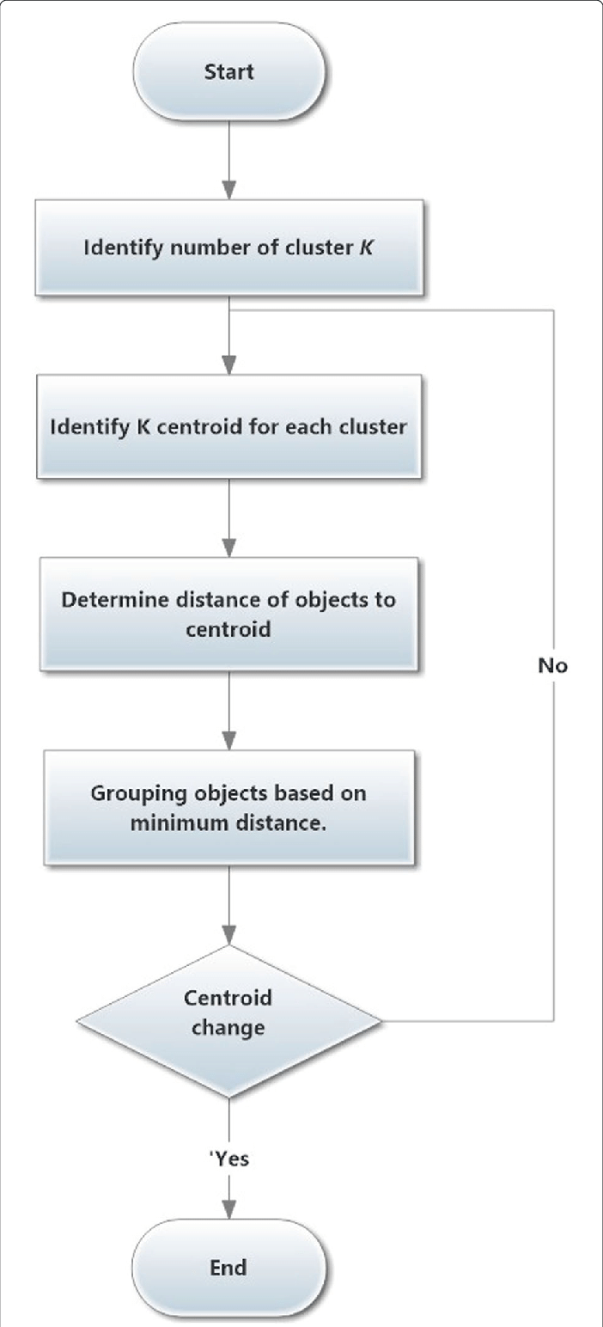
Standard approach to solve K-means Algorithm
https://www.researchgate.net/publication/328411264/figure/fig2/AS:683977018966027@1540084237543/K-means-clustering-algorithm-The-steps-of-K-means-clustering-algorithm-are-outlined.png
Notes:
Now, lets have a look at the traditional k-means algorithm and how it works.
Set K as the number of clusters we want to form.
We need to initialise these centroids for the K clusters. It can be either randomly initialised or initiliased with any of the data points inside the dataset.
Calculate the squared distance between all data points and all centroids.
And then Match each data point with its nearest cluster (centroid).
Using the average of all points belonging to each cluster, determine the new centroids for the clusters.
We need to do this in a loop till there is no major difference between new centroids and previous ones.

Slide 5
Parallelizing Strategies
The following are the frameworks used for parallelization:
OpenMP
CUDA
Notes:
There were two frameworks we used for parallelising K-means algorithm..
Openmp
And CUDA

Slide 6
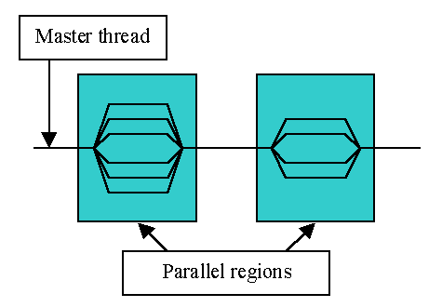

Parallelizing Strategy
OpenMP
(Open Multi-Processing)
OpenMP (Open Multi-Processing) is an application programming interface (API) that supports multi-platform shared-memory multiprocessing programming in C, C++, and Fortran.
The section of code that is meant to run in parallel is marked accordingly, with a compiler directive that will cause the threads to form before the section is executed.
The runtime environment allocates threads to processors depending on usage, machine load and other factors.
Notes:
Moving on to OMP Framework.
We know that OpenMP is an API that supports multi-platform shared-memory multiprocessing programming.
With the help of simple and easy to use compiler directive it runs sections of code parallely. It allocates threads to processors depending on usage, machine load and other factors.

Slide 7
Parallelizing Strategy
OpenMP
Take training/testing input images as a text file with all the pixels of the images in a list.
Equally divide the data points array amongst each of the threads available.
Centroids are initialized and shared among all the threads.
For each iteration, each thread calculates the euclidean distance between all the data points they have in their assigned chunk of the array and the two centroids.
Next, with the distances it will classify the datapoint into one of the two clusters whose centroid is the closest.
All the assigned datapoint values will then be added to a local sum variable for each cluster.
Each thread will compute average global centroids for the two clusters. This particular section needs to be done one at a time hence using the critical construct.
Only after every thread computes the above step, one thread will find the distance between the old centroid and new centroid. If the distance computed is less than the threshold defined, it will break the loop and give the two cluster centroid points, else it will train again.
Only after every thread computes the above step, each thread will increment its local iterator.
This process is repeated until the maximum number of iterations is reached or finds the proper centroid.
Notes:
The parallelizing strategy was as follows,
First the training/testing images are taken in a text file with all the pixels of the image in a list

Slide 8

Parallelizing Strategy
CUDA
(Compute Unified
Device Architecture)
CUDA is a parallel computing platform and application programming interface (API) that allows software to use certain types of GPU for general purpose processing .
It is a software layer that gives direct access to the GPU's virtual instruction set and parallel computational elements, for the execution of compute kernels.
The CUDA platform is accessible to software developers through CUDA-accelerated libraries, compiler directives such as OpenACC, and extensions to industry-standard programming languages including C, C++ and Fortran.

Slide 9
Host
(CPU)
Main Memory
Device
(GPU)
Transfer data and copy back results
Instructions (Kernel function calls)
Memory for GPU
Each blocks executes a team of threads in parallel
Basic CUDA Architecture

Slide 10
Host
(CPU)
Unified Memory
Device
(GPU)
Instructions (Kernel function calls)
Each blocks executes a team of threads in parallel
Using Unified Memory

Slide 11
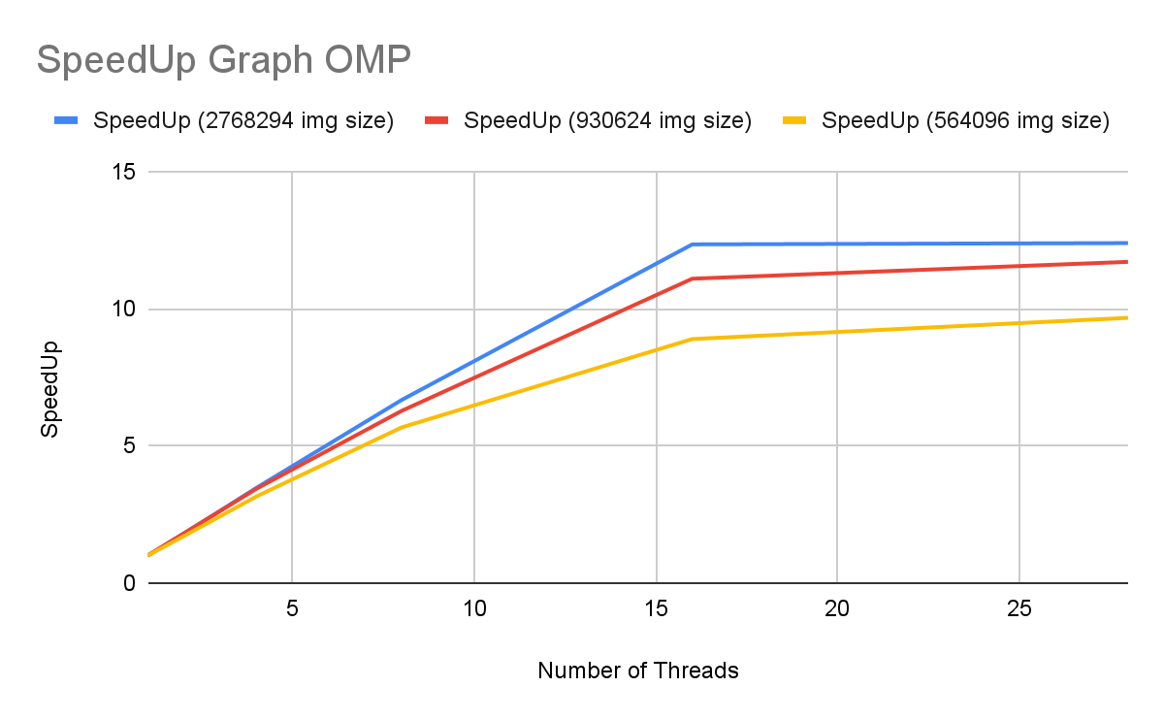
Results & Analysis
OpenMP
Notes:
Here is the speedup graph for OpenMP,
We analysed the time taken to test the model, with 3 varying size images.
As you can see the speed up is better as the size of the problem increases upto a certain point

Slide 12
Results & Analysis
OpenMP
As the number of threads increases the speedup increases and after a certain point it starts to decrease because of two scenarios.
Each thread has very little work to do, thereby the process of creating and terminating those large blocks of threads swamps the useful work.
Each thread may bring the entire row of its assigned chunk of the array to the cache for computation, thereby resulting in increased cache miss rate.
As the size of the data increases, the runtime also increases because of the increase in number of iterations.
Program is not scalable.
Load Balancing is achieved by distributing equal chunks of data points to each thread for computation.
Notes:
From the results obtained,
As the number of threads increases the speedup increases and after a certain point it starts to decrease because of two scenarios.
Each thread has very little work to do, thereby the process of creating and terminating those large blocks of threads swamps the useful work.
Each thread may bring the entire row of its assigned chunk of the array to the cache for computation, thereby resulting in increased cache miss rate.

Slide 13
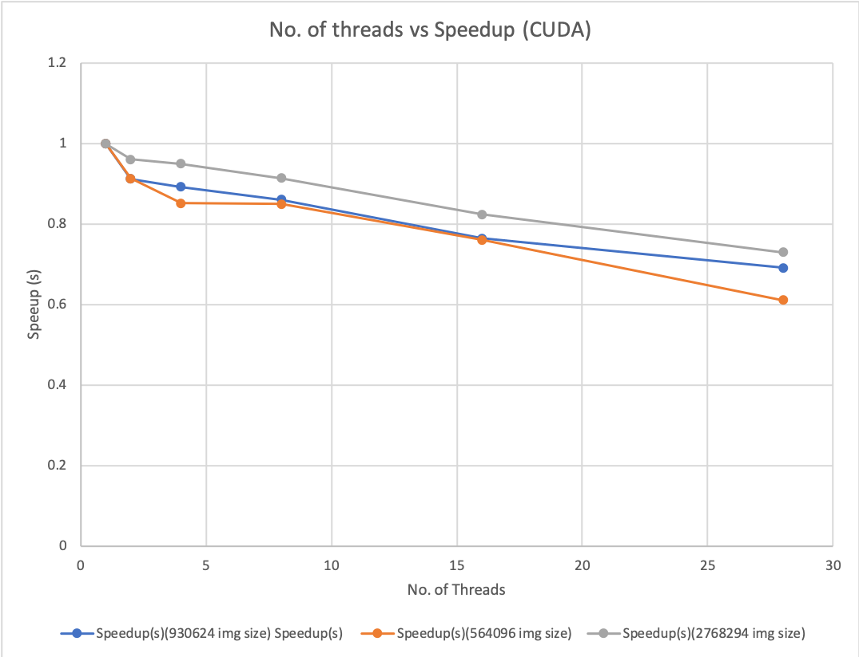
Results & Analysis
CUDA
Notes:
As you can see the run time decreases as the size of the problem increases upto a certain point

Slide 14
Results & Analysis
CUDA
As the number of threads increases the speedup decreases because fewer registers and fewer shared memory per thread are available since we are using dynamically allocated memory.
As the size of the image increases the runtime decreases.
The program is not scalable.
Load Balancing is achieved by distributing equal chunks of data points to each thread for computation.

Slide 15
Thank you! :D

