Slide 1

Project SLVP
A step towards Smarter Governance

Slide 2

Team Members and roles
Member Name | Role(s) | Skills
Deepak Bhattad | Author | Project Management / Business Consulting
Vamsi Krishna | Product Management | Product Management / Project Management
Sreenivas Chinni | Architecture | Solution Architect
Pavan Raju | Front End Development | Angular, HTML, CSS & Bootstrap
Manoj Kumar Chaluvadi | Back End Development / Middleware Development | Mainframes, Ethereum, Hyperledger, Dot Net Stack
Kiran Pochiraju | Machine Learning Expert | ML expert
The Team | Testing | NA

Slide 3
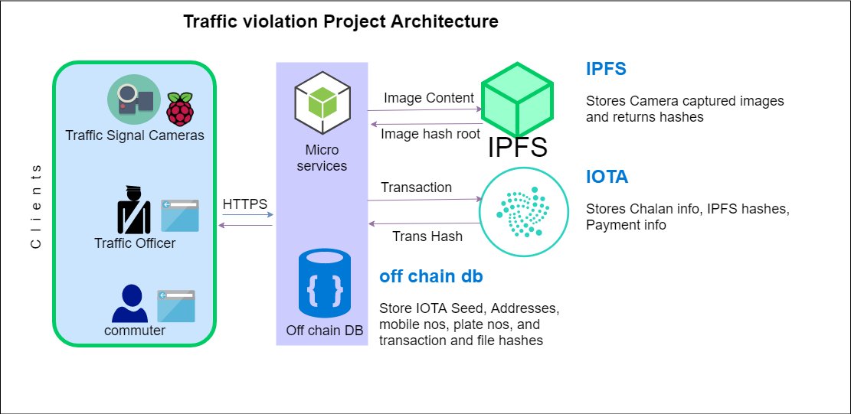
High Level Architecture
Guideline only for reference

Slide 4
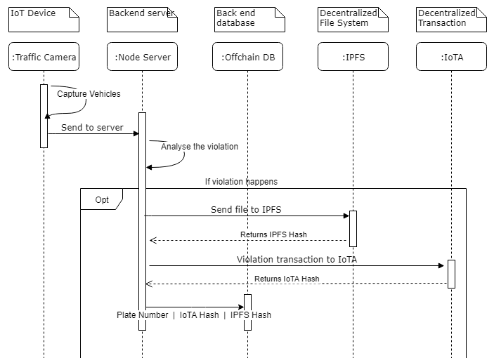
Sequence flow Diagram

Slide 5
Technology Stack
Offchain DB | SQL lite
Repository | GitHub
Web Design | angular 7 and angular material and WEB View for android
Back End | node.js
REST services | express.js
Raspberry pie | python
IOTA | IOTA.js
IPFS | JavaScript
Editor | Visual studio

Slide 6
Epics & User stories
Epic 1: As a Traffic Department, I must be able to search the violation records based on plate number, date, location, appeal so that I can view the violation records.
US1 : As a Traffic Admin, I must be able to access traffic department webpage URL so that I can login.
US2 : As a Traffic Admin, I must be able to search based on my vehicle plate number, date, location, appeal so that I can view corresponding violation records.
US3 : As a Traffic Admin, I must be able to click on detailed icon for each of my Violation record so that I can view the images for the corresponding violation records.
US4 : As a Traffic Admin, I must be able to search based on appeals so that I can accept or reject the appeal from customer
Epic 2: As a Customer, I must be able to search the records based on number plate so that I can view the violation records.
US1 : As a Customer/ User, I must be able to access traffic department webpage URL so that I can search my violation records.
US2 : As a Customer/ User, I must be able to search based on my vehicle plate number so that I can see my violation records.
US3 : As a Customer/ User, I must be able to click on detailed icon for each of my Violation record so that when I can view the images for the corresponding violation record
US4 : As a Customer/ User, I must be able to view appeal button for each of my violation record so that I can appeal to traffic admin
US5 : As a Customer/ User, I must be able to view payment option for each of my violation record so that I can click on it to pay through IOTA's
EPIC 3: As a Smart Camera, I must be able to capture the image so that the backend can store image in ipfs. The Ipfs hash will be store in Offline db.
US1 : As a Smart Camera, I must be able to capture the image so that the backend can store image in ipfs. The Ipfs hash will be store in Offline db
Notes:
https://www.youtube.com/watch?v=tKSUokG3Y0w

Slide 7
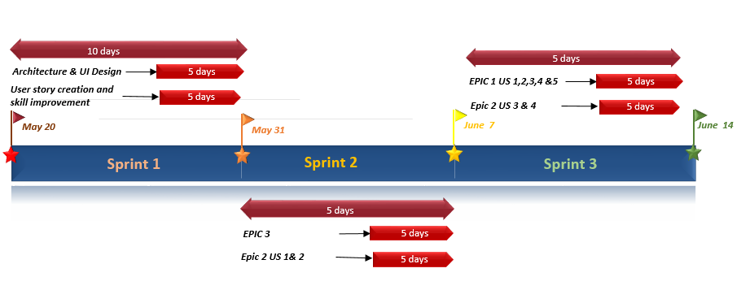
Project Plan

Slide 8
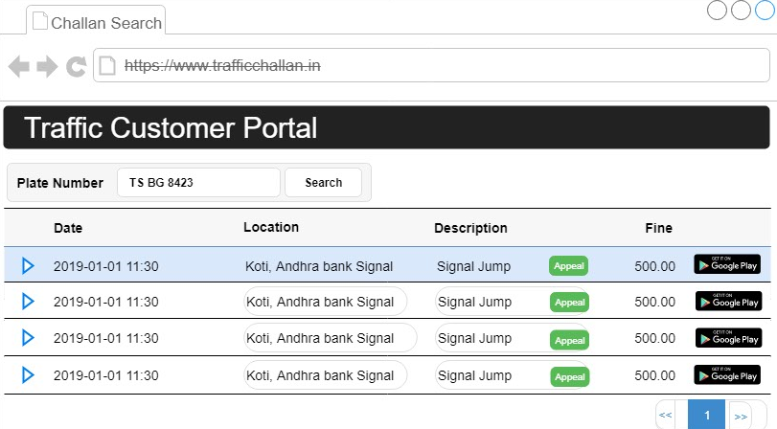
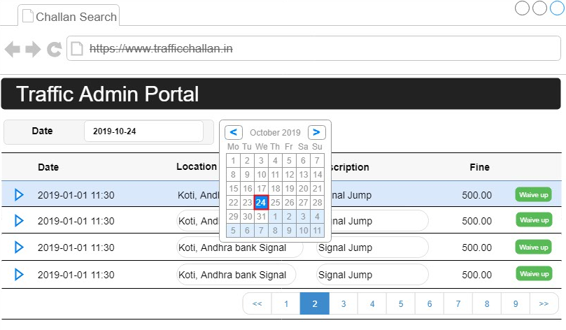
Customer & Traffic Admin Mockup UI

Slide 9
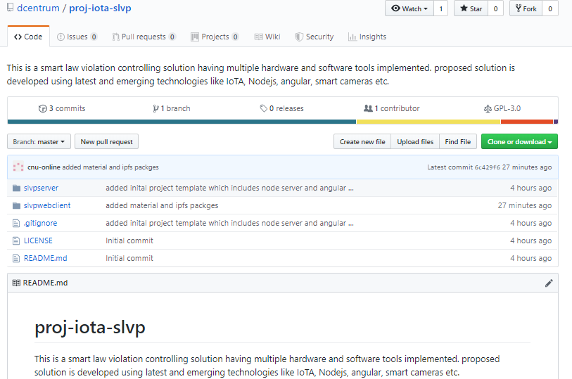
GitHub Folder structure

Slide 10
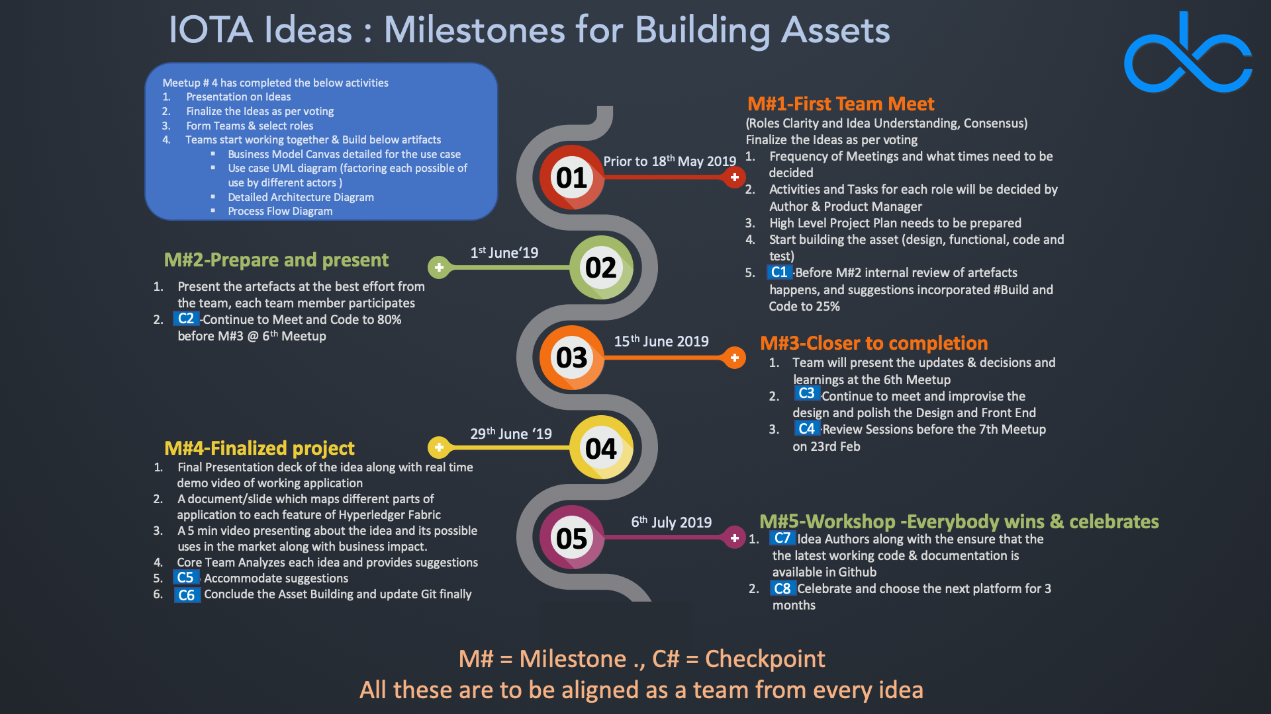

Slide 11


