Slide 1
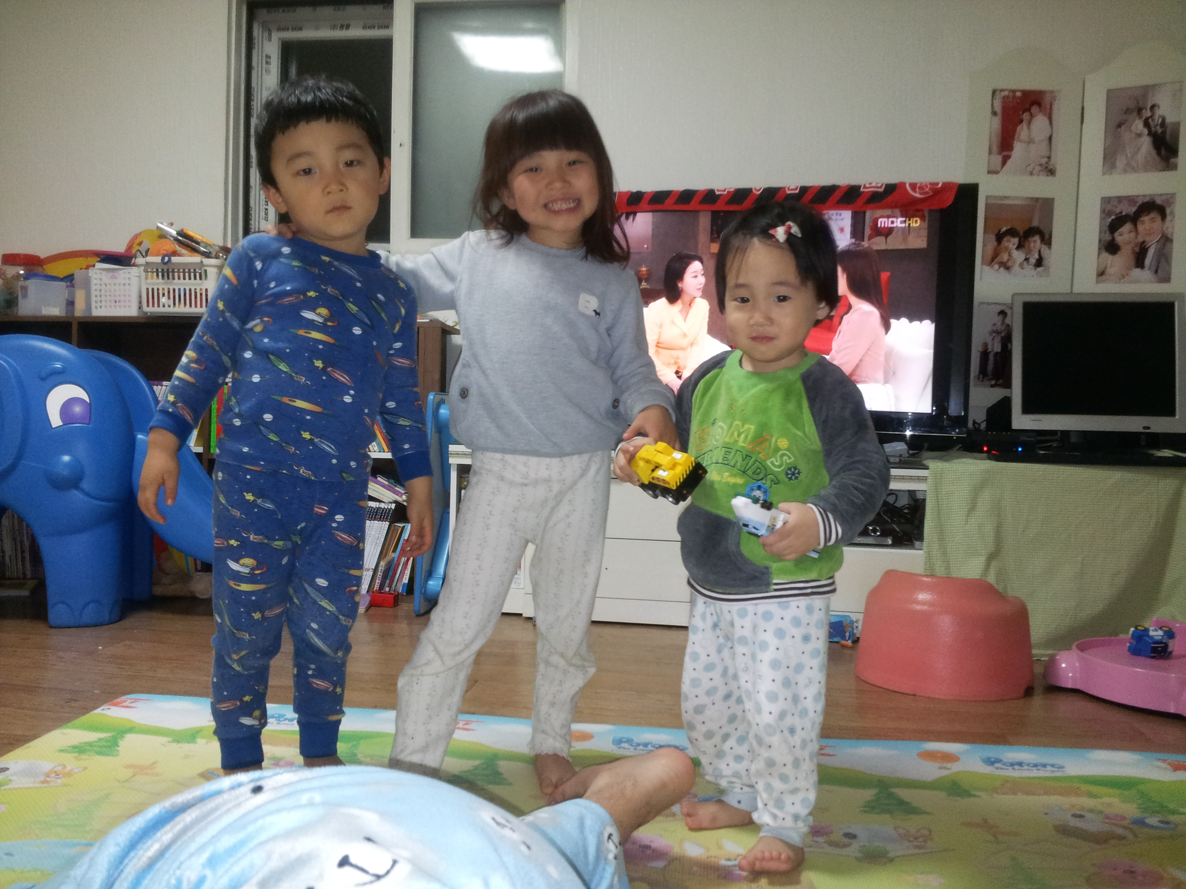
VisInsp
Open Img
Save Img
SCW1-13
Live
Zoom +
Zoom -
Full []
size
↑
move
X:258, y:530 : (R:128, G:128, B:128)
Log
Setting
Recipe
←
↓
→
status
Started VisInsp
Ver. 1.7.2

