Slide 1
J2EE与中间件技术
——JSP技术

Slide 2
The Java EE 5 Tutorial at http://docs.oracle.com/javaee/5/tutorial/doc/

Slide 3
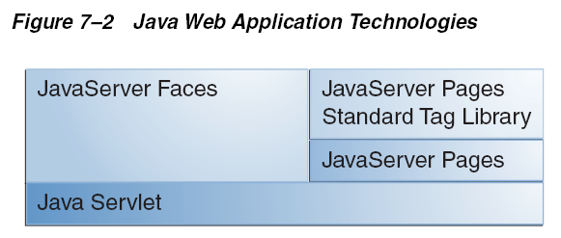
Servlet 技术
Java Servlet technology is the foundation of all the web application technologies.

Slide 4
JavaServer Pages Technology jsp：展现servlet更简单的方式
JavaServer Pages (JSP) technology allows you to easily create web content that has both static and dynamic components. JSP technology makes available all the dynamic capabilities of Java Servlet technology but provides a more natural approach to creating static content.
The main features of JSP technology are as follows:
  A language for developing JSP pages, which are text-based documents that describe how to process a request and construct a response
  An expression language for accessing server-side objects
  Mechanisms for defining extensions to the JSP language

Slide 5
What Is a JSP Page
A JSP page is a text document that contains two types of text: static data, which can be expressed in any text-based format (such as HTML, SVG,WML, and XML), and JSP elements, which construct dynamic content.
The recommended file extension for the source file of a JSP page is .jsp.
The JSP elements in a JSP page can be expressed in two syntaxes, standard and XML, though any given file can use only one syntax.

Slide 6
HelloJsp.jsp
<html>
  <head>
    <title>Hello World</title>
  </head>
  <body>
    <%
      out.print("<p><b>Hello World!</b>");
    %>
  </body>
</html>

Slide 7
The Life Cycle of a JSP Page
A JSP page services requests as a servlet. Thus, the life cycle and many of the capabilities of JSP pages (in particular the dynamic aspects) are determined by Java Servlet technology.
When a request is mapped to a JSP page, the web container first checks whether the JSP page’s servlet is older than the JSP page. If the servlet is older, the web container translates the JSP page into a servlet class and compiles the class. During development, one of the advantages of JSP pages over servlets is that the build process is performed automatically.

Slide 8
Translation and Compilation
During the translation phase each type of data in a JSP page is treated differently.
  Static data is transformed into code that will emit the data into the response stream.
  JSP elements are treated as follows:
    Directives are used to control how the web container translates and executes the JSP page.
    Scripting elements are inserted into the JSP page’s servlet class.
    Expression language expressions are passed as parameters to calls to the JSP expression evaluator.
    jsp:[set|get]Property elements are converted into method calls to JavaBeans components.
    jsp:[include|forward]elements are converted into invocations of the Java Servlet API.
    The jsp:plugin element is converted into browser-specific markup for activating an applet.
    Custom tags are converted into calls to the tag handler that implements the custom tag.

Slide 9
Translation and Compilation
Both the translation and the compilation phases can yield errors that are observed only when the page is requested for the first time.
If an error is encountered during either phase, the server will return JasperException and a message that includes the name of the JSP page and the line where the error occurred.

Slide 10
The Life Cycle of a JSP Page
After the page has been translated and compiled, the JSP page’s servlet (for the most part) follows the servlet life cycle:
  1. If an instance of the JSP page’s servlet does not exist, the container:
    a. Loads the JSP page’s servlet class
    b. Instantiates an instance of the servlet class
    c. Initializes the servlet instance by calling the jspInit method
  2. The container invokes the _jspService method, passing request and response objects.
  If the container needs to remove the JSP page’s servlet, it calls the jspDestroy method.

Slide 11
目录结构
HelloWorld
  ——HelloJsp.jsp
  ——WEB-INF
    ————classes

Slide 12
Servlet存放目录
<Tomcat_home>\ work\Catalina\localhost\HelloJsp\org\apache\jsp

Slide 13
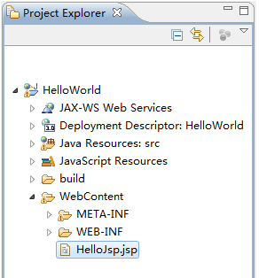
Eclipse

Slide 14
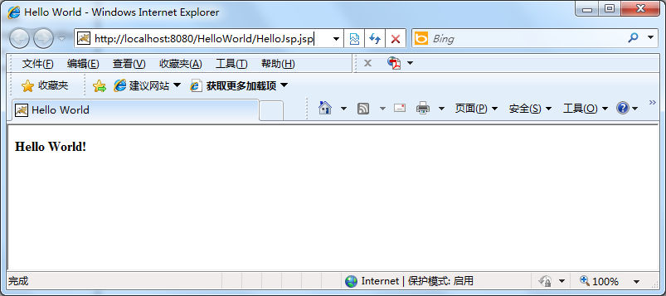

Slide 15
JSP技术
加速了创建动态和个性化内容的Web应用的过程
  程序开发组：编写业务逻辑和表示业务逻辑方面的代码
  Web页面设计组：建立HTML页面和有关的图形
如果某JSP页面有所调整，下一个对该页面的请求会触发重编译——请求慢
只有运行时才能发现页面中的一些错误

Slide 16
JavaServer Pages Documents
A JSP document is a JSP page written in XML syntax.
when you save the file with a .jspx extension, this page is a JSP document.
Because it is written in XML syntax, a JSP document is also an XML document and therefore gives you all the benefits offered by the XML standard.

Slide 17
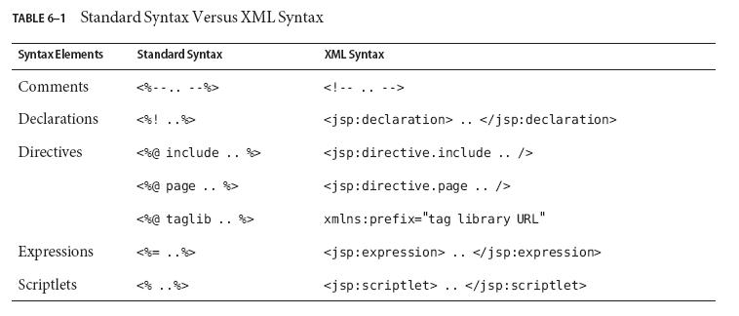
Standard Syntax Versus XML Syntax

Slide 18
HelloJsp.jspx
<jsp:root xmlns:jsp="http://java.sun.com/JSP/Page" version="2.0" >
  <html>
    <head>
      <title>Hello World</title>
    </head>
    <body>
      <jsp:scriptlet>
        out.print("Hello World!");
      </jsp:scriptlet>
    </body>
  </html>
</jsp:root>

Slide 19
Directives
Directives are used to control how the Web container translates and executes the JSP page.
 | XML语法 | 标准语法
page指令 | <jsp:directive.page attribute list/> | <%@ page property-attribs %>
include指令 | <jsp:directive.include file="filename"/> | <%@ include file="filename" %>
Taglib指令 | xmlns:prefix="tag library URL" | <%@ taglib uri="uri" prefix="tagPrefix" %>

Slide 20
page directive
You can control various JSP page execution parameters by using page directives.
  session, import, extends, contentType, buffer, ThreadSafe, errorPage

Slide 21
page指令
<%@ page attribute list %>
属性— attribute：描述了对JSP容器有意义的设置
例如：
  < %@ page session= " true " %>
    指定当前的JSP页面访问请求应包括在一个HTTP会话中，缺省选项" true " （每个jsp都会创建session）
    request.getSession(true)——安全问题！

Slide 22
page指令
可以包含多条属性：
  <% @ page session= " true " import= " java.util.* " % >
    包括一个HTTP会话；
    导入java.util包中的所有类，例如：
      <% @ page import= " package.* " %>
      < % @ page import= " java.util.Hashtable, java.util.Vector " % >

Slide 23
import
下列包是隐含导入到JSP页面中的
  java.lang.*
  javax.servlet.*
  javax.servlet.jsp.*
  javax.servlet.http.*

Slide 24
extends
<%@ page extends= " com.learnweblogic.JspCommon " %>
  扩展其他类

Slide 25
contentType
<% @ page contentType= "text/html,charset=GBK" %>
  设置页面的文本类型和字符编码
  The purpose of the contentType directive is to allow the browser to correctly interpret the resulting content.
Creating Static Content
  Static content can be expressed in any text-based format, such as HTML, WML, and XML. The default format is HTML.
  If you want to use a format other than HTML, at the beginning of your JSP page you include a page directive with the contentType attribute set to the content type.
You also use the contentType attribute to specify the encoding of the response

Slide 26
buffer
When a JSP page is executed, output written to the response object is automatically buffered. You can set the size of the buffer using the following page directive:
  <%@ page buffer="none|xxxkb" %>
A larger buffer allows more content to be written before anything is actually sent back to the client, thus providing the JSP page with more time to set appropriate status codes and headers or to forward to another web resource.
A smaller buffer decreases server memory load and allows the client to start receiving data more quickly.

Slide 27
Servlet:设置缓冲区
缺省情况下：写入输出流的内容会立即发送给客户
当发生错误时，客户看到的是页面的一部分和错误页面组成的页面
需要缓冲页面内容
  response.setBufferSize(8192);
  PrintWriter out= response.getWriter();

Slide 28
errorPage
Any number of exceptions can arise when a JSP page is executed. To specify that the web container should forward control to an error page if an exception occurs, include the following page directive at the beginning of your JSP page:
  <%@ page errorPage="file-name" %>
<%@ page errorPage="errorpage.jsp"%>
  The following page directive at the beginning of errorpage.jsp indicates that it is serving as an error page:
    <%@ page isErrorPage="true" %>
  This directive makes an object of type javax.servlet.jsp.ErrorData available to the error page so that you can retrieve, interpret, and possibly display information about the cause of the exception in the error page.

Slide 29
Servlet:错误处理
指定容器对某种异常返回特定的错误页面
web.xml
  <error-page>
    <exception-type>exceptionname</ exception-type >
    <location>/errorpagename</ location >
  </error-page >

Slide 30
isThreadSafe
其它属性
  isThreadSafe= "true|false"
    false意味着一次只能有一个线程执行JSP中的代码

Slide 31
include directive
The include directive is processed when the JSP page is translated into a servlet class.
The effect of the directive is to insert the text contained in another file (either static content or another JSP page) into the including JSP page.
You would probably use the include directive to include banner content, copyright information, or any chunk of content that you might want to reuse in another page.
The syntax for the include directive is as follows:
  <%@ include file="filename" %>

Slide 32
include指令（静态、重要）
实现JSP页面的模块化，使JSP的开发和维护变得相当简单
  例如：一个站点设计，常规的重用部分（如导航条或Web站点上部的扉页），使用单独的JSP页面生成这些组成部分，然后使用include指令，把这些页面加到自己的页面中

Slide 33
include指令
<%@ include file= " myresponse.jsp"%>
  把myresponse.jsp文件的源代码文本加入到当前的JSP页面中，然后再编译它

Slide 34
Servlet:包含其他Web资源
RequestDispatcher dispatcher=getServletContext().getRequestDispatcher("/banner.jsp");
if(dispatcher!=null)
  dispatcher.include(request,response);

Slide 35
Scripting in JSP Pages
JSP scripting elements allow you to use Java programming language statements in your JSP pages.
Scripting elements are typically used to create and access objects, define methods, and manage the flow of control.
Many tasks that require the use of scripts can be eliminated by using custom tag libraries, in particular the JSP Standard Tag Library.
Because one of the goals of JSP technology is to separate static data from the code needed to dynamically generate content, very sparing use of JSP scripting is recommended.

Slide 36
create and use objects
There are three ways to create and use objects in scripting elements:
  Instance and class variables of the JSP page’s servlet class are created in declarations and accessed in scriptlets and expressions.
  Local variables of the JSP page’s servlet class are created and used in scriptlets and expressions.
  Attributes of scope objects are created and used in scriptlets and expressions.

Slide 37
JSP Declarations
A JSP declaration is used to declare variables and methods in a page’s scripting language. The syntax for a declaration is as follows:
  <%! scripting-language-declaration %>
When the scripting language is the Java programming language, variables and methods in JSP declarations become declarations in the JSP page’s servlet class.

Slide 38
声明
声明的变量只在当前页面中可用
  <%! int foo=3; %>
声明方法:
  < %!
    private int inc(int x){
      return x++;
    }
  %>

Slide 39
Initializing and Finalizing a JSP Page
You can customize the initialization process to allow the JSP page to read persistent configuration data, initialize resources, and perform any other one-time activities; to do so, you override the jspInit method of the JspPage interface. You release resources using the jspDestroy method.
The methods are defined using JSP declarations.
  <%!
    public void jspInit() {
      ……
    }
  %>

Slide 40
JSP Scriptlets
A JSP scriptlet is used to contain any code fragment that is valid for the scripting language used in a page.
The syntax for a scriptlet is as follows:
  <%
    scripting-language-statements
  %>
When the scripting language is set to java, a scriptlet is transformed into a Java programming language statement fragment and is inserted into the service method of the JSP page’s servlet. A programming language variable created within a scriptlet is accessible from anywhere within the JSP page.

Slide 41
Scriptlet
例如:
  <%
    foo=int(foo);
  % >

Slide 42
JSP Expressions
A JSP expression is used to insert the value of a scripting language expression, converted into a string, into the data stream returned to the client.
When the scripting language is the Java programming language, an expression is transformed into a statement that converts the value of the expression into a String object and inserts it into the implicit out object.
The syntax for an expression is as follows:
  <%= scripting-language-expression %>
Note that a semicolon is not allowed within a JSP expression, even if the same expression has a semicolon when you use it within a scriptlet.

Slide 43
隐式对象
脚本元素允许指定任意的Java代码，让容器执行（嵌入JSP页面的Java代码段）
  与servlet相比：JSP包含许多预定义的隐式对象，不必编写代码生成输出流，查找
  非常方便
  ServletContext等

Slide 44
Using Implicit Objects
Implicit objects are created by the web container and contain information related to a particular request, page, session, or application.
Many of the objects are defined by the Java servlet technology underlying JSP technology.
  servletContext: The context for the JSP page’s servlet and any web components contained in the same application.
  session: The session object for the client.
  request: The request triggering the execution of the JSP page.
  response: The response returned by the JSP page.

Slide 45
隐式对象out
javax.servlet.jsp.JspWriter类的实例；
做PrintWriter对象能做的一切事情；
调用print()/println()方法，把信息回送给客户端浏览器
  out.print("<p><b>Hello World!</b>");
作用域是当前页面（page）
  每个JSP页面有一个out对象的实例
缺省采用缓存；可以使用page指令调整其大小

Slide 46
request/response对象
javax.servlet.HttpServletRequest/ HttpServletResponse的实例
使用request对象得到请求信息中的参数
  Enumeration foo=request.getParameter();
  while(foo.hasMoreElements()){
    out.print(foo.NextElement());
  }
使用response对象发送重定向、修改HTTP头、指定URL重写

Slide 47
其他
session对象：javax.servlet.http.HttpSession的实例
application对象：从web.xml获取初始化参数、访问RequestDispatcher
pageContext对象：对页面作用域的属性的访问

Slide 48
BasicJsp.jsp（标准语法）
<!doctype html public "-//w3c/dtd HTML 4.0//en">
<html>
<body>
<p>The following is a JSP declaration</p>
<%!
  int x=5; //定义实例变量
  private int aMethod(int y){
    return x*y;
  }
%>

Slide 49
BasicJsp.jsp
<p>The following is a JSP expression </p>
<%= new java.util.Date() %>
<p>The following is a JSP scriptlet </p>
<UL>
<%
  for(int i=0;i<3;i++){
%>
<LI> <%= aMethod(i) %> </LI>
<%
  }
%>
</UL>
</BODY></html>

Slide 50
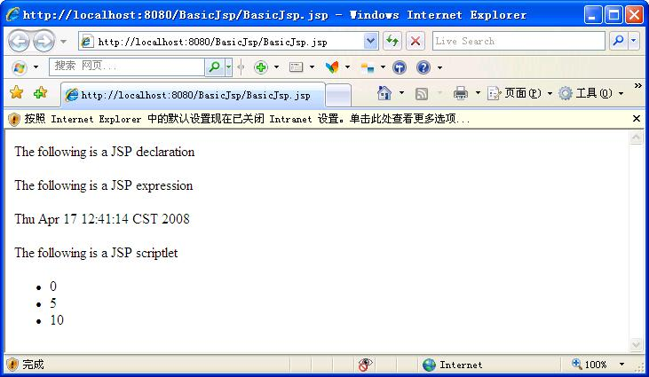

Slide 51
BasicJsp.jspx （XML语法）
<jsp:root xmlns:jsp="http://java.sun.com/JSP/Page" version="2.0" >
  <html>
  <body>
    <p>The following is a JSP declaration</p>
    <jsp:declaration>
      int x=5;
        private int aMethod(int y){
      return x*y;
      }
    </jsp:declaration>
    <p>The following is a JSP expression </p>
    <jsp:expression> new java.util.Date() </jsp:expression>

Slide 52
BasicJsp.jspx
    <p>The following is a JSP scriptlet </p>
    <jsp:scriptlet>
      <![CDATA[for(int i=0;i<3;i++){]]>
    </jsp:scriptlet>
    <LI> <jsp:expression> aMethod(i) </jsp:expression> </LI>
    <jsp:scriptlet>
      <![CDATA[}]]>
    </jsp:scriptlet>
  </body>
  </html>
</jsp:root>

Slide 53
CDATA语法
XML语法
Character data: 字符数据，将CDATA标记下的所有文本都当作字符看待
<![CDATA[
文本内容
]]>

Slide 54
动作
可以使用scriptlet执行动作提供的任何功能
动作改进了scriptlet，易于使用，帮助摆脱java代码
类型：标准动作、自定义动作
标准动作：
  <jsp:include>
  <jsp:forward>
  <jsp:plugin>
  <jsp:useBean>, < jsp:setProperty >, < jsp:getProperty >

Slide 55
<jsp:include>
The jsp:include element is processed when a JSP page is executed.
<jsp:include page= " Copyright.html" />
The include action allows you to include either a static or a dynamic resource in a JSP file.
  If the resource is static, its content is inserted into the calling JSP file.
  If the resource is dynamic, the request is sent to the included resource, the included page is executed, and then the result is included in the response from the calling JSP page.

Slide 56
<jsp:include>
与include指令<%@ include file=%>的差别：
  include指令：包括其他页面，编译时把其他页面的内容加进来，比include动作快
  include标准动作：使用RequestDispatcher，运行时把其他页面的内容加进来（包括到输出流中）

Slide 57
<jsp:include>
被包含的资源为变量时：
  <jsp:include page= " %=dynamicRef %" />
    使用了表达式

Slide 58
<jsp:forward>
把当前JSP请求转发到另一个资源上
<jsp:forward page= " foo.jsp" />
与HTTP重定向的差别：
  HTTP重定向：response.sendRedirect(myNewURL);
    发送的请求信息又回送给客户机，让客户机再转发到另一个资源上，新的URL出现在Web浏览器中，需要在服务器和客户机之间增加一次通信
  forward标准动作：使用RequestDispatcher ，JSP的转发功能是在服务器本身上实现的
  重定向和转发：重定向在客户机可以看到目标url，但是转发在服务器端是看不到目标url的
  转发和包含：包含还会回来原url继续执行，转发直接跳到另一个url

Slide 59
jsp:param Element
When an include or forward element is invoked, the original request object is provided to the target page. If you wish to provide additional data to that page, you can append parameters to the request object by using the jsp:param element:
  <jsp:include page= " /itemdetail.jsp" >
    <jsp:param name= " itemid " value= " %=itemId" />
  </jsp: include >
The scope of the new parameters is the jsp:include or jsp:forward call; that is, in the case of an jsp:include the new parameters (and values) will not apply after the include.

Slide 60
<jsp:plugin>
You can include an applet or a JavaBeans component in a JSP page by using the jsp:plugin element. This element generates HTML that contains the appropriate client-browser-dependent construct (<object> or <embed>) that will result in the download of the Java Plug-in software (if required) and the client-side component, and in the subsequent execution of any client-side component.
<jsp:plugin type=“bean|applet”
code=“classname”
codebase=“codebase-uri”
[…..]>
</jsp:plugin>

Slide 61
Bean动作（一定会用到)
<jsp:useBean>
< jsp:setProperty >
< jsp:getProperty >

Slide 62
JavaBean Components
JavaBeans components are Java classes that can be easily reused and composed together into applications. Any Java class that follows certain design conventions is a JavaBeans component.
JavaServer Pages technology directly supports using JavaBeans components with standard JSP language elements. You can easily create and initialize beans and get and set the values of their properties.

Slide 63
JavaBeans Component Design Conventions
A JavaBeans component property can be:
  Read/write, read-only, or write-only
  Simple, which means it contains a single value, or indexed, which means it represents an array of values
It must simply be accessible using public methods that conform to the following conventions:
  For each readable property, the bean must have a method of the form:
    PropertyClass getProperty() { ... }
  For each writable property, the bean must have a method of the form:
    setProperty(PropertyClass pc) { ... }
In addition to the property methods, a JavaBeans component must define a constructor that takes no parameters.

Slide 64
UserSearchBean.java
package javabean;
public class UserSearchBean{
//必备内容
  public UserSearchBean() {}
  private String keywords;
  public String getKeywords() {
    return this.keywords;
  }
  public void setKeywords(String keywords) {
    this.keywords = keywords;
  }
}

Slide 65
Creating and Using a JavaBeans Component
To declare that your JSP page will use a JavaBeans component, you use a jsp:useBean element.
There are two forms:
  <jsp:useBean id="beanName" class="fully-qualified-classname" scope="scope"/>
  and
  <jsp:useBean id="beanName" class="fully-qualified-classname" scope="scope">
    <jsp:setProperty .../>（initializing bean properties）
  </jsp:useBean>

Slide 66
jsp:useBean
The jsp:useBean element declares that the page will use a bean that is stored within and is accessible from the specified scope, which can be application, session, request, or page. （作用域）
If no such bean exists, the statement creates the bean and stores it as an attribute of the scope object.
The value of the id attribute determines the name of the bean in the scope and the identifier used to reference the bean in EL expressions, other JSP elements, and scripting expressions.

Slide 67
jsp:useBean
The value supplied for the class attribute must be a fully qualified class name. Note that beans cannot be in the unnamed package. Thus the format of the value must be package-name.class-name.
The following element creates an instance of mypkg.myLocales if none exists, stores it as an attribute of the application scope, and makes the bean available throughout the application by the identifier locales:
  <jsp:useBean id="locales" scope="application" class="mypkg.MyLocales"/>

Slide 68
<jsp:useBean>
JSP容器将自动的创建相应的JavaBean的实例
JSP容器将自动的处理JavaBean的清理事项

Slide 69
scriptlet vs JavaBean
创建书店的购物车，并保存在一个会话属性中
scriptlet ：
  <%
    ShoppingCart cart=(ShoppingCart)session.getAttribute(" cart " );
    if(cart==null){
      cart=new ShoppingCart();
      session.setAttribute(" cart " ,cart);
    }
  %>

Slide 70
scriptlet vs JavaBean
JavaBean:
  <jsp:useBean id= "cart " scope= " session " class= " cart.ShoppingCart " / >

Slide 71
Setting JavaBeans Component Properties
The standard way to set JavaBeans component properties in a JSP page is by using the jsp:setProperty element.
The syntax of the jsp:setProperty element depends on the source of the property value.

Slide 72
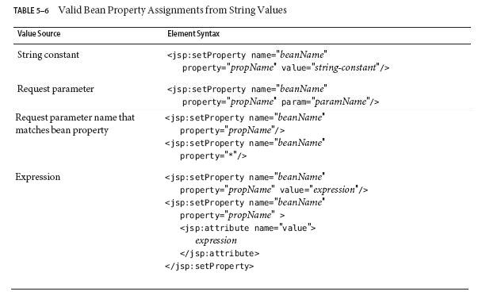
jsp:setProperty

Slide 73
jsp:setProperty
Syntax rules of attribute values used in this table:
  1. beanName must be the same as that specified for the id attribute in a useBean element.
  2. There must be a setPropName method in the JavaBeans component.
  3. paramName must be a request parameter name.

Slide 74
<jsp:setProperty>
当Web表单生成HTTP请求时，JSP规范允许使用请求参数自动填充JavaBean属性
  <jsp:setProperty name="searchBean" property="keywords" param="param_name"/>
通常，property和param名称相同
  <jsp:setProperty name="searchBean" property="keywords"/>
如果一个JavaBean有多个属性，每个property和param名称匹配，可采用通配符
  <jsp:setProperty name="searchBean" property="*"/>

Slide 75
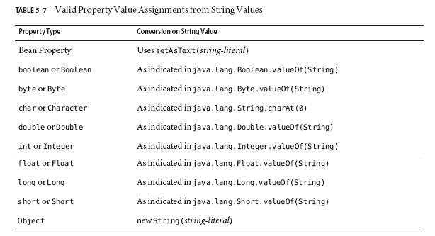
jsp:setProperty
A property set from a constant string or request parameter must have one of the types listed in Table.

Slide 76
Retrieving JavaBeans Component Properties
The jsp:getProperty element converts the value of the property into a String and inserts the value into the response stream:
  <jsp:getProperty name="beanName" property="propName"/>
Note that beanName must be the same as that specified for the id attribute in a useBean element, and there must be a getPropName method in the JavaBeans component.

Slide 77
search.html——welcome-file
<html>
  <head>
    <title>Using Search Bean</title>
  </head>
  <body>
    <h1>Using Search Bean</h1>
    <form action="emptysearch.jsp">
      <p>
        Search keywords:
        <input type="text" size="30" name="keywords"/>
      </p>
      <input type=submit value="Submit">
    </form>
  </body>
</html>

Slide 78
web.xml
<?xml version="1.0" encoding="UTF-8"?>
<!DOCTYPE web-app PUBLIC "-//Sun Microsystems, Inc.//DTD Web Application 2.3//EN" "http://java.sun.com/dtd/web-app_2_3.dtd" >
<web-app>
  <welcome-file-list>
    <welcome-file>search.html</welcome-file>
  </welcome-file-list>
</web-app>

Slide 79
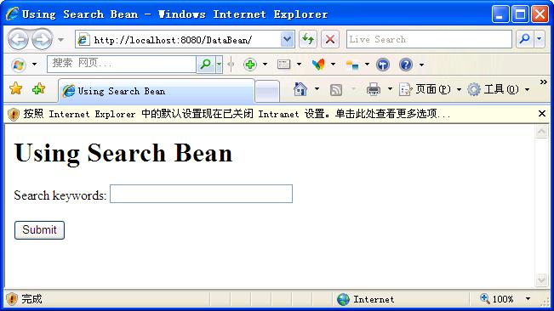

Slide 80
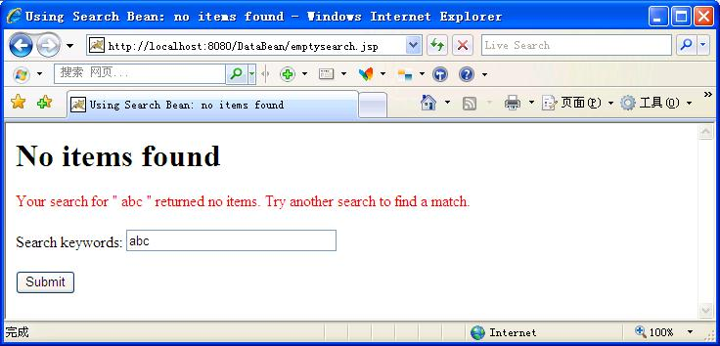
emptysearch.jsp

Slide 81
emptysearch.jsp——
<jsp:useBean>
<%@ page session="false" %>
<jsp:useBean id="searchBean" scope="request" class="javabean.UserSearchBean">
  <jsp:setProperty name="searchBean" property="keywords"/>
</jsp:useBean>
……

Slide 82
<jsp:setProperty> vs setPropName method
或者
<jsp:useBean id="searchBean" scope="request" class="javabean.UserSearchBean">
  <%
    searchBean.setKeywords(request.getParameter("keywords"));
  %>
</jsp:useBean>

Slide 83
emptysearch.jsp——
<jsp:getProperty>
<html>
  <head>
    <title>Using Search Bean: no items found</title>
  </head>
  <body>
  <h1>No items found</h1>
  <form action="emptysearch.jsp">
    <p style="color: red;">
      Your search for "
      <jsp:getProperty name="searchBean" property="keywords"/>
      " returned no items. Try another search to find a match.
    </p>
  ……

Slide 84
<jsp:getProperty> vs getPropName method
或者
<form action="emptysearch.jsp">
  <p style="color: red;">
    Your search for "
    <%= searchBean.getKeywords() %>
    " returned no items. Try another search to find a match.
  </p>
… …

Slide 85
emptysearch.jsp——
<jsp:getProperty>
  ……
  <p>
    Search keywords:
    <input type="text" size="30" name="keywords" value="
    <jsp:getProperty name="searchBean" property="keywords"/>
    "/>
  </p>
  <input type=submit value="Submit">
</form>
</body>
</html>

Slide 86
<jsp:getProperty> vs getPropName method
或者
  <p>
    Search keywords:
    <%
      out.print("<input type=text size=30 name=keywords value=\"");
      out.print(searchBean.getKeywords());
      out.print("\"/>");
    %>
    或者
      <input type=“text” size=“30” name=“keywords” value=“<%=searchBean.getKeywords()%>”/>
  </p>
……

Slide 87
部署
DataBean
——search.html
——emptysearch.jsp
——WEB-INF
————classes
——————javabean
————————UserSearchBean.class
————web.xml

Slide 88
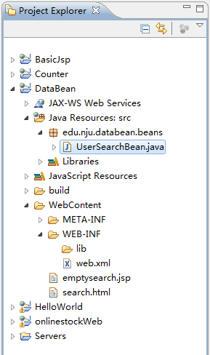
Eclipse

Slide 89
emptysearch.jspx
<jsp:root xmlns:jsp="http://java.sun.com/JSP/Page" version="2.0" >
<jsp:directive.page session="false"/>
<jsp:useBean id="searchBean"
scope="request"
class="javabean.UserSearchBean">
  <jsp:setProperty name="searchBean" property="keywords"/>
</jsp:useBean>
<html>
  <head>
  <title>Using Search Bean: no items found</title>
  </head>
<body>
<h1>No items found</h1>

Slide 90
emptysearch.jspx
<form action="emptysearch.jspx">
  <p style="color: red;">
  Your search for "
  <jsp:getProperty name="searchBean" property="keywords"/>
  " returned no items. Try another search to find a match.</p>
  <p>Search keywords:
  <jsp:text><![CDATA[<input type="text" size="30" name="keywords" value="]]></jsp:text>
  <jsp:getProperty name="searchBean" property="keywords"/>
  <jsp:text><![CDATA["/>]]></jsp:text>
  </p>
  <jsp:text><![CDATA[<input type=submit value="Submit"/>]]></jsp:text>
</form>
</body>
</html>
</jsp:root>

Slide 91
jsp:text
XML语法独特：
<jsp:text>——text动作
  output static data that is not well formed.
  must not contain any other elements. if you need to nest a tag inside jsp:text, you must wrap the tag inside CDATA.

Slide 92
MVC架构
MVC.ppt

