Slide 1
J2EE与中间件技术
——Struts 2

Slide 2
Struts 1 vs. Struts 2
Struts1→WebWork→Struts2
ActionServlet被过滤器替代
没有任何的动作表单（Action Form），HTML表单被直接映射成为一个POJO，不再需要创建一个数据的传输对象，维护更加简单
对用户的输入进行验证——逻辑写在动作类里（Action Class）

Slide 3
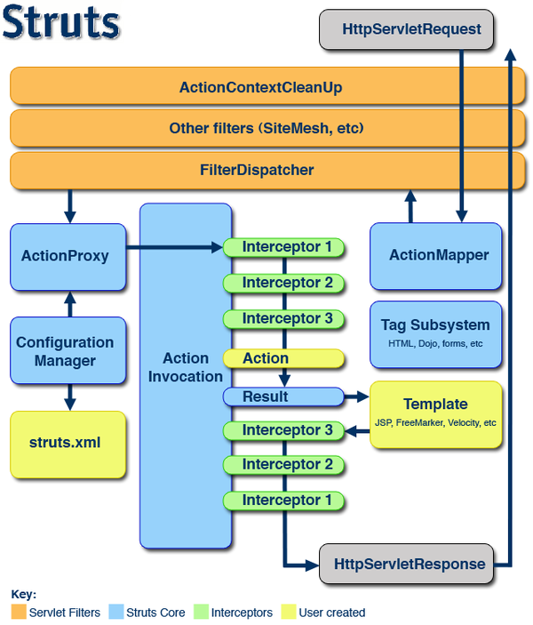
struts2 工作流程
1.Request a resource;
2.Filter Dispatcher determines the appropriate action;
3.Interceptors automatically apply common functionality ;
4.Action method executes

Slide 4
Action
A basic component
Java class
A new instance for each HTTP request
  线程安全
Extends ActionSupport class

Slide 5
Dependency Injection
Action Attributes
Get & Set methods

Slide 6
Action Method
Result name
……
public String register(){
//do something
if(……)
return "success";
else
return “input";
}
……

Slide 7
struts.xml
……
<action ...>
<result name="success">/welcome.jsp</result>
<result name="input">/RegUser.jsp</result>
</action>
……

Slide 8
下载struts2
http://struts.apache.org/
下载struts-2.*.*-all.zip，解压
  在apps目录下有个struts2-*.war样例文件

Slide 9
struts2-*.war
1、解压
2、*.jar
  在WEB-INF\lib目录下*.jar文件
  选中所有jar文件，点击右键->复制
  在Eclipse中，在WebContent\WEB-INF\lib目录上点击右键->Paste

Slide 10
struts2-*.war
3、web.xml文件
  在WEB-INF目录下，点击右键->复制
  在Eclipse中，在WebContent\WEB-INF目录上点击右键->Paste
4、struts.xml文件
  在Eclipse中，Java Resources: src ->new->other->xml File，选择路径“Add/src”，文件命名“struts.xml”，Finish

Slide 11
Web.xml
……
<filter>
  <filter-name>struts2</filter-name>
  <filter-class>org.apache.struts2.dispatcher.ng.filter.StrutsPrepareAndExecuteFilter</filter-class>
</filter>
<filter-mapping>
  <filter-name>struts2</filter-name>
  <url-pattern>/*</url-pattern>
</filter-mapping>
……

Slide 12
示例：sum.jsp
<%@ page language="java" import="java.util.*" pageEncoding="GBK" %>
<%@ taglib prefix="s" uri="/struts-tags"%>
<html>
<head>
<title>输入操作数</title>
</head>
<body>
求代数和
<br/>
<s:form action="/add/sum">
<s:textfield name="operand1" label=" 操作数1"/>
<s:textfield name="operand2" label=" 操作数2" />
<s:submit value="代数和" />
</s:form>
</body>
</html>

Slide 13
struts.xml
<?xml version="1.0" encoding="UTF-8"?>
<!DOCTYPE struts PUBLIC
"-//Apache Software Foundation//DTD Struts Configuration 2.3//EN"
"http://struts.apache.org/dtds/struts-2.3.dtd">
<struts>
<package name="struts2" namespace="/add"
extends="struts-default">
<action name="sum" class="edu.nju.struts.action.FirstAction">
<result name="positive">/positive.jsp</result>
<result name="negative">/negative.jsp</result>
</action>
</package>
</struts>

Slide 14
FirstAction
……
public class FirstAction extends ActionSupport {
private int operand1; //依赖注入
private int operand2;
public int getOperand1() {
return operand1;
}
public void setOperand1(int operand1) {
this.operand1 = operand1;
}
public int getOperand2() {
return operand2;
}
public void setOperand2(int operand2) {
this.operand2 = operand2;
}

Slide 15
public String execute() throws Exception {
if (getSum() >= 0) {// 如果代数和是非负整数，跳到positive.jsp页面
return "positive";
}
else{// 如果代数和是负整数，跳到negative.jsp页面
return "negative";
}
}
public int getSum() {
return operand1 + operand2; // 计算两个整数的代数和
}
}

Slide 16
positive.jsp
<%@ page language="java" import="java.util.*" pageEncoding="GBK"%>
<%@ taglib prefix="s" uri="/struts-tags" %>
<html>
<head>
<title>显示代数和</title>
</head>
<body>
代数和为非负整数<h1><s:property value="sum" /></h1>
</body>
</html>

Slide 17
negative.jsp
<%@ page language="java" import="java.util.*" pageEncoding="GBK"%>
<%@ taglib prefix="s" uri="/struts-tags" %>
<html>
<head>
<title>显示代数和</title>
</head>
<body>
代数和为负整数<h1><s:property value="sum" /></h1>
</body>
</html>

Slide 18
Action类获取表单信息
1、属性及get,set方法
  如sum样例
2、实体类及get,set 方法，如
  private User user;
  public get,set方法
  JSP页面<s:textfield name="user.userId"/>

Slide 19
3、实现模型驱动接口ModelDriven，及new 实体类，如
  private User user = new User();
  public User getModel(){
  return user;
  }

Slide 20
隐式对象的访问
request/response/application/session等
在Struts2中, 不能对request/response/application/session等对象进行操作

Slide 21
四种方式
1. 通过ActionContext来访问，如
  ActionContext.getContext().getSession()
2. 通过实现RequestAware、SessionAware、ApplicationAware接口来访问
3. 通过ServletActionContext来访问
4. 通过实现ServletRequestAware接口来访问

Slide 22
Aware Interface
Struts2提供RequestAware, SessionAware, ApplicationAware, ServletRequestAware....接口
  在XAction中实现相应的接口，相应的setXXX()方法对这些对象进行初始化
    使用依赖注入的实现方式

Slide 23
示例：用户登录/注销/统计在线人数
public class LoginAction implements SessionAware, ServletRequestAware, ServletResponseAware, ServletContextAware {
  private String userName;//与表单中的属性相对应
  private String password;
  private ServletContext servletContext;
  private HttpServletRequest servletRequest;
  private HttpServletResponse servletResponse;
  private Map sessionMap;

Slide 24
getter/setter
public String getPassword() {
  return password;
}
public void setPassword(String password) {
  this.password = password;
}
public String getUserName() {
  return userName;
}
public void setUserName(String userName) {
  this.userName = userName;
}

Slide 25
setter
//依赖注入隐式对象
public void setServletRequest(HttpServletRequest servletRequest) {
  this.servletRequest = servletRequest;
}
public void setSession(Map map) {
  this.sessionMap = map;
}
public void setServletResponse(HttpServletResponse servletResponse) {
  this.servletResponse = servletResponse;
}
public void setServletContext(ServletContext servletContext) {
  this.servletContext = servletContext;
}

Slide 26
execute()
public String execute () {
  String referrer = servletRequest.getHeader("referer");
    if (referrer != null && userName.length() > 0 && password.length() > 0) {
    int onlineUserCount = 0;
    synchronized (servletContext) {
      try {
        onlineUserCount = (Integer) servletContext .getAttribute("onlineUserCount");
      } catch (Exception e) {}
      servletContext.setAttribute("onlineUserCount", onlineUserCount + 1);
    }
    return "success";
  } else {
  return "input";
  }
}

Slide 27
logout()
public String logout() {
  if (sessionMap instanceof SessionMap) {
    ((SessionMap) sessionMap).invalidate();
  }
  int onlineUserCount = 0;
  synchronized (servletContext) {
    try {
      onlineUserCount = (Integer) servletContext.getAttribute("onlineUserCount");
    } catch (Exception e) {
    }
    servletContext.setAttribute("onlineUserCount", onlineUserCount - 1);
  }
  return “logout";
}

Slide 28
struts.xml
…
<package name="LoginAndLogout" extends="struts-default">
<!-- Action类默认为ActionSupport, 执行的方法默认为execute , result默认为success , 以上三者可以省略不写 -->
<!-- 登录提交表单的Action配置 -->
<action name="login" class=“edu.nju.action.LoginAction"> <result>/login-success.jsp</result> </action>
<!– 注销的Action配置 -->
<action name="logout" class="edu.nju.action.LoginAction" method="logout"> <result name="logout">/logout-success.jsp</result></action>
</package>
……

Slide 29
Action,Service,DAO层设计
浏览器
请求
Web层
业务层
数据访问层
Struts
Service
DAO
数据源
响应
JSP
JavaBeans

Slide 30
Struts2+Spring
Spring Web模块
  建立在应用上下文模块基础上，提供适合Web系统的上下文
  支持多项面向web的任务，如
    透明处理多文件上传请求
    自动将请求参数绑定到业务对象中
  对Jakarta Struts的集成支持

Slide 31
Struts2+Spring(+Hibernate)开发
http://struts.apache.org/
下载struts-2.*.*-all.zip，解压
    lib目录
      包含了与Spring集成相关的JAR文件
        struts2-spring-plugin-2.*.*.jar

Slide 32
ContextLoaderListener
配置web.xml，Web容器会自动加载/WEB-INF/applicationContext.xml，初始化ApplicationContext实例
……
<listener>
<listener-class> org.springframework.web.context.
ContextLoaderListener
<listener-class>
</listener>
……

Slide 33
或配置ContextLoaderServlet
……
<servlet>
<servlet-name>context</servlet-name>
<servlet-class>org.springframework.web.context. ContextLoaderServlet
</servlet-class>
<load-on-startup>1</load-on-startup>
</servlet>
……

Slide 34
指定配置文件位置
如果需要指定配置文件位置，可通过context-param加以指定
配置完成后，可以通过WebApplicationContextUtils.getWebApplicationContext方法在Web应用中获取ApplicationContext引用
……
<context-param>
<param-name>
contextConfigLocation</param-name>
<param-value>/WEB-INF/classes/ApplicationContext.xml</param-value>
</context-param>
……

Slide 35
配置applicationContext.xml
Action由Spring创建，如
  <bean id= " UserAction" class="edu.nju.onlinestock.action.UserAction" scope="prototype">
  </bean>
  每个请求产生一个实例

Slide 36
示例:onlineStock
Struts2
  edu.nju.onlinestock.action
    UserAction
Spring
  edu.nju.onlinestock.dao
    UserDao
  edu.nju.onlinestock.service
    UserService
Hibernate
  edu.nju.onlinestock.model
    User

Slide 37
register.jsp
……
<%@ taglib prefix="s" uri="/struts-tags"%>
……
<s:form action="/User/register" method="post">
  <table align="center" border="0">
  <tr>
    <td><s:textfield name="user.userid" label="Userid"/></td>
  </tr>
  ……
  </table>
</s:form>
……

Slide 38
struts.xml
……
<package name="struts2" namespace="/User“ extends="struts-default">
  <action name="register" class="UserAction">
    <result name="success">/user/welcome.jsp</result>
    <result name="input">/user/register.jsp</result>
  </action>
</package>
……
注：
action class必须与applicationContext.xml中*Action的bean id相同
action name则与*.jsp action相同（注意，namespace）

Slide 39
BaseAction设计
封装Struts2 对 request、response、session等的获取，子类直接继承此类即可

Slide 40
BaseAction
……
public class BaseAction extends ActionSupport implements SessionAware,
ServletRequestAware, ServletResponseAware {
public HttpServletRequest request;
public HttpServletResponse response;
public Map session;
public void setSession(Map session) {
this.session = session;
}
public void setServletRequest(HttpServletRequest request) {
this.request = request;
}
public void setServletResponse(HttpServletResponse response) {
this.response = response;
}
}

Slide 41
UserAction.java
……
//@Controller用于标注控制层组件（如struts中的action）
@Controller
public class UserAction extends BaseAction {
@Autowired
private UserService userService; // 使用Spring注解注入业务方法
private User user; //接收表单数据/Struts2注入
public void setUser(User user) {
  this.user = user;
}
public User getUser() {
  return user;
}

Slide 42
public String execute() throws Exception{
  ……
  if((message=userService.registerUser(user))!= null){
    ……
    return INPUT;
  }
  else{
    ……
    session.put("user", user);
    return SUCCESS;
  }
}
……
}

Slide 43
applicationContext.xml
注：
*Action的bean id 必须与struts.xml中action class相同
……
<bean id= " UserAction" class="edu.nju.onlinestock.action.UserAction“scope="prototype">
</bean>
……

Slide 44
welcome.jsp
……
<jsp:useBean id="user"
type="edu.nju.onlinestock.model.User"
scope="session"></jsp:useBean>
user with id
<jsp:getProperty name="user" property="id" />
was added.
……

Slide 45
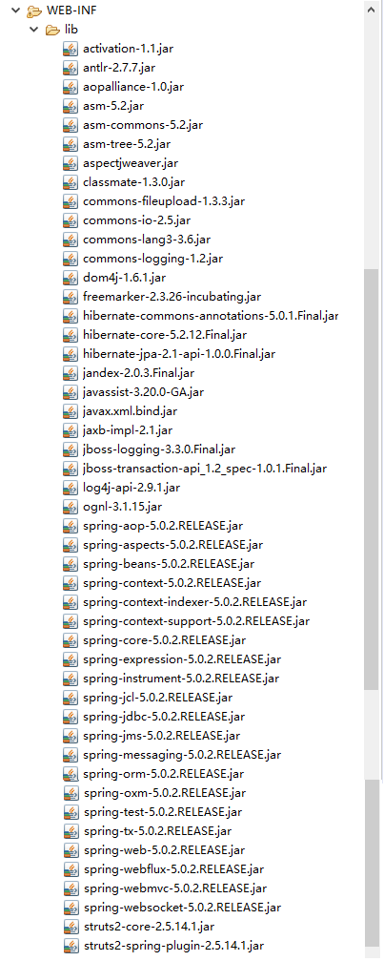
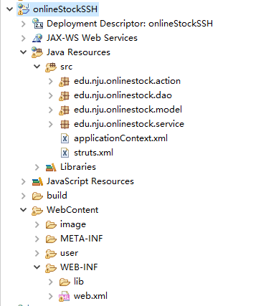
Struts2+Spring+Hibernate5

Slide 46
或使用Spring的XML配置文件注入UserService
……
private UserService userService; // 注入业务方法 /Spring
public void setUserService(UserService userService) {
  this.userService = userService;
}
public UserService getUserService() {
  return userService;
}
……

Slide 47
applicationContext.xml
……
<bean id="UserAction" class="edu.nju.onlinestock.action.UserAction">
  <property name="UserService">
  <ref bean="UserService"/>
  </property>
</bean>
……

