Slide 1
VIDEOJUEGOS CON
PYTHON
PROGRAMA DE FORMACIón

Slide 2
pygame is a Python wrapper for the SDL library, which stands for Simple DirectMedia Layer. SDL provides cross-platform access to your system’s underlying multimedia hardware components, such as sound, video, mouse, keyboard, and joystick. pygame started life as a replacement for the stalled PySDL project. The cross-platform nature of both SDL and pygame means you can write games and rich multimedia Python programs for every platform that supports them!

Slide 3
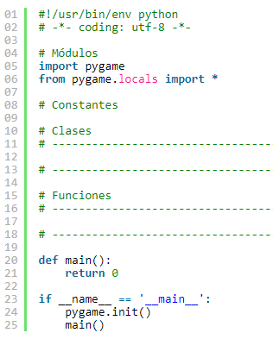
Estructura
básica
Copyright © 2019 Accenture. All rights reserved.

Slide 4
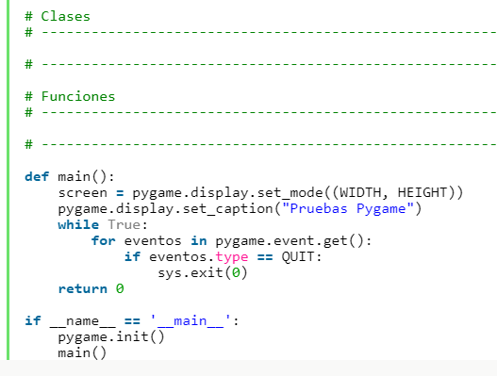
Creando una
ventana
Copyright © 2019 Accenture. All rights reserved.

Slide 5
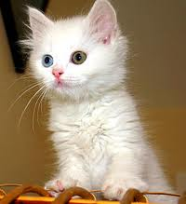
CAT
DOG
Deep Neural Network
Copyright © 2019 Accenture. All rights reserved.

Slide 6
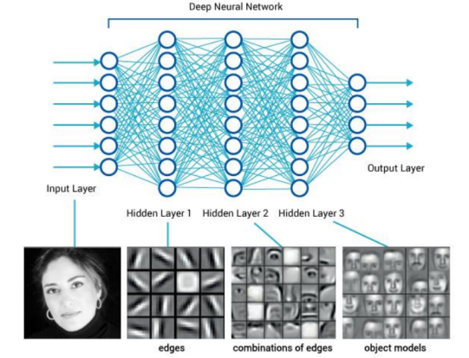
Extracción de características
https://leonardoaraujosantos.gitbooks.io/artificial-inteligence/content/neural_networks.html
Copyright © 2019 Accenture. All rights reserved.

Slide 7
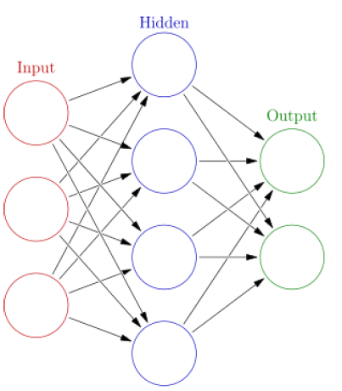
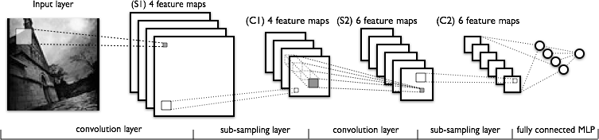
Deep Neural Network
Extracción de características
Clasificación
Copyright © 2019 Accenture. All rights reserved.

Slide 8
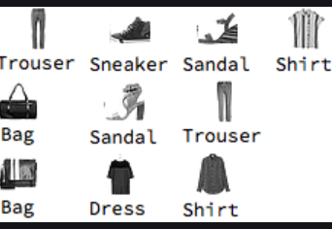
Práctica con el dataset Fashion MNIST
Copyright © 2020 Accenture. All rights reserved.

