Slide 1

DALLAS ANALYST CLUB
BUAN 6356
November 26, 2018
Dongwook Chun, Gahyun Lee, Kuan-Fen Liao,
Anantha Pillai and Juwon Song

Slide 2
Dataset Information
Mushroom Classification
Safe to eat or deadly poison?
https://www.kaggle.com/uciml/mushroom-classification
8,124 Observations and 23 Variables

Slide 3
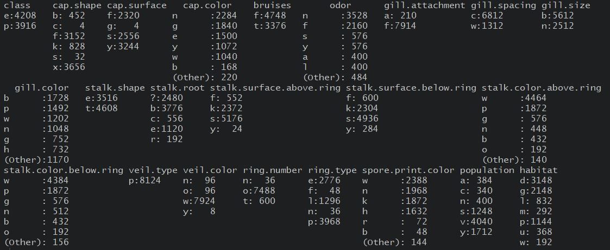
Dataset Information (Cont’d)

Slide 4
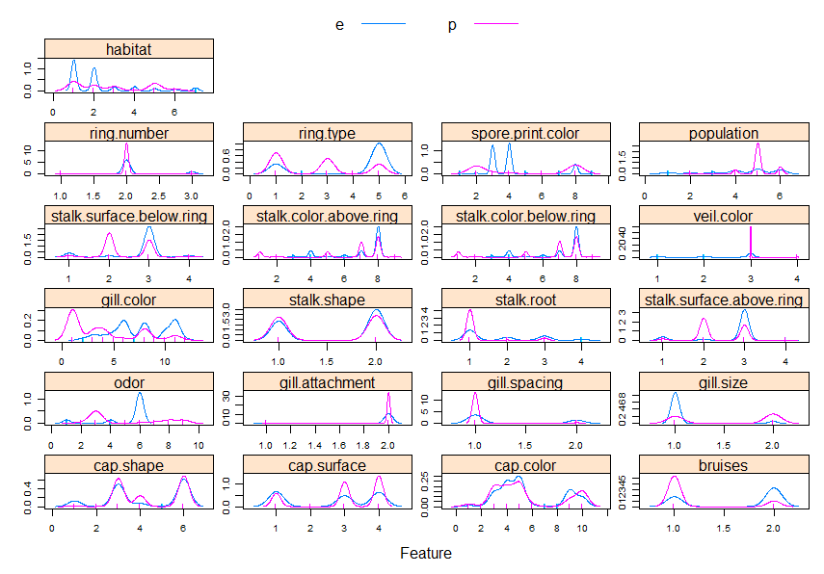
Dataset Information (Cont’d)

Slide 5
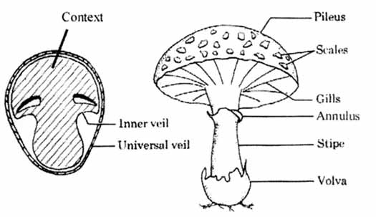
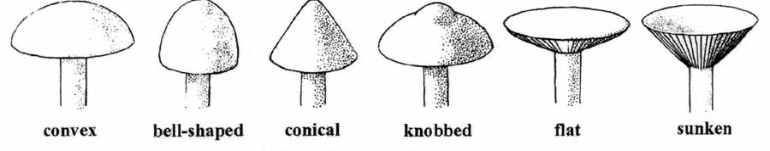
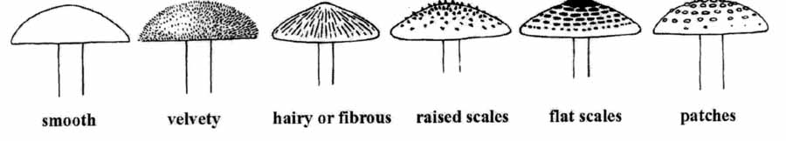
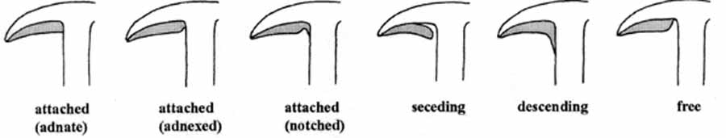
Mushroom Explanation
<Cap Shape>
<Cap Surface>
<Mushroom Structure>
<Gill Attachment>

Slide 6
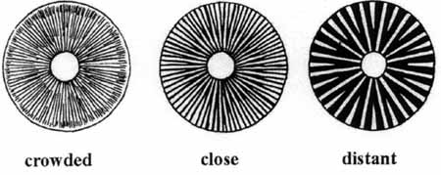
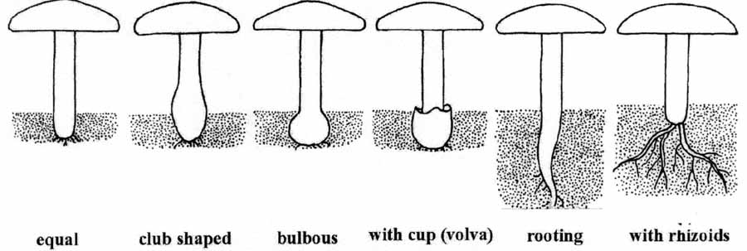
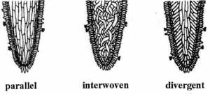
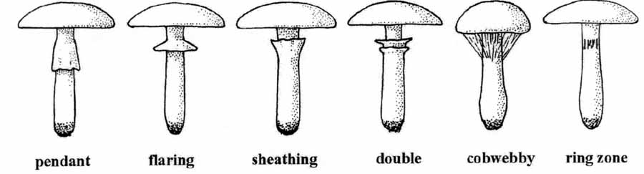
Mushroom Explanation (Cont’d)
<Gill Spacing>
<Stalk Type>
<Gill Tissue Arrangement>
<Ring Type>

Slide 7
Client
Dallas Mushroom Digger, Anantha
His grandma, Stephanie inherit her mushroom data to Anantha
Data was corrupted, especially observations for “Root”
Requests to Dallas Analyst Club
- Make Models to distinguish Mushroom with visual information to edible or not
- Because of heavy smoking, Anantha can’t smell anything

Slide 8
The approach of DAC
Make and Compare 5 Models
- Logistic Regression, LDA, KNN, Random Forest, Decision Tree
Change categorical variables to numerical variables, if needed
Use Multiple Imputation in data preprocessing

Slide 9
Data Preparation
“Veil.type” has only 1 class
- Remove the variable
Handle Missing value
- Change all “?” observations in “Root” variable to NA
Use 2 different methods for multiple imputation
- Poly regression and LDA

Slide 10
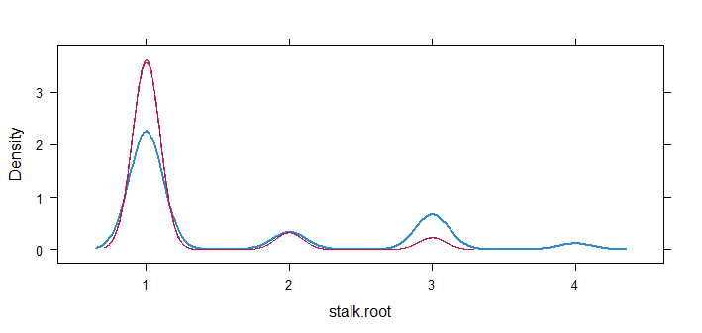
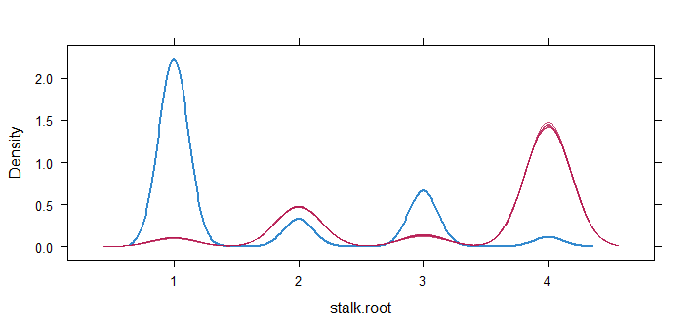
Data Preparation (Cont’d)
Opposite result with 2 imputation method
- Choose LDA in this case
Change all categorical variables to numerical variable using Label Encoding
<LDA>
<Poly Regression>

Slide 11
A Week Later…

Slide 12


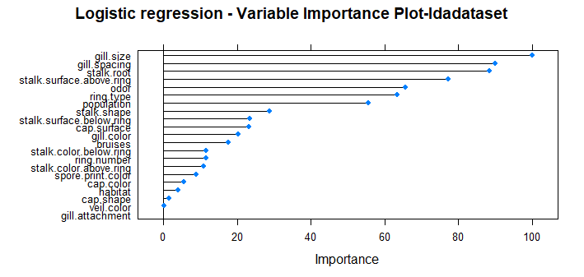

Model 1. Logistic Regression
Training Set Accuracy 97.03%
Test Set Accuracy 97.05%

Slide 13
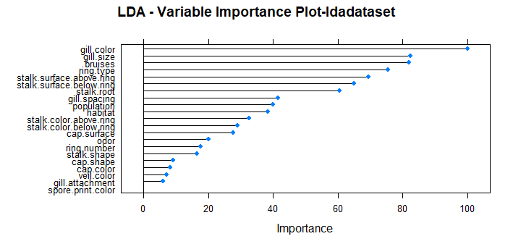
Model 2. LDA
Training Set Accuracy 94.19%
Test Set Accuracy 94.54%

Slide 14

Model 3. KNN (K=5)
Training Set Accuracy 99.81%
Test Set Accuracy 100%

Slide 15
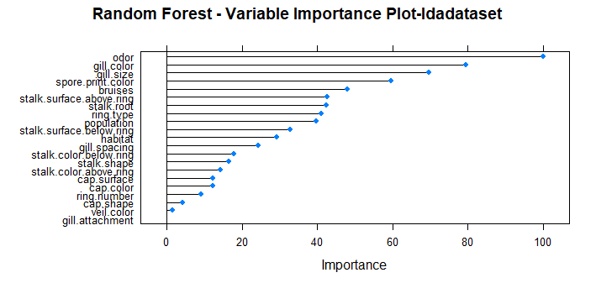
Model 4. Random Forest
Training Set Accuracy 100%
Test Set Accuracy 100%

Slide 16
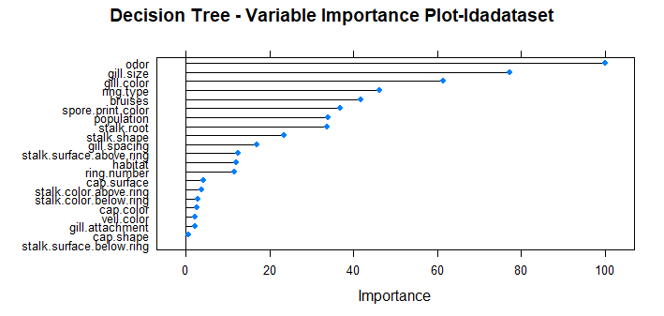
Model 5. Decision Tree
Training Set Accuracy 99.9%
Test Set Accuracy 99.79%

Slide 17
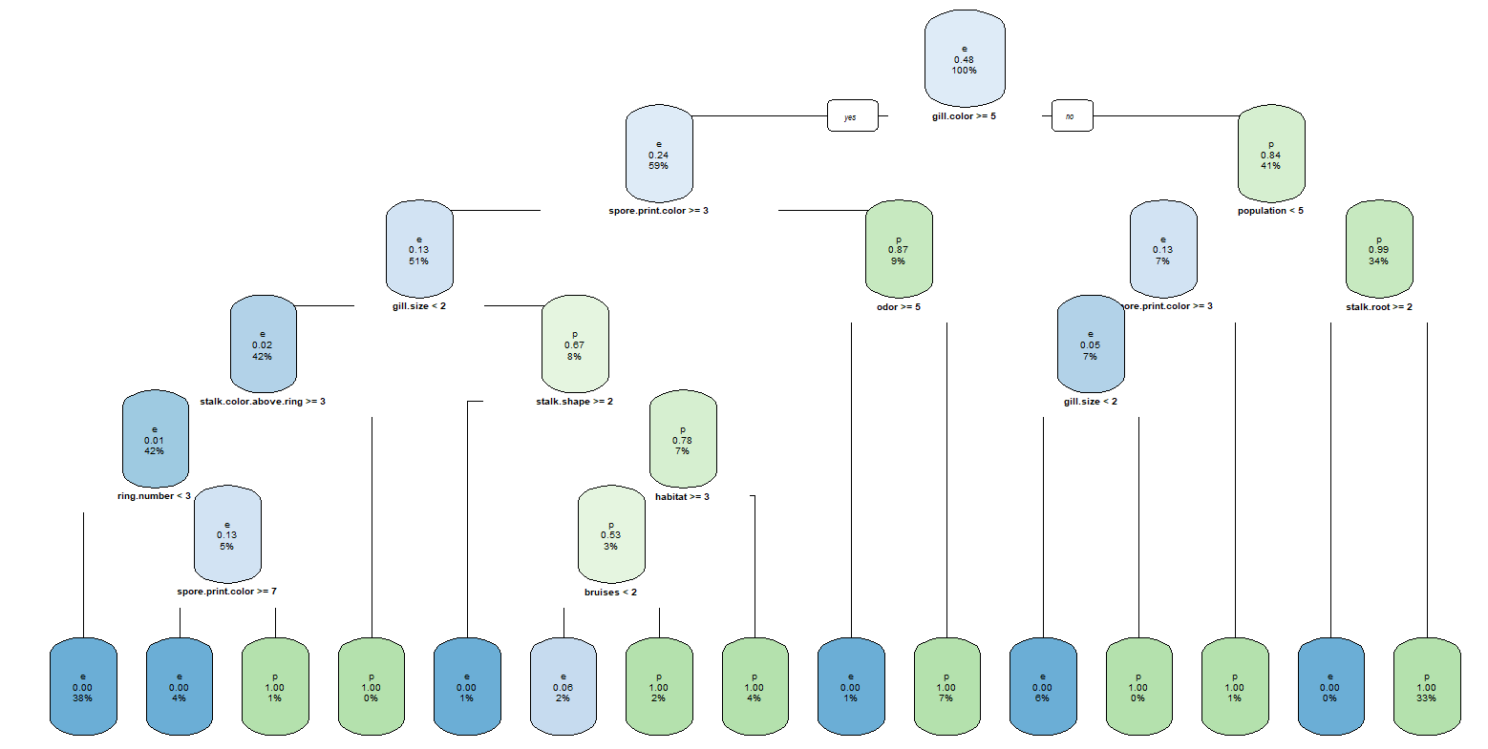

Slide 18
Conclusion
In this case, we suggest Randon Forest model for more accurate prediction
However, considering consumed time to calculate and client’s health problem, KNN model can be reasonable because of fast calculation time and considerable accuracy

Slide 19
Question?

