Slide 1
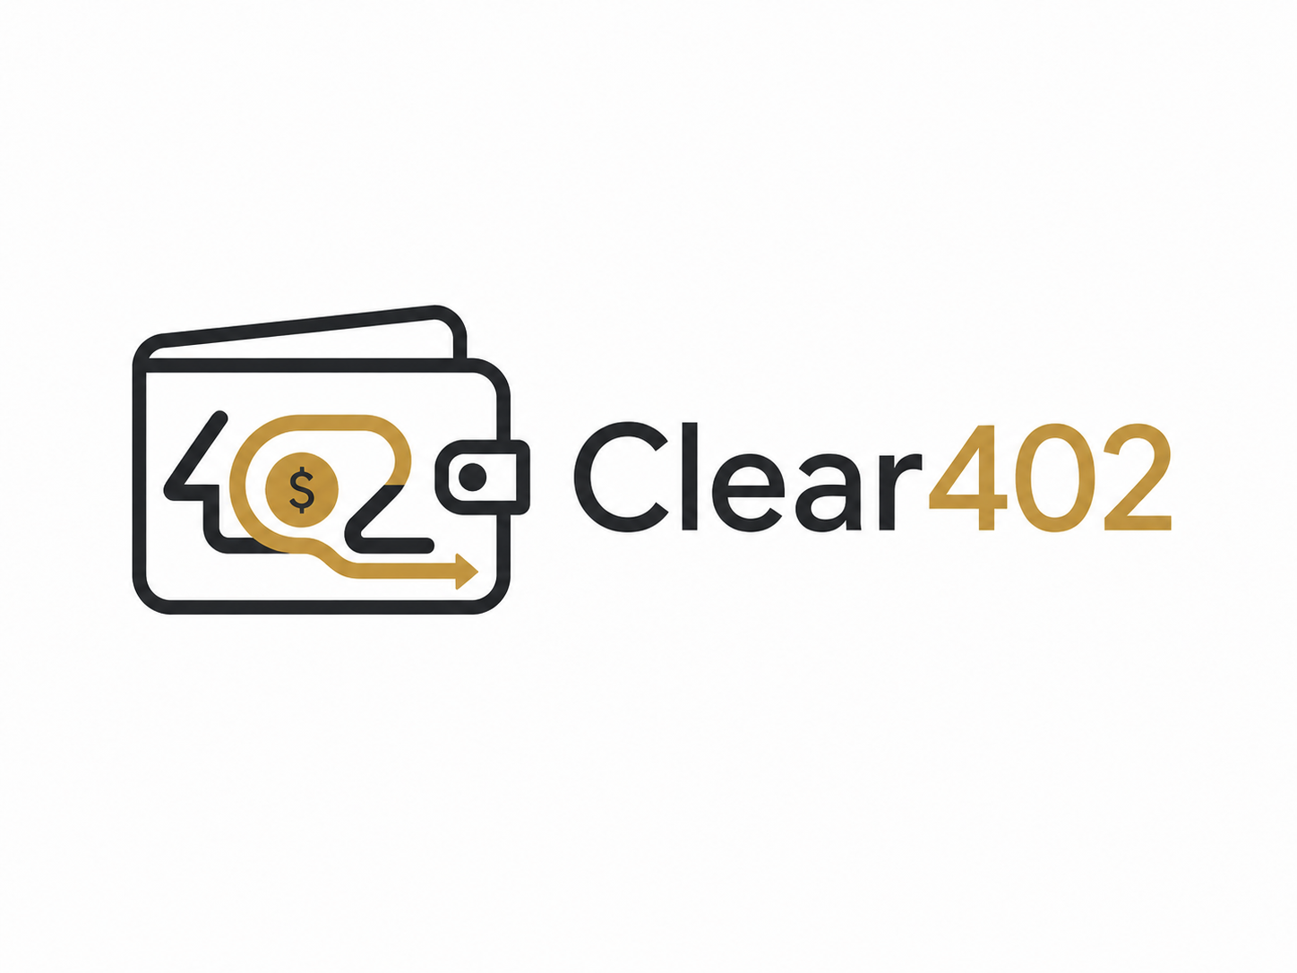
Clear402
CAW-backed x402 guard and evidence workflow for safer agent-native HTTP 402 payments.
x402 lets agents pay. Clear402 makes those payments safer through Cobo Agentic Wallet boundaries, guard evidence, and attack-lab checks.
OriginShift | Every shift starts from one origin.
Simulation / rehearsal deck. Formal PPT and video are being urgently polished.

Slide 2
PROBLEM
HTTP 402 becomes risky when agents pay without context.
An autonomous payment header is only one piece of the evidence chain.
Protocol risk
Wallet risk
Evidence risk
Payment proof can drift from the exact resource, provider, amount, network, or delivery state.
Blind signing, unlimited approvals, replayed nonces, and budget races can move funds outside the intended mission.
PII can leak through metadata and receipts can claim delivery even when the paid service was denied or malformed.
Clear402 treats x402 payment as a guard-and-evidence workflow, not a single checkout action.
Clear402
OriginShift | Hackathon submission

Slide 3
SOLUTION
A hardened x402 runtime sits between the agent, wallet, provider, and evidence pack.
Official CAW remains the funds boundary; Clear402 adds safety checks before and after payment.
1
Normalize the challenge
2
Guard before funds move
3
Execute through CAW boundary
Bind method, URL, body hash, provider, amount, network, asset, and settlement path into PaymentContext.
Provider trust, quote lock, nonce lock, budget ledger, metadata firewall, and clearsig semantic checks.
Recorded Sepolia evidence shows CAW allow and destination-allowlist denial with request and pact IDs.
4
Verify service delivery
5
Export auditable evidence
Receipt verifier detects paid-but-denied and malformed delivery instead of trusting provider text.
Dashboard exports JSON/Markdown evidence with live, fallback, and mock labels kept explicit.
Clear402
OriginShift | Hackathon submission

Slide 4
ARCHITECTURE
Four services create one inspectable payment control plane.
Dashboard
Runtime
Provider
Attack Lab
Next.js operator console\nmissions, attack state, export
Guard pipeline\nCAW adapter, SQLite, evidence
Local x402 service\n402 challenge, proof, receipt
16 fixtures\nreal local guard execution
CAW boundary + evidence docs
Recorded Sepolia tx, recorded policy denial, sample evidence pack, limitations, security boundaries, demo script, and final gate report.
Clear402
OriginShift | Hackathon submission

Slide 5
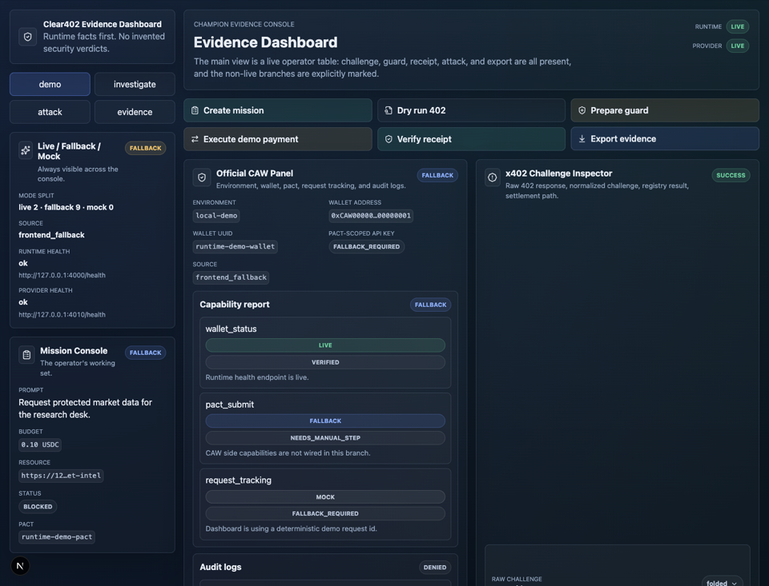
DEMO FLOW
The browser demo shows happy, denied, attack, and evidence-export paths.
Create mission and receive an x402-style 402 challenge.
Run guard preflight before any ordinary dashboard payment state.
Execute demo/fallback payment path without claiming live tx hash.
Show denied and attack evidence in the operator console.
Export evidence as JSON and Markdown for review.
Clear402
OriginShift | Hackathon submission

Slide 6
ATTACK LAB
The demo gate blocks all 16 attack fixtures through the real guard pipeline.
16/16
37
2
5
attack scenarios blocked
runtime guard tests
browser E2E projects
final gate commands pass
Replay / substitution
replay_same_proof, cross_resource_substitution, settlement_path_substitution
Wallet / calldata
dynamic_price_overspend, malicious_approve, multicall_hidden_operation
Provider / delivery
paid_but_denied, malformed_delivery, discovery_poisoning
Web / metadata
pii_leakage, cache_confusion, duplicate X-PAYMENT headers
Race / trust
20-request free-riding, low-reputation provider, ERC-8004 identity mismatch
Clear402
OriginShift | Hackathon submission

Slide 7
EVIDENCE
Clear402 separates live testnet facts from fallback and mock evidence.
0.0001
1
0
SETH recorded allow-path transfer
recorded CAW policy denial
ordinary dashboard live tx hashes claimed
Sepolia evidence
Agent wallet: 0xab42bb255c4660b0879f007ab3ed9ae049d85859\nAllow tx: 0xf0f257dad181ec835c09e131177402c0d2073bf345ca13d394b6aaa170a69011\nPolicy denial: ADDRESS_NOT_WHITELISTED / policy_denied, no tx hash produced
Boundary: hackathon demo only; no mainnet, no production readiness, no unrestricted CAW execution.
Clear402
OriginShift | Hackathon submission

Slide 8
COMPLETION
Code and evidence are submission-ready; formal PPT and video are still being polished.
100%
100%
95%
35%
P0 core completion
Phase 16-21 final gate
overall final gate report
P1 championship backlog
Ready now
Still future work
README, proposal, runbook, evidence pack, team page, tests, browser E2E, attack lab, and final gate report.
ServiceEscrow fund/refund, message_sign, params/message/ABI policies, SSE timeline, signed ProviderQuote, full dual receipt, gateway mode.
PPT/video status: current materials are simulation/rehearsal only; formal versions are in urgent polish.
Clear402
OriginShift | Hackathon submission

Slide 9





ORIGINSHIFT
Every shift starts from one origin.
Qy
Damia
Max
Chris
Water is one origin of life and movement. The droplet is the starting point, the reflection is the hoped-for return, and the ripple is the impact we hope careful work can have on blockchain and beyond.
GitHub: https://github.com/pillowtalk-Qy/clear402
Clear402
OriginShift | Hackathon submission

