Slide 1
기초SoC설계 최종 프로젝트 FPGA Matrix Multiplication
9조
20191476 전자공학 김태한
20190544 경제학/컴퓨터공학 배상원

Slide 2
Matrix Multiplication using BRAM
Architecture
Dual port BRAM for input matrix A and B
Control logic for address generation and synchronization
Computation Unit
Implementation Step
Create BRAM IP
Configure AXI-BRAM controller
Design memory map
Implement control logic

Slide 3
Evaluation
Data
Random generated matrix
Performance Evaluation Metric
Compare the execution time between PS and PL
Clock Cycles
PS : ARM Processor Clock
PL : FPGA Clock
Computation Result
Whether the results of both methods are the same or not

Slide 4
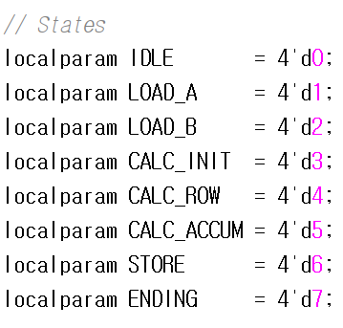
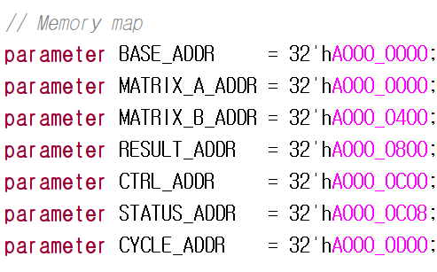
Matrix Multiplication using BRAM
Generate 16-by-16 matrices and initialize in the PS
Load matrices into BRAM
Multiply matrices and save results
Compare the result with the PS

Slide 5
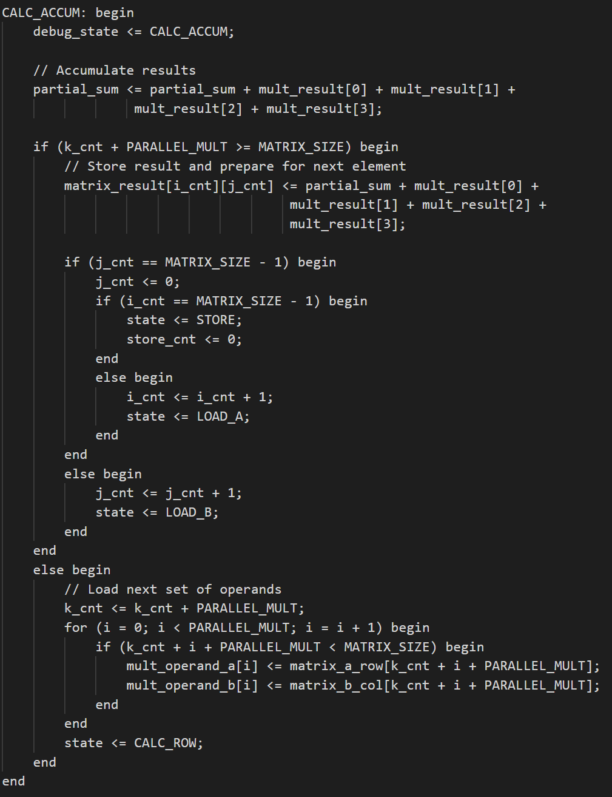
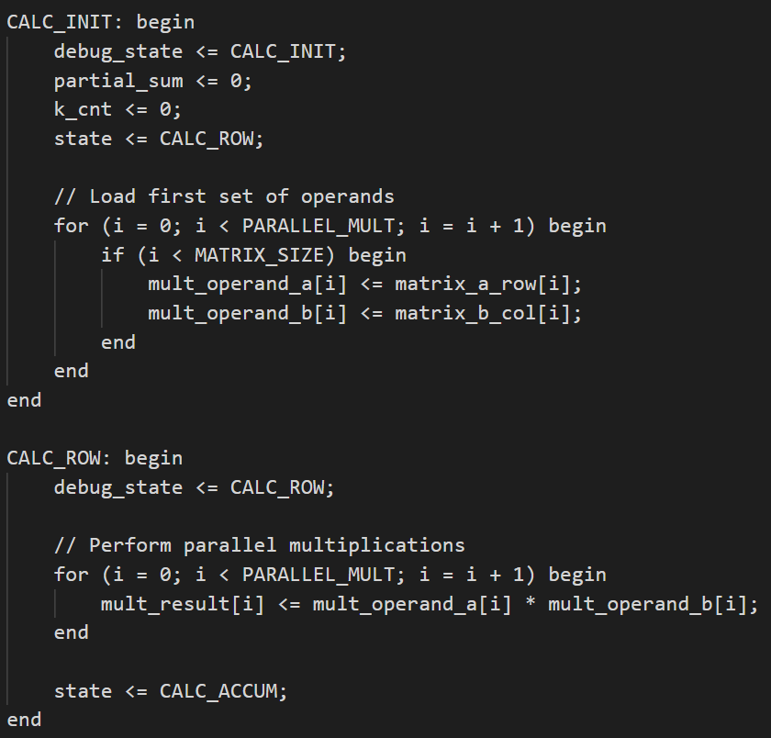
Matrix Multiplication using BRAM
첫 번째 병렬 연산: (A[0][0]×B[0][0]) + (A[0][1]×B[1][0]) + (A[0][2]×B[2][0]) + (A[0][3]×B[3][0])
둘째 병렬 연산: (A[0][4]×B[4][0]) + (A[0][5]×B[5][0]) + (A[0][6]×B[6][0]) + (A[0][7]×B[7][0])
셋째 병렬 연산: (A[0][8]×B[8][0]) + (A[0][9]×B[9][0]) + (A[0][10]×B[10][0]) + (A[0][11]×B[11][0])
넷째 병렬 연산: (A[0][12]×B[12][0]) + (A[0][13]×B[13][0]) + (A[0][14]×B[14][0]) + (A[0][15]×B[15][0])

Slide 6
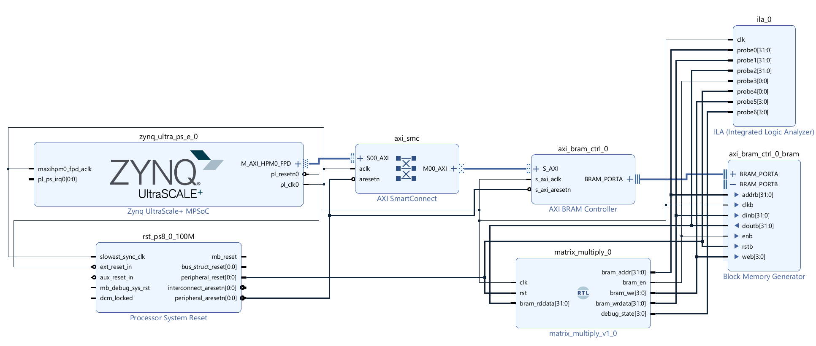
Matrix Multiplication using BRAM

Slide 7
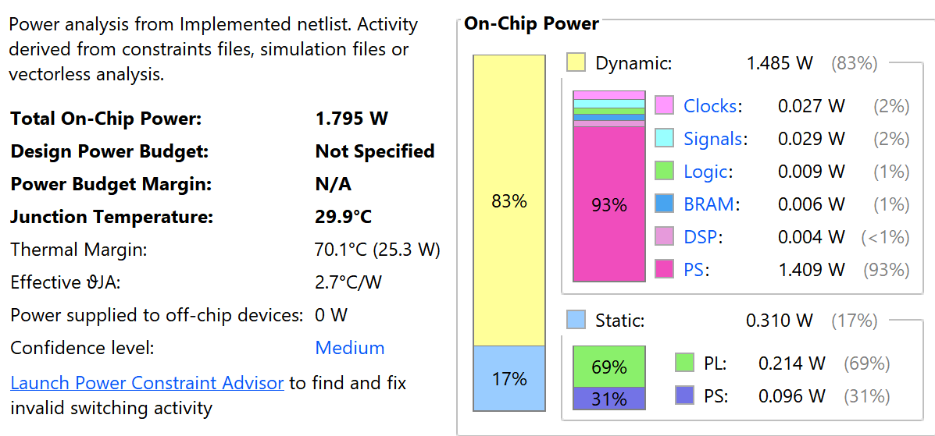
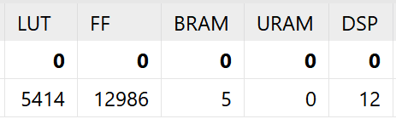
Matrix Multiplication using BRAM

Slide 8
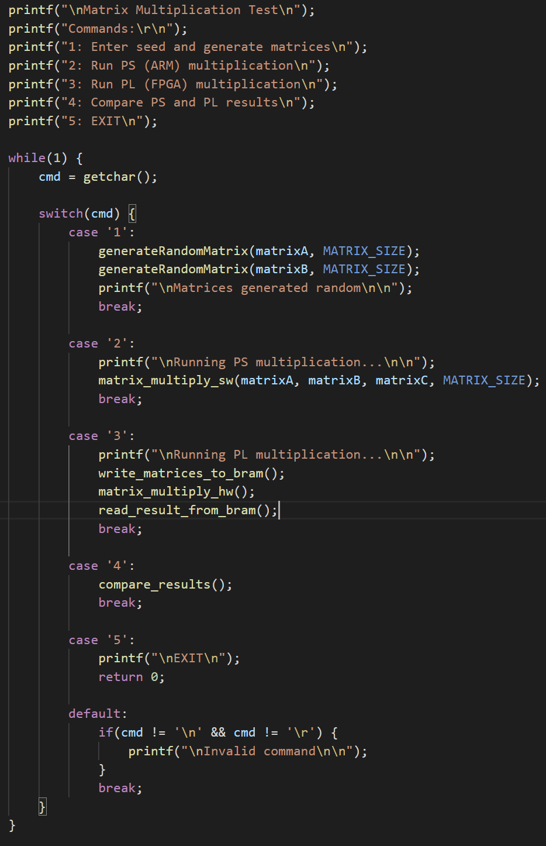
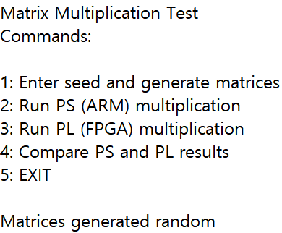
Implementation

Slide 9
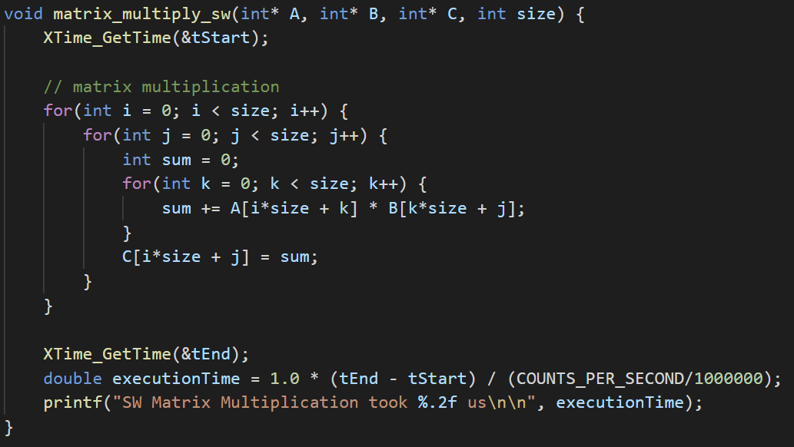
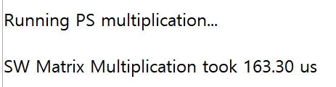
Implementation

Slide 10
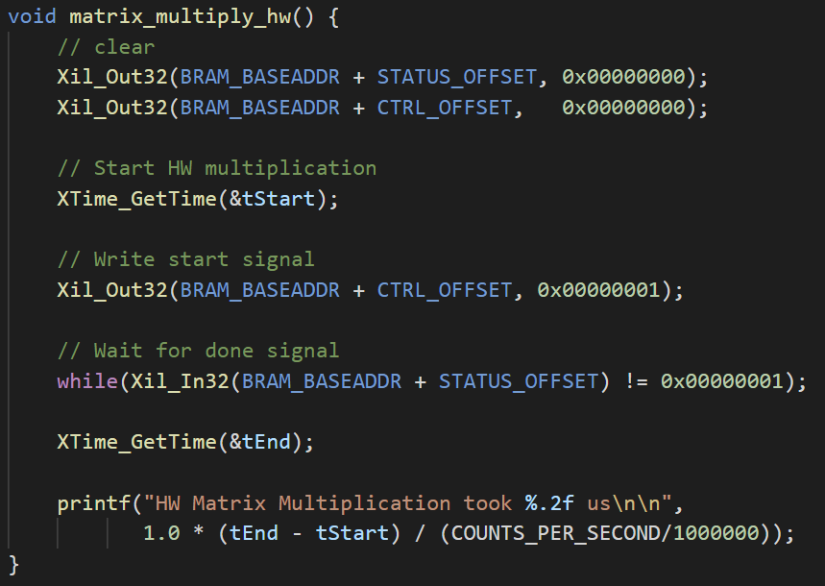

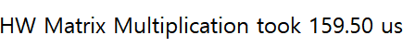
Implementation

Slide 11
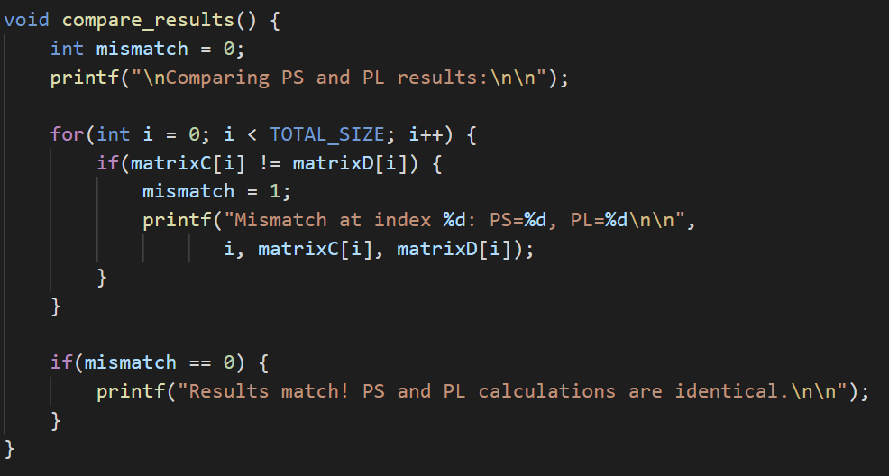
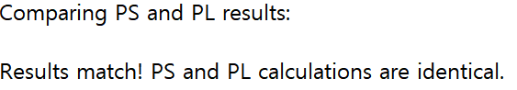
Implementation

Slide 12






Implementation
Alternative method for execution time measurement required

Slide 13
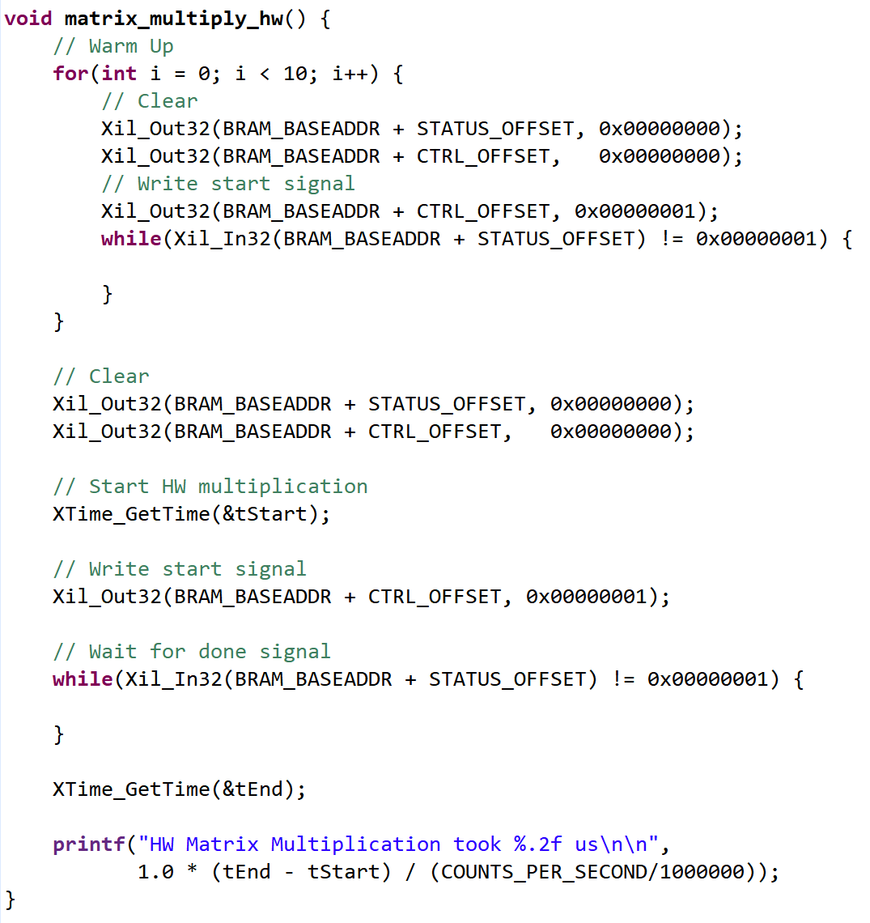


Implementation
Warming Up

Slide 14
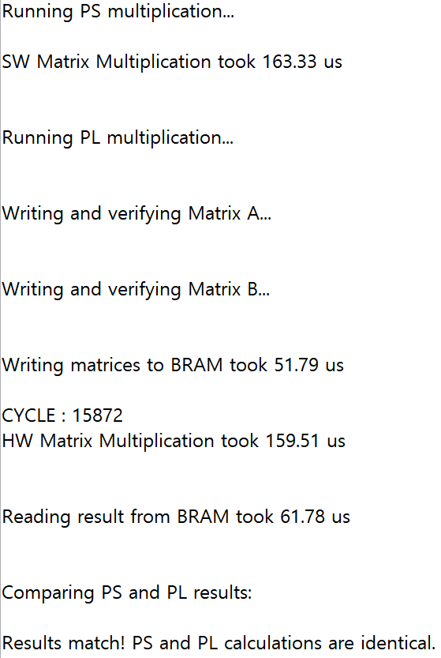
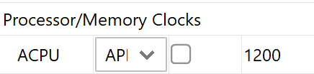
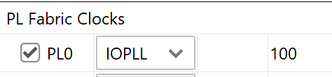
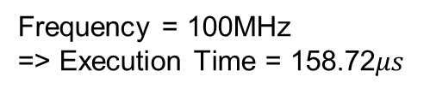
Implementation
Counting Cycles
cycle_count <= cycle_count + 1
Frequency = 100MHz
=> Execution Time = 158.72$μs$
Using XTime()

Slide 15
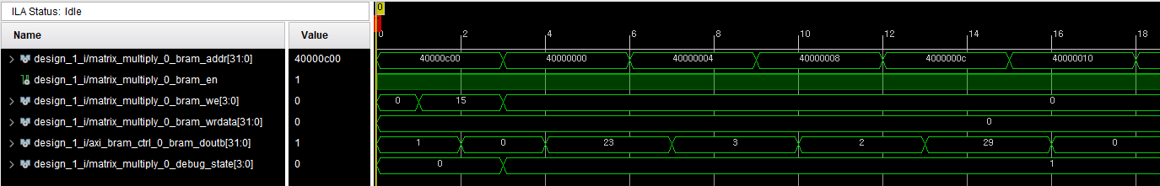
Implementation
Check Control Bit from hA000_0C00
=> Read Matrix A from hA000_0000
State 0
State 1

Slide 16
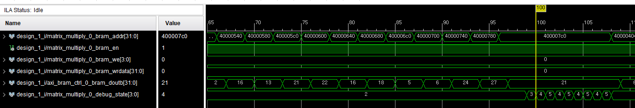
Implementation
State Change

Slide 17
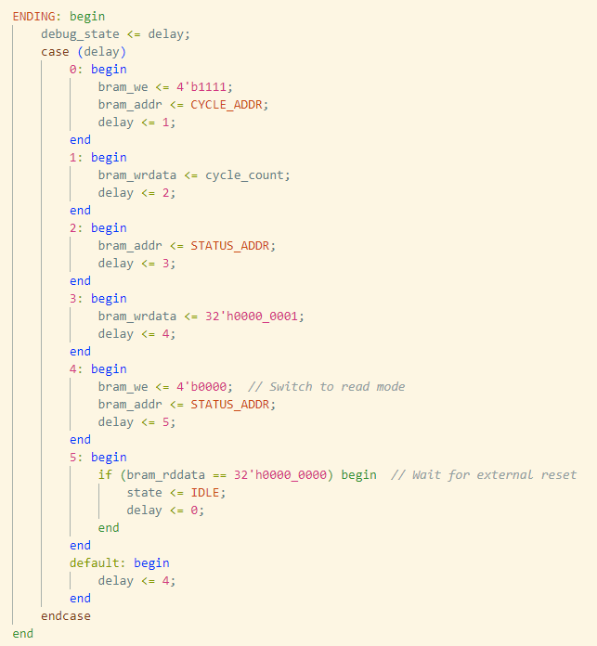
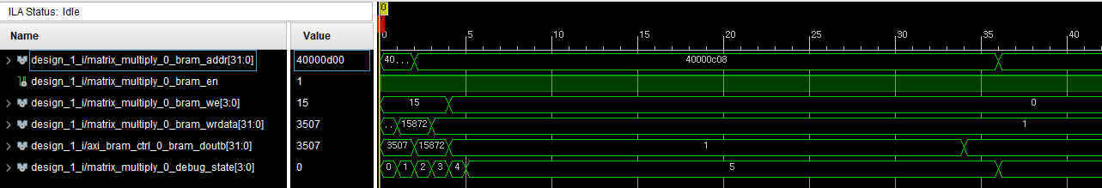
Implementation
CYCLE_ADDR = hA000_0D00
STATUS_ADDR = hA000_0D00
Write Cycle Count
Write 1

Slide 18
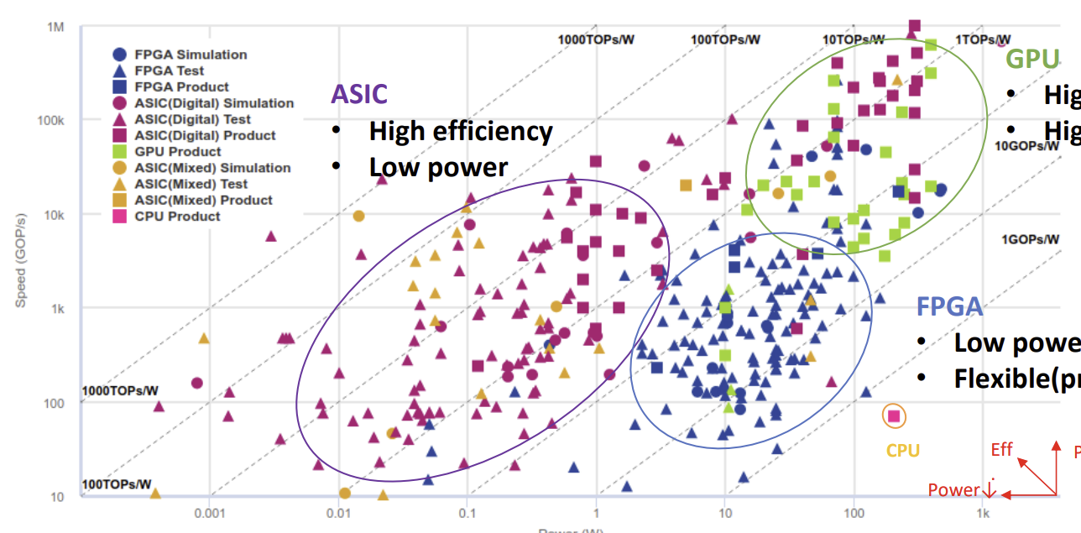
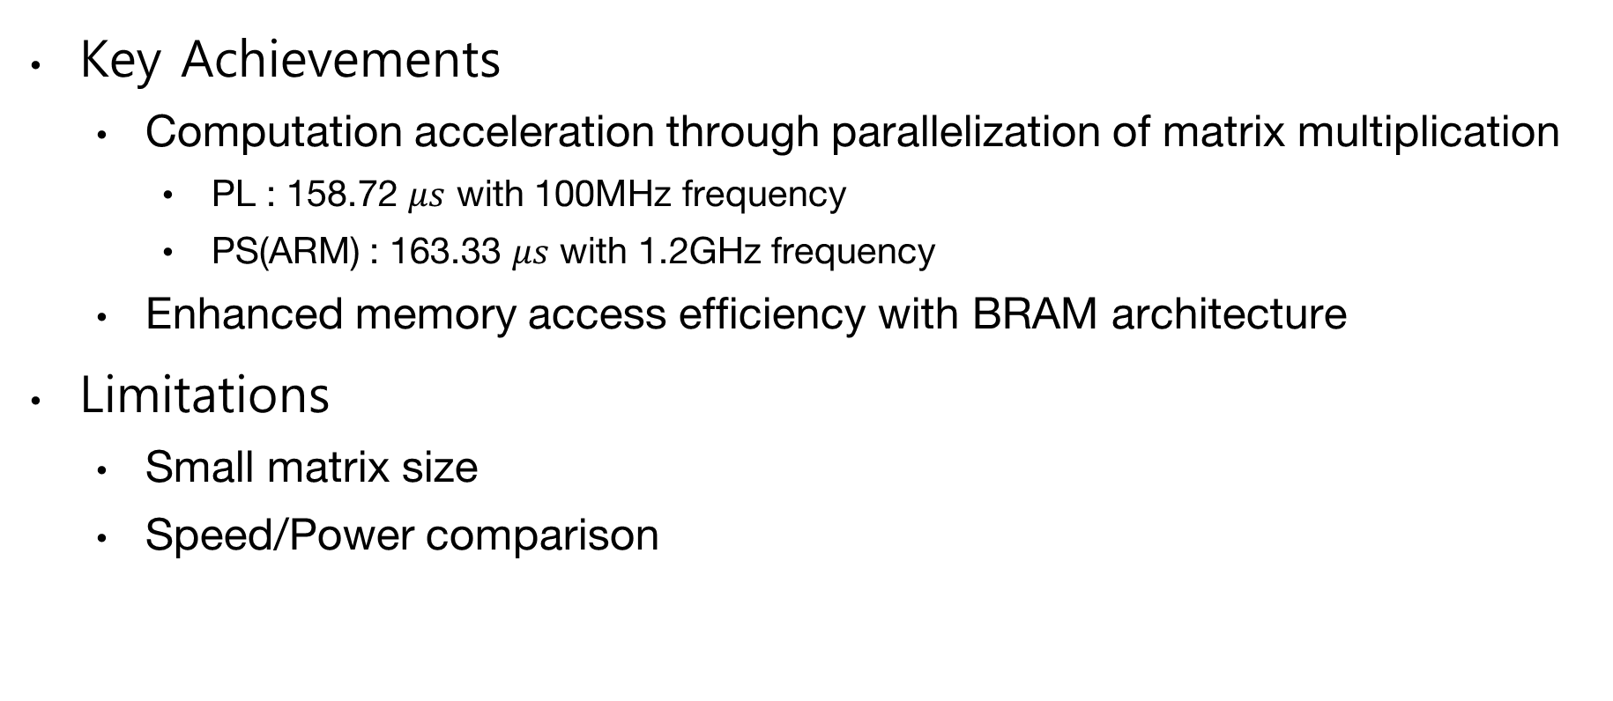
Conclusion
Key Achievements
Computation acceleration through parallelization of matrix multiplication
PL : 158.72 $μs$ with 100MHz frequency
PS(ARM) : 163.33 $μs$ with 1.2GHz frequency
Enhanced memory access efficiency with BRAM architecture
Limitations
Small matrix size
Speed/Power comparison
Notes:
어려웠던 점
Bram 구축에 시간이 많이 들었다
Time 측정에 어려움
Vivado에서 bit stream을 만들고 export를 해야하는데, bit stream을 만드는게 너무 오래걸려서 힘들었음

