Slide 1

University Management System CSE 498
A Proposal Presentation on
Submitted BY
Md Rashel Ahmed
ID: 171442038
Md Saiful Islam
ID: 171442110
Project Supervisor
Nazneen Islam
Lecturer
Department of Computer Science & Engineering.
City University.
1

Slide 2
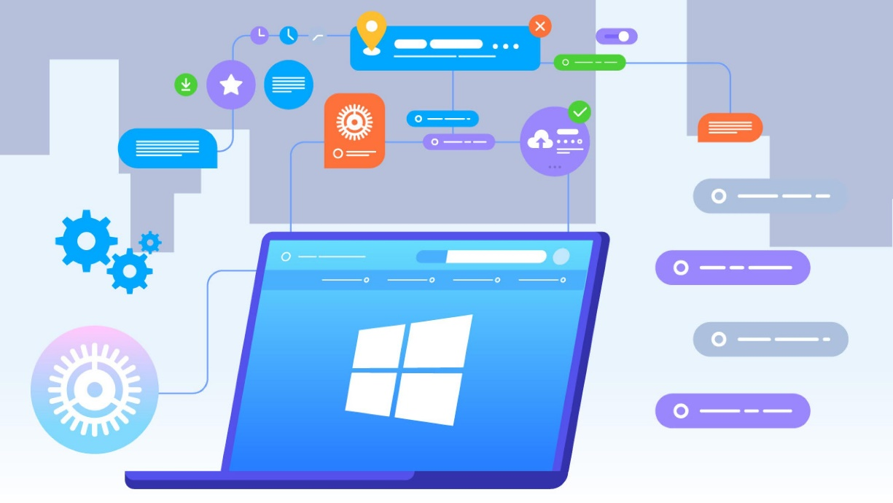
Outline
1
Introduction of The Project
2
The Project Aim
3
Module Diagram
4
Challenges of The Project
5
Tools & Technology
6
Facilities & Services
7
Hardware Requirement
8
Conclusion
2

Slide 3

Introduction : University management System
University Management System deals with is a kind of page that deals with the charge of university data,records,indications, students actuality and also generates the individual and overall performance of the students.UMS is an automation system and it is used to contain the informationa,students record and information of courses.It sustains all the niceties over the attendance and marks of the student even the registration of a new student in the university. This is a programme which deals with saving of informtaion via an INTRANET based campus mass portal.It is system analysis which is involves creating formal model of solving the problem by understanding requirements.
3

Slide 4

Project Aim : University management System
Drive operational efficiency.
Self-service systems with simple to use with little or no training.
Elimination of duplicate data entry processes.
Integrated with Online Application workflow with unified data model.
Monitoring and decision support system.
Automation of all the Academic / Examination / Administration operations.
Ease and accuracy of reporting.
4

Slide 5
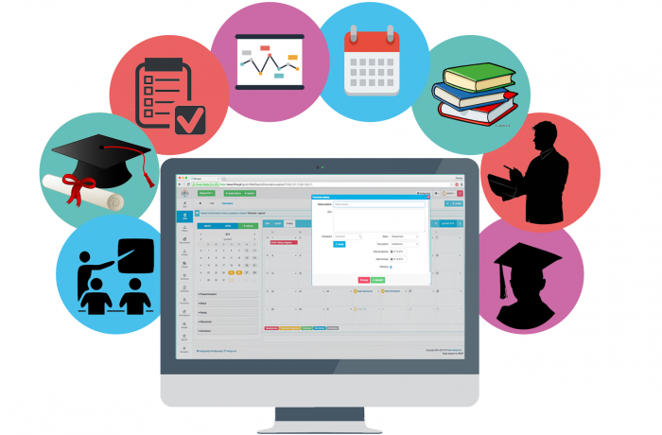
Module Diagram : University management System
Modules
Registration& Online Application.
Student Performance.
Lesson Management System.
Core Examinations.
Student Portal.
Online Class.
Homework & Assignment Submission.
E-payment.
Digital Notice Board.
Operations
Add
Update
Delete
5

Slide 6
Module Diagram : University management System
Students Profile
Student
Admin
Admins Profile
User Management System
Examination Management System
Notice & Schedule
Online Class
Attendance System
Homework & Assignment Submission
E-payment
Resource Management System
6

Slide 7

Challenges: University management System
Data migration:
The people in the management such as you need to make sure that it is uploaded onto the database and is then properly checked to verify how accurate the data is.
Internet Connectivity:
The thing about this is that the ERPs used by schools these days are web-based. This is why good connectivity is needed so that the system could be provided with all the support that it needs
Training:
The success of a school management system is normally dependent on how well the end users are able to use it. It is very important that all the technical and non-technical staff members in your school know how to use the system.
Monitoring:
It would also be great if the vendor is able to monitor how the system is going after you have implemented it. This is a key element in making sure that the system functions well and the implementation is successful.
7

Slide 8
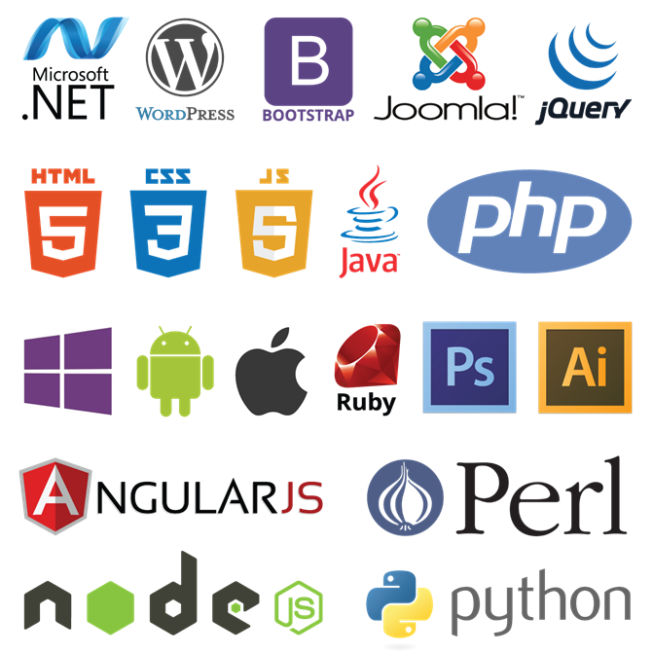
Tools & Technologies
1
PHP
2
HTML
3
CSS
4
Xampp Server
5
Java Script
6
My SQL
7
Net Beans
8
Ajax
8

Slide 9
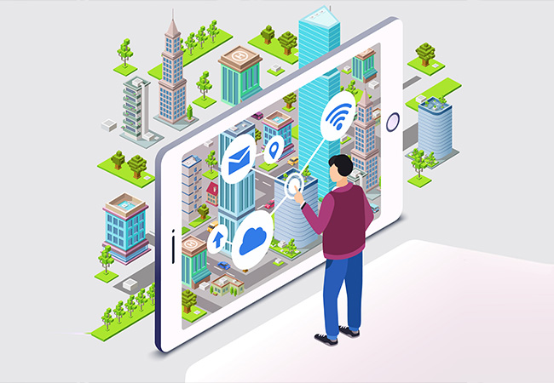
Facilities & Services
Seamless management of all in-house activities.
Role-based login access for data security.
User Friendly Graphical User Interface.
Attendance System.
Student’s & Teacher’s Profile & Academic Activities.
Examination Results & Important Notice from University.
Centralized Database & Access from Anywhere through Web.
9

Slide 10
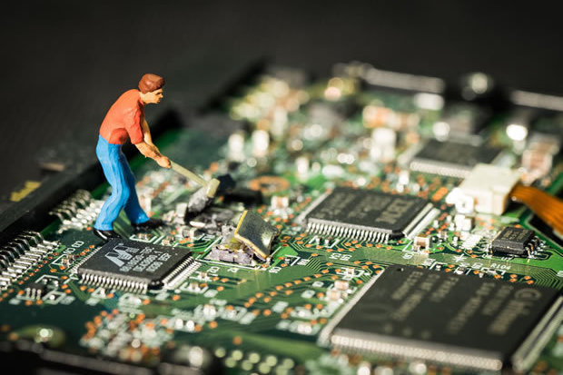
Hardware requirement
1
Processor: Intel dual core or above
2
Processor Speed: 1.0 GHZ or above
3
RAM : 2 GB RAM or above
4
Hard Disk: 80 GB hard disk or above
10

Slide 11
Conclusion
Conclusion
Automation and computerization have made things easier for universities to manage student enrollment, admissions, fees collection, conducting examinations.
University management system will provide an Easy Solution which covers all aspects of Universities. Our Solution will covers every minute aspects of a universities work flow and integrates all processes with user friendly interface.
Collecting data and managing data is an overwhelming task when it handled manually- Especially when an institute is growing fast. With a robust university management system, we will be able to store all our data digitally in a centralized hub.
11

Slide 12

Thank You for your patience
Question & Answer
12

