Slide 1
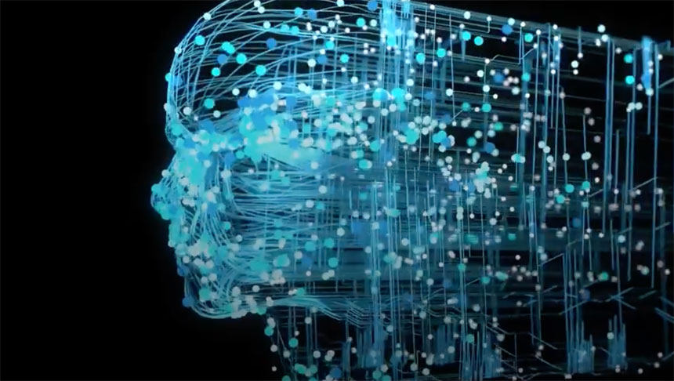
IE7374 GEN-AI

Slide 2
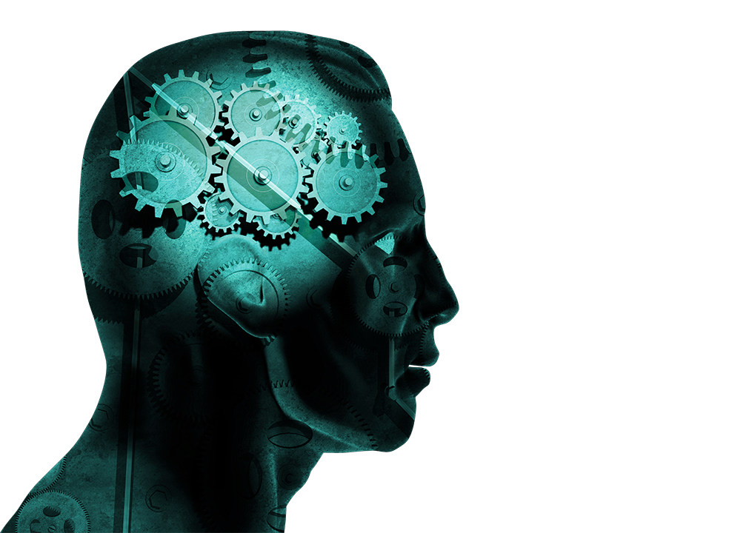
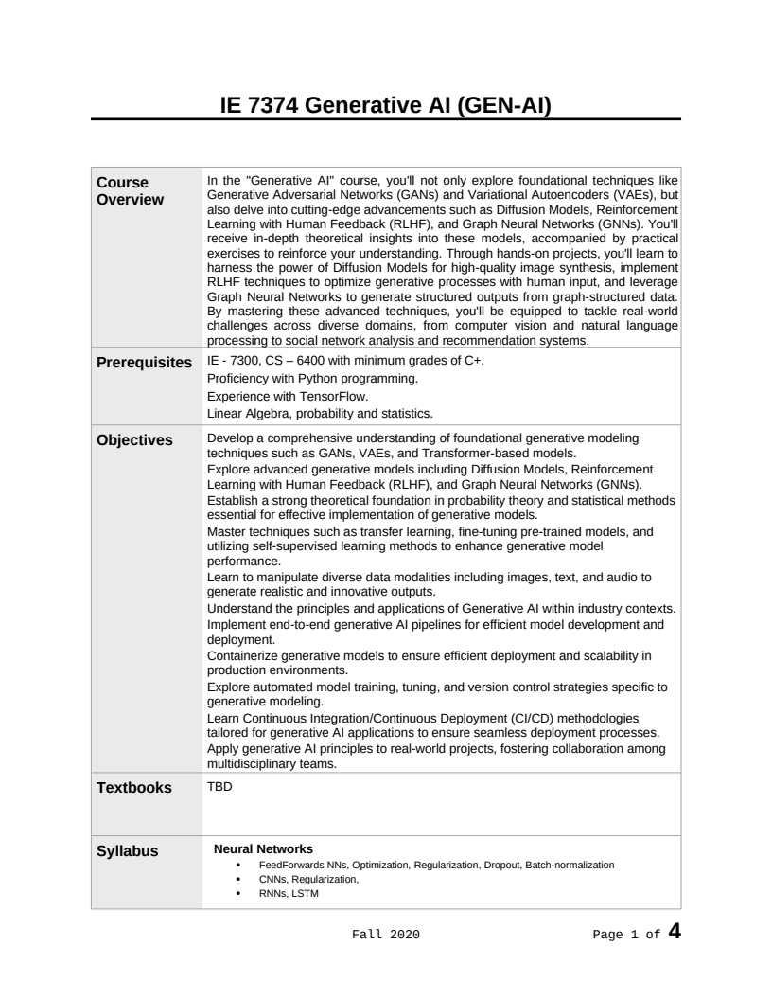
Syllabus

Slide 3

Motivation

Slide 4
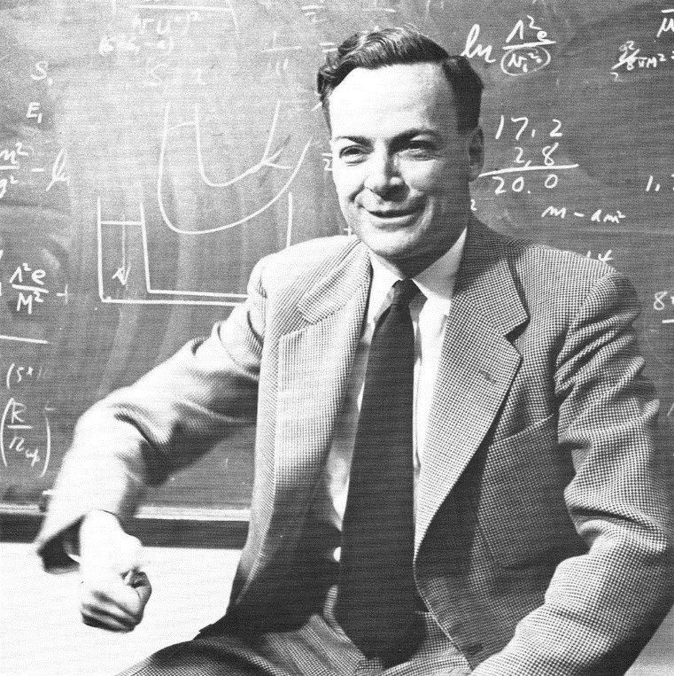
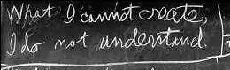
Introduction
Richard Feynman: “What I cannot create, I do not understand”
Generative modeling: “What I understand, I can create”
Notes:
Https://commons.wikimedia.org/wiki/Category:Richard_Feynman#/media/File:Richard_Feynman_1959.png
http://archives-dc.library.caltech.edu/islandora/object/ct1%3A483

Slide 5
Generative Modeling: Computer Graphics
How to generate natural images with a computer?
Many of our models will have similar structure (generation + inference)
High level description
Cube(color=blue, position=(x,y,z), size=…)
Cylinder(color=red, position=(x’,y’,z’), size=..)
Generation (graphics)
Inference (vision as inverse graphics)
Raw sensory outputs
Notes:
Computer graphics:
Produce plausible images
You choose models, conditions, imging parameters, etc.
Vision:
Given images with noise, estimate physical quantities (ill-posed problem)
Building a generative model is not the entire story. Inference (e.g. vision) is still hard. So not entirely true that if we can create we understand. But it’s a useful step

Slide 6
Generative AI
Generative AI focuses on creating data that mimics real-world examples, enabling machines to produce text, images, music, and more.
Generative AI refers to a class of algorithms that learn to generate new, synthetic data resembling the input data they were trained on.
These methods are transforming numerous fields including content creation, design, personalized marketing, healthcare, and scientific research.
Generative AI has advanced the state-of-the-art in natural language processing, image synthesis, drug discovery, and personalized recommendations.
4

Slide 7
Deep Learning
Deep learning attempts to learn representations of data with multiple levels of abstraction.
Deep learning usually refers to a set of algorithms and computational models that are composed of multiple processing layers.
These methods have significantly improved the state-of-the-art in many domains including, speech recognition, classification, pattern recognition, drug discovery, and genomics.
4

Slide 8
Abstraction: the act of ignoring irrelevant details and focusing on the relevant parts.
Abstraction in neural networks (NNs) refers to the process of simplifying complex information by focusing on high-level representations rather than low-level details.
Layer Abstraction: Each layer in a neural network transforms the input data into more abstract representations. For example, in a convolutional neural network (CNN) for image recognition, early layers might detect edges and textures, while deeper layers identify more complex features like shapes and objects.
Feature Extraction: Neural networks automatically learn to extract relevant features from raw data.
Hierarchical Abstraction: Neural networks, especially deep ones, create a hierarchy of abstractions. Lower layers capture basic elements, middle layers combine these elements into higher-level features, and top layers make decisions based on these high-level features.
Generalization: Abstraction enables neural networks to generalize from training data to unseen data. By learning abstract features that capture the essence of the data, neural networks can perform well on new, similar inputs.

Slide 9
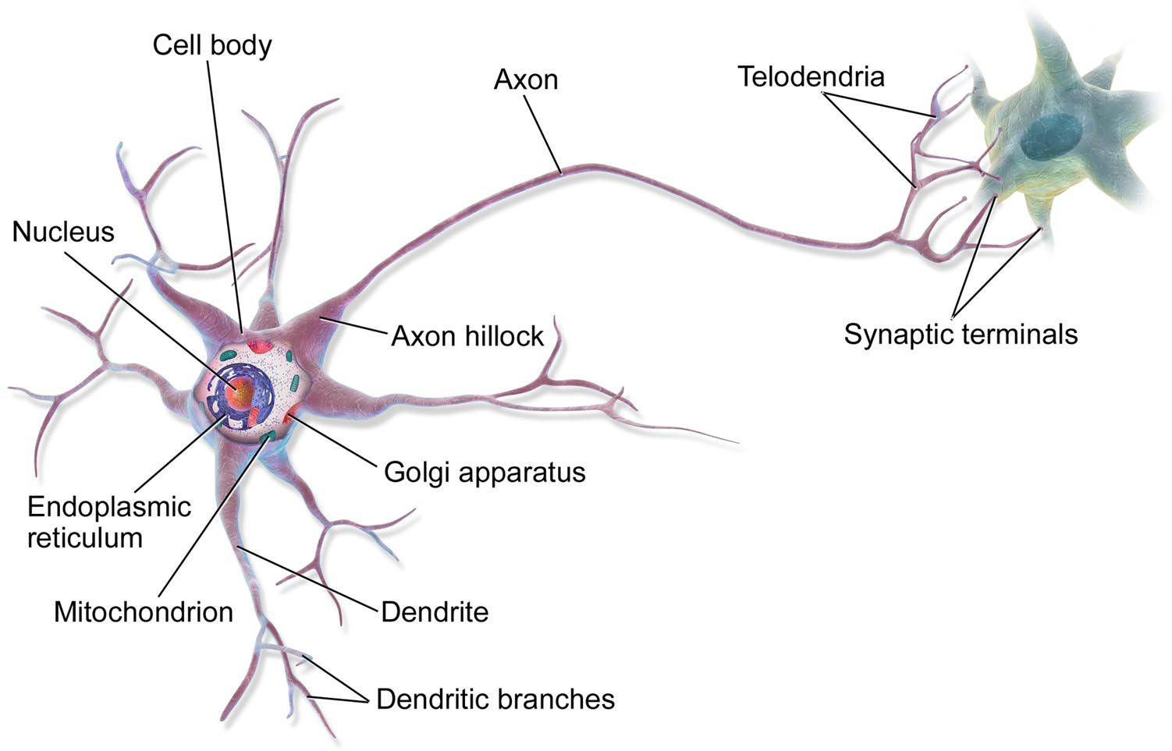
Biological Inspiration

Slide 10
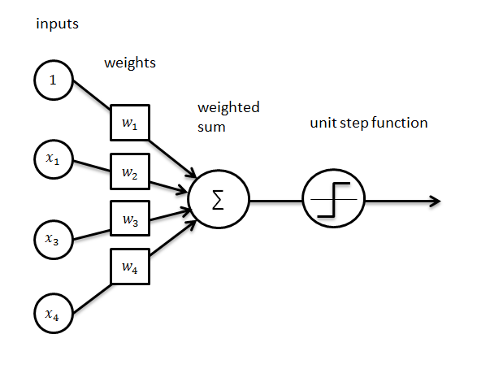
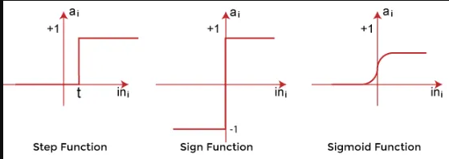
Perceptron
1958 - The perceptron was developed by Rosenblatt (physiologist).
6

Slide 11
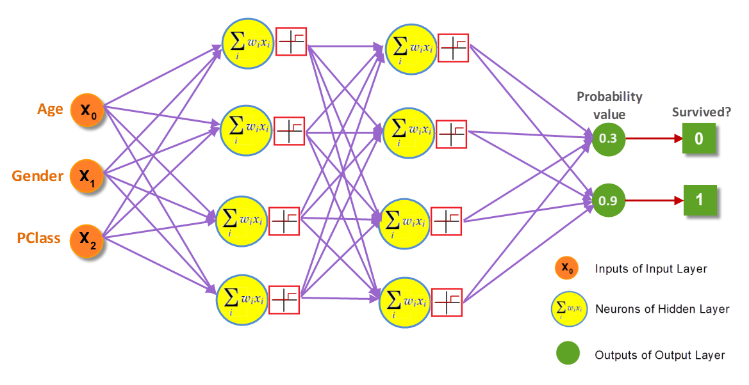
Neural Network Architecture
Synapse
6
Neuron

Slide 12
Feedforward Deep Networks

Slide 13
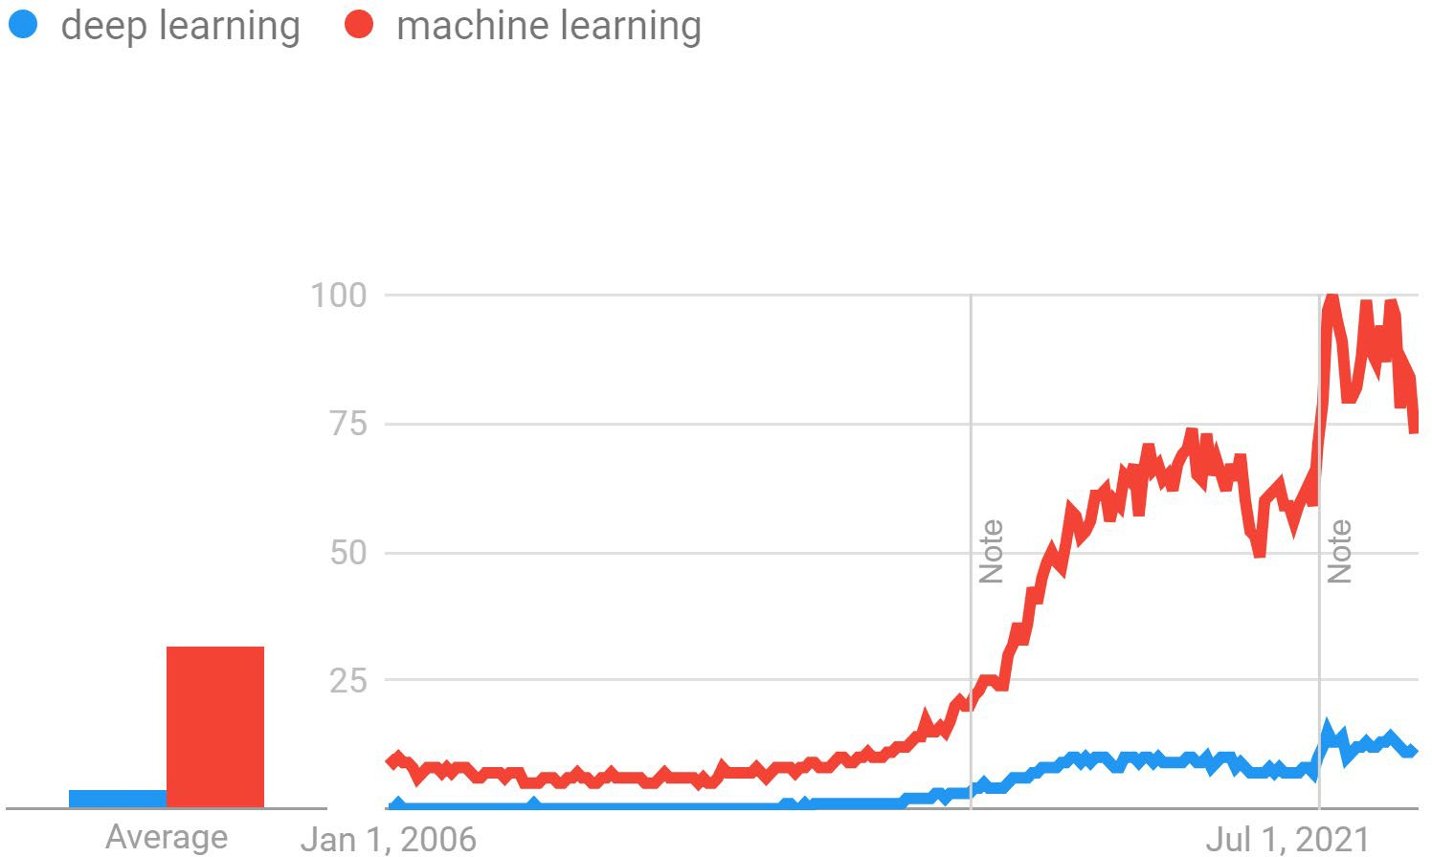
Interest over time

Slide 14
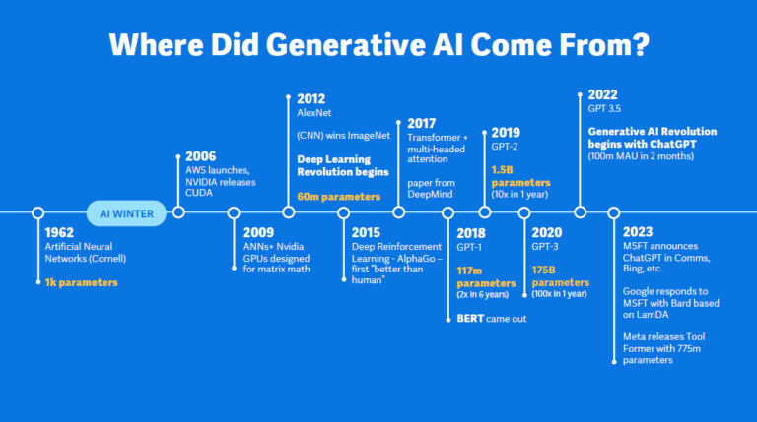
Interest over time

Slide 15
Building a simulator for the data generating process
Data simulator
Data

Slide 16
Building a simulator for the data generating process
Control signals
Data simulator
=Statistical model
=Generative model
New datapoints
Potential datapoints
Probability values

Slide 17
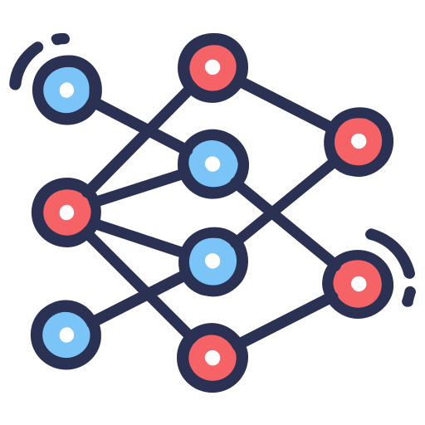
Building a simulator for the data generating process
Control signals
New datapoints
Potential datapoints
Probability values
Generative model

Slide 18
Milestones in Deep Learning History
2006: Geoffrey Hinton's "Deep Belief Networks" - The modern era of deep learning begins.
2012: AlexNet's ImageNet victory brings mainstream attention.
2014-2015: Introduction of Generative Adversarial Networks (GANs).
2016: Google's AlphaGo uses deep learning to defeat a Go world champion.

Slide 19
Milestones in Deep Learning History
2017: Transformer architecture revolutionizes Natural Language Processing.
2018-2019: GPT-2 and BERT gain popularity.
2020-2021: COVID-19 drives deep learning in healthcare.
2022: LLM (Large Language Model) and ChatGPT
2022-2023: Anticipated breakthroughs in the maturing field.

Slide 20
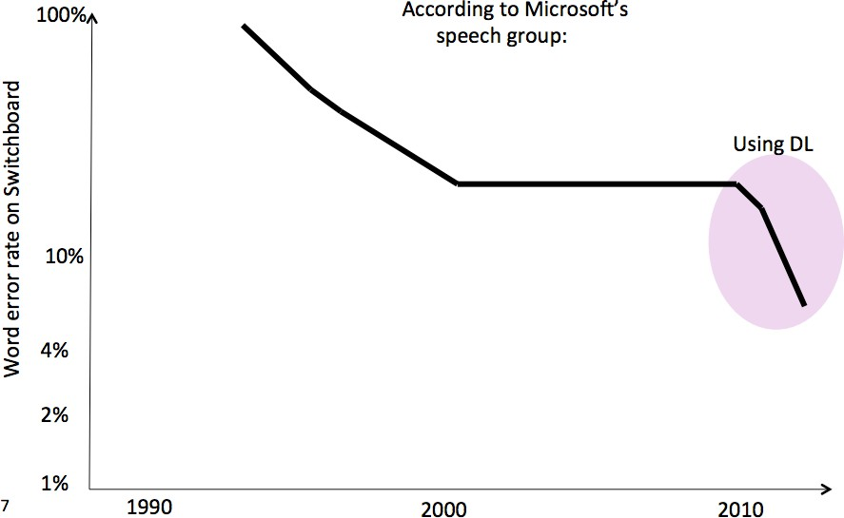
Impact on Speech Recognition

Slide 21
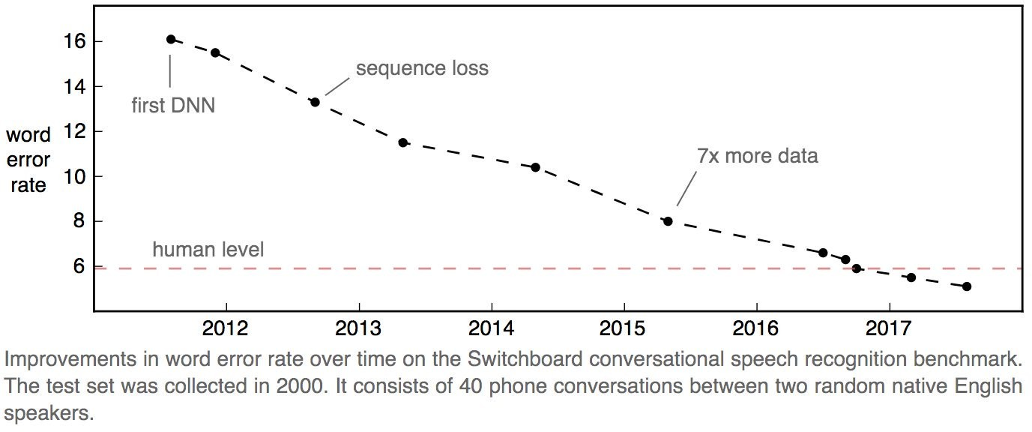
Impact on Speech Recognition

Slide 22
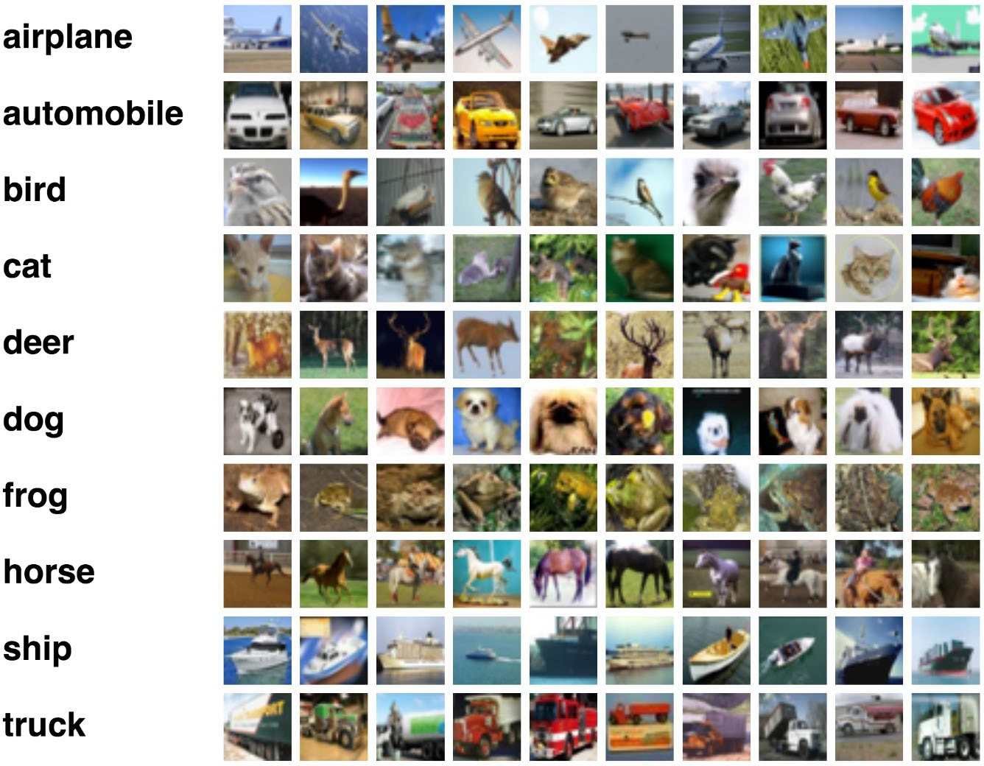
ImageNet

Slide 23
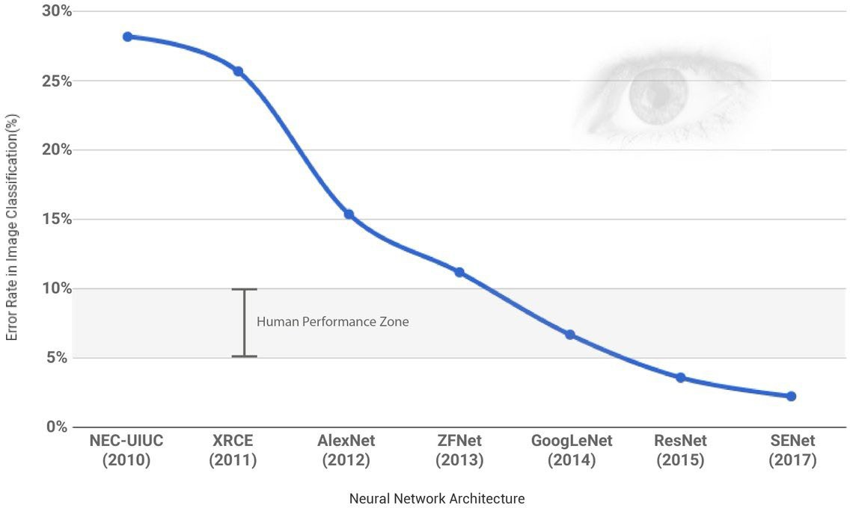
Credit: ML review
20

Slide 24
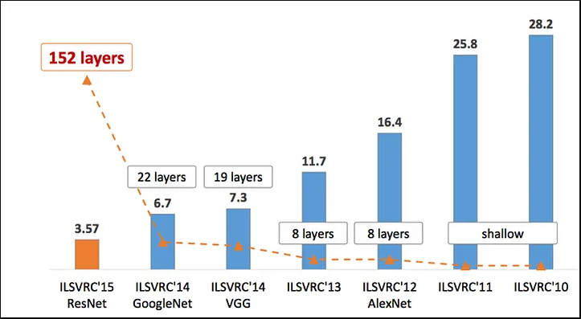

Slide 25
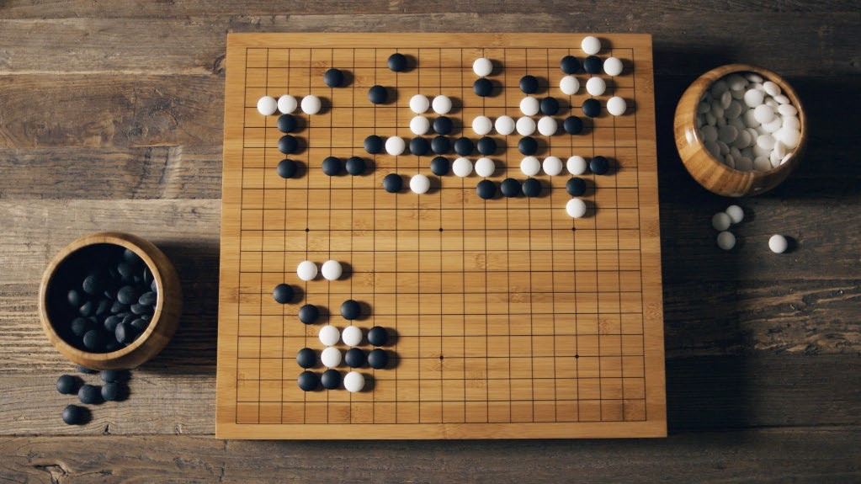

AlphaGo (2016) algorithm masters ancient game of Go
Deep-learning software defeats human professional for first time.

Slide 26
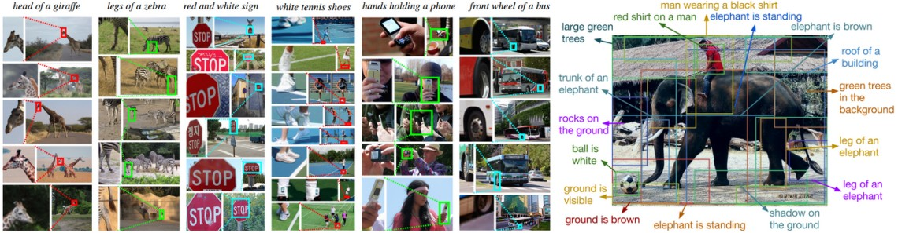
Describing photos

Slide 27
Winning Atari Breakout

Slide 28

Audio Super Resolution
Conditional generative model P(high-res signal | low-res audio signal)
Low res signal
High res audio signal
Kuleshov et al., 2017

Slide 29
Code Generation
OpenAI Codex

Slide 30

Video Generation
Suddenly, the walls of the embankment broke and there was a huge flood

Slide 31

Video Generation

Slide 32

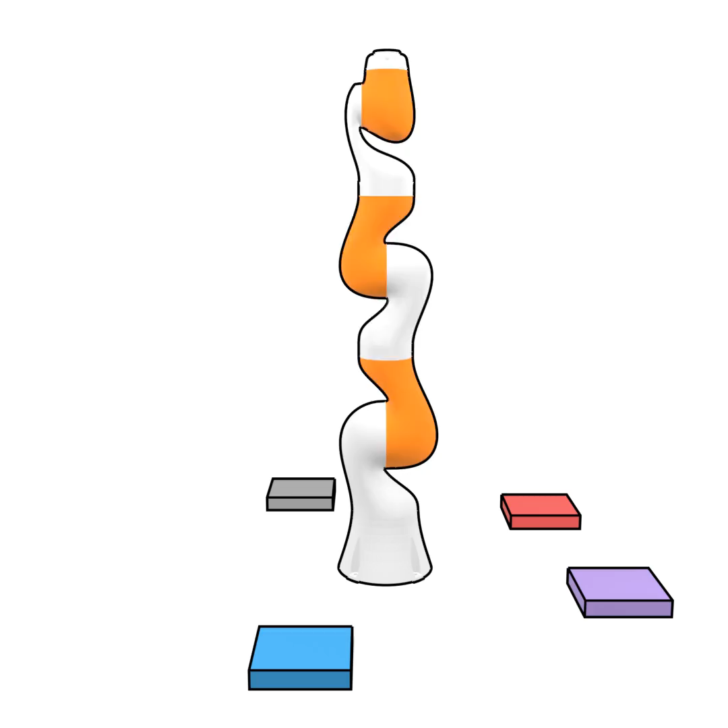
Imitation Learning
Conditional generative model P(actions | past observations)
Li et al., 2017
Janner et al., 2022

Slide 33
Generative Models
Image Generation
Data Augmentation
Text Generation
Music Generation
Drug Discovery
Speech Synthesis
https://thispersondoesnotexist.com/

Slide 34
ChatGPT - The Conversational AI
Text Summarization
Language Translation
Code Generation
Content Creation
Customer Support
Tutoring & Education
General Q&A

Slide 35
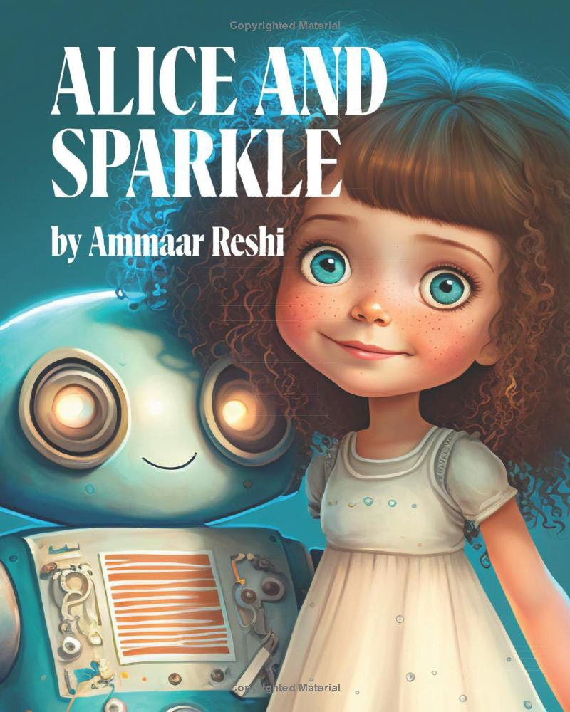
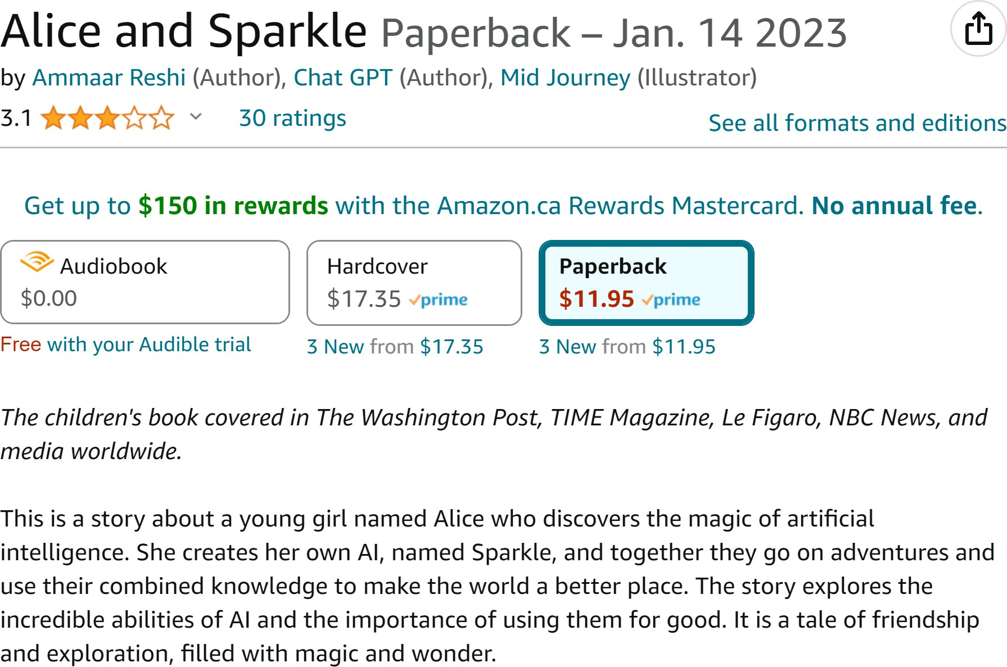
Books written by AI

Slide 36

Books written by AI
The novella is the result of a collaboration between Stephen Marche and three artificial intelligence programs.

Slide 37
Books written by AI
There were over 200 e-books in Amazon’s Kindle store as of mid- February 2023 listing ChatGPT as an author or co-author
AI-Generated Books of Nonsense - These are books that are created by AI and are often nonsensical. They have been found on Amazon's bestseller lists, but Amazon has been removing them due to copyright violations

