Slide 1
Alex Kelly & Simmigon Flagg GE Digital

Slide 2



A little more about me.
2013 – Bachelors of Science in Computer Science, Clemson

Slide 3

2011-2013, NYC – Berkshire Hathaway

Slide 4


2013-2015, Redmond - Microsoft
Power BI

Slide 5
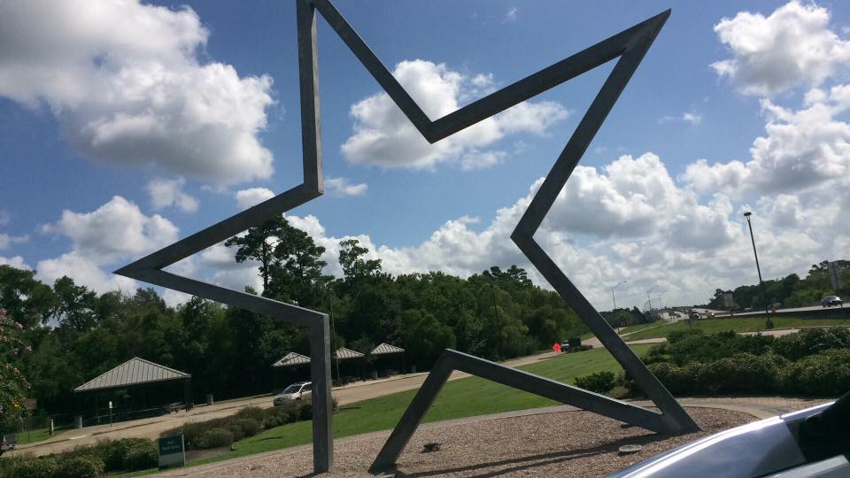
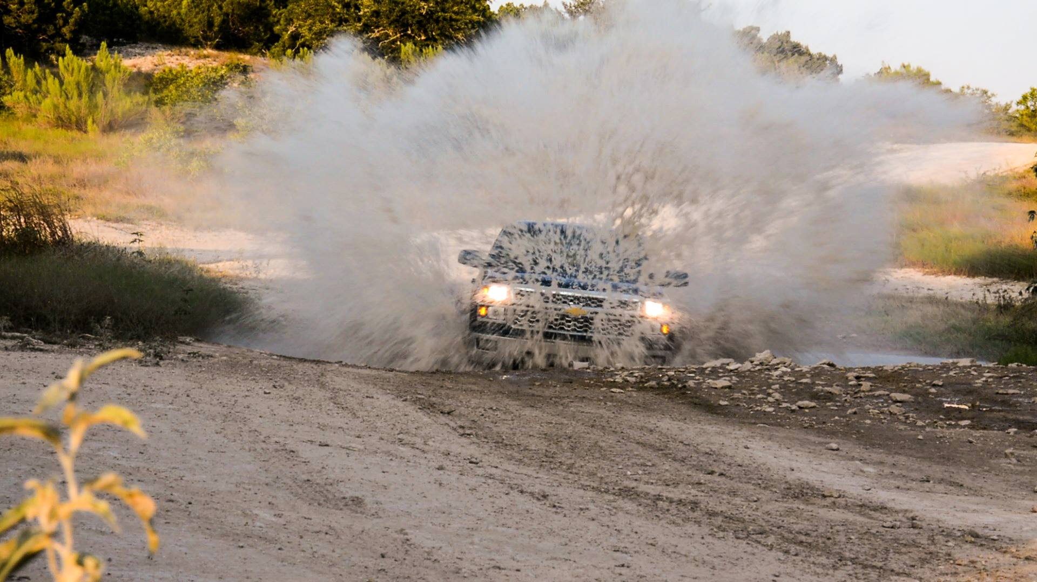
2015-2017, Austin – GM
http://gm.com

Slide 6
Current

Slide 7

About me.
2017 – Bachelors of Science in Computer Science, Georgia State University
I have 2 AWS Associate Certifications
Developer
Solutions Architect
I’ve was a Teacher’s Assistant for a Georgia Tech Bootcamp 2019
Web Dev for Marta 2013 – 2014
Created the first version of the MARTA
on-the-go app for Android.

Slide 8

A little more about me.
Georgia Tech Bootcamp
2019 – Professional Education
I have 1 Full Stack Flex MERN Certifications
Georgia Tech University
Currently working on Cyber and Network Security Certifications
Georgia Tech University / CompTIA Security+

Slide 9
Current

Slide 10
git clone https://github.com/pilotdeveloper/iot_lab.git
Mac users:
Try this solution:
https://medium.com/@tony92151/arduino-ch340-chip-driver-for-high-sierra-39e621dae1e4

Slide 11
ENSURE YOUR BAG HAS
8 male to female jumper cables
10 male to male jumper cables
10 µf electrolytic capacitor
1x NRF24L01+ Transceiver
4 tactical buttons
Arduino
Breadboard
USB Cable

Slide 12
Test your board
Open the Arduino IDE
Select Tools, Click Board -> Arduino Nano
Take note of the current devices under Tools -> Port (write down so you don’t select them later)
Plug your Arduino in, wait about 20 seconds, and then check under Tools -> Port.
Windows – should show as a COM# device
Mac Users – check the file called “mac_help.txt” in the repo.
Open the file helloworld/helloworld.ino and click the run button in Arduino

Slide 13
hello_world.ino
Once you have hello_world running, you should be able to type a character and have your Arduino respond. If it doesn’t, please see me before we continue!

Slide 14
Parts we’re using
NRF24L01+ Wireless Transceiver
Arduino Nano
10 µf Capacitor
Breadboard
Shoe Boxes

Slide 15
How to connect the NRF24L01 to Arduino
NRF24L01+ | Arduino Pin
1 – GND | Ground
2 – VCC | 3v3
3 – CE | D9
4 – CSN | D10
5 – SCK | D13
6 – MOSI | D11
7 – MISO | D12
8 – IRQ | D8

Slide 16
Capacitor
Bursting a signal requires a lot of energy – around 100 mA depending on the transmission strength. The Arduino Mano is not capable of handling this burst over 3.3v, so you have to add a capacitor to account for the voltage drops.
The capacitor must be connected across 3.3v and Ground on your NRF24L01. See photo in diagrams called “capacitor” for info on how to do this.
Be sure that the - - - (on the side of the capacitor) is on the ground side – you’ll short out the device if not!

Slide 17
Tactical Switches

Slide 18
Connect GND to the Negative Rail (Blue – on either side)
Press your buttons in to the bread board, ensure AB are on left & CD are on right
Connect the left side of the switches (A) to the Negative rail with four male to male jumper wires.
Connect the right side of the switch to D2, D3, D4, and D5 respectively
(see all images in github repository for additional info)

Slide 19
Program your board
Open Transmitter.ino and set your group number equal to tableNumber.
Fix the code!
Add NRF24 to your dependencies before you compile!!!

Slide 20
Connect with me!
https://ajkelly.net
https://linkedin.com/in/alexanderjkelly

