Slide 1
Alex Kelly & Abhinav Reddy GE Digital

Slide 2




A little more about me.
2013 – Bachelors of Science in Computer Science, Clemson
2019 - 2021 – Masters of Computer Science, GA Tech

Slide 3

2011-2013, NYC – Berkshire Hathaway

Slide 4


2013-2015, Redmond - Microsoft
Power BI

Slide 5

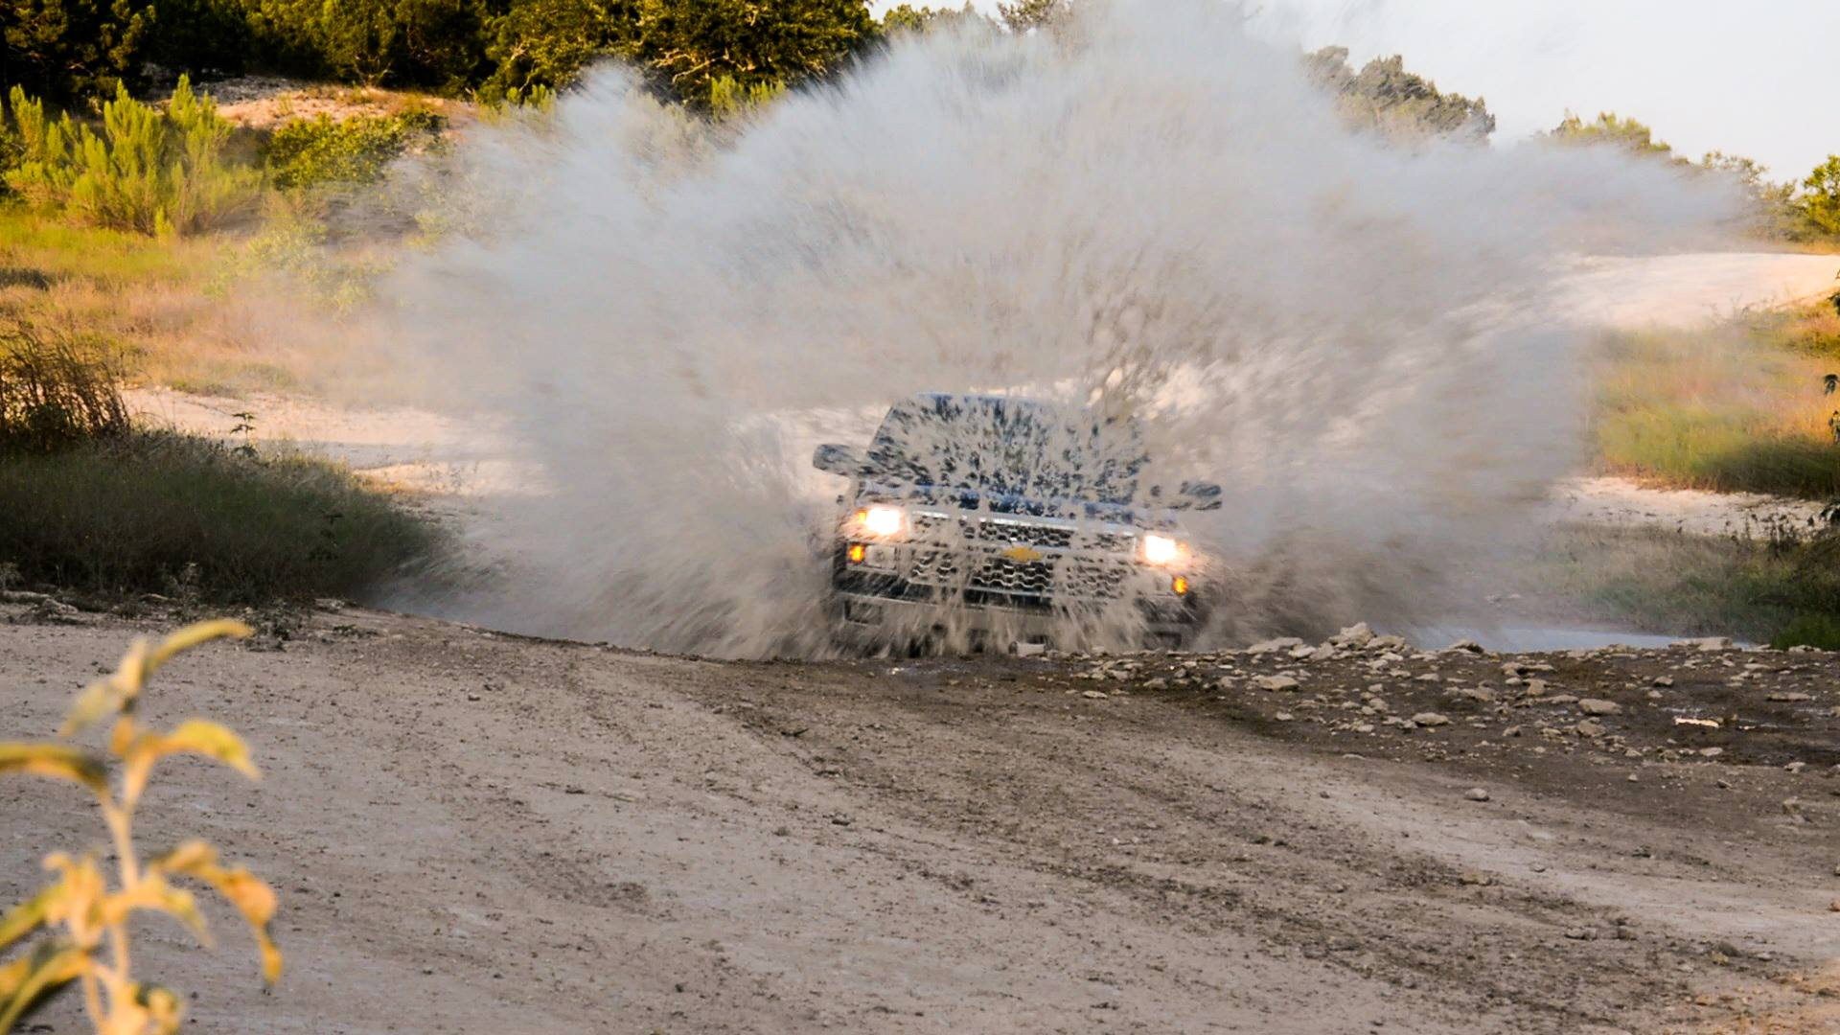
2015-2017, Austin – GM
http://gm.com

Slide 6
Current

Slide 7

The Sidekick
Abhinav Reddy
GSU Alumni!
- Graduated Summer 2017
GE Software Engineer
- Summer 2017-Present
Once wrote a cryptocurrency trading bot
- Only lost $80 :D
Currently working on a news aggregator
- everything.news (migration imminent)

Slide 8
git clone https://github.com/pilotdeveloper/sensors_lab.git
Mac users:
Install below and reboot http://www.ftdichip.com/Drivers/VCP/MacOSX/FTDIUSBSerialDriver_v2_4_2.dmg

Slide 9
Please Pick Up
8 male to female jumper cables
10 male to male jumper cables
10 µf electrolytic capacitor
1x NRF24L01+ Transceiver
4 tactical buttons
Arduino
Breadboard
USB Cable

Slide 10
Test your board
Open the Arduino IDE
Select Tools, Click Board -> Arduino Nano
Take note of the current devices under Tools -> Port (write down so you don’t select them later)
Plug your Arduino in, wait about 20 seconds, and then check under Tools -> Port.
Windows – should show as a COM# device
Mac Users – check the file called “mac_help.txt” in the repo.
Open the file helloworld/helloworld.ino and click the run button in Arduino

Slide 11
hello_world.ino
Once you have hello_world running, you should be able to type a character and have your Arduino respond. If it doesn’t, please see me before we continue!

Slide 12
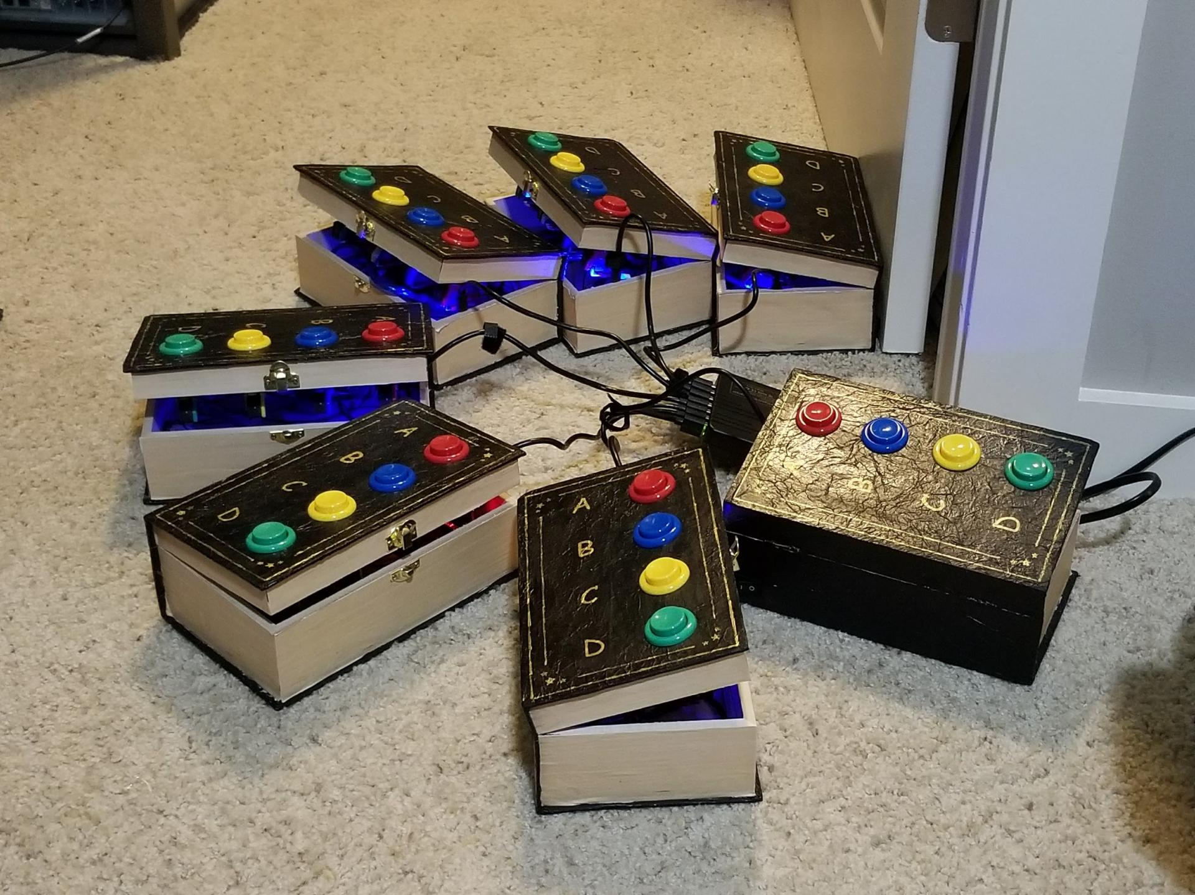
What we’re building

Slide 13
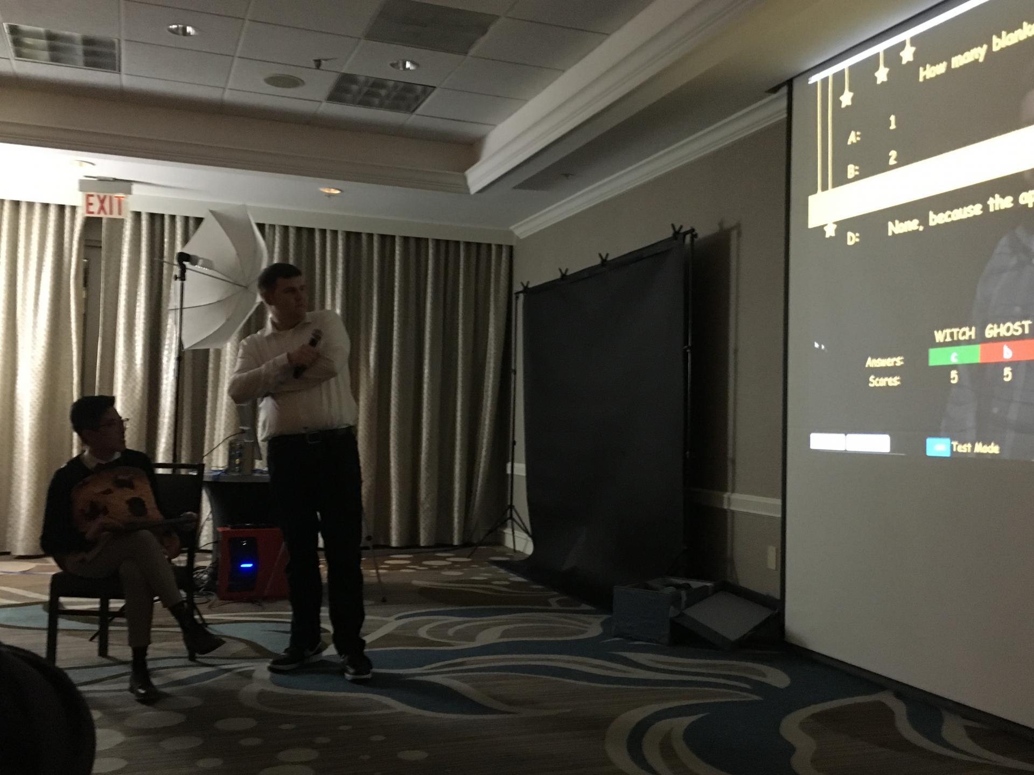
What we’re building

Slide 14
Parts we’re using
NRF24L01+ Wireless Transceiver
Arduino Nano
10 µf Capacitor
Breadboard
Shoe Boxes

Slide 15
The build
Start by connecting the Arduino and the NRF24L01+
NRF24L01+ | Arduino Pin
1 – GND | Ground
2 – VCC | 3v3
3 – CE | D9
4 – CSN | D10
5 – SCK | D13
6 – MOSI | D11
7 – MISO | D12
8 – IRQ | D8

Slide 16
Capacitor
Bursting a signal requires a lot of energy – around 100 mA depending on the transmission strength. The Arduino Mano is not capable of handling this burst over 3.3v, so you have to add a capacitor to account for the voltage drops.
The capacitor must be connected across 3.3v and Ground on your NRF24L01. See photo in diagrams called “capacitor” for info on how to do this.
Be sure that the - - - (on the side of the capacitor) is on the ground side – you’ll short out the device if not!

Slide 17
Tactical Switches

Slide 18
Connect GND to the Negative Rail (Blue – on either side)
Press your buttons in to the bread board, ensure AB are on left & CD are on right
Connect the left side of the switches (A) to the Negative rail with four male to male jumper wires.
Connect the right side of the switch to D2, D3, D4, and D5 respectively
(see all images in github repository for additional info)

Slide 19
Program your board
Open Transmitter.ino and set your group number equal to tableNumber.
Compile the source and upload to your Arduino!

Slide 20
What happened?

Slide 21
Root Cause Analysis
When programming Team 6’s board, I remember turning to them and saying “It’s funny that you’re team 6 and the device mounted as COM6.” After programming their board, I handed the device to them and couldn’t figure out why I wasn’t receiving any responses. During the tests, I never noticed that COM6 was still connected – meaning, I was using the transmission file to receive.

Slide 22
Transmission Bugs
Previously, the code was resetting the table to be “1” regardless of the entered value.
We were setting a hard integer in the type definition – you don’t do this generally when you have a reusable data type.
Too many messages in the debug log making it difficult to read.

Slide 23
Receive Bugs
Massively cleaned up the code to be one simple line instead of a huge if then block
Updated the transmission ports to Node to match the actual table numbers (1-10).
Removed code that looked for different transmission channels (not needed)

Slide 24
Web App Bugs
Fixed the spacing issues in the code that would have made it unusable on 1920x1080
Fixed the team names so that they match the correct groups
Fixed the random linear display bug (lack of a table)
Fixed the transmit variables

Slide 25
Bad code
struct dataStruct1 { int table = 6; float t1; char response; } transmitter1_data;

Slide 26
Code walkthrough

Slide 27
Connect with us!
https://ajkelly.net
https://linkedin.com/in/alexanderjkelly
https://blog.reddyman.com
https://idonthavelinkedin.com

