Slide 1
EEO311 – Quiz 2
Pete Mills

Slide 2
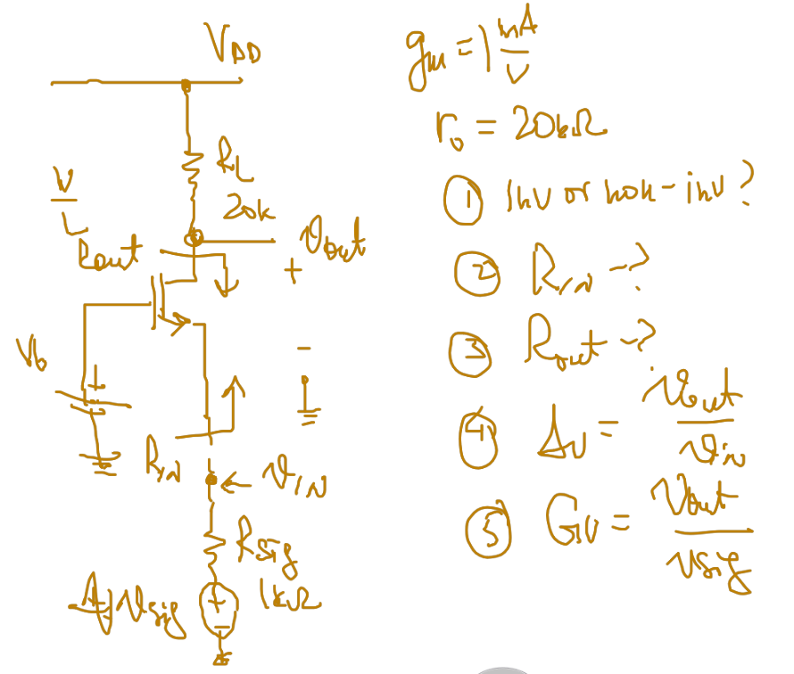
Schematic Question Reference

Slide 3
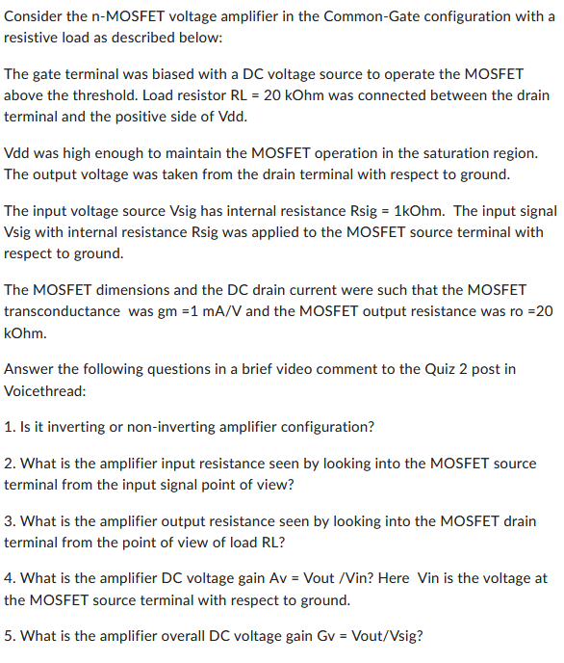
Quiz Instructions

Slide 4
Quiz Response
The common gate amplifier is non-inverting. Only the common source amp is inverting
Rin = (ro + RL)/Ao = (20k + 20k ) / (20k * 1mA ) = 2k ohm
Rout = ro + Rs + Ao*Rs = 20k + 1k + 20*1k = 21k + 20k = 41k ohm
DC voltage gain Av = RL / Rin = 20k / 2k = 10
Overall gain Gv = Av*Rin / Rin+RS = (10*2k) / (2k+1k) = 20k / 3k ~= 6.7

