Slide 1
EEO311 – Quiz 3
Pete Mills

Slide 2
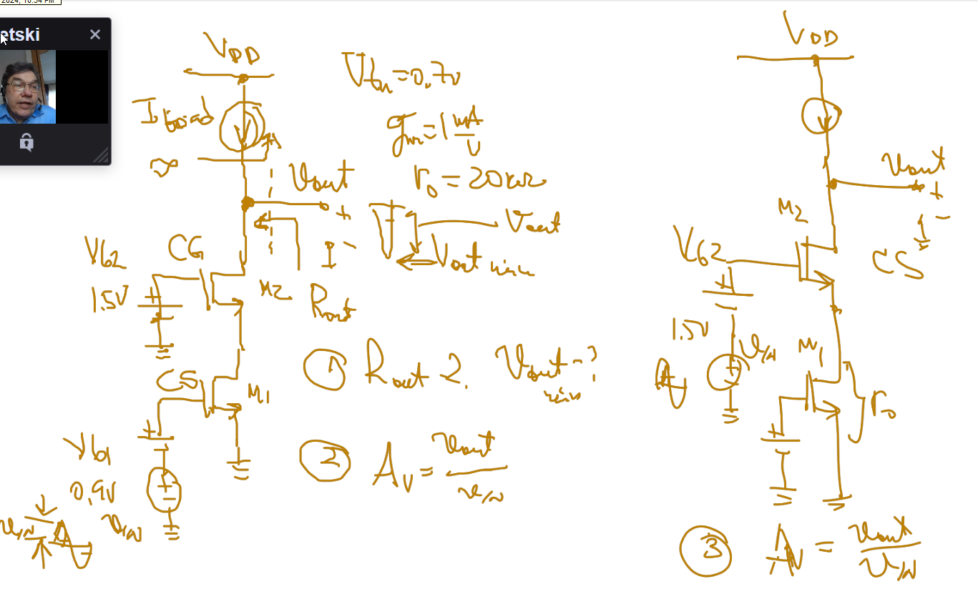
Schematic Question Reference

Slide 3
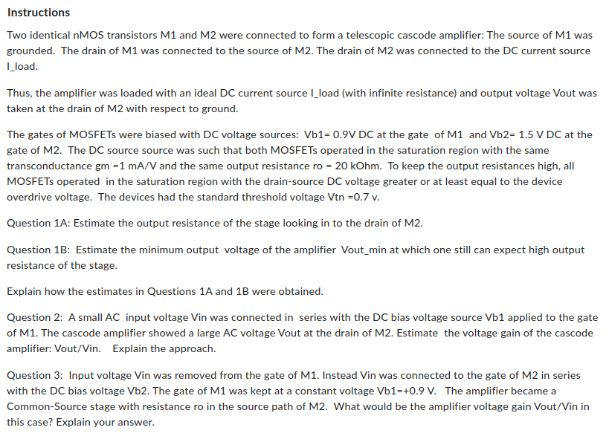
Quiz Instructions

Slide 4
Quiz Response

