Slide 1

Design Project
Scope of Project
Define Problem
List Objectives
Management of Project
Partition of Work
Timeline
Engineering
Design / Calculation and Simulation
Selection / Cost Analysis
Implementation
Diagnosis
Report

Slide 2
Multistage Amplifier Design
High gain
High input impedance
Low output impedance
Large signal swing
Large bandwidth
Opportunity for DESIGN!

Slide 3
Design Goals
A_{v} > 300
Peak-to-peak output voltage without distortion > 4 V
Low frequency -3dB point < 50 Hz
High frequency -3dB point > 15 kHz
Input resistance at 10 kHz > 200 kΩ
Output impedance < 200 Ω

Slide 4
Rules
V_{CC} < 10 V; V_{DD} > -10 V
No operational amplifier
Any number and combinations of BJT, MOSFET or JFET
10-kΩ load resistor attached

Slide 5
Procedures
Design from last stage backward.
Run simulation.
Find ac frequency response.
Revise the circuit.
Run simulation again.
Get sufficient gain and bandwidth.
Increase the input signal.
Adjust biases to eliminate clipping.

Slide 6
Considerations
High Input Impedance
JFET or MOSFET
High Gain
BJT in CE configuration
Low Output Impedance
BJT in CC configuration
AC Coupling
Isolate bias conditions

Slide 7
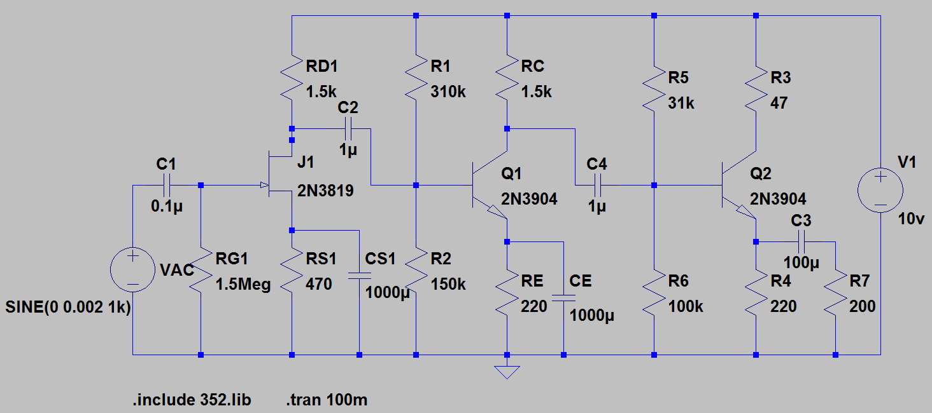
Example

Slide 8
Functional Blocks
JFET or MOSFET Input Stage
High impedance
BJT CE Gain Stage
High voltage gain
BJT CC Output Stage
Low output impedance
Coupling Capacitors
DC bias conditions isolated

Slide 9
Optimization
Bias Conditions
Waveform clipping
One stage at a time
Low Frequency Cut Off
Capacitors
High Frequency Cut Off
Gain related

Slide 10
Self Oscillation
Oscillation
High gain
Positive feedback via stray inductance
Waveform blur with high f oscillation
Solutions:
Connect a bypass capacitor across power supply and ground on the prototype board.
Connect a small capacitor between collector and base.

Slide 11
A Real Challenge
Build a dc coupled multi-stage amplifier.
Level shifter or dual power supply

Slide 12
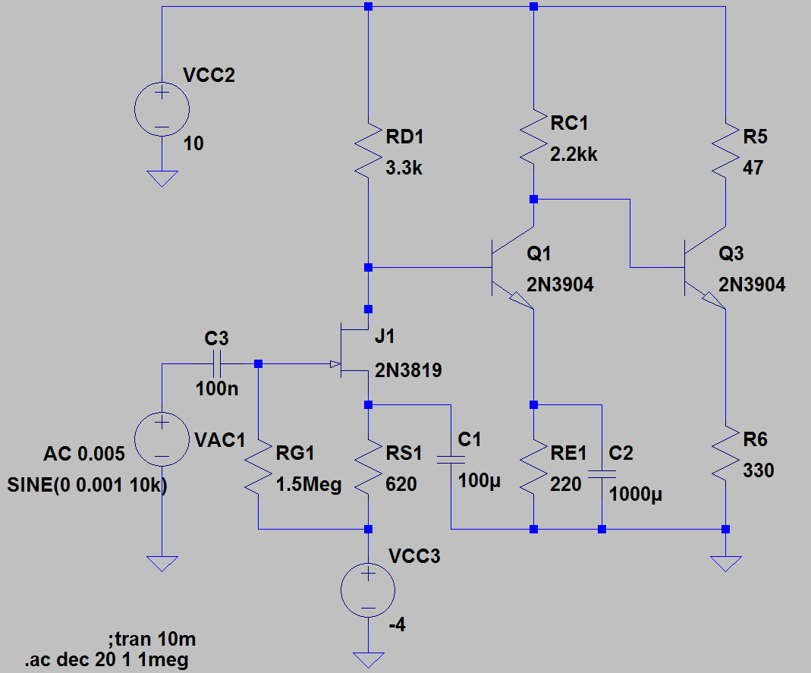
DC Coupled Amplifier
No coupling capacitors
No bias resistors
Next challenge – bypass capacitors

Slide 13
More Ambitious Endeavor
Design your own operational amplifier!

