Slide 1

Oscillators
Positive Feedback
In phase from output to input
Unity Loop Gain
Saturation

Slide 2
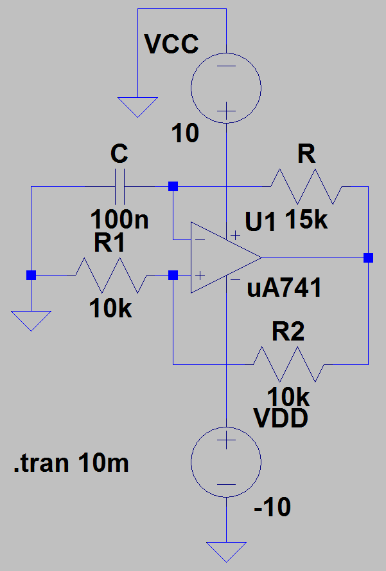
Square Wave Oscillator

Slide 3
Positive Feedback
R₁, R₂
Frequency Control
R₃, C₁
Capacitor charging and discharging
Saturation Voltage

Slide 4
Period or Frequency
Switching
RC charging time

Slide 5
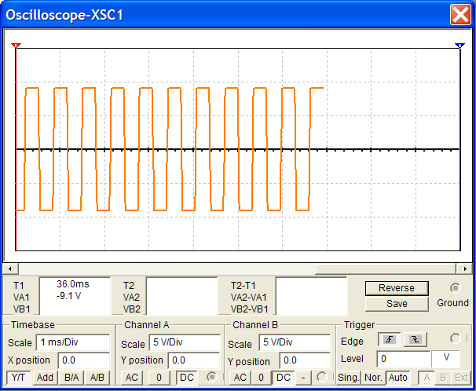
Output Waveform

Slide 6
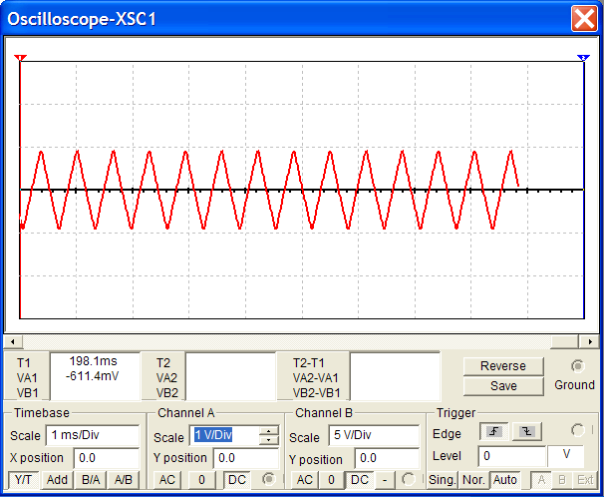
Capacitor Waveform

Slide 7
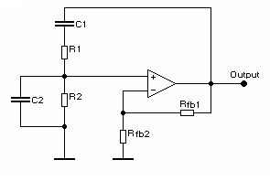
Wien Bridge Oscillator
Sine wave www.ti.com/sc/docs/apps/msp/journal/aug2000/aug_07.pdf

Slide 8
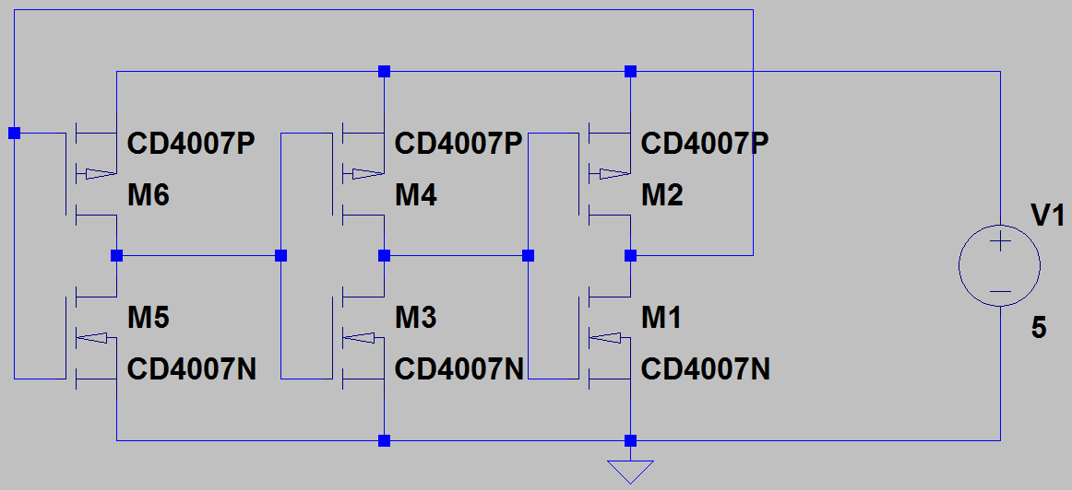
Ring Oscillator
Cascade 3 CMOS inverters.
Connect the output back to input.

Slide 9
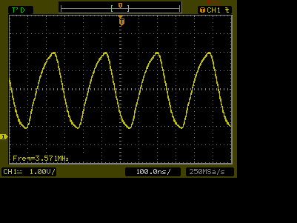
Ring Oscillator
Relation between oscillation frequency, delay, and stage count

Slide 10
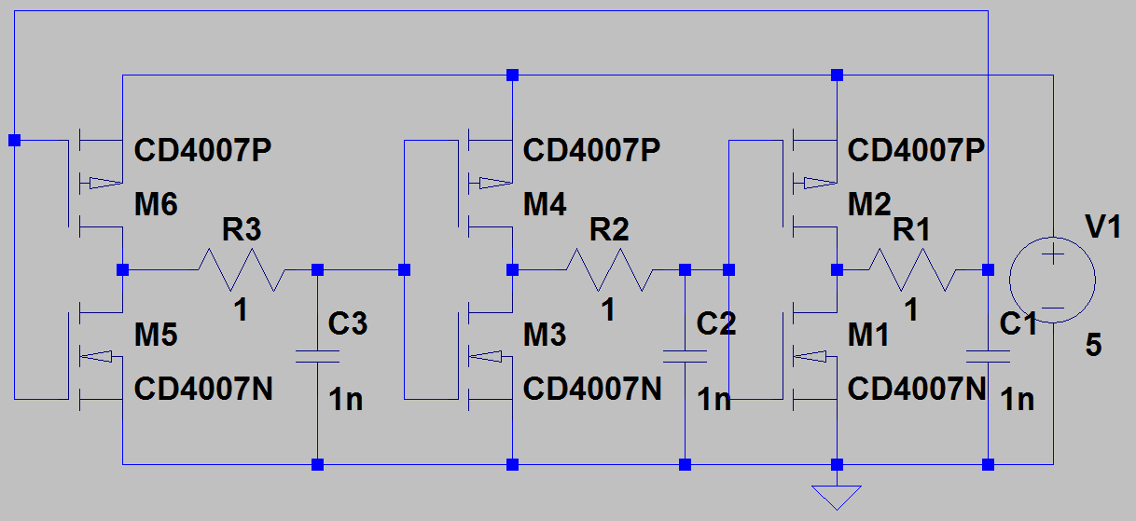
Ring Oscillator Loading
Control the oscillation frequency.

Slide 11
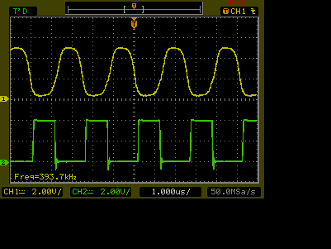
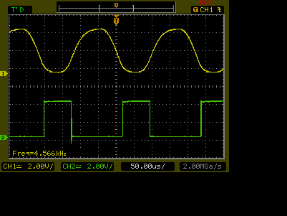

Slide 12
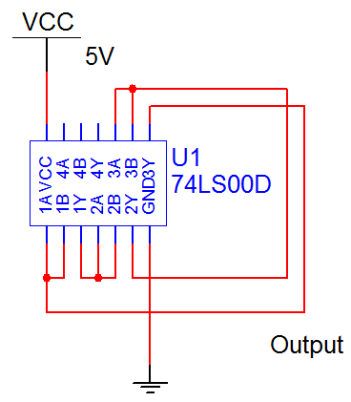
74LS00
Cascade 3 stages forming a faster ring oscillator

Slide 13
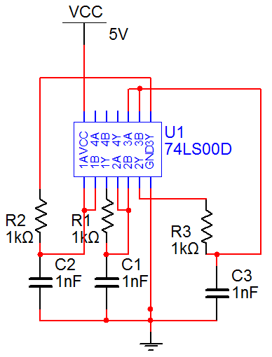
74LS00
Slow down the ring oscillator by RC loading.

Slide 14
Review
Oscillator
Positive feedback
RC charging
Two-Tone Oscillator
Diode coupling
Ring Oscillator

