Slide 1


Unit 4
Mobility
u_n = 500 cm^2 / (V*S)

Slide 2
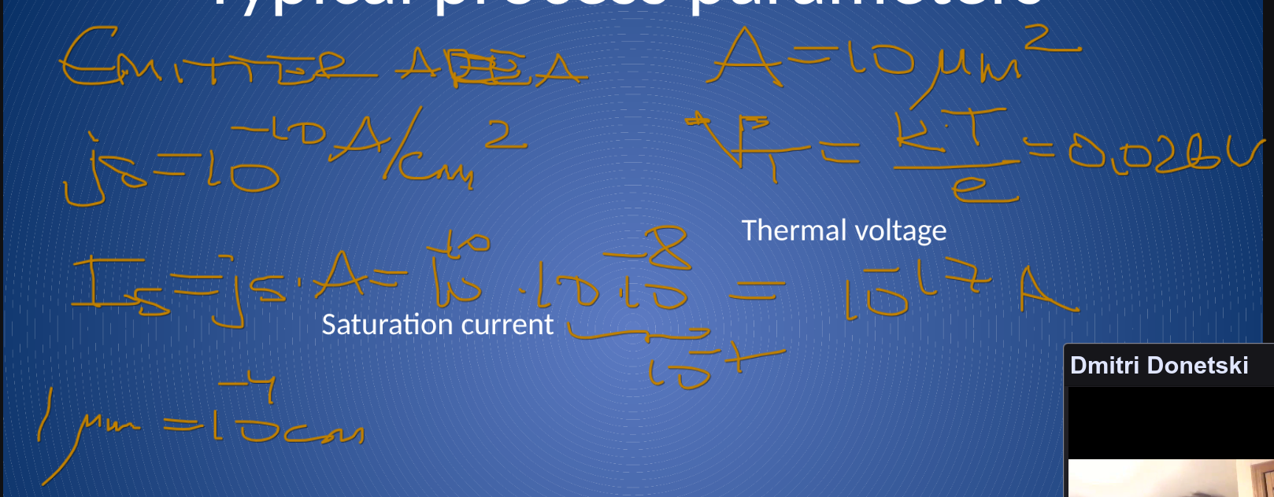
Unit n

Slide 3
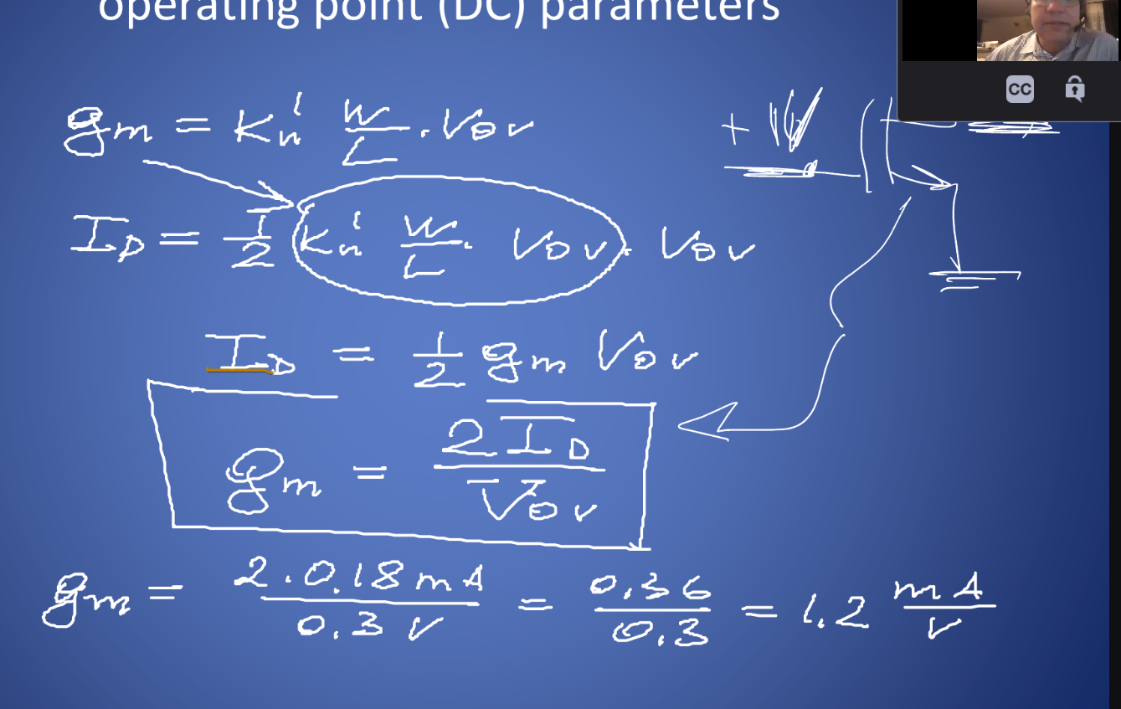
Unit n

