Slide 1
EEO311 – Quiz 1
Pete Mills

Slide 2
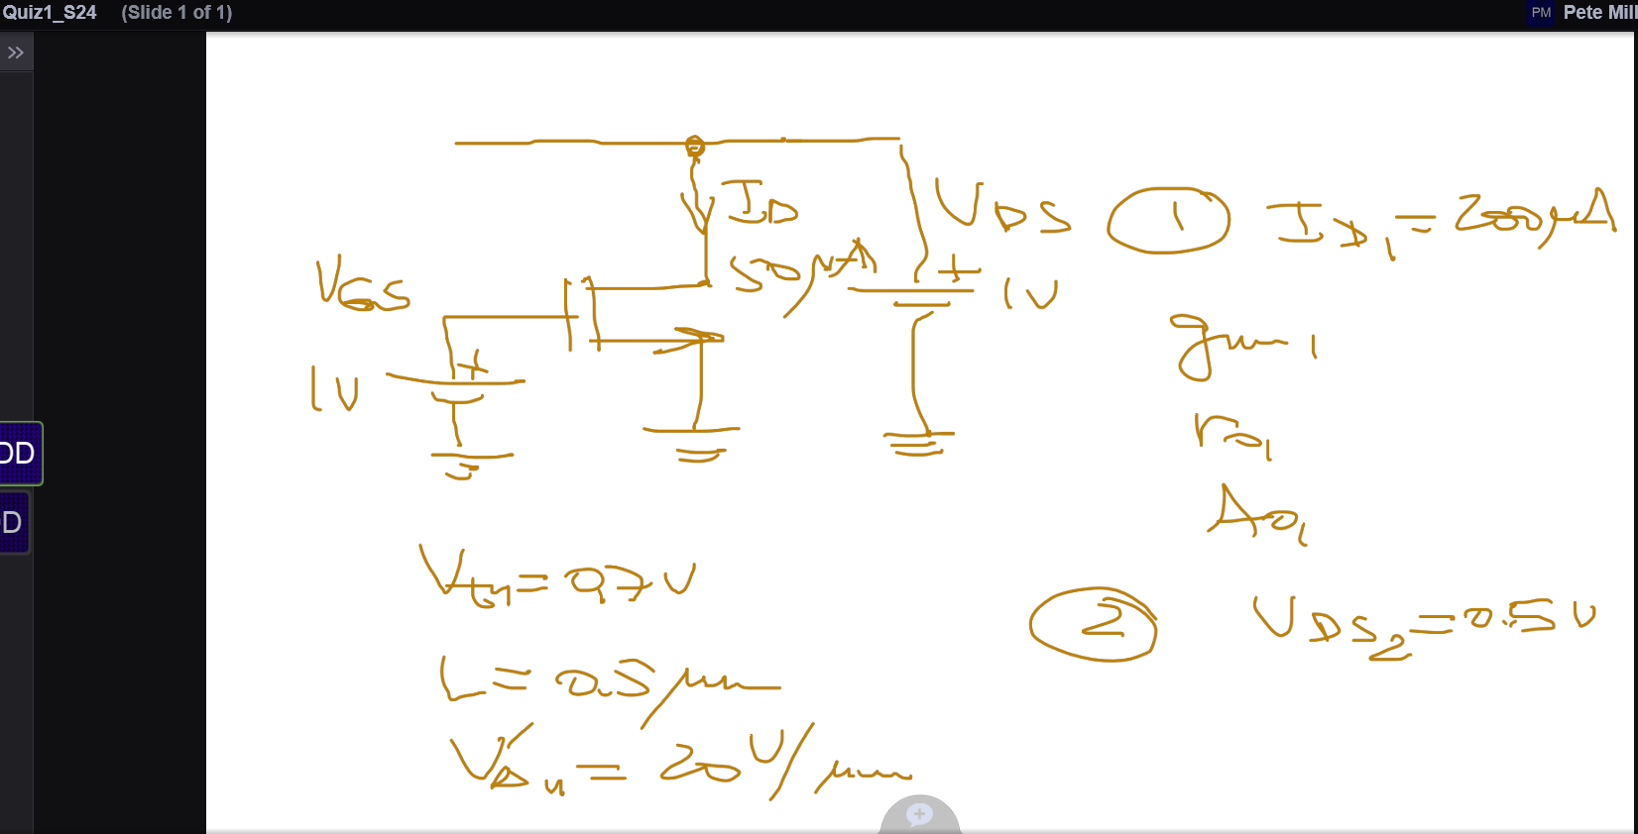
Schematic Question Reference

Slide 3
Quiz Instructions
: Consider the reference circuit with an enhancement mode n-MOSFET biased to operate in the saturation region with a DC voltage source VGS = 1 V DC (assume the operation with strong inversion). The drain to source voltage was maintained with a DC voltage source to VDS = 1 V DC. The DC drain current was found to be 50 uA DC. The MOSFET parameters shown below can be used for reference (not required): Design parameter: MOSFET gate length L = 0.5 um. Standard process parameters: threshold voltage = 0.7 V, Early voltage parameter = 20 V/um. The circuit was modified as follows
Modification 1: The drain current was increased to 200 uA DC by increase of VGS while VDS was kept the same at 1 V. The change of the drain current resulted in scaling MOSFET parameters by some factors in comparison to those in the reference circuit.
Compare the changes of following 3 MOSFET parameters with increase of the drain current by a factor of 4 from that in the reference circuit.
1. Transconductance. 2. Output resistance. 3. Intrinsic gain.
No numerical values of gm, ro and Ao are requested however one can estimate them if needed. Discuss how the parameters were changed (increased, decreased, not changed) and by what factors the parameters were changed (square root of 2, 2 times, 4 times,..).
Modification 2: VGS was kept at the increased level of Modification 1 while VDS was decreased from 1 V DC down to 0.5 V. It was noticed that the drain current was reduced to some value below 200 uA DC.
The schematic and modifications above are discussed in my video post in Voicethread. Please click any lecture unit link to get to the Voicethread for the course. Navigate the pop-up menu at the bottom center of Quiz 1 post and record a brief (2-3 minutes) video comment about the MOSFET operating modes after modifications (triode vs saturation) and changes in n-MOSFET gm, ro and Ao after each modification. Please share it with the class (encouraged) or with me so that I will be able to see it. In the later case select the mode with a padlock.

Slide 4



Quiz Response
Modification 1 - Saturation
Transconductance: Increases proportional to twice the increase in drain current.
Output Resistance: Decreases proportional to the increase in drain current.
Intrinsic Gain: Increases primarily due to the increase in transconductance.
Modification 2 – triode region
Transconductance: Decreases by 2x the drain current
Output Resistance: Increases proportionally to the decrease in drain current.
Intrinsic Gain: Decreases primarily due to the decrease in transconductance.

