Slide 1
EEO-311 Quiz 5
Pete Mills

Slide 2
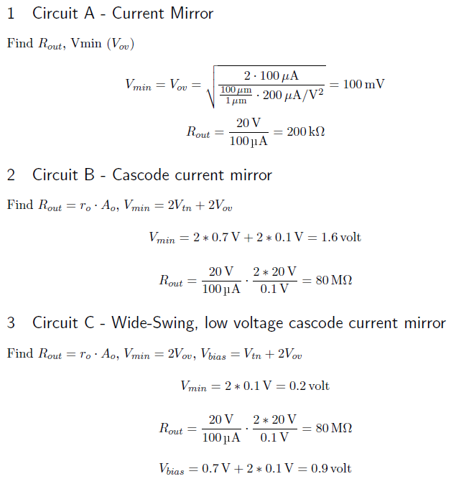
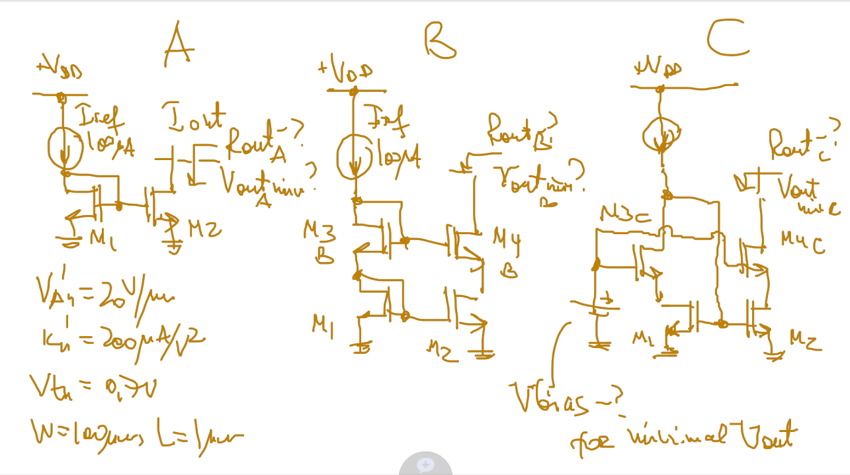




Input formulae

