Slide 1

Unit 4. Current-voltage characteristics of ideal MOSFETs Design and process parameters
Enhancement mode
n-channel MOSFETs
Required bias voltages
for constant output current
Operation in saturation mode
Family of output characteristics
Transfer characteristic
p-channel MOSFETs
Design and process parameters
MOSFET symbols

Slide 2
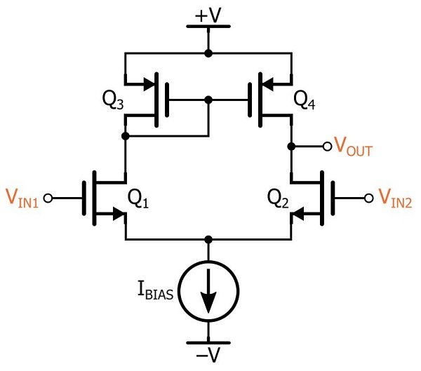
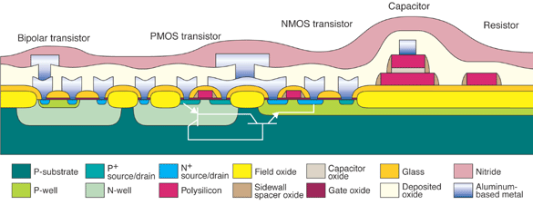
Major integrated circuit technologies
Which one is better for integrated circuits (OpAmp)? It depends..
Bipolar CMOS
npn + pnp nMOS + pMOS
High frequencies: Lower dissipated power
Low frequencies: Lower noise Lower dissipated power
Lower DC offset voltage
(better device matching)
Lower input current

Slide 3
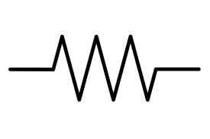
TRANsfer reSISTOR
npn BJT or n-channel MOSFET in AC voltage amplifier
Emitter in BJT
Source in FET
Collector in BJT
Drain in FET
Load
DC bias current
+
+
DC Voltage
Source 1 (Vbias)
DC Voltage
Source 2
Base in BJT
Gate in FET
Vin

Slide 4
TRANSISTOR
in AC voltage amplifier
Emitter in BJT
Source in FET
Collector in BJT
Drain in FET
Load
DC bias current
+
+
DC Voltage
Source 1 (Vbias)
DC Voltage
Source 2
Base in BJT
Gate in FET
Vin

Slide 5
TRANSISTOR
in AC voltage amplifier
Emitter in BJT
Source in FET
Collector in BJT
Drain in FET
Vcc in BJT circuits
Vdd in MOSFET
circuits
Load
DC bias current
+
+
DC Voltage
Source 1 (Vbias)
DC Voltage
Source 2
Base in BJT
Gate in FET
Vin

Slide 6
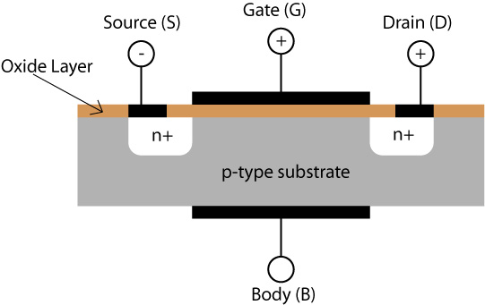
(n-channel) MOSFET current -voltage characteristics
DC Gate-to-source voltage > Threshold voltage Vtn
we adopt Vtn = +0.7V for n –channel MOSFET fabricated with 0.5 um technology
VGS = + 1V => overdrive voltage Vov = 0.3 V
DC drain current
A
VGS
VDS
+
+
depth

Slide 7


Testing MOSFET
Let us use two separate power supplies : gate-source and drain-source voltage sources
ID
We will keep VGS constant at a certain value above threshold: VGS =1 V
and will measure drain current ID as a function of drain-source voltage VDS

Slide 8





MOSFET output characteristic
VGs =const = 1 V
(it means Vov = const =0.3 V)
The drain current is almost constant for VDS > Vov =VGS-Vtn

Slide 9


Output characteristic
Saturation region
Linear
region
V_DS > V_ov
You have to keep all MOSFETs in the saturation region under any conditions
(otherwise you get a resistor of inferior quality)

Slide 10



Family of output characteristics
Vov3=0.4V
=0.3V
Vov2= 0.2 V
Vov1= 0.1 V
Keep MOSFET in the saturation region all the time!
V_DS > V_ov

Slide 11
Transfer characteristic
Keep the MOSFET in the saturation region: VDS > Vov
Design parameter: Overdrive voltage Vov = VGS-Vtn
DC drain current
in the saturation region
Varied with Vgs
VGS varied => overdrive voltage Vov varied
VDS = const
A
VGS
VDS
+
+

Slide 12




Transfer characteristic
Keep the MOSFET in the saturation region: VDS > Vov
Overdrive voltage Vov = VGS-Vtn
is a design parameter
DC drain current
in the saturation region
Varied with Vgs
VDS = const
IDsat
VGS

Slide 13
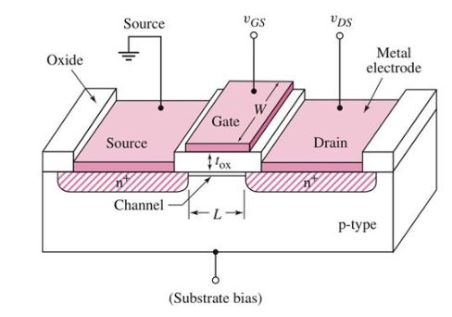








(n-channel) MOSFET drain current in the saturation region

Slide 14
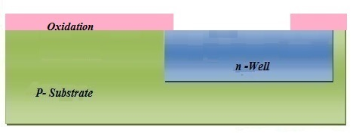
p-channel MOSFETs

Slide 15














Typical process parameters for a 0.5 µm node technology
Mobility of electrons is approximately a factor of 3 greater than that for holes
The process transconductance parameters for n-MOSFET and p-MOSFET:

Slide 16










Design parameters
To obtain the required current you have control on 3 design parameters: W, L, Vov
MOSFET represents a voltage-controlled current source (given VDS > Vov)

Slide 17











Design parameters: Vov, W, L
Example:

Slide 18










Symbols for enhancement–mode MOSFETs
Equivalent symbols for p-channel devices.
In circuit diagrams p-MOSFETs appears
up-side down with the source terminal on the top because it has higher potential compared to the gate and drain potentials
Equivalent symbols for the n-channel devices
The source terminal at the bottom, it has
negative potential compared to the gate
and drain potentials. Connection of the body
terminal to –Vss is assumed for the lower level symbols.

