Slide 1

Unit 5. Current-Voltage Characteristics of Bipolar Junction Transistors. Design and process parameters
BJT device structure:
heavily doped emitter,
moderately doped base,
low-doped collector
Bias voltages for forward active mode: forward bias for base-emitter and reverse bias for collector-base junctions
Input, output and transfer characteristics of BJT
Complementary BJT: npn and pnp symbols

Slide 2
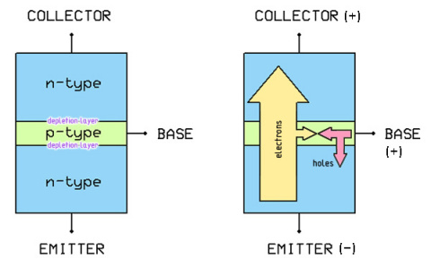
BJT Device structure
n-p-n BJT: current between emitter (E) and collector (C) is supported by electrons (also there will by an unwanted base-emitter current supported by holes) : IE = IC +IB
Current direction

Slide 3
BJT Device structure
Emitter region of n-type is heavily doped with donors (at least 100 times more than the Base region doped with acceptors)
Collector is the least doped region, the same n-type as emitter
n- (10¹⁶/cm³)
+
+
p (10¹⁷/cm³)
+
n⁺(10¹⁹/cm³)
Forward active mode

Slide 4
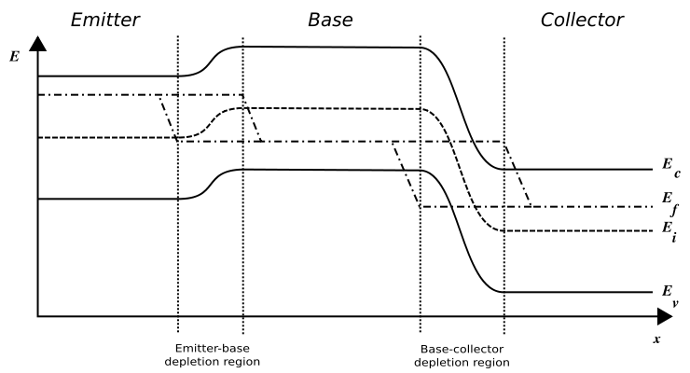










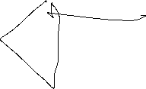
BJT in the forward-active mode
Emitter-Base junction is forward biased,
Collector-Base junction is reverse biased.
Conduction band energy profile
+
+
+
n⁺(10¹⁹/cm³)
p (10¹⁷/cm³)
Valence band energy profile

Slide 5
BJT in the forward-active mode
Emitter-Base junction is forward biased,
Collector-Base junction is reverse biased.
Electron diffusion
Conduction band energy profile
+
+
+
Electron hole diffusion
n⁺(10¹⁹/cm³)
p (10¹⁷/cm³)
Valence band energy profile

Slide 6
BJT in the forward-active mode
Both flow of electrons from emitter to base and flow of holes from base to emitter
depend exponentially on VBE
For a given VBE there will be a large flow of electrons from the emitter into the base due to large emitter doping. There will be a very small flow of holes from the base to emitter due small doping in the base
+
+
+
n⁺(10¹⁹/cm³)
p (10¹⁷/cm³)

Slide 7
BJT in the forward-active mode
Practically all electrons injected into the base will reach collector by diffusion.
Variation of VBE results in a large variation of the emitter current and a small variation of the base current. The emitter and collector currents are very close since electrons pass the base without losses and the base current us small => BJT shows a 100 times “current gain”
+
+
+
n⁺(10¹⁹/cm³)
p (10¹⁷/cm³)

Slide 8
BJT output characteristic
IC
Forward active region
Ib = 2 µA
200 µA
Saturation
region
Vsat
VCE
The collector current is almost constant for VCE > Vsat = 0.2V.
We should avoid saturation region in BJT unless we want to obtain a short circuit

Slide 9
Family of BJT output characteristics
IC
Ib = 3 µA
300 µA
Ib = 2 µA
200 µA
Ib = 1 µA
100 µA
Vsat
VCE
The collector current is nearly proportional to the base current

Slide 10
BJT transfer characteristic
The same as the input one, just collector current is scaled up 100 times
VCE=const
Icollector
200
(µA)
100
0.7
VBE(V)
If one bias both BJT and MOSFET to operate with the same bias currents
The BJT will show a much faster dependence of the collector current on VBE
compared to drain current dependence on VGS in MOSFET.
i.e. for the same bias currents BJTs have greater transconductance than MOSFETs

Slide 11



BJT input characteristic
Interestingly, BJTs often operate with VBE close to 0.7 V
VCE=const
Ibase
2
(µA)
1
0.7
VBE (V)
BJTs have NO threshold voltage,
the base current increases exponentially with base-emitter voltage in a broad range of VBE

Slide 12
Typical process parameters
Thermal voltage
Saturation current
There are much less means to control bias current in BJT compared to MOSFET.
To increase bias current one can increase VBE or perhaps to scale up the
emitter area, i.e. connecting several BJTs in parallel (the latter does not work for discrete BJTs due to variation of their parameters).

Slide 13
BJTs can be considered either as Voltage-controlled Current Sources (VCCS) or as Current-controlled Current Sources (CCCS) thanks to presence of a considerable base current
Current gain

Slide 14
Finding BJT bias current

Slide 15









BJT symbols
n-p-n
p-n-p

