Slide 1
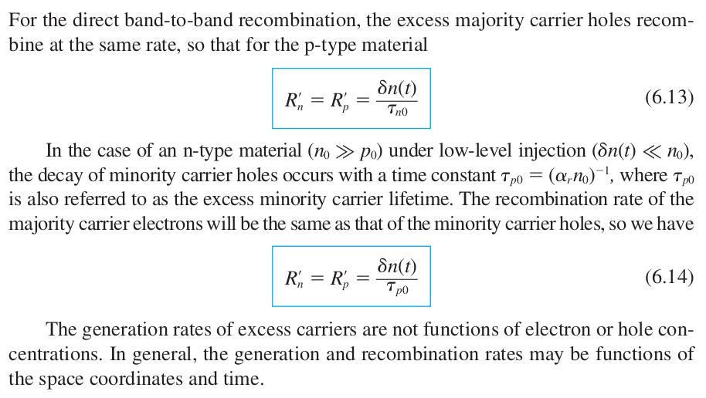
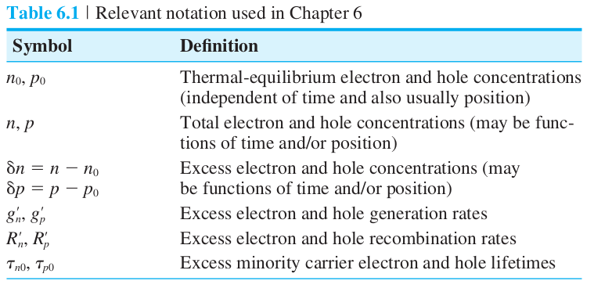
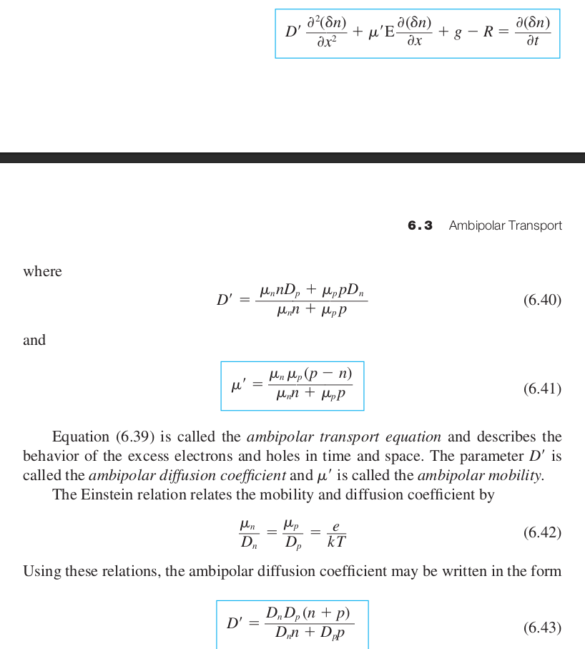
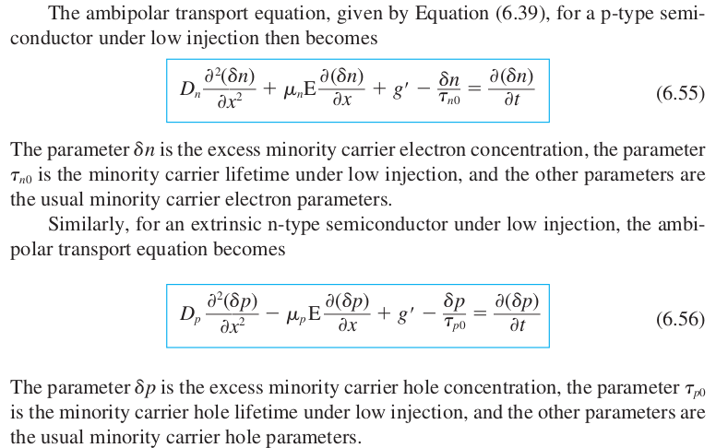
Ch 6 – Nonequilibrium Excess Carriers in Semiconductors
Readings:
192 – 197
198 – 210

Slide 2
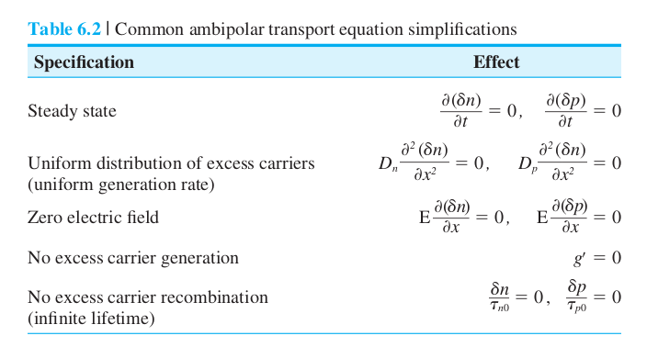
Ch 6 – Nonequilibrium Excess Carriers in Semiconductors Cont...
Readings:
192 – 197
198 – 210

Slide 3
Exam 1

Slide 4
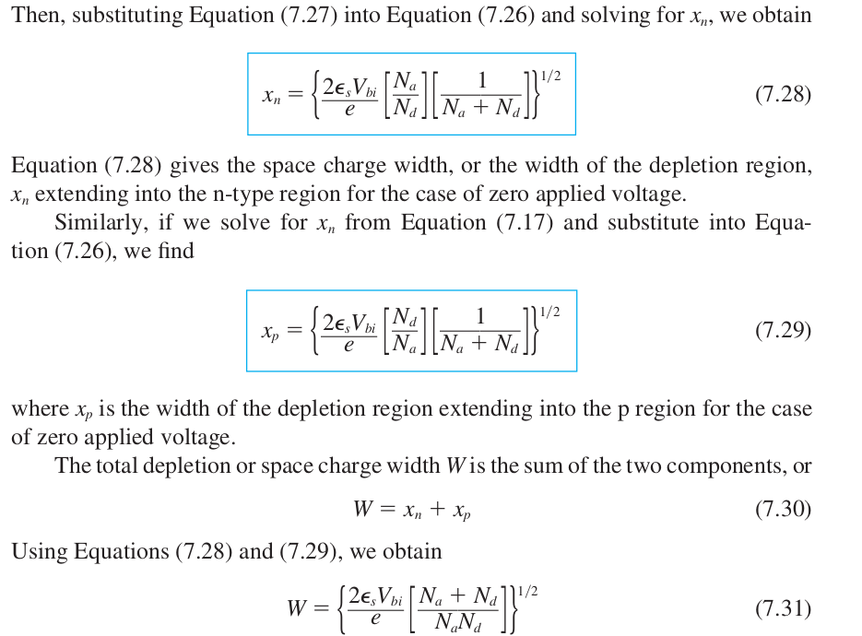
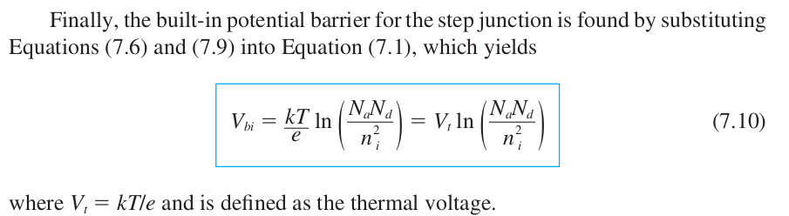

Ch 7 – The PN Junction
Readings:
241 – 250
251 – 257

Slide 5
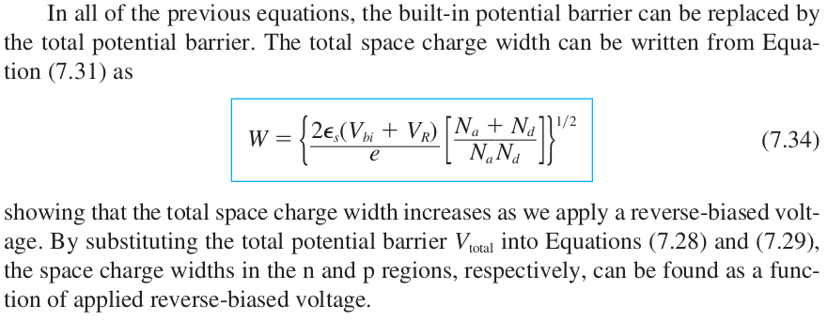
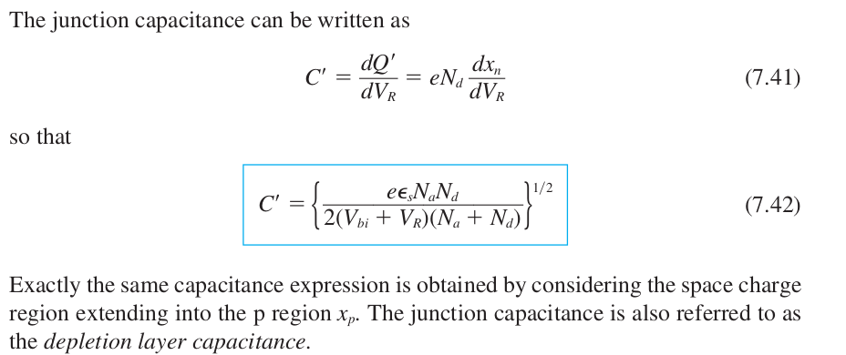
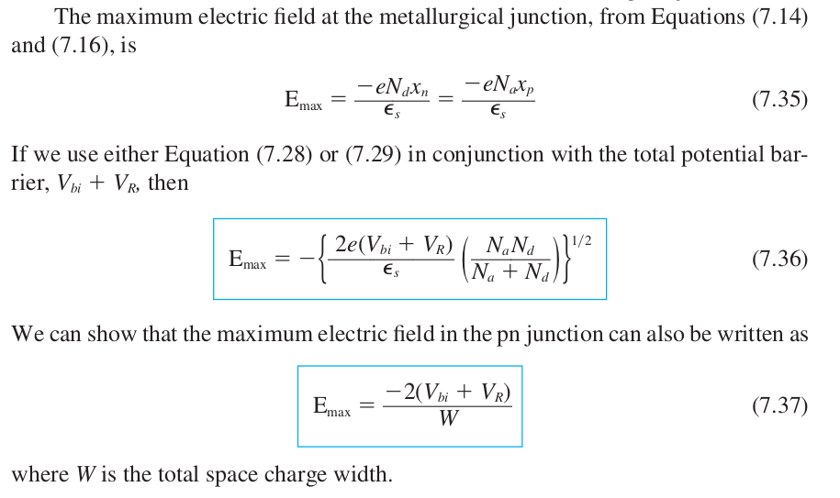
Ch 7 – cont...
7.3.3 One-Sided Junctions...
p+n junction

Slide 6
Ch 8 –
Readings:
277 – 278
278 – 293

Slide 7
Ch 8 & 7 –
Readings:
295 – 302
304 – 314
258 - 262

Slide 8
Ch 12 –
Readings:
491 – 500
501 – 508
509 – 521
522 - 530

Slide 9
Ch 10 –
Readings:
371 - 385

Slide 10
Exam 2

