Slide 1
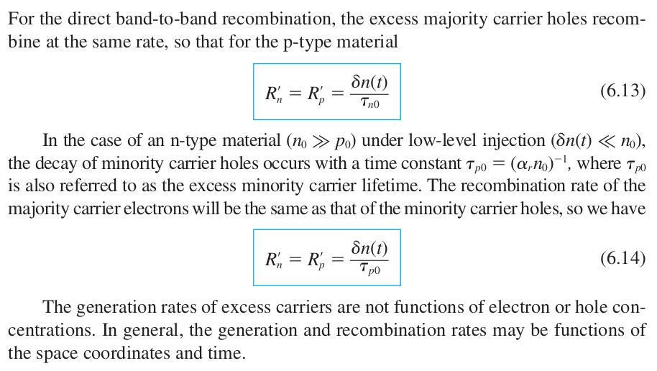
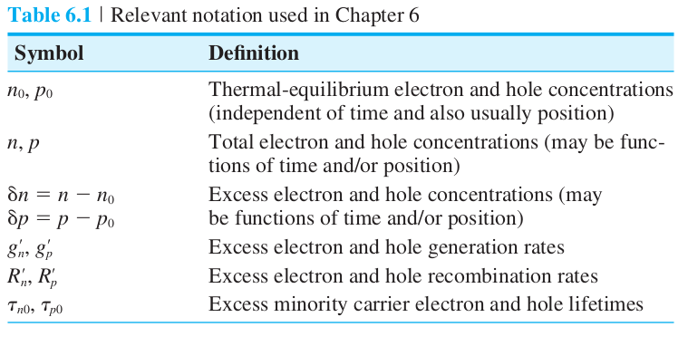
Ch 6 – Nonequilibrium Excess Carriers in Semiconductors
Readings:
192 – 197
198 – 210

Slide 2
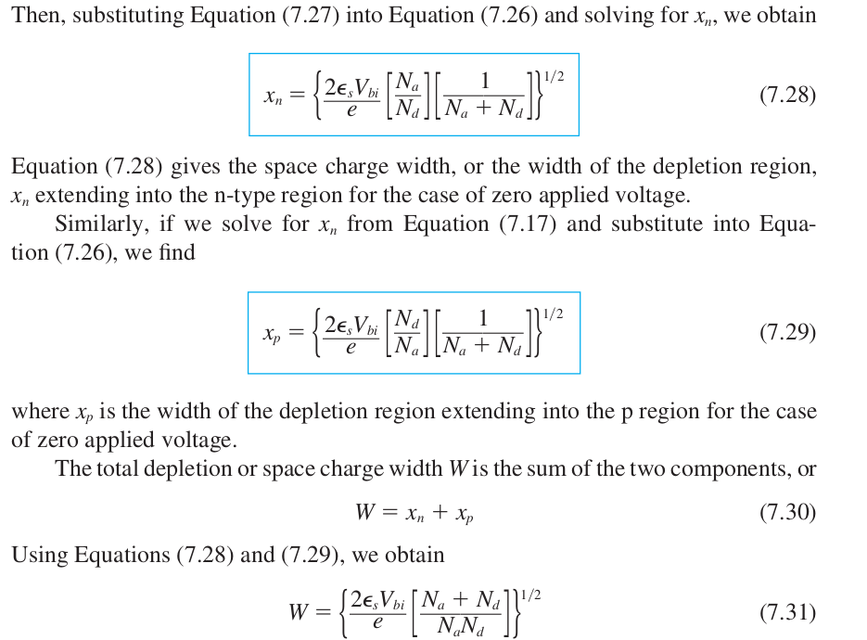
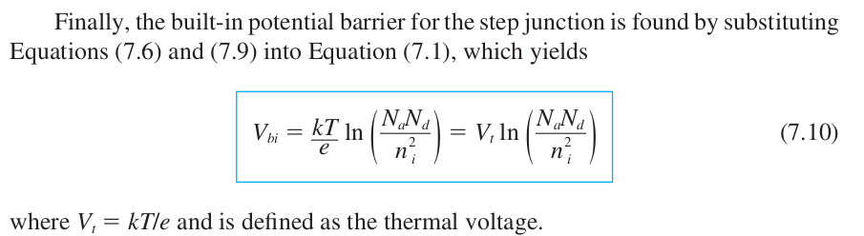

Ch 7 – The PN Junction
Readings:
241 – 250
251 – 257

Slide 3
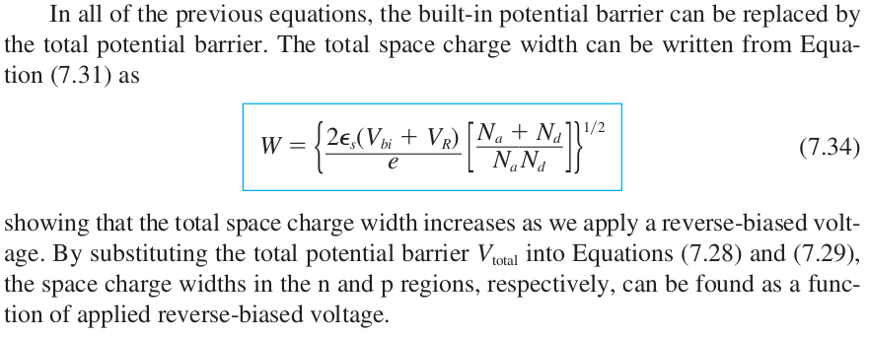
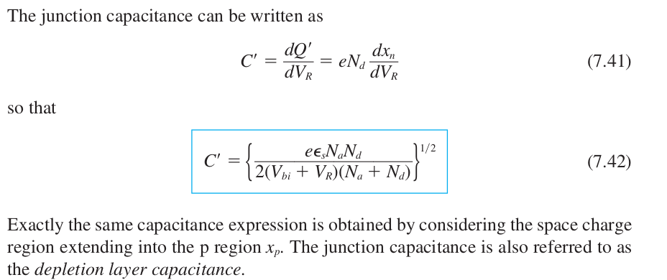
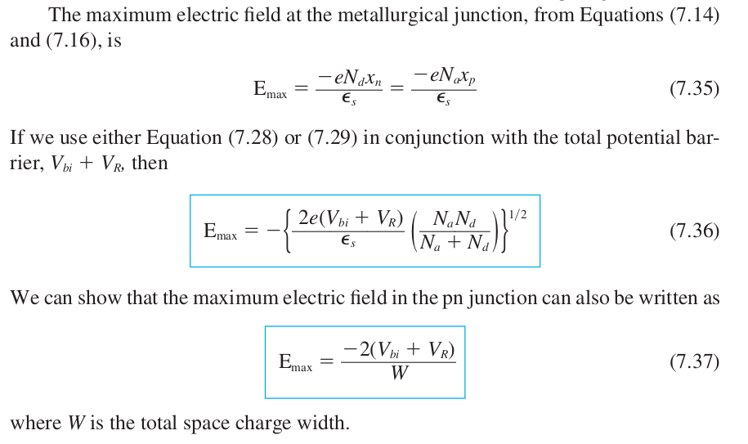
Ch 7 – cont...
7.3.3 One-Sided Junctions...
p+n junction

Slide 4
Ch 8 –
Readings:
277 – 278
278 – 293

