Slide 1
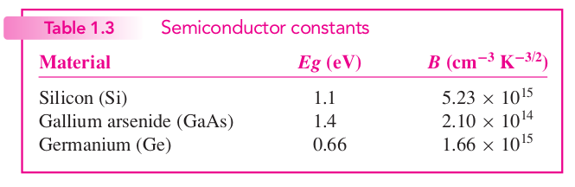
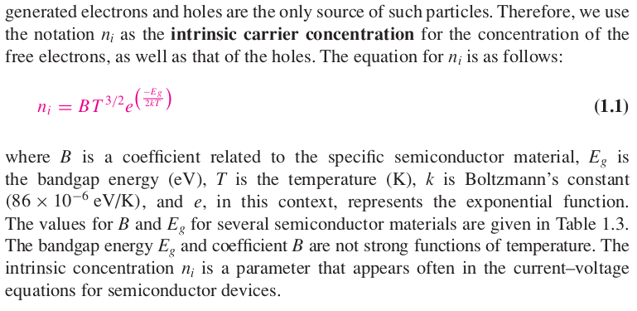
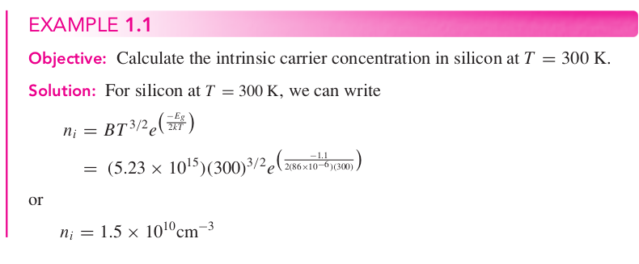
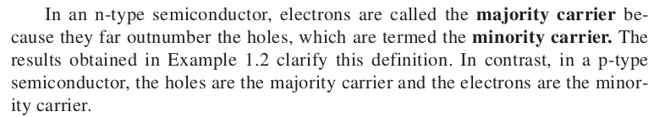
Module 1
Intrinsic semiconductors: pure element
Extrinsic (doped) semiconductors: added impurities to increase current
- Donor impurities like phosphorus produce N-type semiconductors
- Acceptor impurities like boron produce P-type semiconductors
Electrons move by drift and diffusion

Slide 2
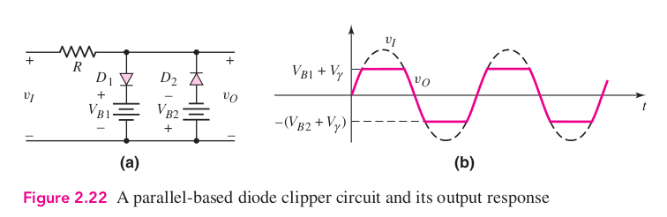
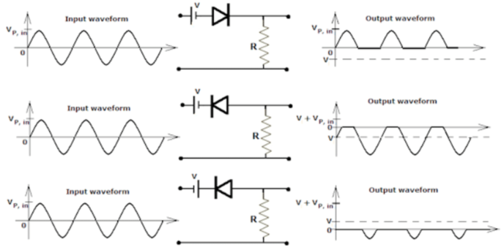
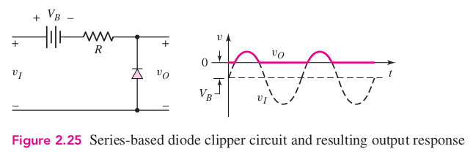
Biased Clipper Circuits
- Clips signals

Slide 3
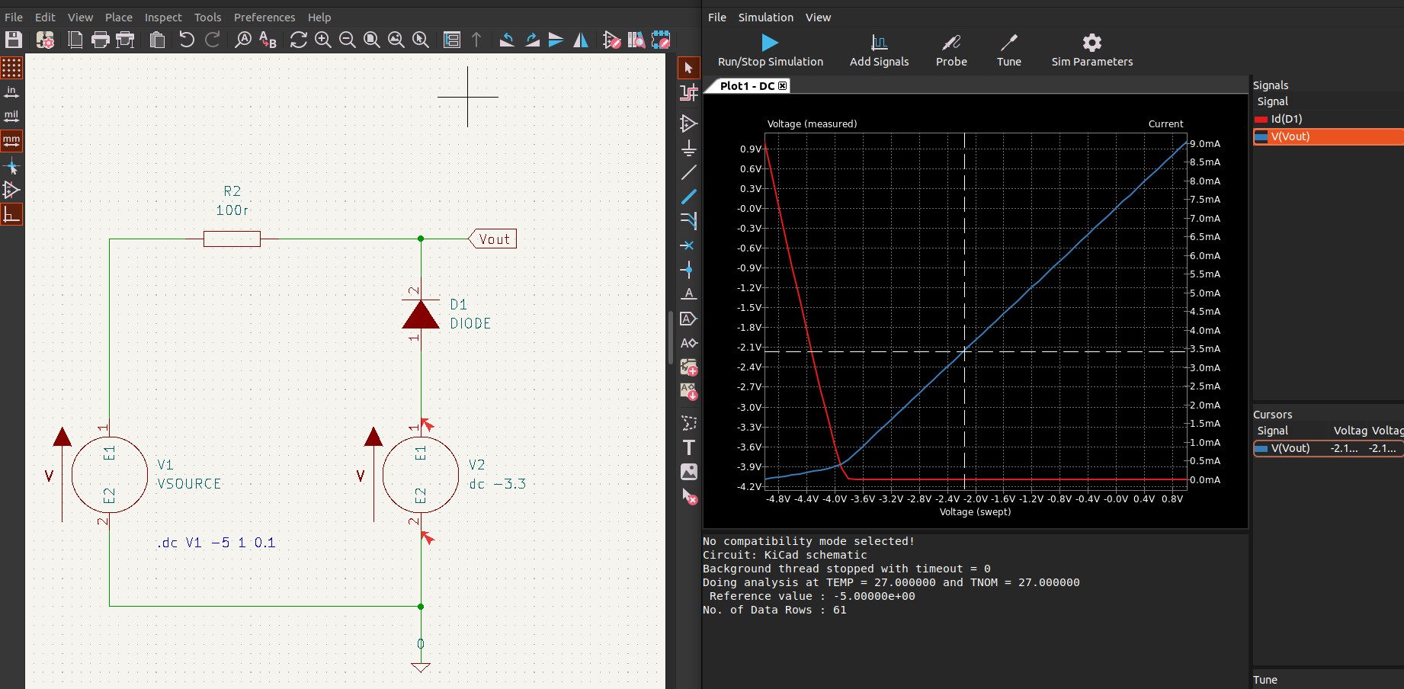
Biased Clipper Circuit

Slide 4
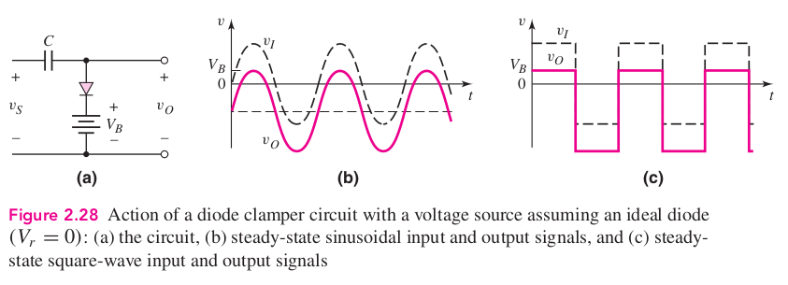
Biased Clamper Circuit
- Shifts signals

Slide 5
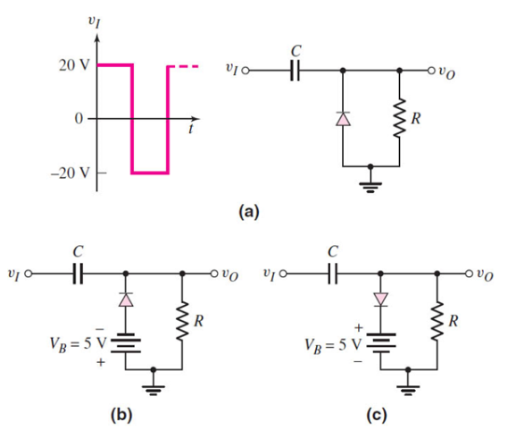
Biased Clamper Circuit
- Shifts signals
(a) shifts signal waveform up to 0v min
(b) shifts signal waveform up to -5v min
(c) shifts signal waveform down to +5v max
Remember to account for Vf.

Slide 6
Diode parameters
PIV – Peak inverse (reverse) voltage
Reverse biased diodes are treated as open
Forward biased diodes are treated as shorts and a voltage source

Slide 7
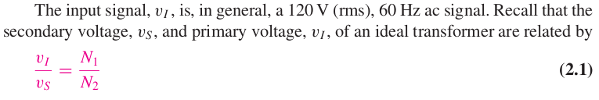
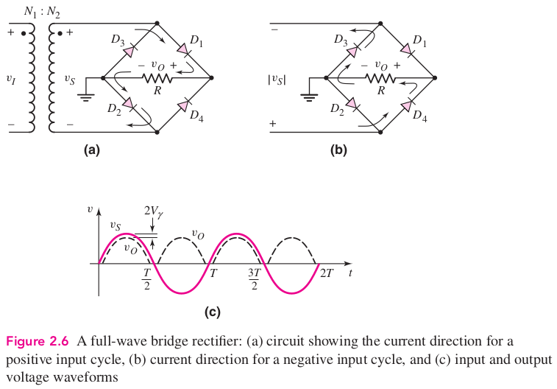
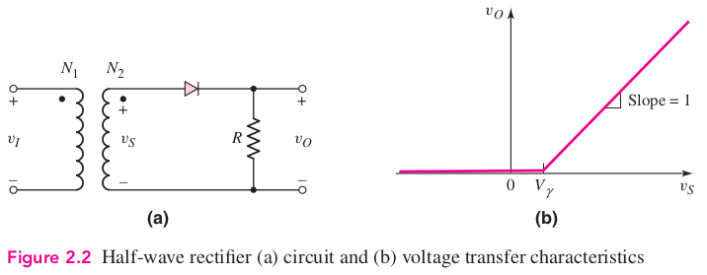
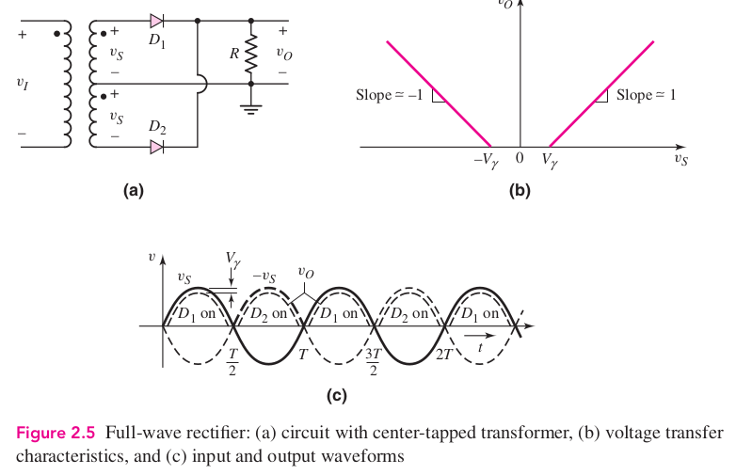
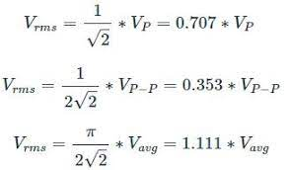
Rectifier Circuits
Center tapped formulae
- v S (max) = v O (max) + Vγ
- PIV = v R (max) = 2v S (max) − Vγ
Bridge rectifier formulae
- v S (max) = v O (max) + 2Vγ
- PIV = v R (max) = v S (max) − Vγ

