Slide 1
Vector Database Benchmarking

Slide 2
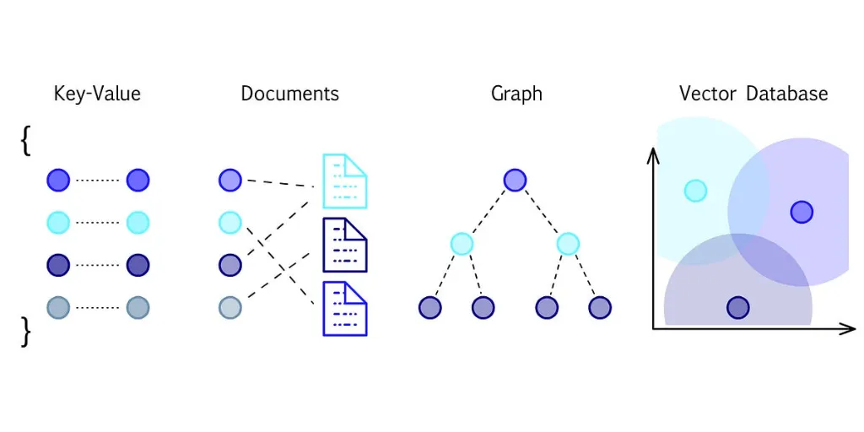
What is a Vector Database?
A vector database is a specialized storage system designed to efficiently handle and query high-dimensional vector data, commonly used for fast retrieval and similarity search.

Slide 3
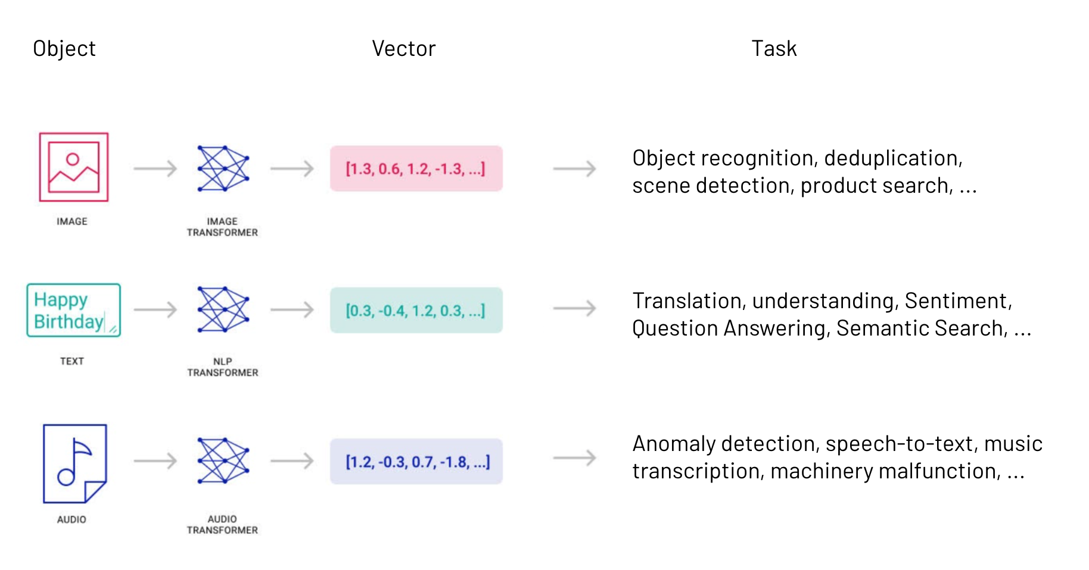
What is a vector embedding?
Vector embeddings are a way to convert words and sentences and other data into numbers that capture their meaning and relationships.

Slide 4
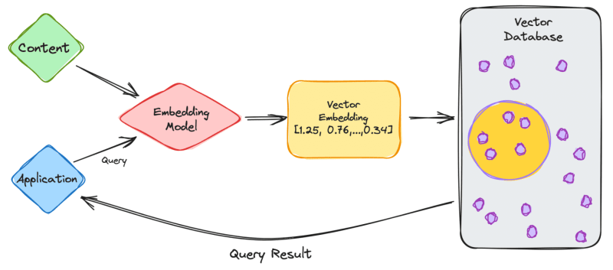
How does it work together?

Slide 5
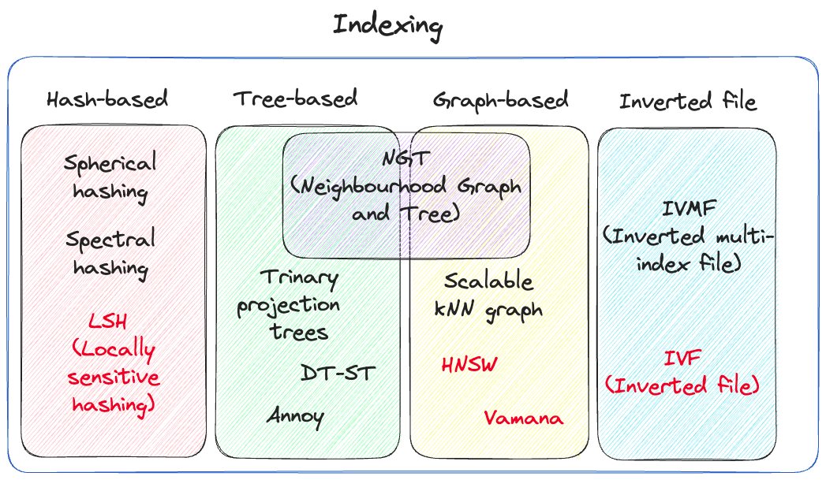
Vector indexation
A vector index is a data structure used in computer science and information retrieval to efficiently store and retrieve high-dimensional vector data, enabling fast similarity searches and nearest neighbor queries.

Slide 6
Common indexes
Flat Index: A simple index that stores all vectors in a single list. It is fast for small datasets but may become inefficient as the dataset size increases due to the exhaustive search.
IVF (Inverted File): A two-level index structure that divides the vector space into cells and assigns each vector to one or more cells. It uses inverted lists to store the vectors belonging to each cell, enabling efficient approximate nearest neighbor search.
HNSW (Hierarchical Navigable Small World): A graph-based index that constructs a hierarchical graph of data points in the vector space. It organizes data points into different levels of granularity, allowing for fast approximate nearest neighbor search by navigating through the graph.
LSH (Locality-Sensitive Hashing): A family of hashing techniques that map similar data points to the same hash buckets with high probability. It enables approximate nearest neighbor search by partitioning the vector space into hash buckets and searching within the same bucket for similar vectors.
PQ (Product Quantization): An index structure that compresses high-dimensional vectors into compact codes using vector quantization techniques. It reduces memory usage and accelerates search operations by quantizing vectors into subvectors and storing codebooks for each subvector.
Annoy (Approximate Nearest Neighbors Oh Yeah): A tree-based indexing method that constructs random projections of the data space. It builds a tree structure that can quickly approximate nearest neighbor search by traversing the tree and comparing query vectors with tree nodes.

Slide 7



Faiss vs Chroma vs Milvus
Faiss is a library for efficient similarity search and clustering of dense vectors
Chroma DB is a popular open-source vector store used for storing and retrieving vector embeddings
Milvus is a mature open-source vector store used for storing and retrieving vector embeddings

Slide 8
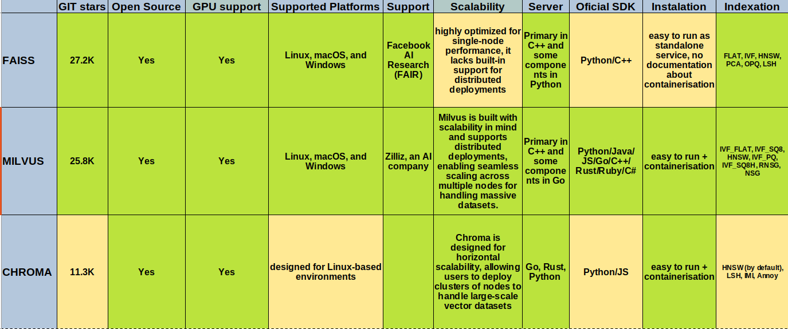
General

Slide 9
Test data
Environment
Operating System: Ubuntu 20.04.6 LTS
OSType: linux
Architecture: x86_64
CPUs: 4
Total Memory: 15.5GiB
Dataset and embedding model
135k radiology medical reports https://huggingface.co/datasets/Ka4on/radiology
all-MiniLM-L6-v2 https://huggingface.co/sentence-transformers/all-MiniLM-L6-v2
Indexation
Index type | HNSW
Metric type | COSINE
M | 16
efConstruction | 500
efSearch | 200

Slide 10
Test data
metric_type: This parameter specifies the distance metric to use when computing the similarity between vectors. In this case, "COSINE" indicates that the cosine similarity metric will be used. Cosine similarity is a measure of similarity between two vectors that measures the cosine of the angle between them.
index_type: This parameter specifies the type of index structure to use for organizing the vectors in the vector database. In this case, "HNSW" stands for Hierarchical Navigable Small World, which is an approximate nearest neighbor search algorithm.
params: This sub-dictionary contains additional parameters specific to the chosen index type. For the HNSW index, the following parameters are commonly used:
M: This parameter controls the degree of the graph in the HNSW index. A higher value of M results in a denser graph, which can lead to more accurate search results but requires more memory and computational resources.
efConstruction: This parameter controls the size of the dynamic list during the construction of the HNSW index. It affects the quality of the index and the efficiency of the construction process.
efSearch: This parameter controls the size of the dynamic list during the search process. A larger value of efSearch may lead to more accurate search results but requires more computational resources during search operations.

Slide 11
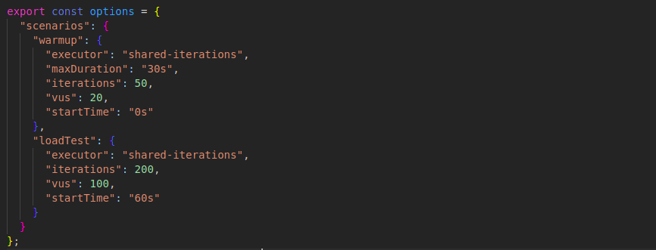
Test data
Load test has been made with k6 framework:
API has been queried by one user with 60 different vectors (words has been taken from “radiology” terminology and embeded with the same model as tested dataset) and asked to return 10 nearest vectors per request.

Slide 12
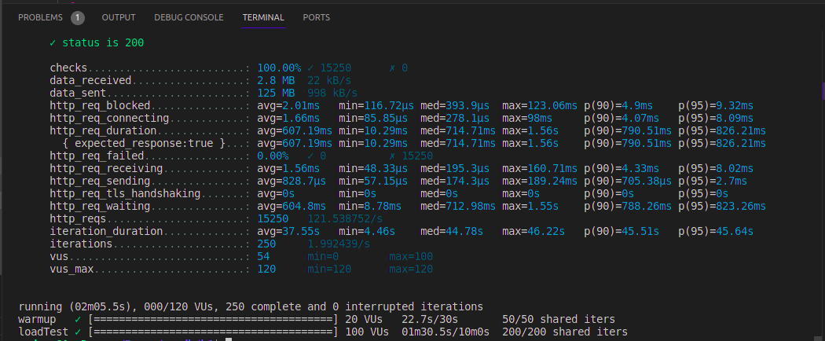
Test results
Faiss:

Slide 13
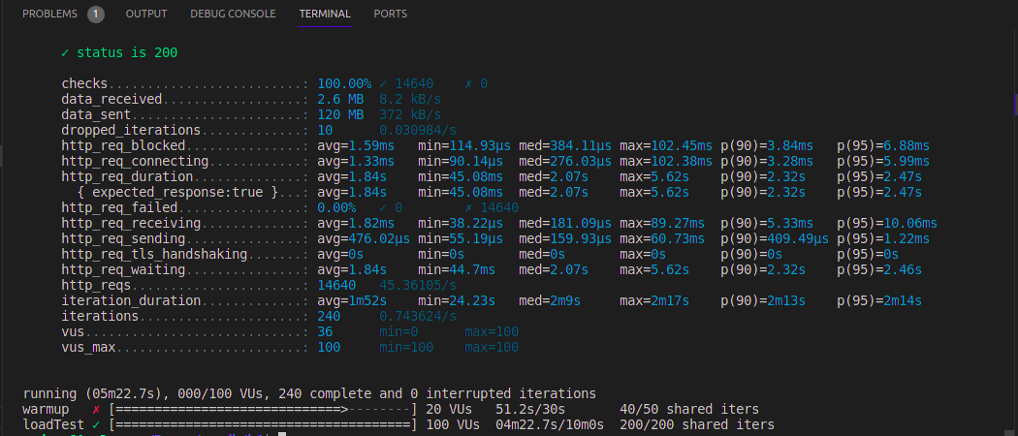
Test results
Chroma:

Slide 14
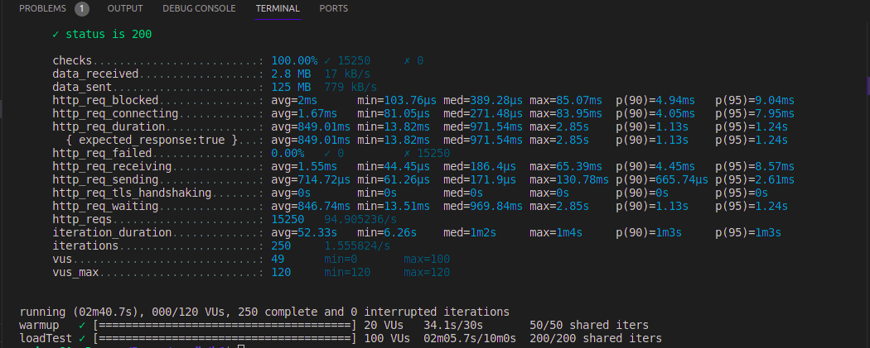
Test results
Milvus:

Slide 15

Final results

Slide 16
Conclusion
According to the results, Faiss looks like a winner in this competition, but it could be challenging to manage a scalling. There is existing projects which wrap Faiss with REST, providing monitoring and more.
Milvus looks like a good and mature choice. It could scale, it have a good documentation about containerisaition and K8s config includding precise RAM memmory calculation.
Unfortunatelly Chroma looks not mature enough, not enough documentaion, although it could be an option too, as less RAM memmory consumer. A new version https://www.trychroma.com/blog/chroma_0.4.0 eliminated duckDb and clickhouse for sqllite, this probably caused for slow responses.

Slide 17
Sources
Code is avalible here https://github.com/pilotofbalance/vector_db_benchmarking
Use READMY files to build and run your own comparation tests.

Slide 18

Questions

