Slide 1


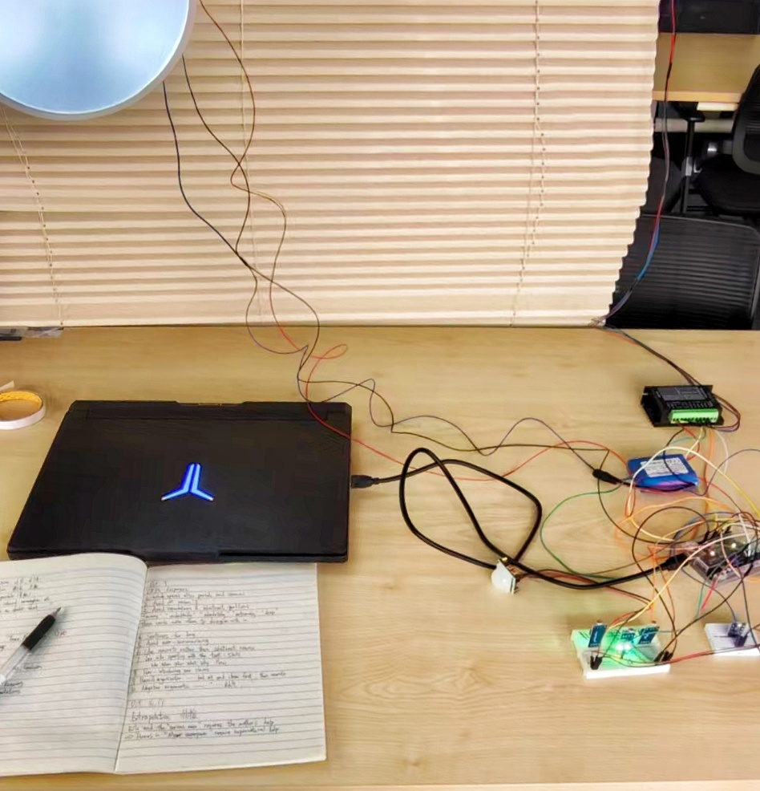
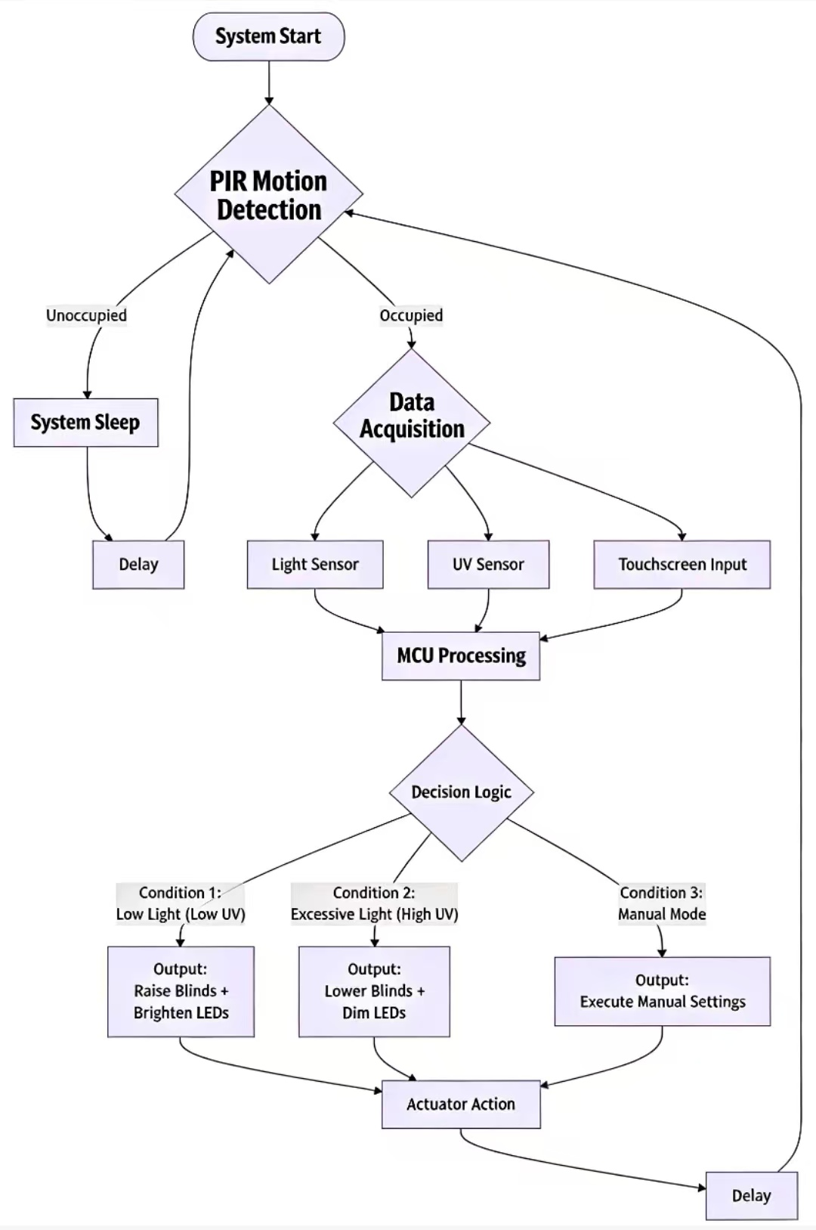
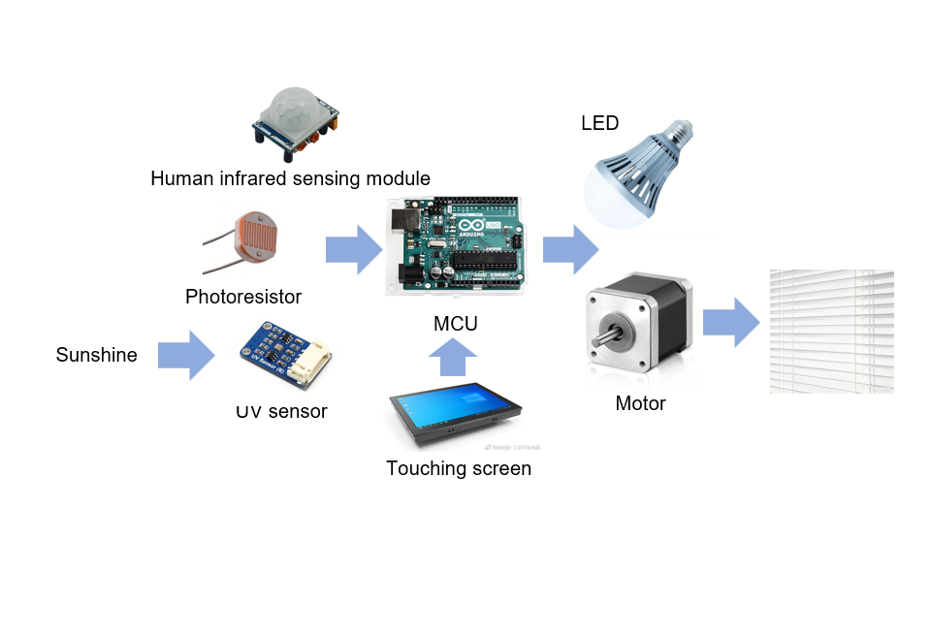
ENGR1000J • Introduction to Engineering
Lighbrary - Intelligent Lighting System For Libraries
Instructors: Prof. Yibo Pi, Prof. Irene Wei
Team Members: Kuangdi Li, Shuhan Guo, Congyu Yang, Chen Liang
Problem Statement
Libraries have long been plagued by two issues due to lighting system:
Continuous lighting wastes energy and raises costs.
The uneven light intensity from the sunshine often strains readers’ eyes around noons, which reduce study efficiency and increase the risk of eye diseases[1].
Concept Generation
Our project aims at building an IoT-based library adaptive lighting environment system, integrating light sensors, motorized blinds and dimmable LED bulbs. The system shall automatically detect real-time light intensity, block glare by adjusting the blinds, and regulate LED brightness for consistency, thereby improving these issues.
Design Description
Fig 1 The Structure of the System
The system adopts a hardware-software integrated design to achieve adaptive lighting control. Hardware core components are labelled detailedly in Fig 1. The software processes real-time data collected by sensors, triggering corresponding responses: blocking glare via motor-controlled blinds, regulating LED brightness, and activating the system only when human presence is detected. Also, a touching screen is integrated to allow users manually adjust indoor lighting.
Fig 2 The Whole Set-up System
Modeling and Analysis
Fig 3 The Flowchart of System’s Model
The whole system works as shown in Figure 3. By programming this control logic model into a feasible program and uploading it into the MCU, it is expected to realize its functions.
Validation
System hardware was deployed in a simulated library zone. An adjustable
light source (including UV-A) simulated natural sunlight variations. Target illuminance (500 lux) was set. Light/UV intensity was gradually increased to trigger automatic
shading and LED dimming.
Table 1 Adjustment Results
Conclusion:
Integrated UV sensor and photoresistor works. System auto-regulates for lighting.
Core functionality and energy savings are validated.
Conclusion
Lighbrary presents the feasibility of an IoT-based adaptive lighting system that improves reading comfort and energy efficiency in libraries.
Key advantages include:
Automatic light regulation for consistent illumination
Energy savings via smart dimming and presence sensing
User-friendly automated and manual touchscreen control
Future efforts will focus on adding personalized brightness settings and optimizing performance across different weather conditions.
Acknowledgement
We thank Prof.Pi, Prof.Wei and ENGR1000J TAs. For more project information, please contact: idgnaukil@sjtu.edu.cn
Reference
[1] R. Kurniawati, M. Mardji, and A. Kurniawan, "Effect of Light Intensity On Eye Fatigue," in Advances in Health Science Research (AHSR), vol. 7, Proc. 2nd Int. Conf. on Sports Sciences and Health 2018 (ICSSH 2018), 2018.
Initial UV(µW/cm²) | Blinds status | Initial illuminance(lux) | Final illuminance(lux)
8 | open | 200 | 476
50 | partly closed | 700 | 545
85 | fully closed | 900 | 562

