Slide 1
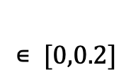
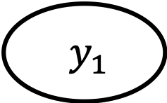


Y$y_{1}$
$$∊ [0,0.2]$$
$$∊(0.2,0.6]$$
$$∊(0.6,1]$$
…
…
…

