Slide 1
OOP Final Programming Test Instruction
There are three questions.
You must use the template to implement all of them.

Slide 2
We will rebuild your program to mark it. Delete all the .exe file(s) before marking. Upload your solution to E3 before the deadline. If you do not use the template to implement, your score is zero.

Slide 3
Instruction
How to open the file?
- Open VC 2013. Must support vc100.
Drag the .sln file into VC.
Rebuild the solution
How to run the program?
- Go to the folder ./bin/release/
Run SelfMotivatedSystem.exe
You can only modify the files in the folder:
./00Student_Work/00_SimpleInteractiveSystem

Slide 4
Instruction. IMPORTANT
You must enter your information
student name, student ID, email address
in mySystemApp.h
//********************************************
// Student Name:
// Student ID:
// Student Email Address:
//********************************************
Set your name and student ID to cn_StudentInfo
in mySystemApp.h
If you do not do so, your score is zero.

Slide 5
Files
You can add new functions/methods or delete existing functions/methods in the following files:
mySystemApp.h, mySystemApp.cpp
graph_basics.h
mySystem_GraphSystem.h
mySystem_GraphSystem.cpp
mySystem_MonteCarlo.h
mySystem_MonteCarlo.cpp
mySystem_SortingVisualization.h
mySystem_SortingVisualization.cpp
The message “Fill your or modify own stuff” is only for your own reference. You can modify anything in the above files.
You must not modify other files that are not listed here.

Slide 6
About the demo program
The demo program may have bugs. It shows you some functions that are relevant to the questions. But some of the functions may be incorrect. It is for your own reference.
You must follow the instruction to finish the questions. We mark your programs based on the instruction.

Slide 7
System key usage
F1: The Graph system
F2: The Monte Carlo simulation
F3: Sorting Visualization
F5: Show student information on the top bar
‘s’: Show student information on the console window
ESC: quit the program

Slide 8
Main Task (MUST IMPLEMENT)
Press ‘s’ to show the student information.
Implement function MY_SYSTEM_APP:: showStudentInfo_2021()
You must implement this function.
If not, your score is zero.

Slide 9
Question 1. Press F1: Graph System mySystem_GraphSystem.cpp and .h
Implement a graph system
Add nodes
Add edges
Select/unselect a node by clicking the left mouse button
Show the adjacent nodes and attached edges of the selected node
Use breadth-first traversal to compute depths of all nodes with respect to a selected node. The depth of the selected node is 0. Show the nodes with correct colors.

Slide 10
Question 1. Press F1: Graph System mySystem_GraphSystem.cpp and .h
There are three options
enum GraphOption {
GR_None = 0, // option one
GR_Neighbor, // option two
GR_BFS, // option three
GR_End // dummy
};
Press ‘r’ to change option mOption

Slide 11
Question 1
You can modify GRAPH_NODE and GRAPH_EDGE
in graph_basics.h
The key handling function:
handleKeyPressedEvent( unsigned char key )
Find the nearest node to the point (x,z):
GRAPH_NODE *findNearestNode( double x, double z, double &cur_distance2 ) const

Slide 12
Question 1.
mSelectedNode is the selected node
mPassiveSelectedNode is the passive node
void bfs( )
is the function to compute the depths of all the nodes with respect to mSelectedNode if it’s not null.

Slide 13
Question 1.
Get the information of a node:
getNodeInfo( int nodeIndex, double &r, vector3 &p, float &depth ) const
int getNumOfNodes( ) const
int getNumOfEdges( ) const
vector3 getNodePositionOfEdge( int edgeIndex, int nodeIndex ) const

Slide 14
Question 1.
int getNumOfNodes( ) const;
void getNodeInfo( int nodeIndex, double &r, vector3 &p ) const;
void getNodeInfoOfAttachedEdgeOfSelectedNode(
int edgeIndex // inside [0, numAttachedEdges - 1]
, int nodexIndex // node index: 0 or 1
, double &r // radius
, vector3 &p // position of the node
) const;
void getNodeInfoOfAdjacentNodeOfSelectedNode(
int nodexIndex // inside [0, numAdjacentNodes - 1]
, double &r
, vector3 &p
) const;
int getNumOfAttachedEdgesOfSelectedNode( ) const; // numAttachedEdges
int getNumOfAdjacentNodesOfSelectedNode( ) const; // numAdjacentNodes

Slide 15
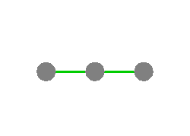
Question 1: Tasks
1. [5%] Press ‘1’ shows
void createDefaultGraph( )
Default graph

Slide 16
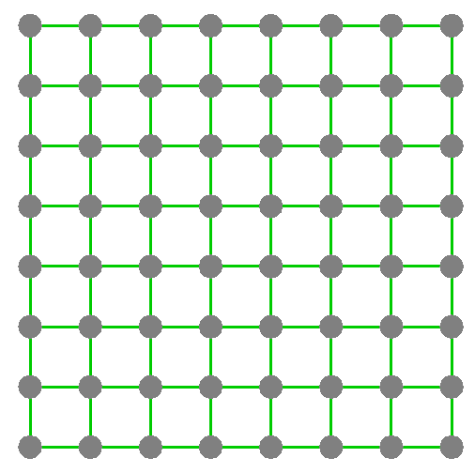
Question 1: Tasks
A 8x8 square net
2. [5%] Press ‘2’ shows
void createNet_Square( int n )

Slide 17
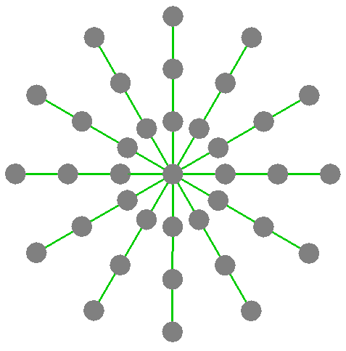
Question 1: Tasks
A radical net
One node is at the center.
And there are three layers and each layer has 12 nodes.
The nodes of each layer are on a circle.
The radius of the inner circle is 5.
3. [5%] Press ‘3’ shows
void createNet_RadialCircular(
int n, int num_layers )

Slide 18
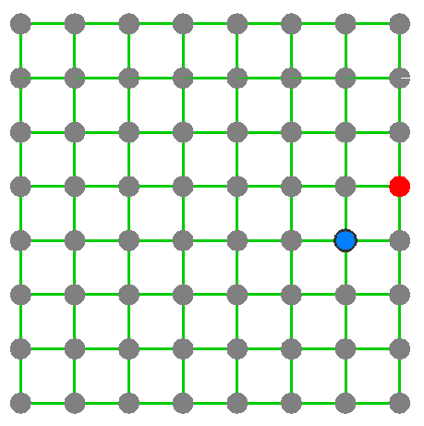
Question 1: Tasks
4. [5%] Click the left mouse button to select/unselect a node. clickAt(double x, double z).
All nodes are gray if there is no selected node.
The selected node is red.
The passive node is blue.
Option None

Slide 19
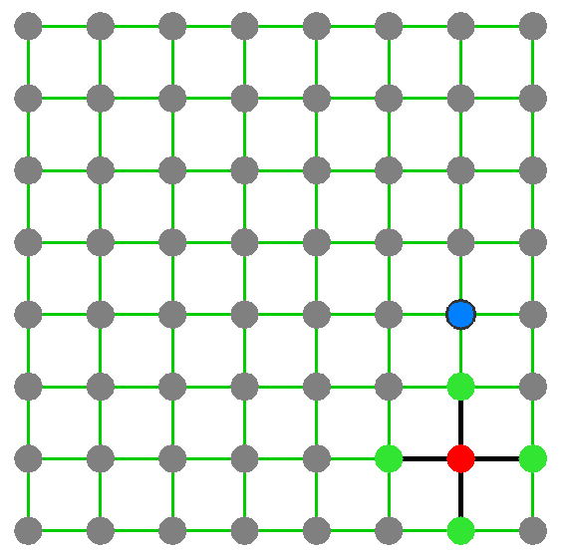
Question 1: Tasks
Option None
6. [2%] Press ‘r’ to change option. There are three options: None, Neighbor, and BFS.
7. [3%] Option None: The selected node and passive node are colored as red and blue, respectively.
8. Option Neighbor: Compute the attached edges and adjacent nodes of the selected node.
[10%] The attached edges are black.
[10%] The adjacent nodes are green.
Option Neighbor

Slide 20
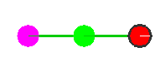
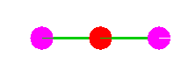
Question 1: Tasks
9. Option BFS: Use breadth-first traversal (search) to compute the depth of all nodes with respect to the selected node. The depth of the selected node is 0. The node(s) are colored as rainbow colors. The nodes with the largest depth are purple. The colors of the nodes are correct.
There must be a red node (selected node with the lowest depth) and a purple node (with the largest depth)
9(a) [10%] Node colors are correct in the default graph. The result depends on the selected node.

Slide 21
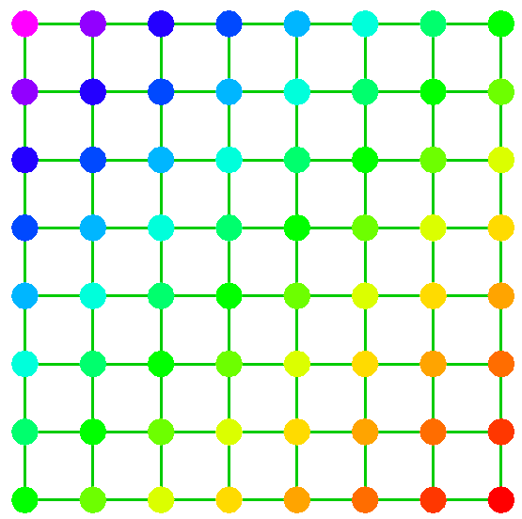
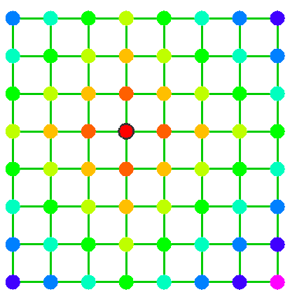
Question 1: Tasks
9. Option BFS: Use breadth-first traversal to compute the depth of all nodes with respect to the selected node. The depth of the selected node is 0. The node(s) are colored as rainbow colors. The nodes with the largest depth are purple. The colors of the nodes are correct.
9(b) [25%] Node colors are correct in the square net.

Slide 22
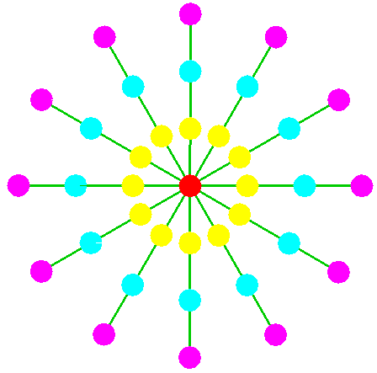
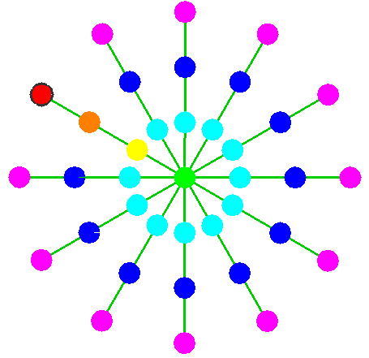
Question 1: Tasks
9. Option BFS: Use breadth-first traversal to compute the depth of all nodes with respect to the selected node. The depth of the selected node is 0. The node(s) are colored as rainbow colors. The nodes with the largest depth are purple. The colors of the nodes are correct.
9(c) [20%] Node colors are correct in the radical net.

Slide 23
Question 2.
The Monte Carlo simulation

Slide 24
Question 2: The Monte Carlo simulation mySystem_MonteCarlo.cpp or .h
Implement a program to generate samples points inside a region bounded by two shapes.
Generate the samples points and sort them radically about a reference point. The sample points are drawn as smooth colors.
Use Monte Carlo simulation to compute the area bounded by two curves inside the region.
There are four pairs of functions.

Slide 25
Key usage
‘1’, ‘2’, ‘3’, ‘4’: curve pairs
‘c’: sort the sample points about the reference point (L,0)
‘r’: cycle the regions. And use the current region for generating the sample points
‘s’: show student information

Slide 26
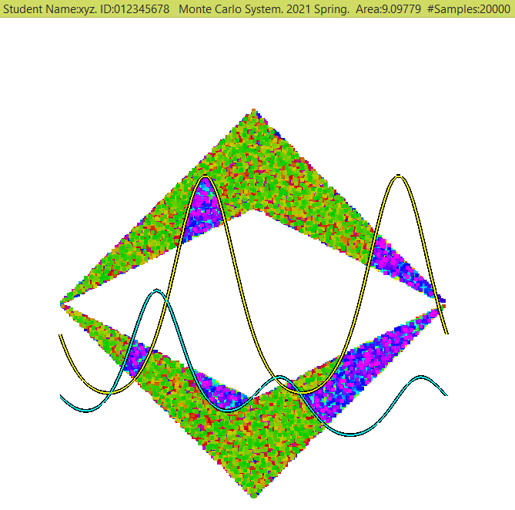
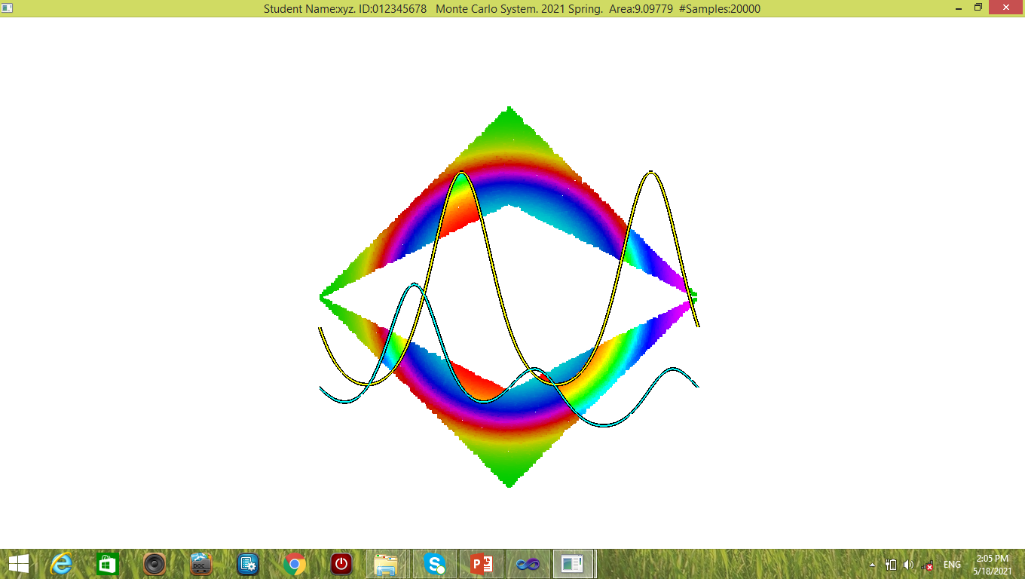
Before sorting the points
After sorting the points

Slide 27
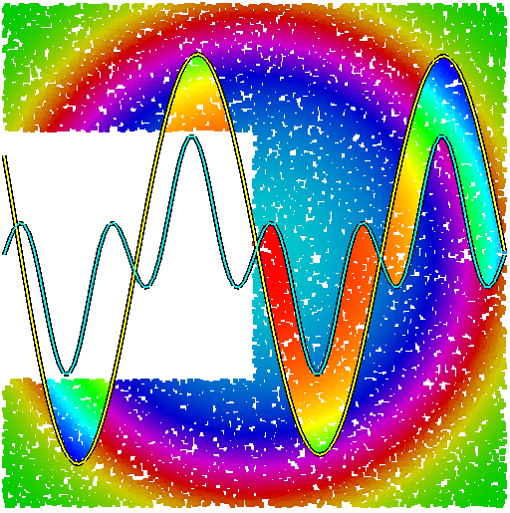

Slide 28
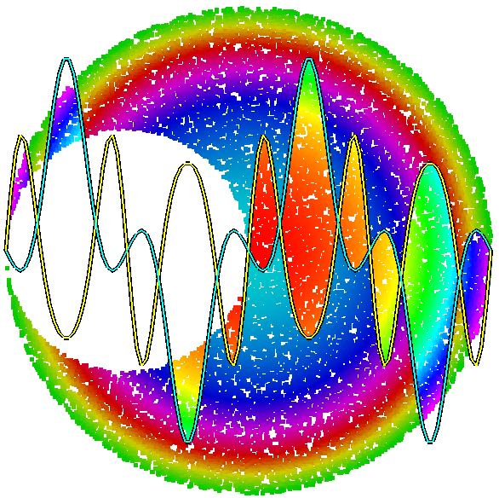

Slide 29
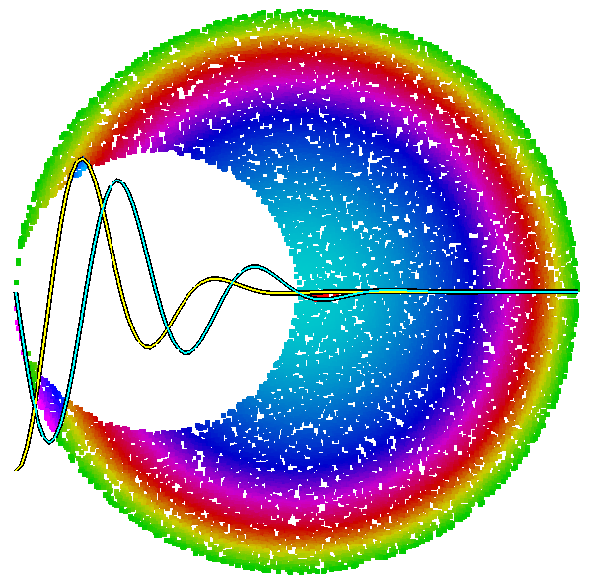

Slide 30
Student ID
Area
Number of
points
A result with sorted sample.
There are 20000 sample points uniformly generated inside the region bounded between two diamonds.
Some sample points lie between the two curves. These points are used for computing the area bounded by the two curves.

Slide 31
The regions
L = 2*3.14159
center_X = L; center_Y = 0
Each region is bounded by two shapes: large and small.
The sample points are inside the large shape but not the small shape.
Two Circles
The centers are (L/2, 0) and (center_X, 0).
Radii are L and 2L.
Squares
The centers are (L/2, 0) and (center_X, 0).
Side lengths are L and 2L.
Diamonds.
Both centers are at (center_X, 0).

Slide 32
The regions
L = 2*3.14159
center_X = L; center_Y = 0
Each region is bounded
between two shapes.
Two Circles
The centers are (L/2, 0)
and (center_X, 0).
Radii are L and 2L.
L
L/2
(L/2, 0)
(L, 0)

Slide 33
The regions
2L
L = 2*3.14159
center_X = L; center_Y = 0
Each region is bounded
between two shapes.
Squares
The centers are
(L/2, 0) and (center_X, 0).
Side lengths L and 2L.
L
(L/2, 0)
(L, 0)

Slide 34
The regions
(L, L)
L = 2*3.14159
center_X = L; center_Y = 0
Each region is bounded
between two shapes.
Diamonds
The centers of both shapes are
at (center_X, 0).
L/2
(L, L/2)
L/2
(0, 0)
L
y=x/2
(center_X, 0)
(2L, 0)
y=x
(L, -L)

Slide 35
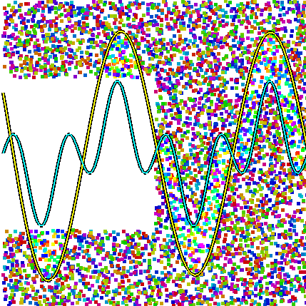
Question 2: Monte Carlo Simulation mySystem_MonteCarlo.cpp or .h
Hints:
Randomly generate n points inside the region.
How do we know that a point lies inside the region bounded by two shapes?
The point must be inside one shape but outside of another shape.

Slide 36
Question 2: Monte Carlo Simulation mySystem_MonteCarlo.cpp or .h
How do we know that a point lies inside an area bounded between two curves?
A point (x, y) is inside the area if it satisfies the following condition:
It is bounded by the two curves f(x) and g(x)
if g(x) <= y <= f(x) or f(x) <= y <= g(x).

Slide 37
Curve pairs. The curves are correct.
1. [5%] Case One: Press ‘1’ to set the two curves to be:
f(x) = -5 sin( x ) + 2.5 cos( x ) e^{-x/4}
g(x) =3 cos( 2x ) sin ( x )
2. [5%] Case Two: Press ‘2’ to set the two curves to be:
f(x) = 3 sin (4 sin( |x| ))
g(x) = 5 cos (2 cos ( |x| ) ) sin ( |x| )
3. [5%] Case Three: Press ‘3’ to set the two curves to be:
f(x) = - 4 cos ( -2x ) e^{-x*x/8}
g(x) = 7 sin( -x ) cos ( -x ) e^{-x*x/16}
4. [5%] Case Four: Press ‘4’ to set the two curves to be:
f(x) = -4 + 3 e^{-sin(x)}
g(x) = -5 + 2 e^{–cos( x ) sin( x/2 )}
e = 2.718281828

Slide 38
Question 2: Tasks
5. [10%] Press ‘r’ to cycle the sampling region:
squares->circles->diamonds->squares->…
Generate sample points in the three cases: squares, circles, and diamonds
mSR_Option indicates the option
enum SamplingRegion {
SR_Double_Squares=0,
SR_Double_Circles,
SR_Double_Diamonds,
SR_End // dummy
};

Slide 39
Question 2: Tasks
6. Compute the area bounded by the two curves inside the specified region. The answers are correct in each region.
6.(a) [10+10%] Squares. The sampling region is correct. The area is correct.
6.(b) [10+10%] Circles. The sampling region is correct. The area is correct.
6.(c) [10+10%] Diamonds. The sampling region is correct. The area is correct.

Slide 40
Question 2: Tasks
7. [10%] Press ‘c’ to sort the sample points about the center point (L,0). The colors of the sample points must be correct.
Assume that there are two points p1(x1, y1) and p2(x2,y2).
p1 is ordered before p2
iff (x1-L)²+y1² < (x2-L)²+y2².
If the distances of p1 and p2 to (L,0) are the same,
p2 can be placed in front of p1.

Slide 41
Question 2: mySystem_MonteCarlo.cpp Implement the functions for MONTE_CARLO_SYSTEM
computeSamples( )
computeArea( ) const
getNumSamples( ) const
getSample(int sampleIndex, double &x, double &y ) const
getValue(double x, int func_index) const
bool isInsideSamplingRegion( double x, double y ) const
isInsideArea_FuncPair(double x, double y) const
sortAboutCenter()
You can add or modify any functions.

Slide 42
Samples
Read computeSamples( ) to see how
mPointIndices
is reset.
for ( int i = 0; i < mNumSamples; ++i ) {
mPointIndices[i] = i; // reset the indices
double x, y;
……

Slide 43
Question 3. Sorting Visualization

Slide 44
Question 3. Sorting Visualization
Visualize the process of insertion sort.
Sort 50 non-negative integers which are generated randomly inside [1,50]
Elements are non-negative integers which are stored in an array x.
The sorting procedure sorts the integers in an ascending or descending order.
After each insertion operation, show the result of the integers in the array.
If the sorting method is not insertion sort, your score is zero.

Slide 45
Question 3. The pseudo code of insertion sort
The pseudo code of insertion sort for sorting an array x in ascending order:
i = 0; n is the number of elements of x
while ( i < n)
j = i // store the previous index
find j such that x[ i ] < x[ j ], where 0 <= j < i
If such j exists do // insert one element, i.e., x[ i ]
tmp = x[ i ] // save x[ i ]
shift x[ j ], x[ j+1 ], …, x[ i-1 ] to // shift to right by one element
x[ j+1], x[ j+2 ], …, x[ i ]. // Make sure the order is correct
x[ j ] = tmp // assign tmp to x[ i ]
end do
++i; // After this line is executed, one insertion operation is done
}
The index i is called as current index and index j is called as previous index.

Slide 46
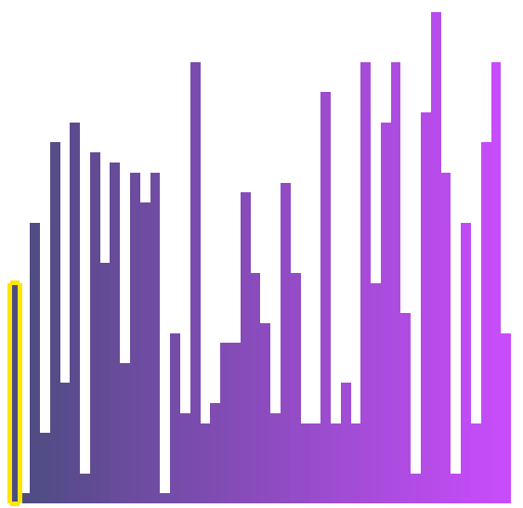
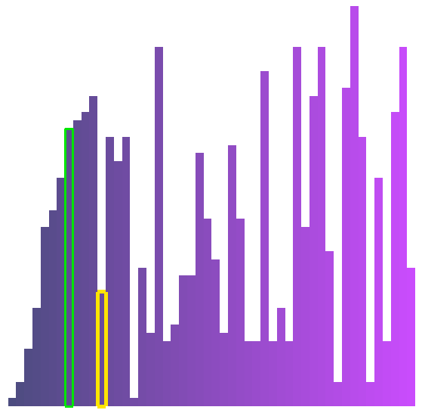

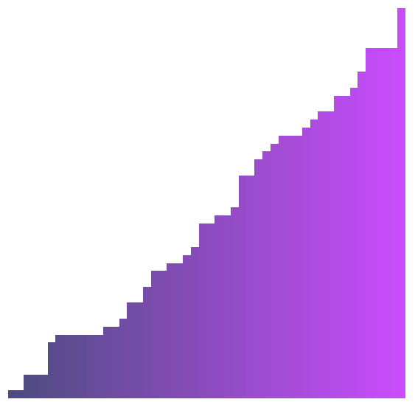
Question 3. Key usage
‘1’: Set the sorting order as ascending. Reset the indices. Do not generate new elements.
‘2’: Set the sorting order as descending. Reset the indices. Do not generate new elements.
‘ ‘ (spacebar): Insert one element based on the sorting order
‘r’: Generate new elements of the array
Sorting the elements in ascending order
Initial result
Intermediate result
Intermediate result
Final result

Slide 47
Question 3: mySystem_SortingVisualization.cpp Implement the functions for SORTING_VISUALIZATION
bool handleKeyPressedEvent( unsigned char key ) // handle key events
void reset( ); // generate new elements
int getNumOfElements( ) const; // get the number of elements
int getElement( int elementIndex ) const // get the element
int getPreviousElementIndex( ) const // get the previous index
int getCurrentElementIndex( ) const // get the current index
void shiftToRight( int start_index, int end_index ) // shift the element(s)
void processOneStep( ) // perform one insertion step
You can add or modify any other functions in mySystem_SortingVisualization.h or mySystem_SortingVisualization.cpp.
You must not modify other files.

Slide 48
Question 3: Marking Scheme
Must sort 50 positive integers which are generated randomly inside [1,50].
1. [20%] Reset( ) works correctly. Press ‘r’.
2. [20%] The result is correct for sorting the elements in ascending order. Must include the intermediate result(s). Press the spacebar to perform one insertion operations.
3. [20%] The result is correct for sorting the elements in descending order. Must include the intermediate result(s). Press the spacebar to perform one insertion operations.
Intermediate result
Intermediate result

Slide 49
Question 3: Marking Scheme
Must sort 50 positive integers which are generated randomly inside [1,50].
4. [10%] The sorting options work correctly at any time, e.g., sorting some elements and then using another sorting option. Press ‘1’ or ‘2’.
5. [15%] The previous index is shown correctly. The corresponding element is drawn as a green frame.
6. [15%] The current index is shown correctly. The corresponding element is drawn as an orange frame.

Slide 50
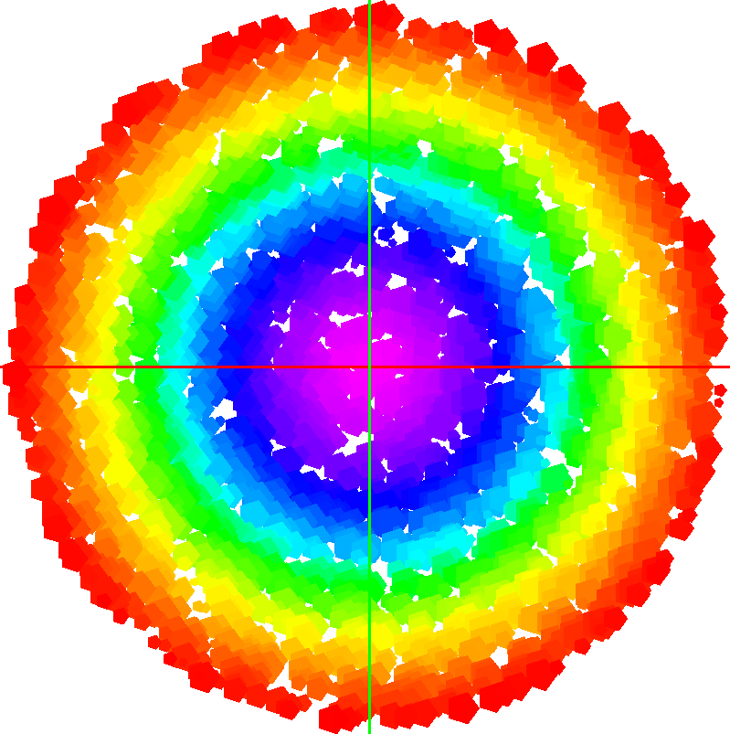
End
Enjoy programming!

