Slide 1

IET Signal Processing Journals, 2020
A Bayesian Step Least Mean Squares Algorithm for Gaussian Signals
Paulo Alexandre Crisóstomo Lopes
Date：2024/05/31
Group: 26
Member : 曾遠騏 N26120498
黃御倫 N26121795
李宗祐 N26121842
1

Slide 2
1
Introduction
2
Algorithm Derivation
Outline
3
Simulation Results
4
Conclusion
2

Slide 3
Introduction
Some results show that the LMS is equivalent to the Kalman filter (KF) if the state noise of the KF and
the step of the LMS algorithm are carefully selected.
3

Slide 4
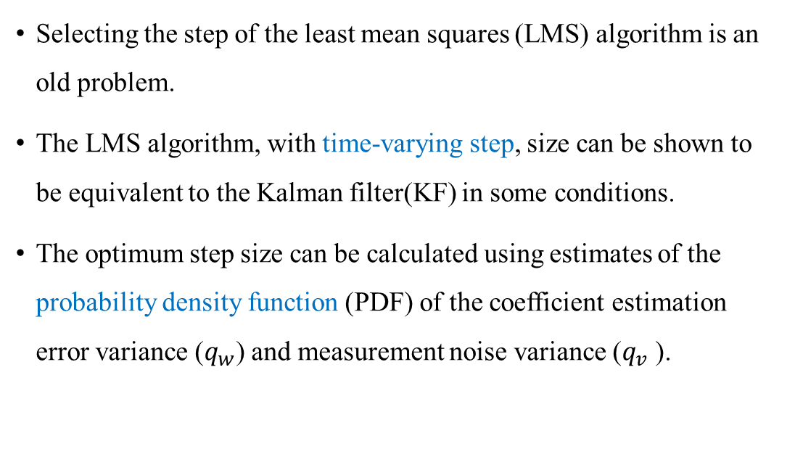
Introduction
Selecting the step of the least mean squares (LMS) algorithm is an old problem.
The LMS algorithm, with time-varying step, size can be shown to be equivalent to the Kalman filter(KF) in some conditions.
The optimum step size can be calculated using estimates of the probability density function (PDF) of the coefficient estimation error variance ($q_{w}$) and measurement noise variance ($q_{v}$ ).
4

Slide 5
Introduction
Algorithms such as NLMS,EM,JO-LMS can choose the step size are based on reference is white or known measurement noise.
[27] use autocorrelation to obtain noise covariance matrices , however, it’s assuming that the measurement noise is white.
[28,29] they derive formulas for the covariance matrix of the measures C and invert them to obtain the state noise covariance matrix Q assuming the measurement noise matrix R is known.
[27]Mehra, R.: ‘On the identification of variances and adaptive Kalman filtering’,IEEE Trans. Autom. Control, 1970, 15, (2), pp. 175–184
[28] Feng, B., Fu, M., Ma, H., et al.: ‘Kalman filter with recursive covariance estimation-sequentially estimating process noise covariance’, IEEE Trans.Ind. Electron., 2014, 61, (11), pp. 6253–6263
[29] Wang, H., Deng, Z., Feng, B., et al.: ‘An adaptive Kalman filter estimatingprocess noise covariance’, Neurocomputing, 2017, 223, pp. 12–17
5

Slide 6
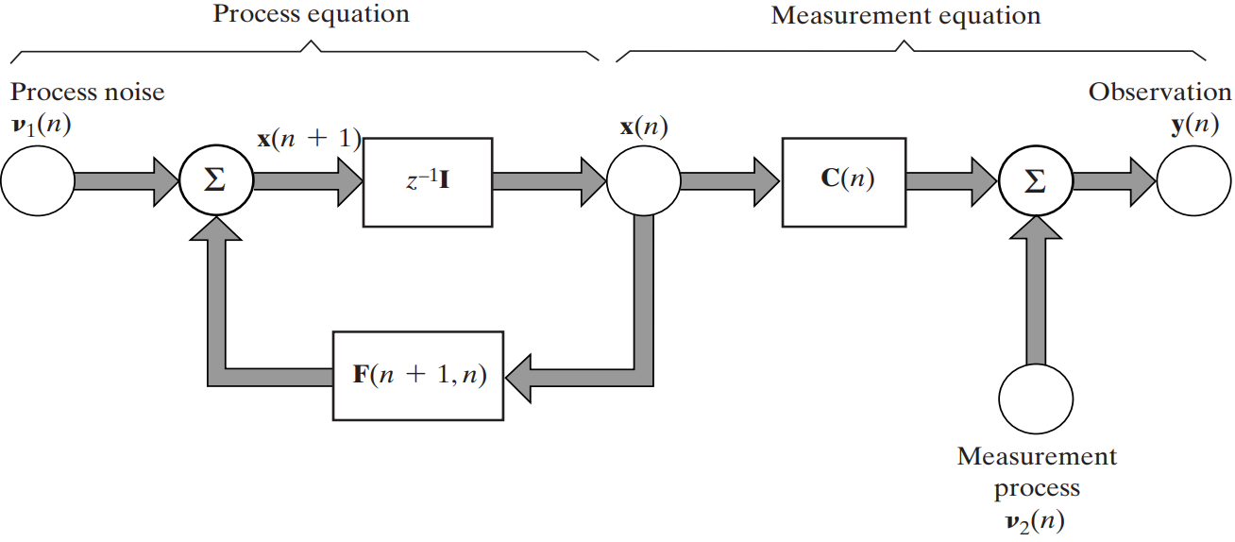
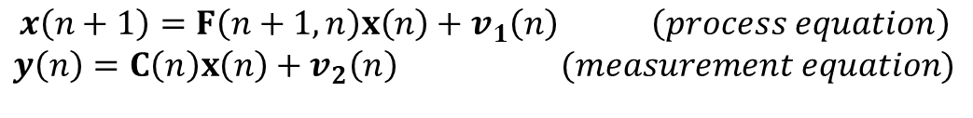
Introduction
$$x\left(n+1\right)=F\left(n+1,n\right)x\left(n\right)+v_{1}\left(n\right) \left(process equation\right)$$
$$y\left(n\right)=C\left(n\right)x\left(n\right)+v_{2}\left(n\right) (measurement equation)$$
$$R\left(n\right)=C\left(n\right)K\left(n+1,n\right)C^{H}\left(n\right)+Q_{2}\left(n\right)$$
6

Slide 7
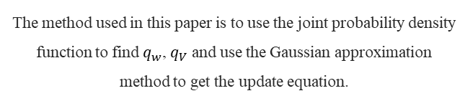
Algorithm Derivation
The method used in this paper is to use the joint probability density function to find $q_{w}$, $q_{V}$ and use the Gaussian approximation method to get the update equation.
7

Slide 8
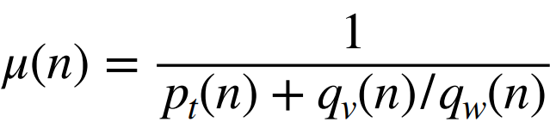

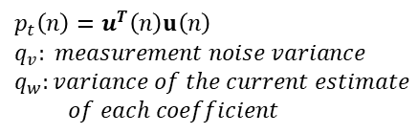
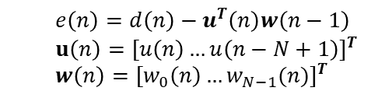
Step Size Calculation[5]
$$e\left(n\right)=d\left(n\right)−u^{T}\left(n\right)w\left(n−1\right)$$
$$u\left(n\right)={[u\left(n\right)…u\left(n−N+1\right)]}^{T}$$
$$w\left(n\right)={[w_{0}\left(n\right)…w_{N−1}(n)]}^{T}$$
LMS algorithm:
Step size from:
$$p_{t}\left(n\right)=u^{T}\left(n\right)u\left(n\right)$$
$$q_{v}: measurement noise variance$$
$$q_{w}:variance of the current estimate$$
$$of each coefficient$$
Optimum coefficient:
$$x\left(n\right)=w_{0}\left(n\right):optimal values$$
for a carefully chosen state noise
[5] Lopes, P.A., Gerald, J.B.: ‘New normalized LMS algorithms based on the Kalman filter’. IEEE Int. Symp. on Circuits and Systems, 2007. ISCAS 2007.IEEE, New Orleans, LA, USA, 2007, pp. 117–120
8

Slide 9
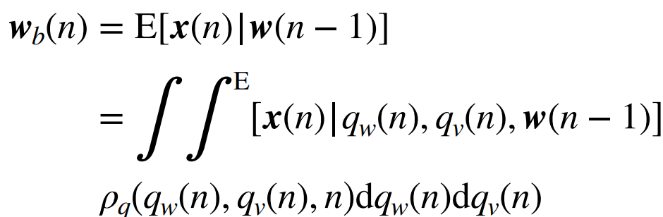
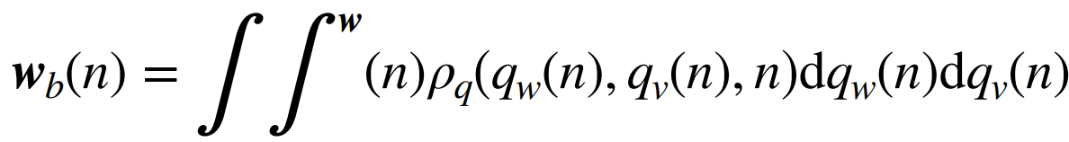
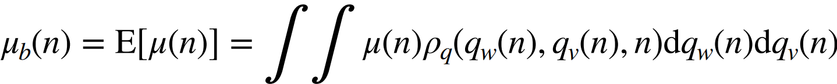
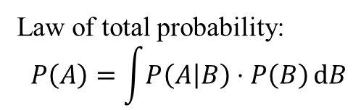


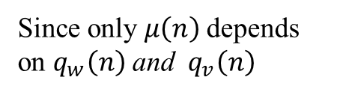
Step Size Calculation
$q_{w}(n)$ and $q_{v}\left(n\right) \text{are} \text{unknown}$
$$ρ_{q}\left(q_{w}\left(n\right),q_{v}\left(n\right),n\right):the joint PDF$$
$$ofq_{w}\left(n\right) and{ q}_{v}\left(n\right)$$
Law of total probability:
$$P\left(A\right)=\int{P\left(\left.A\right|B\right)⋅P\left(B\right)ⅆB}$$
Since only $μ\left(n\right)$depends on $q_{w}\left(n\right)$and ${ q}_{v}\left(n\right)$
9

Slide 10
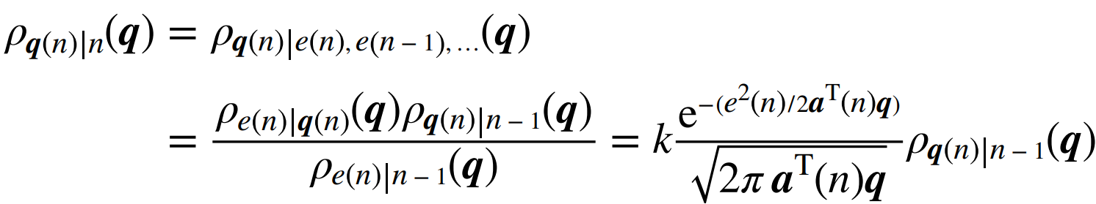
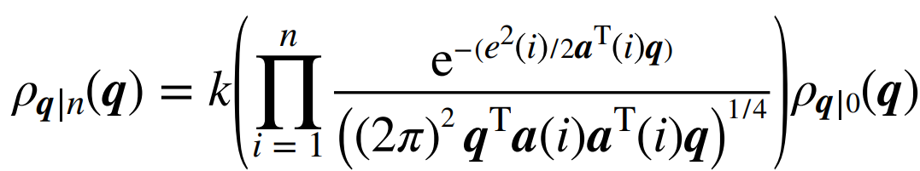
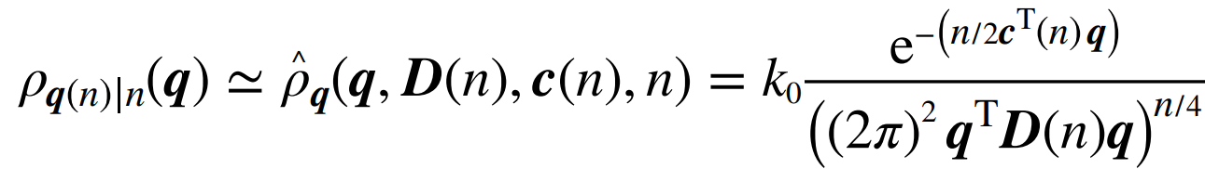



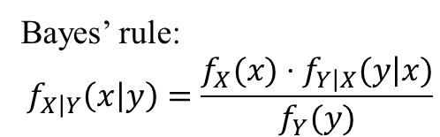

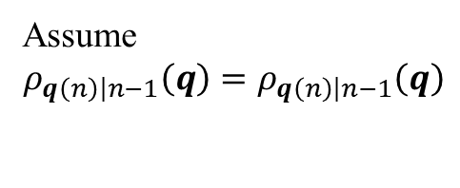
State Variables PDF
Calculate ${ q}_{w}ρ_{q}\left(q_{w}\left(n\right),q_{v}\left(n\right),n\right)$
$$q\left(n\right)={[q_{w}\left(n\right),q_{v}\left(n\right)]}^{T}$$
$$a\left(n\right)={[p_{t}\left(n\right),1]}^{T}$$
$$E[ⅇ^{2}(n)]=a^{T}\left(n\right)q(n)$$
$e\left(n\right):$zero-mean Gaussian
Bayes’ rule:
$$f_{\left.X\right|Y}\left(\left.x\right|y\right)=\frac{f_{X}(x)⋅f_{\left.Y\right|X}(\left.y\right|x)}{f_{Y}(y)}$$
Assume
$$ρ_{q\left.\left(n\right)\right|n−1}\left(q\right)=ρ_{q\left.\left(n\right)\right|n−1}\left(q\right)$$
$$D\left(n\right)=\left[\begin{matrix}d_{1,1}(n) & d_{1,2}(n) \\ d_{2,1}(n) & d_{2,2}(n)\end{matrix}\right]$$
$$c\left(n\right)={[c_{1}\left(n\right),c_{2}\left(n\right)]}^{T}$$
10

Slide 11
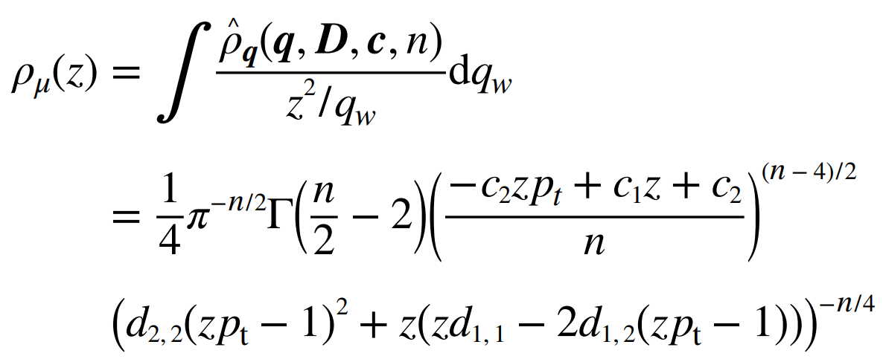
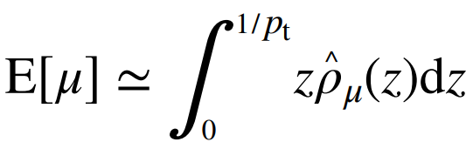
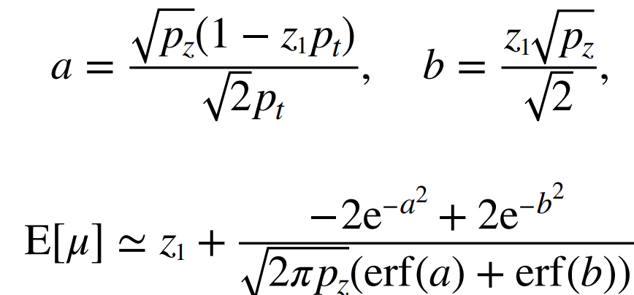

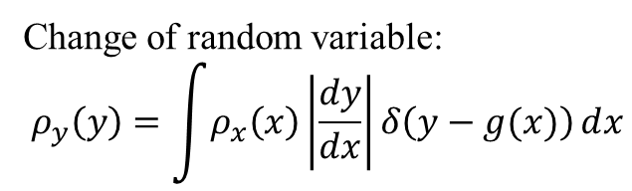

State Variables PDF
Calculate ${ q}_{w}ρ_{q}\left(q_{w}\left(n\right),q_{v}\left(n\right),n\right)$
$Γ=$Gamma function
Change of random variable:
$$ρ_{y}\left(y\right)=\int{ρ_{x}\left(x\right)\left|\frac{dy}{dx}\right|δ\left(y−g(x)\right)ⅆx}$$
Approximated by a Gaussian function
mean:$z_{1}=z_{0}−\frac{δ_{1}\left(z_{0}\right)}{δ_{2}\left(z_{0}\right)}$
variance:$q_{z}=−\frac{1}{δ_{2}\left(z_{0}\right)}$
let $p_{z}=\frac{1}{q_{z}}$
$erf(x)=Gauss error function$
11

Slide 12
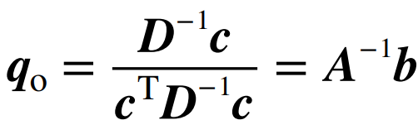
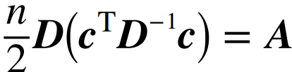
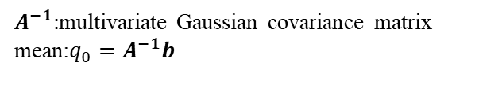
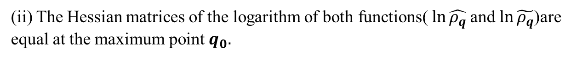
Measure Update Equations
Determine how to update D and c
$A^{−1}:$multivariate Gaussian covariance matrix
mean:$q_{0}=A^{−1}b$
Approximated by a Gaussian function
(i) The values of q that maximizes both functions are equal.
(ii) The Hessian matrices of the logarithm of both functions( $\ln{\hat{ρ_{q}}}$and $\ln{\tilde{ρ_{q}}}$)are equal at the maximum point $q_{0}.$
12

Slide 13
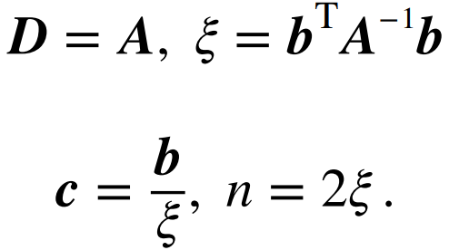
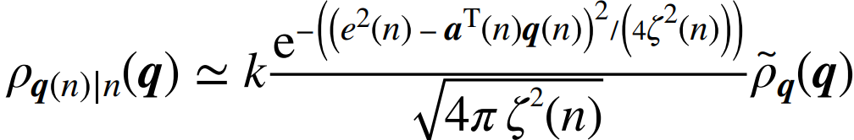
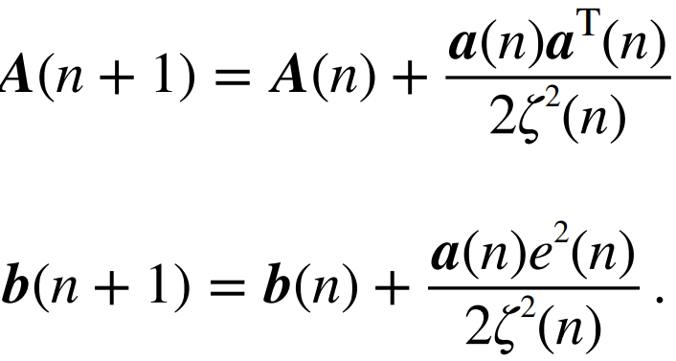


Measure Update Equations
Determine how to update D and c
a
a
$$ξ=b^{T}q_{0}={q_{0}}^{T}Aq_{0}$$
$ζ=a^{T}q_{0}$
mean:$a^{T}\left(n\right)q\left(n\right)$
variance:${2ζ}^{2}$
the measure update equations
13

Slide 14
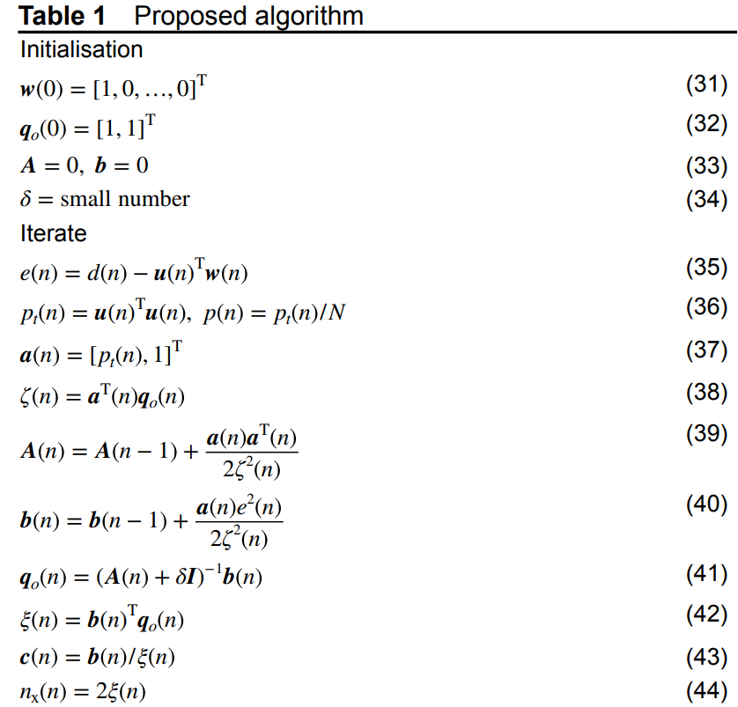
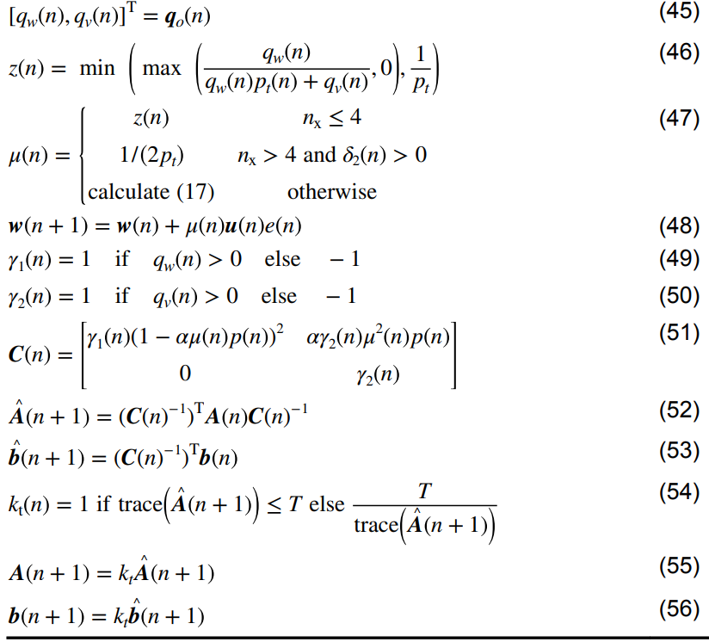
Time Update Equations
14

Slide 15
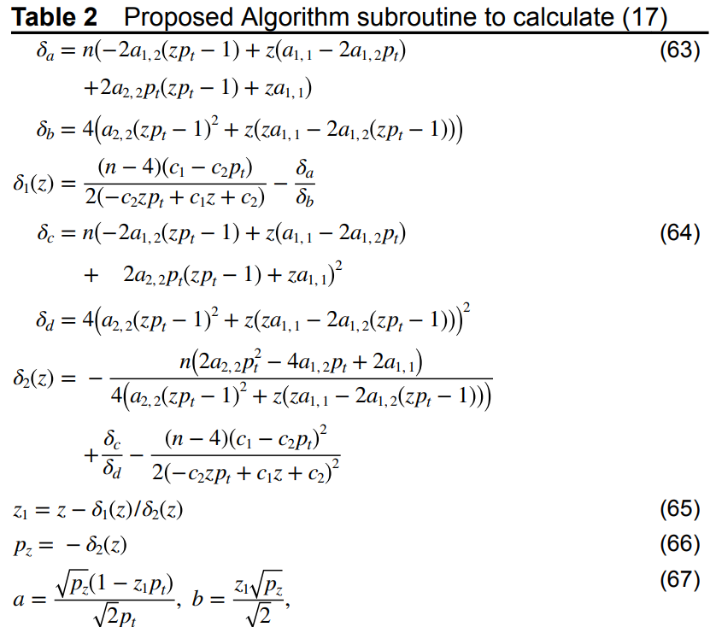
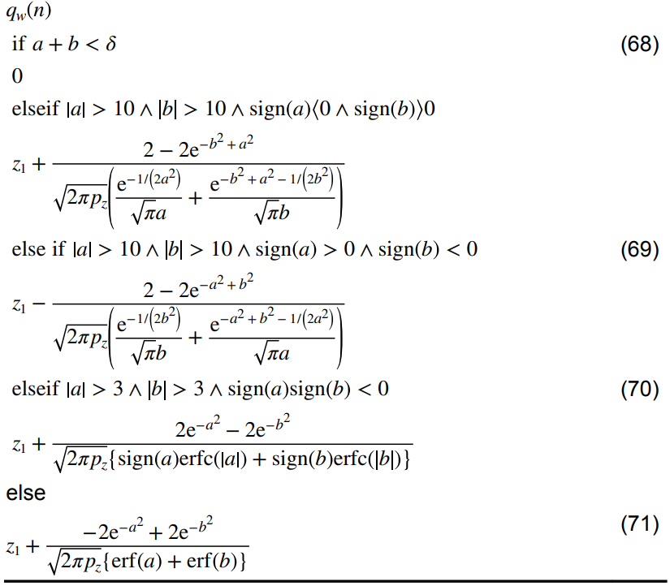
Time Update Equations
15

Slide 16
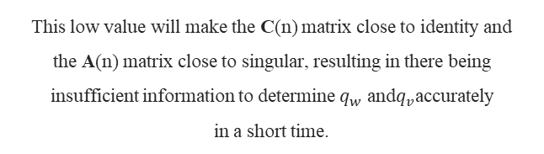
Simulation Results
This low value will make the C(n) matrix close to identity and
the A(n) matrix close to singular, resulting in there being
insufficient information to determine $q_{w}$ and$q_{v}$accurately
in a short time.
16

Slide 17
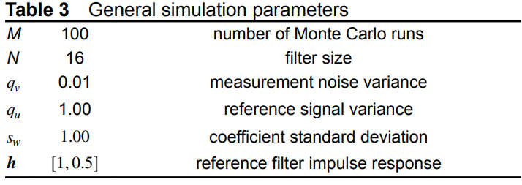
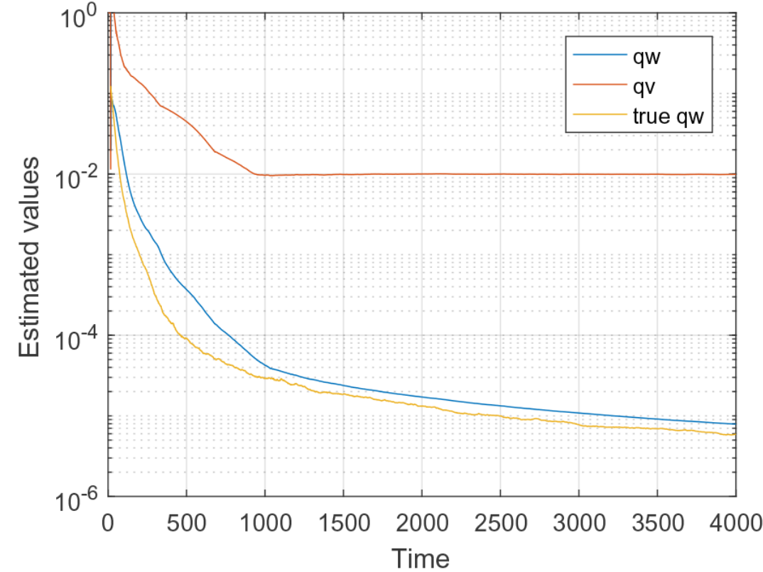
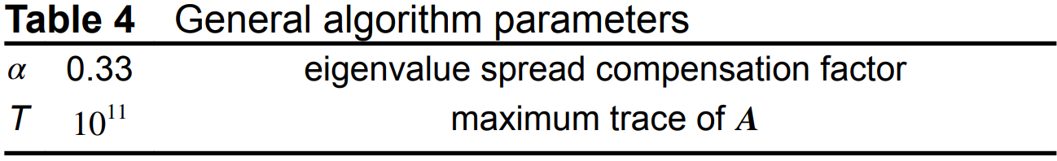
Simulation Results
Estimation of $q_{v}$ and $q_{w}$ . Average of 50 simulations
17

Slide 18
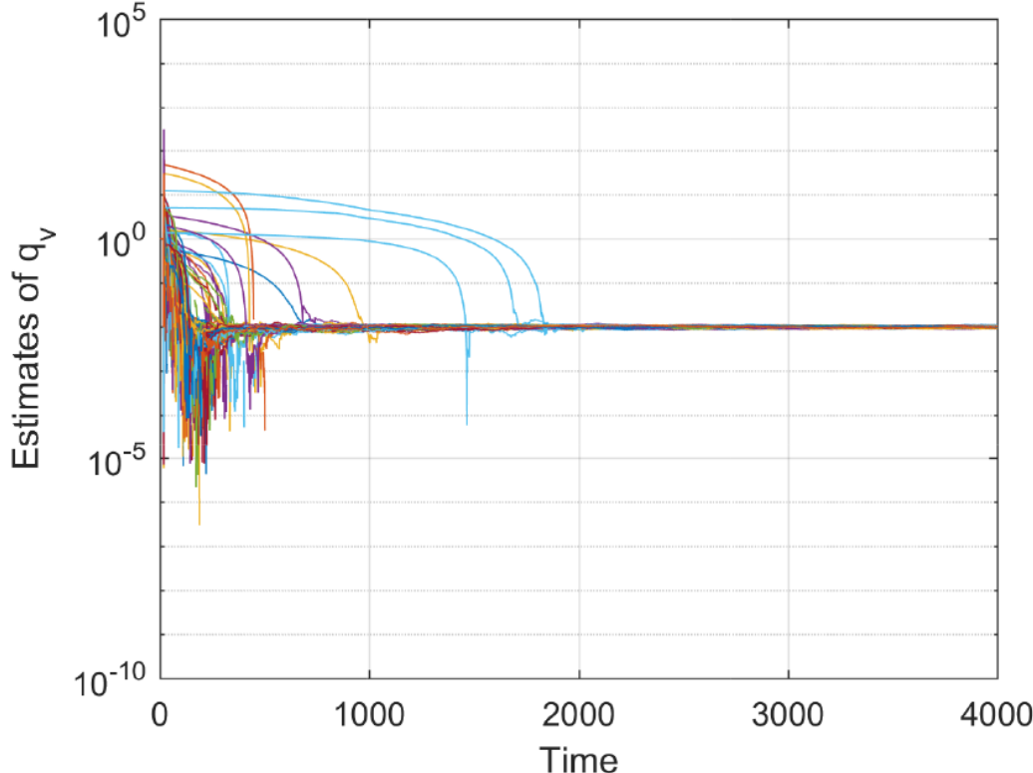
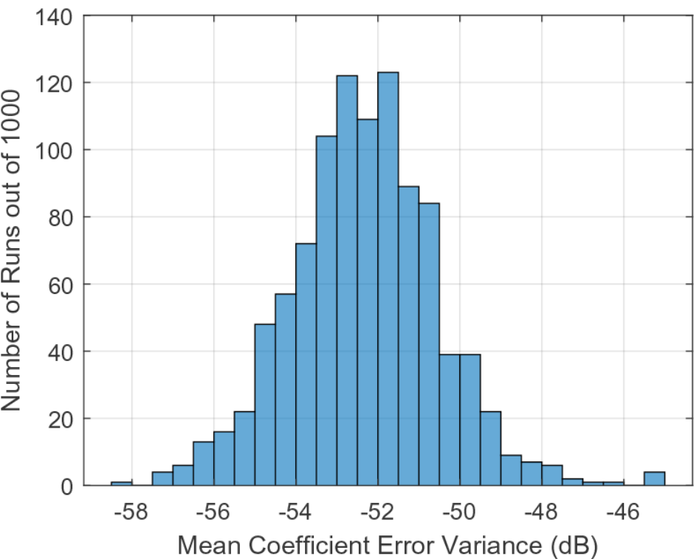

Simulation Results
Estimates of $q_{v}$.Results of 100 single Monte Carlo runs.
Histogram of the final value for the mean coefficient error variance
18

Slide 19
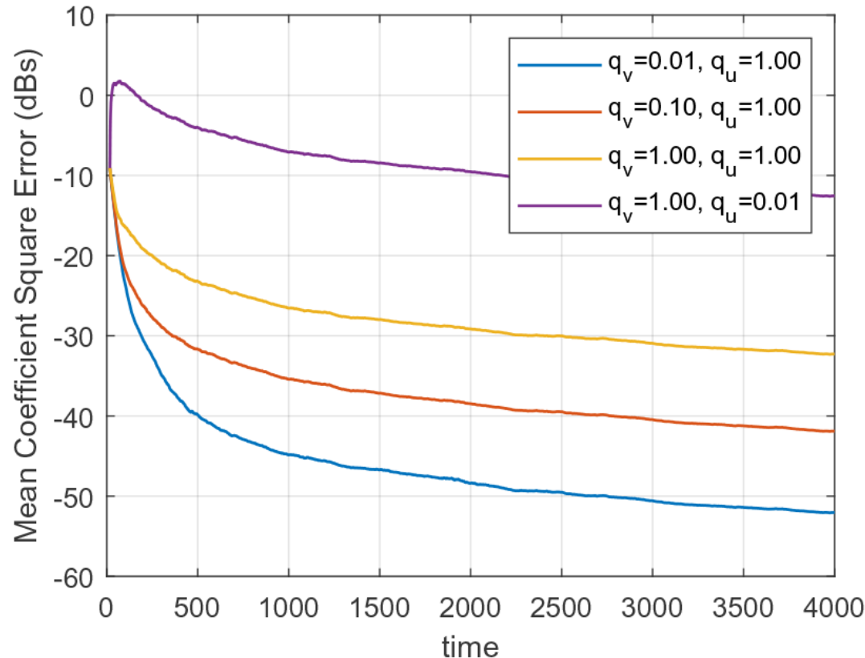
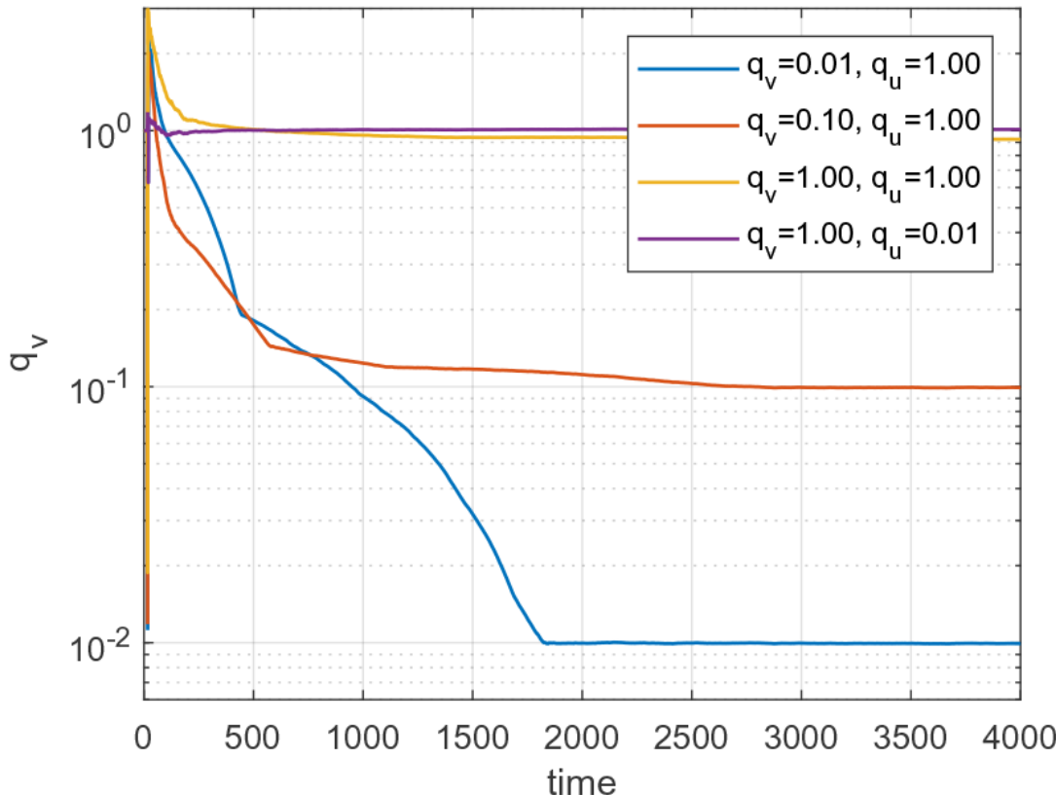


Simulation Results
Mean coefficient estimation error for different values of true- $q_{v}$ and $q_{u}$.
Estimate of the measurement noise variance $q_{v}$ for different values of true- $q_{v}$ and $q_{u}$.
19

Slide 20
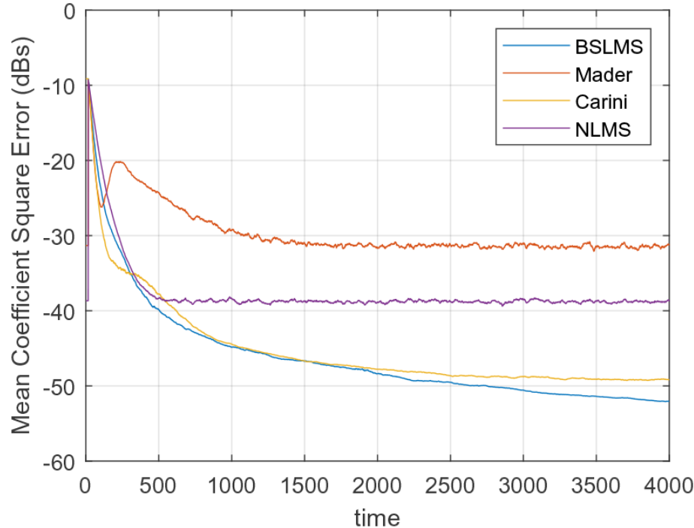
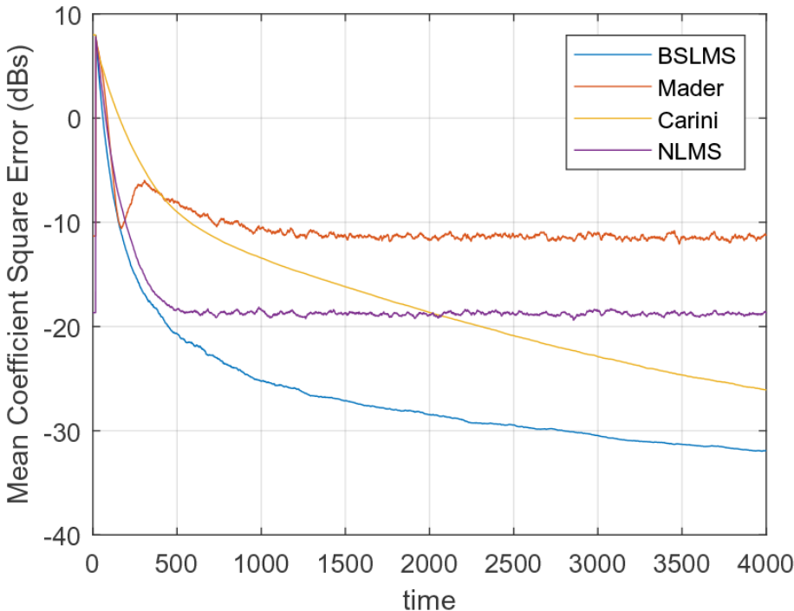
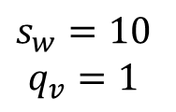
Simulation Results
Comparison with other algorithms with optimized parameters
Comparison with other algorithms with non-optimized parameters
$$s_{w}=10$$
$$q_{v}=1$$
20

Slide 21
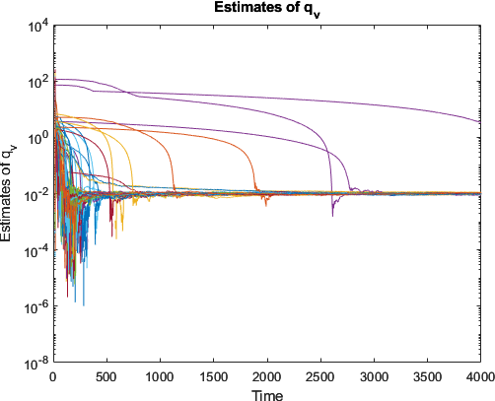

Change Initial Value
Simulation results in paper
Our simulation results
21

Slide 22


Change Initial Value
Simulation results in paper
Our simulation results
$$s_{w}=10$$
$$q_{v}=1$$
22

Slide 23
Conclusion
The step size
is selected using the expected value of the step of the KLMS
algorithm by integrating the corresponding PDF.
23

Slide 24

Conclusion
This presents an algorithm with excellent performance in system identification, namely, with a very small estimation error, thanks to the carefully selected step size of the LMS algorithm.
To obtain estimates of coefficients error variance $q_{w}$ and measurement noise variance $q_{v}$ in a short time, it is required to model the decreases in $q_{v}$ with the convergence of the filter.
24

Slide 25
End of My Presentation
Thank you for listening

