Slide 1
CAPACITOR
CACITOR
CAPACITANCE
STORED ENERGY
ELECTRICAL CIRCUIT
NETWORK
APPLICATION

Slide 2
Capacitor
A Capacitor is an electrical device that can store energy in the electric field between a pair of closely spaced conductors (called 'plates'). When current is applied to the capacitor, electric charges of equal magnitude, but opposite polarity, build up on each plate.
Capacitors are used in electrical circuits as energy-storage devices. They can also be used to differentiate between high-frequency and low-frequency signals and this makes them useful in electronic filters. Capacitors are occasionally referred to as Condensers. This is now considered an antiquated term. A capacitor consists of two conductive electrodes, or plates, separated by a dielectric.

Slide 3
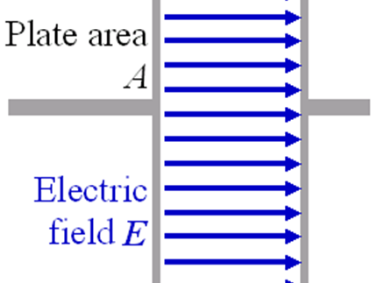
CAPACITOR

Slide 4
Capacitance
When electric charge accumulates on the plates, an electric field is created in the region between the plates that is proportional to the amount of accumulated charge. This electric field creates a potential difference
V= E•d
between the plates of this simple parallel-plate capacitor. The capacitor's capacitance(C) is a measure of the amount of charge (Q) stored on each plate for a given potential difference or Voltage (V) which appears between the plates :
C=Q/V

Slide 5
Stored energy
As opposite charges accumulate on the plates of a capacitor due to the separation of charge, a voltage develops across the capacitor owing to the electric field of these charges. Ever-increasing work must be done against this ever-increasing electric field as more charge is separated. The energy (measured in joules, in SI) stored in a capacitor is equal to the amount of work required to establish the voltage across the capacitor, and therefore the electric field. The energy stored is given by:
E(STORED)=C*V*V/2=VQ/2=Q*Q/2C

Slide 6
ELECTRICAL CIRCUIT
The electrons within dielectric molecules are influenced by the electric field, causing the molecules to rotate slightly from their equilibrium positions. The air gap is shown for clarity; in a real capacitor, the dielectric is in direct contact with the plates. Capacitors also allow AC current to flow and block DC current.

Slide 7
DC sources
The dielectric between the plates is an insulator and blocks the flow of electrons. A steady current through a capacitor deposits electrons on one plate and remove the same quantity of electrons them from the other plate. This process is commonly called 'charging' the capacitor. The current through the capacitor results in the separation of electric charge within the capacitor, which develops an electric field between the plates of the capacitor, equivalently, developing a voltage difference between the plates. This voltage V is directly proportional to the amount of charge separated Q. Since the current I through the capacitor is the rate at which charge Q is forced through the capacitor (dQ/dt), this can be expressed mathematically as:
I=dQ/dt=c*dV/dt

Slide 8
AC sources
The current through a capacitor due to an AC source reverses direction periodically. That is, the alternating current alternately charges the plates: first in one direction and then the other. With the exception of the instant that the current changes direction, the capacitor current is non-zero at all times during a cycle. For this reason, it is commonly said that capacitors "pass" AC. However, at no time do electrons actually cross between the plates, unless the dielectric breaks down. Such a situation would involve physical damage to the capacitor and likely to the circuit involved as well. Since the voltage across a capacitor is proportional to the integral of the current, as shown above, with sine waves in AC or signal circuits this results in a phase difference of 90 degrees, the current leading the voltage phase angle. It can be shown that the AC voltage across the capacitor is in quadrature with the alternating current through the capacitor. That is, the voltage and current are 'out-of-phase' by a quarter cycle. The amplitude of the voltage depends on the amplitude of the current divided by the product of the frequency of the current with the capacitance, C.

Slide 9
Impedance
The ratio of the phasor voltage across a circuit element to the phasor current through that element is called the impedance Z. For a capacitor, the impedance is given by:
Z(c)=V(c)/I(c)=-j/2*3.14*f*c=-j*X(c)
Where
X(c)=1/wC
Is the capacitive reactance,

Slide 10
NETWORK
Capacitors in a parallel configuration each have the same potential difference (voltage).Their total capacitance (C eq) is given by:
C(eq)=C1+C2+……………+Cn
The reason for putting capacitors in parallel is to increase the total amount of charge stored. In other words, increasing the capacitance also increases the amount of energy that can be stored. Its expression is:
E(stored)=c*v*v/2
The current through capacitors in series stays the same, but the voltage across each capacitor can be different. The sum of the potential differences (voltage) is equal to the total voltage.

Slide 11
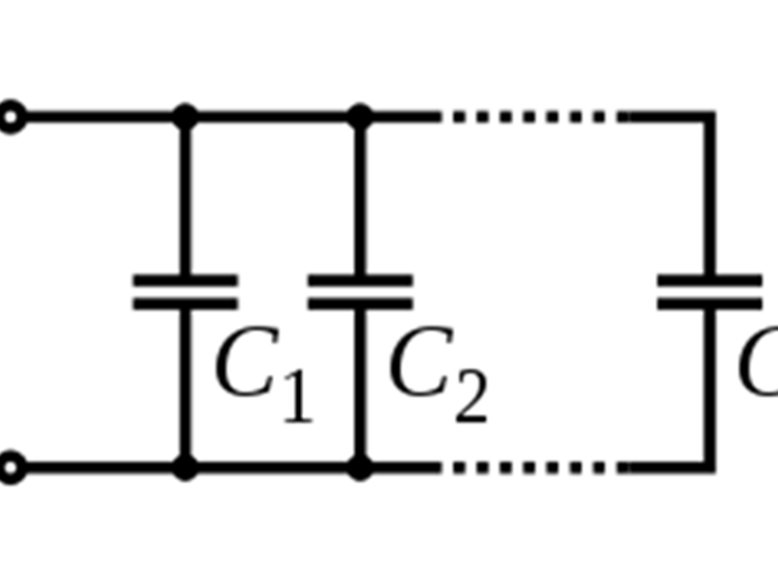
Parallel circuit

Slide 12
APPLICATION
1.Energy storage
2.Power factor correction
3.Filtering
4.Sensing
5.Pulsed power and weapons

Slide 13
GROUP
1.PINAKI SUBHRA BHATTACHARYA (Roll No – 212434)
2.SOHAM NANDI (Roll No-212455)
3. SAYON ISLAM (Roll No – 212452 )
4. QASID SHOAIB (Roll No – 212443 )
5. ANIMESH MONDAL (Roll No -212409)

