Slide 1

“Content Sharing Platform For College Students”
Group No:-14
Pinaki Subhra Bhattacharya (11500219053)
Sayon Islam (11500219054)
Debangsh Bose (11500219055)
Subhradip Barik (11500219056)

Slide 2
Objective :
This project is completely based on Python and it’s various web frameworks.
College students can upload, download image, document file and video file by using this web application.
Users need to sign-up and make their account in our application first.
Next login, to their verified account to use this application.

Slide 3



Front End :

Slide 4


Back-end :
Backend of a web application consists of a server, a database for data collecting. It serves the web pages to the user at its requirement.
Django is a high level Python web framework which we are using for backend .
Version : 3.1.3

Slide 5

Storage :
DataBase :
Database is mainly use to store data and manupulate them.
We basically use database to store different sets of data, which need to be manupulate together.
Like user’s personal information, authentication details etc.
We use SQLite 3 here in this project.
Cloud :
Cloud storage is a computer data storage which stores digital data like the image , document files, videos etc, which will be uploaded by students.
We use GCP cloud storage for this project.

Slide 6

Problem Description :
It is a platform where everyone can share their pictures, documents or video files on the server.
It’s easy to access for all. Any valid, authenticate person can upload their belongings to all.
All type of image (.jpg, .jpeg, .png) is acceptable, and also any kind of document (pdf, ppt, word, csv) can be uploaded.

Slide 7




Problem Description :
People can make their account by sign-up and need to log-in with particular username and password to access our application
Not only, upload but also can download their needed item, to their local storage.
There’s also an search engine where anyone can search for the file, image or video which one looking for.
Logged in person can also add like, comment to any post he/she wants.

Slide 8
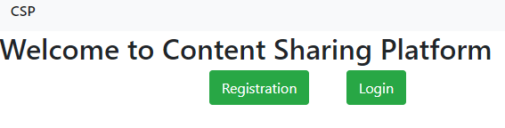
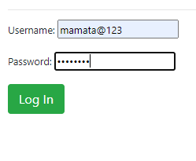
User Authentication :
Registration :
Every student need to first sign-up and make an account in our web application, by giving their personal information, and set a unique username and password for each.
Log-in :
After registration, students need to log-in to their specific account to use upload or download from our web application.

Slide 9
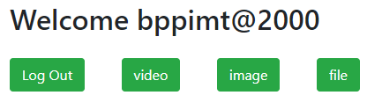
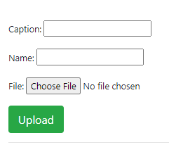
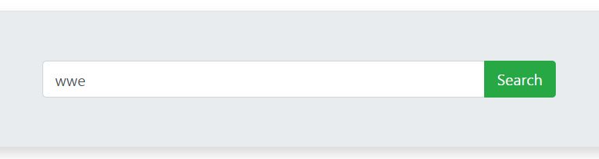
Content Upload :
After Log-in students can upload their content (image, document, video file) to the server.
All the content is easily accessible by all the participants.
Also students can use the search option, to search for their content all over the application.

Slide 10
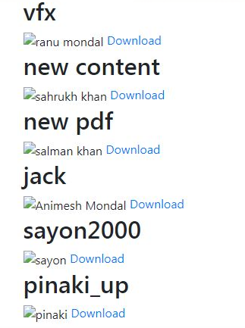
Content Download :
Students can also Download others documents, to their local storage.
For file download, students can click on the download button, provided besides the content.
Only logged in students can download the content from the server.

Slide 11
Algorithm With Flow Of Data :
Register
Log- In
Video Upload
Image Upload
File Upload
File Download
File Download
File Download
Log-Out

Slide 12
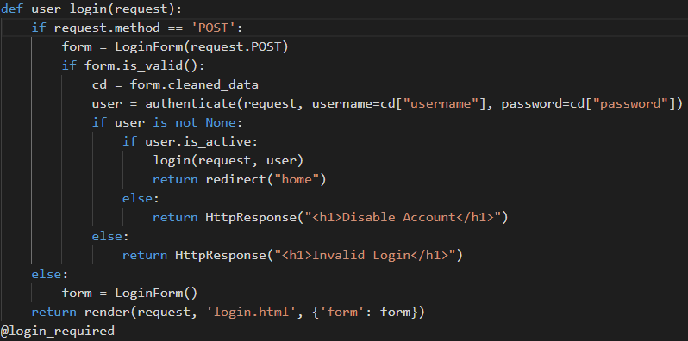
User – Login code (Django) :

Slide 13
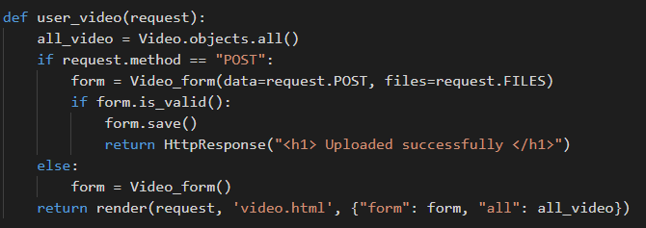
Video Upload code (Django) :

Slide 14
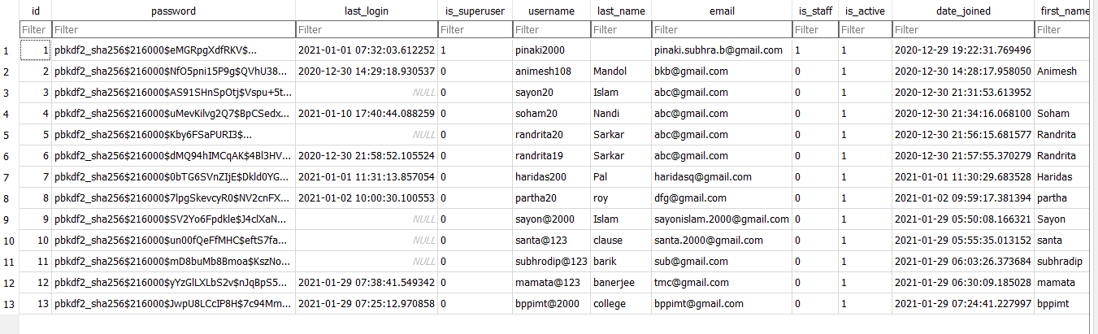
Authentication table in DataBase

Slide 15
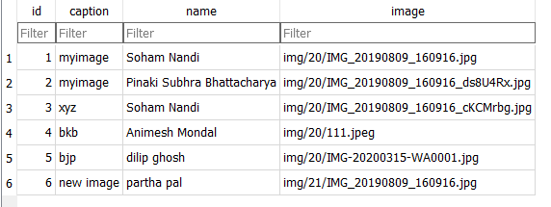
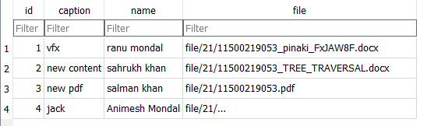
Content table in DataBase

Slide 16
Present Condition Of The Project :
We’ve completed the initial part of the project i.e., Registration page, Log-in page. The Authentication process is completed.
We have also done the main part of our project, i.e., content upload and download part of the web application. So students can upload and download their content.
We have created the search engine which will be helpful for the students to search any content they want.
Next, We are looking forward about the like & comment section, under each content, so that students can express their valuable opinion about the content.

Slide 17
“ Summary ”
Registration
It is a creation of an account in the app.
Log-in
After registration user can enter into the application by log-in
Upload
Students can share their content with the other studebts using this application.
Download
It is a process by which any authenticated student can save any uploaded document to their storage.
Search
Student can easily access any content by using the search engine.
Log-Out
After using the web application , user can leave from the app, via Log-out button.

Slide 18
Thank You

