Slide 1

Statistical Analysis of Academic Performance of Postgraduate Students in IIT Bombay
For the Course Project
in
BM 602: Biostatistics
Submitted By: Group 4
Pinaki Dey (113300003)
Hitendra Sahu (113300017)
Durga Kumari (113300018)
Praveen Kumar (113300024)

Slide 2
Outline
Purpose of the Project
Data collection
Statistical Analysis:
Methods & Justification
Analysis and Results
Conclusion
Limitations
Contributions

Slide 3
Purpose of the Project
To analyse the academic performance of Postgraduate students in IIT Bombay with reference to the following parameters:
Stream of Education in Undergraduate
Type of University in Undergraduate
Academic Performance in Undergraduate
Performance in PG Entrance Test (GATE)
Gender
To find how these parameters influence academic performances in PG.
To find out performance satisfaction of students and its comparison based on specific factors.

Slide 4
Data Collection
Sources of data: 1) Online Methods
2) Manual Methods
Questionnaire:
Gender of student
Last qualifying degree
Stream of undergraduate study
Name of university
Status of university
CPI at undergraduate level
GATE Percentile
CPI at Post graduate level
Performance satisfaction index in PG level

Slide 5

Survey Form

Slide 6
Statistical Analysis
Methods & Justification
1) One way ANOVA --- Single source of variation
2) Two way ANOVA --- Multiple sources of variation
3) Regression --- Prediction
4) Box Plot

Slide 7
Statistical Analysis
Analysis and Results
1) 1- way ANOVA: Stream in UG vs. PG CPI
2) 1- way ANOVA: Status of UG University vs. PG CPI
3) 1-way ANOVA: Gender vs. PG CPI
4) 2-way ANOVA: GATE Percentile and UG CPI vs. PG CPI
5) 2-way ANOVA: Gender and UG stream vs. PG CPI
6) 2-way ANOVA: Gender and Status of UG university vs. PG CPI
7) 2-way ANOVA: Gender and PG CPI vs. Satisfaction Level
8) Regression Analysis: a) UG CPI and PG CPI
b) GATE Percentile and PG CPI

Slide 8
1- way ANOVA: Stream in UG vs. PG CPI
Motive of analysis:
To find if there is any effect of change in stream, from UG to PG level, on academic performance (say from Biotech to Biomedical).
To find the perception of students towards the level of difficulties of PG course based on their stream.
How well can they adapt to new academic program?

Slide 9
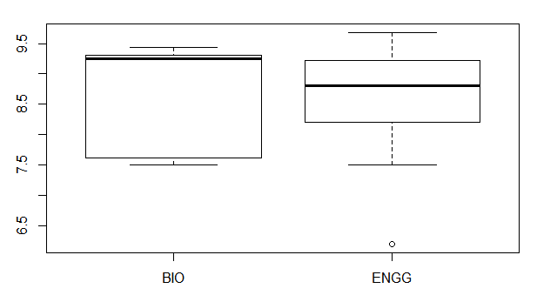


1- way ANOVA: Stream in UG vs. PG CPI
Results & Interpretations:
The median of PG CPI is higher for students from Biosciences streams as compared to those from core engineering.
The majority of students from Biosciences streams perform better as depicted by their PG CPI whereas the performances of students from core engineering streams are almost equally dispersed in terms of PG CPI.
However, the highest level of PG CPI has been observed from student belonging to core engineering category.

Slide 10
1- way ANOVA: Status of UG University vs. PG CPI
Motive of analysis:
Perception vs. Perseverance
To find if the nature of universities in UG level really influence academic performance of students in higher level or is it the student’s own capabilities and merit which determine his/her performance?
Notes:
Motive of analysis:
The infrastructure, academic policies and competence of faculties differ among Government and Private universities, which might have an effect on the academic foundation of students and thereby on their academic performances on higher level of education.
• Apart of that there is a cynical perception in the society about the quality of education provided in the private colleges and the students passing out from there.
• To find if the nature of universities really matters in academic performance of students in higher level or is it the student’s own capabilities and merit which determine his/her performance?

Slide 11
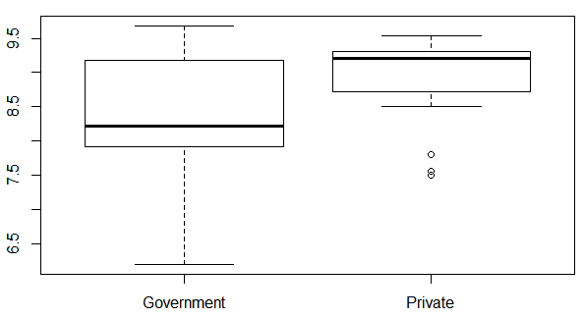


1- way ANOVA: Status of UG University vs. PG CPI
Results & Interpretations:
The median of PG CPI is much higher for students from Private universities as compared to those from Government universities.
Although the highest level of academic performance, in terms of PG CPI, came from the student of Government university but this is also true for the lowest performance as well.
We can infer that the students from private universities maintain a standard in their performance and do not deviate much in terms of their acquired CPI. But students from Government universities differ in their academic performance within themselves to a large extent without being able to hold any standardized level of performance.

Slide 12
1- way ANOVA: Gender vs. PG CPI
Motive of analysis:
To find if there is any role of gender behind the academic performance of students in PG level.
Do the female students are more committed to their studies than their male counterparts or is it the opposite?
Notes:
Motive of analysis:
The infrastructure, academic policies and competence of faculties differ among Government and Private universities, which might have an effect on the academic foundation of students and thereby on their academic performances on higher level of education.
• Apart of that there is a cynical perception in the society about the quality of education provided in the private colleges and the students passing out from there.
• To find if the nature of universities really matters in academic performance of students in higher level or is it the student’s own capabilities and merit which determine his/her performance?

Slide 13
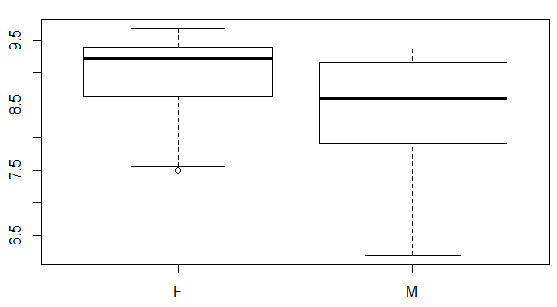


1- way ANOVA: Gender vs. PG CPI
Results & Interpretations:
The median of PG CPI is higher for female student as compared to that of male students.
The majority of female students perform better as depicted by their PG CPI whereas the performances of male students are almost equally dispersed in terms of PG CPI.

Slide 14
2-way ANOVA: GATE Percentile and UG CPI vs. PG CPI
Motive of analysis:
To determine the trend of academic performance of students who have performed well in both GATE and their UG level to those who did not.
Are the better performers in GATE and UG level being able to hold their level of performance in PG as well?
Was there any positive effect of relatively lower performance in GATE and/or UG level on the performance in PG?
Was there any negative effect of relatively higher performance in GATE and/or UG level on the performance in PG?
Notes:
Motive of analysis:
The infrastructure, academic policies and competence of faculties differ among Government and Private universities, which might have an effect on the academic foundation of students and thereby on their academic performances on higher level of education.
• Apart of that there is a cynical perception in the society about the quality of education provided in the private colleges and the students passing out from there.
• To find if the nature of universities really matters in academic performance of students in higher level or is it the student’s own capabilities and merit which determine his/her performance?

Slide 15
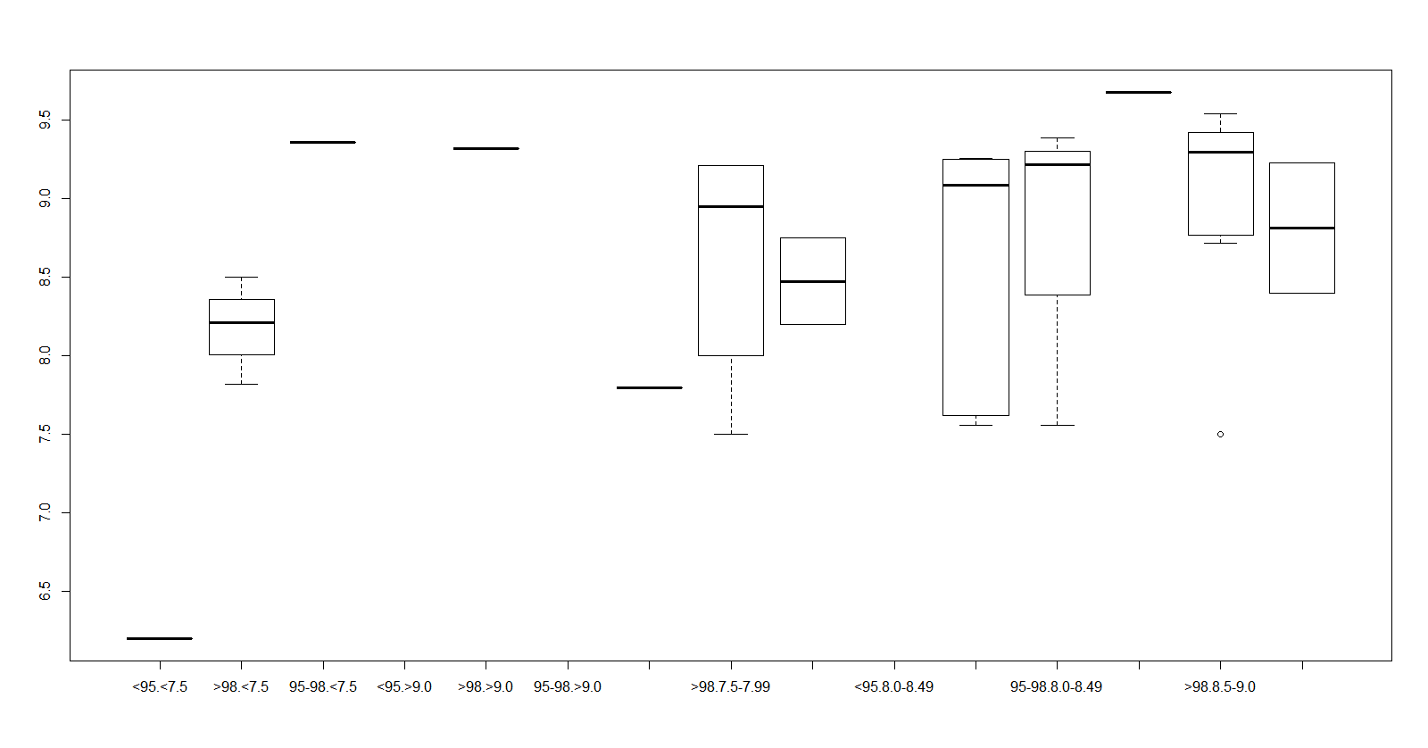
2-way ANOVA: GATE Percentile and UG CPI vs. PG CPI

Slide 16

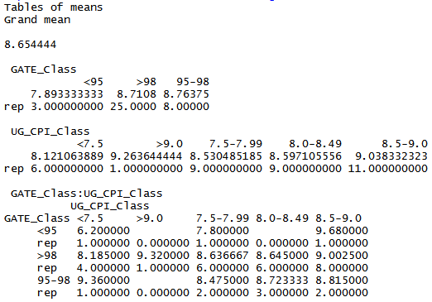
2-way ANOVA: GATE Percentile and UG CPI vs. PG CPI
Results & Interpretations:
Results show that UG CPI is a better determinant of student’s academic competence than that represented by the GATE percentile.
As it can be observed , amongst the students who have secured >98 percentile in GATE, those who have obtained higher UG CPI also have performed better in PG. Hence, they have maintained a consistency in their performance.
Those combinations of GATE percentile and UG CPI which have only one data have resulted in those horizontal lines and hence they are neglected in interpreting the results.

Slide 17
2-way ANOVA: Gender and UG stream vs. PG CPI
Motive of analysis:
To find if students from any specific gender perform better in PG based on their UG stream?
To find if students from any specific UG stream perform better in PG based on their gender?
Notes:
Motive of analysis:
The infrastructure, academic policies and competence of faculties differ among Government and Private universities, which might have an effect on the academic foundation of students and thereby on their academic performances on higher level of education.
• Apart of that there is a cynical perception in the society about the quality of education provided in the private colleges and the students passing out from there.
• To find if the nature of universities really matters in academic performance of students in higher level or is it the student’s own capabilities and merit which determine his/her performance?

Slide 18
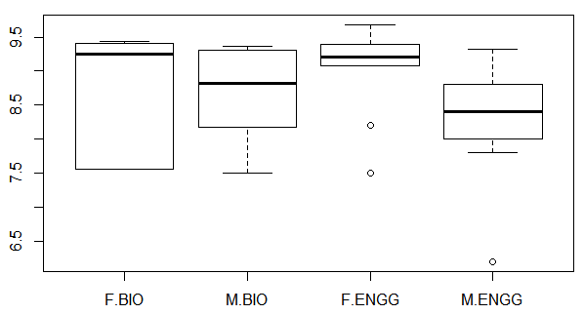
2-way ANOVA: Gender and UG stream vs. PG CPI

Slide 19

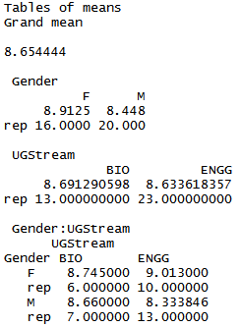
2-way ANOVA: Gender and UG stream vs. PG CPI
Results & Interpretations:
For female students, performance in PG is equally good irrespective of their stream in UG.
Male students from Biosciences stream perform better in PG as compared to other male students from core engineering background.
The median level of performance of female in PG is found to be always better than their male counterparts, irrespective of their stream in UG.

Slide 20
2-way ANOVA: Gender and Status of UG university vs. PG CPI
Motive of analysis:
To ascertain if there is any effect of the type of UG university of students on their performance in PG based on their gender.
More specifically, do the students from any particular gender better groom in any particular type of universities in their UG level.
Notes:
Motive of analysis:
The infrastructure, academic policies and competence of faculties differ among Government and Private universities, which might have an effect on the academic foundation of students and thereby on their academic performances on higher level of education.
• Apart of that there is a cynical perception in the society about the quality of education provided in the private colleges and the students passing out from there.
• To find if the nature of universities really matters in academic performance of students in higher level or is it the student’s own capabilities and merit which determine his/her performance?

Slide 21
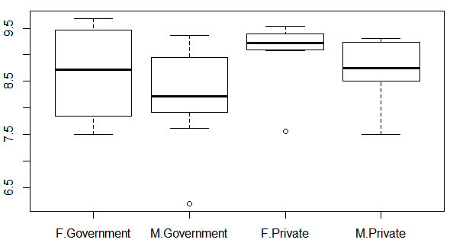
2-way ANOVA: Gender and Status of UG university vs. PG CPI

Slide 22

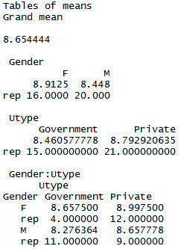
2-way ANOVA: Gender and Status of UG university vs. PG CPI
Results & Interpretations:
The median level of performance in PG is better for both the male and female students in private universities than respective male and female students in Government universities.
Although, male students from private universities have shown slightly higher level of performance in PG compared to the female students from Government universities.
The role of the type of UG university is more dominant than the effect of gender of students in their performance in PG.

Slide 23
2-way ANOVA: Gender and PG CPI vs. Satisfaction Level
Motive of analysis:
This test was performed to find how PG CPI level of a student, influence his/her satisfaction level based on their gender.
Notes:
Motive of analysis:
The infrastructure, academic policies and competence of faculties differ among Government and Private universities, which might have an effect on the academic foundation of students and thereby on their academic performances on higher level of education.
• Apart of that there is a cynical perception in the society about the quality of education provided in the private colleges and the students passing out from there.
• To find if the nature of universities really matters in academic performance of students in higher level or is it the student’s own capabilities and merit which determine his/her performance?

Slide 24
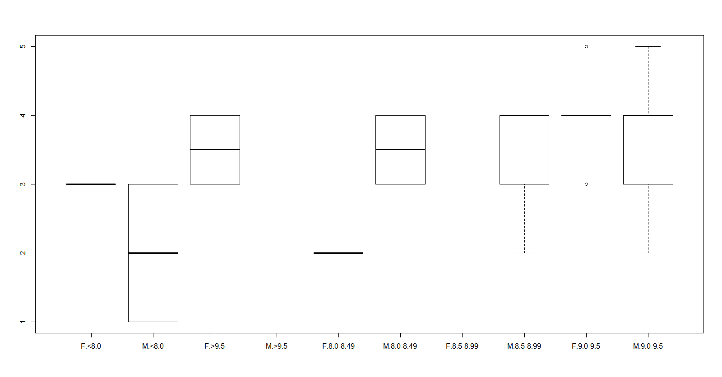
2-way ANOVA: Gender and PG CPI vs. Satisfaction Level

Slide 25

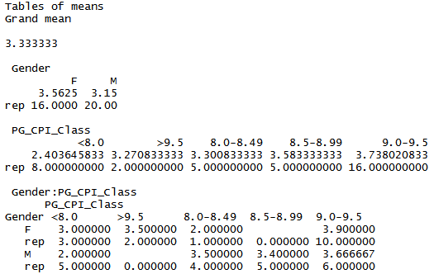
2-way ANOVA: Gender and PG CPI vs. Satisfaction Level
Results & Interpretations:
It’s been observed that for any given level of CPI in PG, the male students are more satisfied with their academic performance compared to their female counterparts.

Slide 26
Regression Analysis: UG CPI and PG CPI
Motive of analysis:
To test for dependency of PG CPI on UG CPI.
To predict or estimate the PG CPI of a student from his/her UG CPI by means of a mathematical relation.
Null Hypothesis: H₀: B = 0
Alternate Hypothesis: H_{a}: B != 0
B = slope of the line
Notes:
Motive of analysis:
The infrastructure, academic policies and competence of faculties differ among Government and Private universities, which might have an effect on the academic foundation of students and thereby on their academic performances on higher level of education.
• Apart of that there is a cynical perception in the society about the quality of education provided in the private colleges and the students passing out from there.
• To find if the nature of universities really matters in academic performance of students in higher level or is it the student’s own capabilities and merit which determine his/her performance?

Slide 27
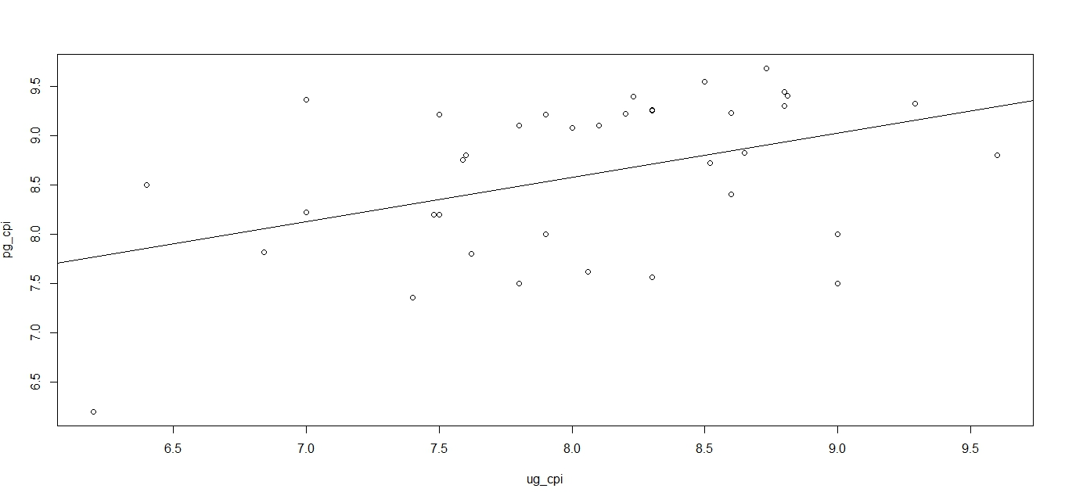
Regression Analysis: UG CPI and PG CPI
Results & Interpretations:
Hypothesis H₀ is rejected because the slope of the line is not equals to zero or parallel to the x-axis.
There is a dependency of PG CPI on UG CPI.

Slide 28
Regression Analysis: GATE Percentile and PG CPI
Motive of analysis:
To test for dependency of PG CPI on GATE Percentile.
To predict or estimate the PG CPI of a student from his/her Performance in GATE by means of a mathematical relation.
Null Hypothesis: H₀: B = 0
Alternate Hypothesis: H_{a}: B != 0
B = slope of the line
Notes:
Motive of analysis:
The infrastructure, academic policies and competence of faculties differ among Government and Private universities, which might have an effect on the academic foundation of students and thereby on their academic performances on higher level of education.
• Apart of that there is a cynical perception in the society about the quality of education provided in the private colleges and the students passing out from there.
• To find if the nature of universities really matters in academic performance of students in higher level or is it the student’s own capabilities and merit which determine his/her performance?

Slide 29
Regression Analysis: GATE Percentile and PG CPI
Results & Interpretations:
Hypothesis H₀ is rejected because the slope of the line is not equals to zero or parallel to the x-axis.
There is a dependency of PG CPI on GATE Percentile.

Slide 30
Conclusions
Academic performance in PG (i.e. PG CPI) is better for the students from Biosciences background compared to those from core engineering background.
Students from Private universities show satisfactory and better results, on average, in terms of their academic performance in Post-graduation level compared to their counterparts from Government universities.
Academic performances of Female students are better compared to that of the male students in PG.
There is not much deviation in the academic performance of the student who had secured at least 95 percentile in GATE and CPI of 8.0 in UG level.
Female students from private universities show better academic performances compared to other female students in Government universities as well as than that of male students from both type of universities.
Male students are more satisfied than the female students in terms of the academic performance at PG level.
There exist dependency and correlation between student’s academic performances in PG with that in UG as well as in GATE.

Slide 31
Limitations
Collected data limited to M.Tech BME only.
Offline data limited to Hostel 11 - Randomness might be challenged.
Verification of data – Not feasible.
NOT equal representation from both streams- BIO, ENGG
CPI at UG is not standardized as the GATE percentile is.
The volume of the collected data could not be abundant as this kind of survey was not encouraged by neither of the General Secretary Academic Affairs, PG nor the Dean, Academic Programs of IIT Bombay, since disseminating such kind of data is against the Institute policy; which limits the credibility of our study.

Slide 32
Contributions
The Project idea was thought by Praveen Kumar and Hitendra Sahu and developed under the guidance of Prof. S. Arunkumar.
The data were collected through an Online Survey as well as an offline questionnaire limited to IIT Bombay PG Students only. The online questionnaire was designed and developed by Pinaki Dey; and Durga Kumari took the responsibility of collecting data through offline survey.
The data analysis methods were conceived by the entire team in a team meeting.
The statistical analysis of data was performed on R software and the underlying codes were developed by Pinaki Dey, Praveen Kumar and Hitendra Sahu.
Interpretation of the results was done by Durga Kumari and Pinaki Dey.
Final report and presentation were developed by Durga Kumari and Pinaki Dey.

Slide 33
Thank You!

