Slide 1
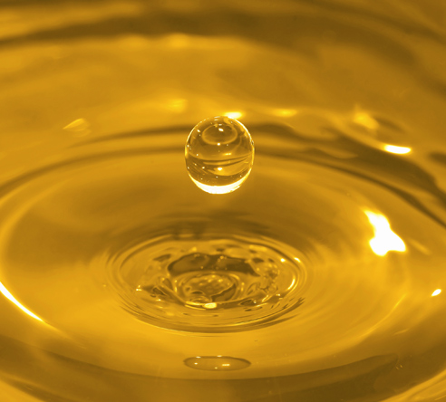
Production of biodiesel
by chemical and enzymatic transesterification
Presented by:
MRIGANKA PAUL
PINAKI CHANDRA DEY
RAJDEEP PAUL
Notes:
Hello & Welcome Everyone…
It’s good to see all of us on the same platform to share our knowledges & ideas… I appreciate…
As we all know, this is the era, we live in, is completely dependent on transportation…
And the most important thing on which this whole transportations are based on, is, in turn, Fuel… Among which diesel is the most important one!
But as our World prospers there seems to be an overwhelming concern over the depleting resources of crude oil…
Which gives us no other choice but to seek for alternative sources of renewable energy… Biodiesel is just one of them! But, having a greater prospect!
So… Ladies & Gentlemen, today, my friend Mriganka Paul, Rajdeep Paul & Me, Pinaki Dey, would like to make you aware of the facts of Production of Biodiesel…

Slide 2
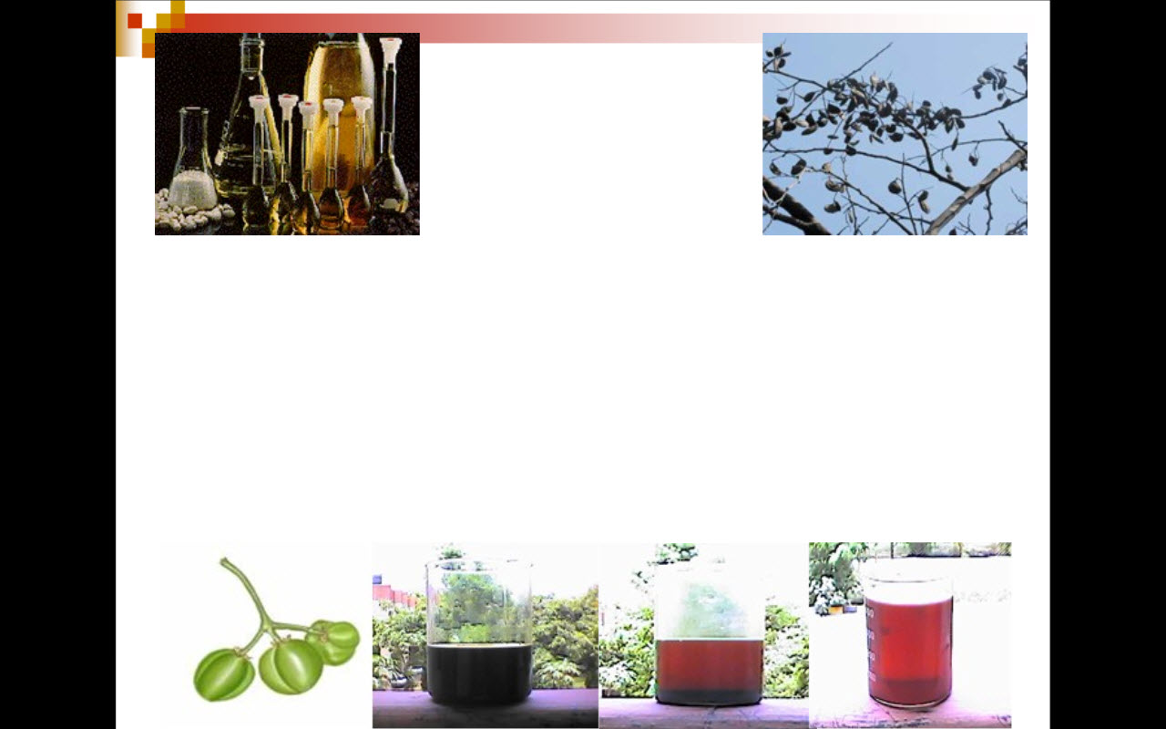
What is Biodiesel
Biodiesel, a fuel composed of mono-alkyl esters of long chain fatty acids or triglycerides, is derived from variety of vegetable oils or animal fats.
Alternative fuel for diesel engines.
Lower emissions, High flash point (>300 ˚F), Safer.
Biodegradable, Essentially non-toxic.
Notes:
So, what we must need to know is ‘What is Biodiesel’…
In a more lucid terms…

Slide 3

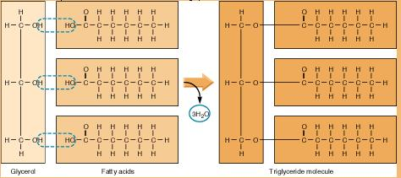
Chemistry of Triglycerides
Biodiesel is made from the combination of a triglyceride with a mono-hydroxy alcohol (i.e. methanol, ethanol…).
What is a triglyceride?
Made from a condensation of a glycerol and three fatty acids:
Notes:
Well…. A couple of new terms have just been introduced, one of them is ‘triglycerides’…
We should take a look at the structure of triglyceride, I just mentioned!

Slide 4
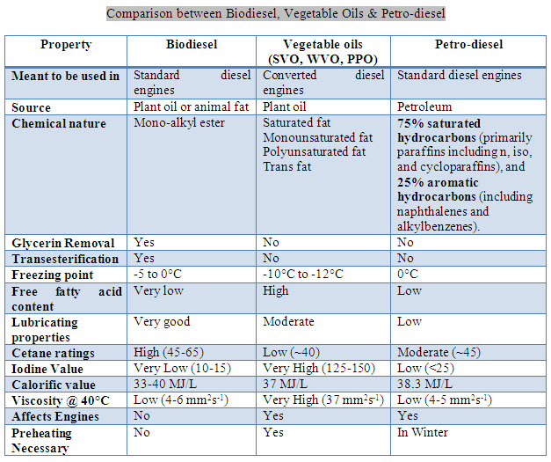
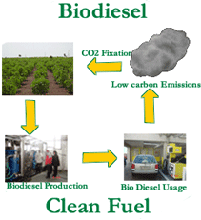
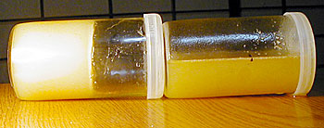
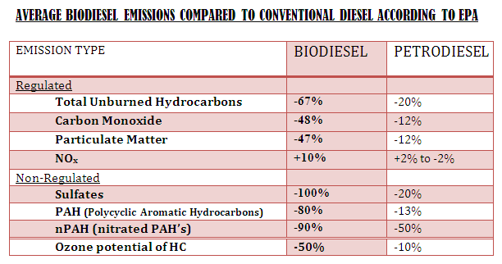
Why use Biodiesel ?
Biodiesel is a suitable alternative to diesel
Biodiesel provides significant lubricity improvement over petroleum diesel fuel
Compatibility of biodiesel with engine components
Biodiesel in cold weather
Reduction of pollution as compared with petroleum
Mitigation of “Global Warming”
Health perspective
Biodiesel is a suitable alternative to diesel
Biodiesel provides significant lubricity improvement over petroleum diesel fuel
Compatibility of biodiesel with engine components
Biodiesel in cold weather
Reduction of pollution as compared with petroleum
Mitigation of “Global Warming”
Health perspective
Notes:
But there must be some intricate reasons behind the use & future prospect of biodiesel… Let’s see those…
1. Biodiesel is a suitable alternative to diesel --- We all know that, but the term itself doesn’t count, what counts is the fact… And the facts are these…
Comparative studies have shown that biodiesel can proved to be beneficial over SVOs/WVOs and even petro-diesel, with its improved characteristics in many aspects, if not all…
2. They have a better lubricity…
3. Better compatibility…
4. Better stability in cold weather…
5. Reduced effects on pollution, a significant one…
6. Lesser contribution to Global Warming and
7. Solution of some very important health issues.
===============================================================================
Biodiesel offers similar power to diesel fuel :
One of the major advantages of biodiesel is the fact that it can be used in existing engines and fuel injection equipment with little impact to operating performance. Biodiesel has a higher cetane number than most fuel. In more than 50 million on-road miles and countless marine and off-road applications, biodiesel shows similar fuel consumption, horsepower, torque, and
haulage rates as conventional diesel fuel.
Biodiesel provides significant lubricity improvement over petroleum diesel fuel :
Biodiesel addition reduces fuel system wear, and in low levels in high pressure systems increases the life of the fuel injection equipment that relies on the fuel for its lubrication.
Lubricity results of biodiesel and petroleum diesel using industry test methods indicate that there is a marked improvement in lubricity when biodiesel is added to conventional diesel fuel. Even biodiesel levels as low as one percent can provide up to a 65 percent increase in lubricity in distillate fuels.
Compatibility of biodiesel with engine components :
The switch to low sulfur diesel fuel has caused most OEMs to switch to components suitable for use with biodiesel, but users should contact their OEM for specific information. In general, pure biodiesel will soften and degrade certain types of elastomers and natural rubber compounds overtime. Using high percent blends can impact fuel system components (primarily fuel hoses and fuel pump seals), that contain elastomer compounds incompatible with biodiesel. Manufacturers recommend that natural or butyl rubbers not be allowed to come in contact with pure biodiesel. Blends of B20 or lower have not exhibited elastomer degradation and need no changes. If a fuel system does contain these materials and users wish to fuel with blends over B20, replacement with compatible elastomers is recommended.
Biodiesel in cold weather :
Cold weather can cloud and even gel any diesel fuel, including biodiesel. Users of a 20 percent biodiesel blend with #2 diesel will usually experience an increase of the cold flow properties (cold filter plugging point, cloudpoint, pour point) approximately 2 to 10° Fahrenheit. Precautions employed for petroleum diesel are needed for fueling with 20 percent blends. Neat (100 percent) biodiesel will gel faster than petrodiesel in cold weather operations. Solutions for winter operability with neat biodiesel are much the same as that for low-sulfur #2 diesel (i.e., blending with #1 diesel, utilization of fuel heaters, and storage of the vehicle in or near a building). These same solutions work well with biodiesel blends, as do the use of cold flow improvement additives.
Reduction of Pollution as Compared with Petroleum:
The use of biodiesel in a conventional diesel engine results in a substantial reduction of unburned hydrocarbons, carbon monoxide, and particulate matter compared to emissions from diesel fuel.
In addition, the exhaust emissions of sulfur oxides and sulfates (major components of acid rain) from biodiesel are essentially eliminated compared to diesel.
Of the major exhaust pollutants, both unburned hydrocarbons and nitrogen oxides have reduced substantially. Emissions of nitrogen oxides are either slightly reduced or slightly increased depending on the duty cycle of the engine and testing methods used.
Mitigation of “Global Warming”:
Biodiesel is the best greenhouse gas mitigation strategy for today’s medium and heavy duty vehicles. A 1998 biodiesel lifecycle study, jointly sponsored by the U.S. Department of Energy and the U.S. Department of Agriculture, concluded biodiesel reduces net carbon dioxide emissions by 78 percent compared to petroleum diesel. This is due to biodiesel’s closed carbon cycle. The CO² released into the atmosphere when biodiesel is burned is recycled by growing plants, which are later processed into fuel.
Health Advantages :
Scientific research confirms that biodiesel exhaust has a less harmful impact on human health than petroleum diesel fuel. Pure biodiesel emissions have decreased levels of polycyclic aromatic hydrocarbons (PAH) and nitrited PAH compounds that have been identified as potential cancer causing compounds. Also, particulate matter, an emission linked to asthma and other diseases, is reduced by about 47 percent, and CO, a poisonous gas, is reduced by about 48 percent.
The ozone (smog) forming potential of biodiesel hydrocarbons is less than diesel fuel:
The ozone forming potential of the hydrocarbon emissions is 50 percent less than that measured for diesel fuel.
Sulfur emissions are essentially eliminated with pure biodiesel:
The exhaust emissions of sulfur oxides and sulfates (major components of acid rain) from biodiesel are essentially eliminated compared to diesel.
Criteria pollutants are reduced with biodiesel use:
Tests show the use of biodiesel in diesel engines results in substantial reductions of unburned hydrocarbons, carbon monoxide, and particulate matter. Emissions of nitrogen oxides stay the same or are slightly increased.
Carbon Monoxide –
The exhaust emissions of carbon monoxide (a poisonous gas) from biodiesel are on average 48 percent lower than CO emissions from diesel.
Particulate Matter –
Breathing particulate has been shown to be a human health hazard. The exhaust emissions of particulate matter from biodiesel are about 47 percent lower than overall particulate matter emissions from diesel.
Hydrocarbons –
The exhaust emissions of total hydrocarbons (a contributing factor in the localized formation of smog and ozone) are on average 67 percent lower for biodiesel than diesel fuel.
Nitrogen Oxides –
NOx emissions from biodiesel increase or decrease depending on the engine family and testing procedures. NOx emissions (a contributing factor in the localized formation of smog and ozone) from pure (100%) biodiesel increase on average by 10 percent. However, biodiesel’s lack of sulfur allows the use of NOx control technologies that cannot be used with conventional diesel. Additionally, some companies have successfully developed additives to reduce NOx emissions in biodiesel blends.
Biodiesel reduces the health risks associated with petroleum diesel:
Biodiesel emissions show decreased levels of polycyclic aromatic hydrocarbons (PAH) and nitrated polycyclic aromatic hydrocarbons nPAH), which have been identified as potential cancer causing compounds. In Health Effects testing, PAH compounds were reduced by
75 to 85 percent, with the exception of benzo(a)anthracene, which was reduced by roughly 50 percent. Targeted nPAH compounds were also reduced dramatically with biodiesel, with 2-nitrofluorene & 1-nitropyrene reduced by 90 percent, and the rest of the nPAH compounds reduced to only trace levels.

Slide 5
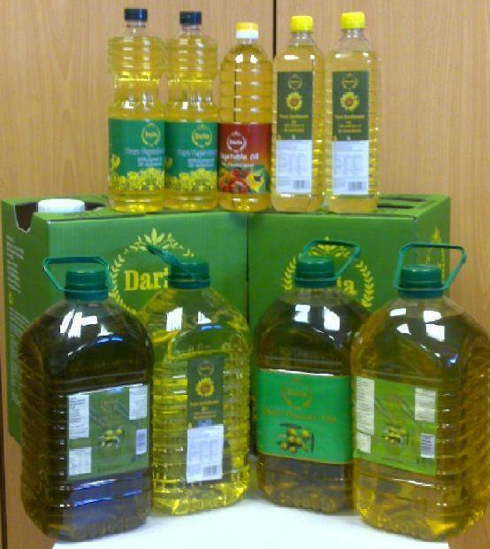
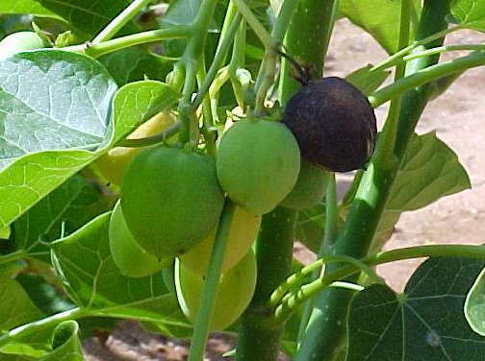
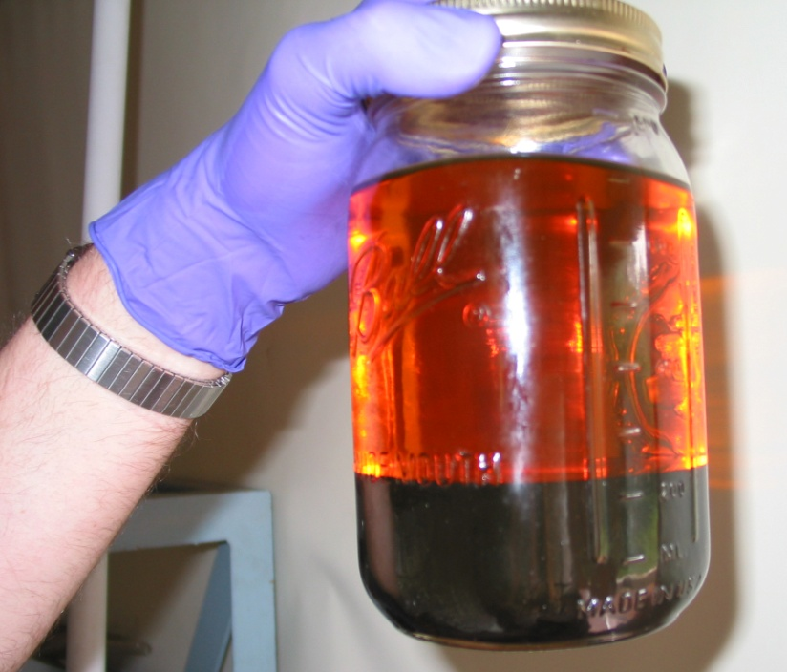
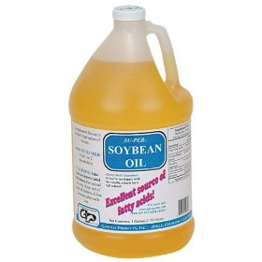
So, How Do We Make Biodiesel ?
Keep in Mind…
Production of Biodiesel
Production of biodiesel from Soybean oil, Rapeseed oil, Waste Vegetable Oil (WVO) and Jatropha curcas.
Production of biodiesel by Immobilized Microbial Lipase-catalyzed enzymatic transesterification and also by Base-catalyzed chemical transesterification.
Make it in an economical way
Keep the process simpler
Avoid high value sources
Food or Fuel ?
Quality matters !
Biology prevails !
Notes:
Now, I wonder, if some of us getting a bit impatient to see those intricate processes for the production of this precious liquid…
So for those and all of you Ladies & Gentlemen, I present my friend Rajdeep Paul to quench your curiosity…

Slide 6
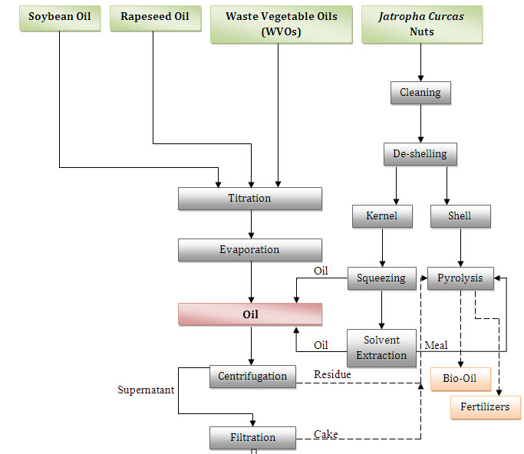
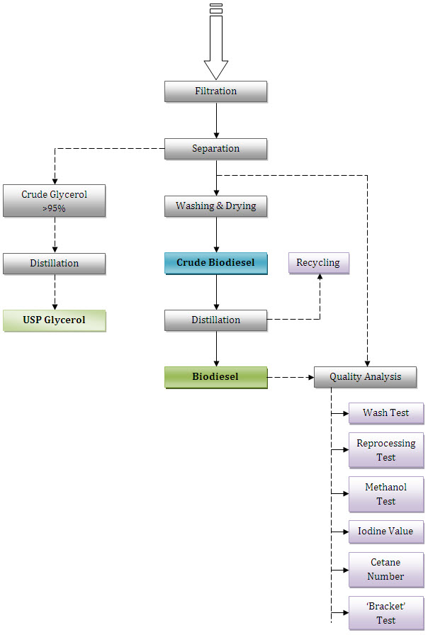
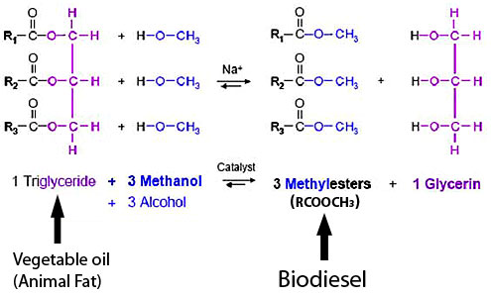
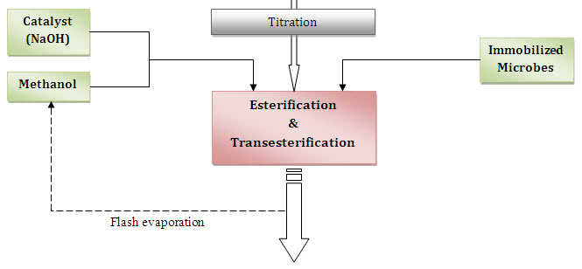
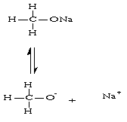
Procedure of Biodiesel Production
Notes:
Treatment of Jatropha curcas
The nuts are cleaned and de-shelling is done to remove the shell and the kernel
The kernel is squeezed and solvent extracted to get it ready for esterification.
On the other hand the shell part is pyrolyzed to give bio-oil and fertilizers.
Pyrolysis is a thermo-chemical decomposition of organic material at elevated temperatures in the absence of oxygen. Pyrolysis typically occurs under pressure and at operating temperatures above 430 °C (800 °F).
An "esterification" is the conversion of a non-ester into an ester. FFAs are non-esters. FFAs are converted into esters by acid esterification in the first stage of the two-stage acid-base biodiesel process, but cannot be converted by the more common single-stage base transesterification process. Here the FFAs must be removed from the process, or they will dissolve in the biodiesel being formed, yielding an acidic, poor-quality fuel that will not meet quality standards. In transesterification, extra lye is used to neutralize the FFA content of the oil, turning it into soaps. These soaps drop out of the process as a by-product, joining the so-called "glycerine layer" at the bottom -- often more of a "soap layer" as it may contain more soap than glycerine.
How the process works
First, vegetable or animal fats and oils are triglycerides (TGs), composed of three chains of fatty acids bound together by a glycerine molecule. Oil molecule -- graphic by Jeff Welter Triglycerides are esters. Esters are acids, such as fatty acids, combined with an alcohol, and glycerine (glycerol) is a heavy alcohol. The transesterification process converts triglyceride esters into mono-alkyl esters (biodiesel) by means of a catalyst (lye) and an alcohol reagent, usually methanol, which yields methyl esters biodiesel -- the methanol replaces the glycerine. In transesterification the triglyceride molecule is broken into three separate methyl ester molecules plus glycerine as a by-product. The lye catalyst breaks the bond holding the fatty acid chains to the glycerine, the glycerine falls away, and each fatty acid chain then bonds with a methanol molecule. It happens in three stages (this has nothing to do with the single-stage or two-stage processes). First, one fatty acid chain is broken off the triglyceride molecule and bonds with methanol to form a methyl ester molecule, leaving a diglyceride molecule (DG) -- two chains of fatty acids bound by glycerine. Then a second fatty acid chain is broken off the diglyceride molecule and bonded with methanol to form another methyl ester molecule, leaving a monoglyceride molecule (MG). Finally the monoglycerides are converted to methyl esters -- completion. However, the process can run out of reagent or catalyst before it gets as far as completion, or the agitation, temperature or processing time may not be adequate. The result is some unconverted or partly converted material remaining in the biodiesel. Well, so what if the process isn't completed? SVO (straight vegetable oil) is a good fuel anyway, so what's it matter if some of it is unreacted? But it's not just unreacted material that's the problem so much as the partly-reacted stuff. Diglycerides and monoglycerides are fuel pollutants: diglycerides don't combust well and lead to coking problems, monoglycerides can lead to corrosion and other problems -- bad fuel.
Post-transesterification steps
After esterification and transesterification the oil that we get is filtered and it is allowed to stand for a considerable amount of time for settling.
The glycerol that is separated due to settling is removed without disturbing the crude oil on top.
The crude oil is then distilled to get the original required oil.
This oil is then taken for quality test.
On the other hand the glycerol is than distilled to get its purest for USP Glycerol

Slide 7
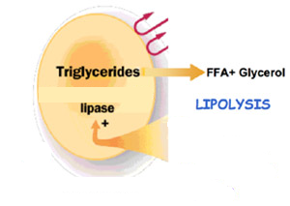
Microbes & their Immobilization
Microbial Transesterification
Microbial Lipase-mediated transesterification is an enzymatic process in which triglycerides are essentially converted into Fatty Acyl Methyl Ester (FAME) or Biodiesel.
Microorganisms that will be tested for there performance in
enzymatic transesterification as whole cell biocatalyst:
Candida antarctica immobilized with Hydrotalcite or Zeolite
Arthrobacter sp. immobilized with Celite
Pseudomonus fluorescens immobilized with Kaolinite

Slide 8

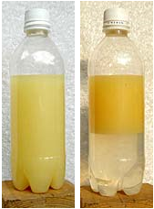
Quality Analysis
Reprocessing Test
Iodine Value
Cetane Number
Methanol Test
Wash Test
This is the most useful all-round test to check the quality of biodiesel.
Failing this test signifies presence of contaminants in the biodiesel.
It also checks for improper use of excess catalyst & incomplete reactions.
It checks for the presence of emulsions.
This method does not cover every aspect of quality, but it gives a hint.
It is valid only for biodiesel made from vegetable and animal oils.
It checks for the presence of pollution in biodiesel.
It shows the unconverted oil left in the biodiesel.
This is applicable only to the failed batches in biodiesel production.
The batches are reprocessed with same amount of lye but lesser methanol.
Resist formation of emulsion.
It signifies the level of unsaturation in oil.
It demonstrates the polymerization potential of biodiesel.
It’s a major determinant of the quality of biodiesel.
Cetane numbers rate the ignition properties of biodiesel & diesel fuels.
It's a measure of a fuel's willingness to ignite when it's compressed.
The higher the cetane number, the more efficient the fuel.
Biodiesel has a higher cetane number than petrodiesel because of its oxygen content.

Slide 9
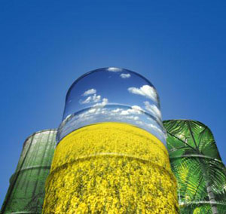
IMPACT OF BIODIESEL
Technological Readiness | Can be used in existing diesel engines, which have already been in use for 100 years
Fuel Distribution System | Can be distributed with existing filling stations with no changes.
Fossil Energy Balance [higher is better] | 3.2 units (soy) 4.3 units (rapeseed)
Large scale fuel development cost analysis | For an estimated $169 billion, enough algae farms could be built to completely replace petroleum transportation fuels with biodiesel
Safety | Flash point over 300°F (considered “not flammable”)
Time scale for wide scale use | 5-15 years
Cost of engines | Comparable to existing vehicles
Tank capacity required for 1,000 mile range in conventional sedan | 20 gallons
Economies of worldwide petroleum industry, impacts on US (trade deficits, military obligations, etc.)
Co-product economies (co-products of feed-stocks (i.e. soy meal) and processing (glycerin).
Economic incentives for greater fuel efficiency and alternative fuel use.

Slide 10
COST EFFECTIVENESS
Fuel Type | Avg. cost per mile (in cents) | Millage per gallon (in city) | Millage per gallon (on highway)
B100 | 8.2 | 37 | 45
B20 | 6.0 | 37 | 45
Petrodiesel | 5.2 | 38 | 46
Unleaded gasoline | 6.9 | 25 | 31
The mileage one gets from using biodiesel as compared with regular, unleaded gasoline more than makes up for the slightly higher biodiesel cost, especially when you consider that biodiesel prices should only go down over time, whereas the cost of crude oil, and therefore the price of gas at the pump, is only expected to rise or, at best, settle off somewhere around current prices.

Slide 11
CONCLUSIONS
Reduction in the overall production cost of biodiesel.
Scope for biodiesel production from different sources using different transesterification processes.
Find the most suitable strategy for biodiesel production in future, keeping the Indian economical and agricultural aspects in purview.

Slide 12

Acknowledgements
References
"Waste Vegetable Oil as a Diesel Replacement Fuel" by Phillip Calais, Environmental Science, Murdoch University, Perth, Australia, and A.R. (Tony) Clark, Western Australian Renewable Fuels Association Inc.
Sims, R. Yields, Costs and Availability of Natural Oils/Fats as Diesel Fuel Substitutes, Report No LF2021 for the Liquid Fuels Trust Board, Wellington (NZ) 1982
Environment Australia (National Heritage Trust) (2000b). Setting National Fuel Quality Standards – Paper 2 - Proposed Standards for Fuel Parameters (Petrol and Diesel), Canberra.
Beer, T., Grant, T., Brown, R., Edwards, J., Nelson, P., Watson, H., Williams, D. (2000) Life-Cycle Emission Analysis of Alternative Fuels for Heavy Vehicles. CSIRO, Australia.
Microbial lipases: Potential biocatalysts for the future industry R. K. Saxena, P. K. Ghosh, Rani Gupta, W. Sheba Davidson, Sapna Bradoo and Ruchi Gulati.
Conversion of Vegetable Oil to Biodiesel Using Immobilized Candida antarctica Lipase Yuji Shimadaa, Yomi Watanabea, Taichi Samukawab, Akio Sugiharaa, Hideo Nodac, Hideki Fukudab, and Yoshio Tominagaa.
Lipase-Catalyzed Production of Biodiesel- Lloyd A. Nelson, Thomas A. Foglia, and William N. Marmer.
Dr. Banani Ray Chowdhury, Faculty, Dept. of Biotech, BIT
Dr. Nityananda Roy, HoD, Dept. of Biotech, BIT

