Slide 1
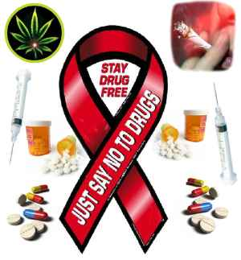
Drug Addiction
The Effects of Drugs on Human…
Treatments & Rehabilitation…
…A Comprehensive Preview

Slide 2
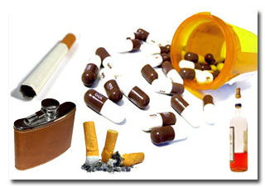
Drug
In pharmacology, a drug is "a chemical substance used in the treatment, cure, prevention, or diagnosis of disease or used to otherwise enhance physical or mental well-being.”
Recreational drugs are chemical substances that affect the central nervous system, such as opioids or hallucinogens. They may be used for perceived beneficial effects on perception, consciousness, personality, and behavior.

Slide 3
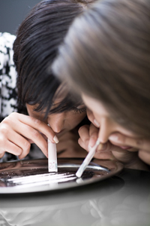
Addiction
Compulsion to seek and take a drug.
Chronologically relapsing disorder.
Loss of control on intake.
Different from ‘recreational’ drug use
Notes:
Substance dependence or addiction is a chronologically relapsing disorder that is characterised by a compulsion to seek and take a drug (loss of control in limiting intake), and an impairment in social and occupational function.
Impulse control disorders are characterized by an increasing sense of tension or arousal before committing an impulsive
act, pleasure, gratification or relief at the time of committing the act, and possibly regret, self-reproach or guilt following
the act [8]. In contrast, compulsive disorders are characterized by anxiety and stress before committing a compulsive
repetitive behavior, and relief from the stress by performing the compulsive behavior. As an individual moves from an
impulsive disorder to a compulsive disorder there is a shift from positive reinforcement driving the motivated behavior
to negative reinforcement driving the motivated behavior.

Slide 4
Drug Addiction
The 1957 World Health Organization (WHO) Expert Committee on Addiction-Producing Drugs defined addiction as components of drug abuse:
Drug addiction is a state of periodic or chronic intoxication produced by the repeated consumption of a drug (natural or synthetic).
Its characteristics include:
an overpowering desire or need (compulsion) to continue taking the drug and to obtain it by any means;
a tendency to increase the dose;
a psychic (psychological) and generally a physical dependence on the effects of the drug; and
detrimental effects on the individual and on society.

Slide 5
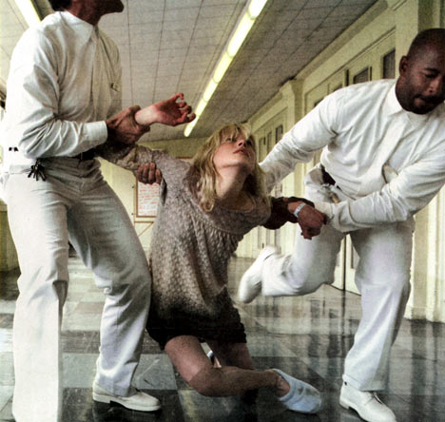
Stages of addiction
Acute drug effects- dopamine levels are spiked to very high levels.
Transition to addiction-
glutamatergic projections from the
prefrontal cortex to the accumbens is
mainly responsible for drug seeking
behaviour.
3. End stage addiction-
characterised by overwhelming urge to
obtain the drug, a diminished ability to
control drug seeking and reduced
pleasure from biological rewards.

Slide 6
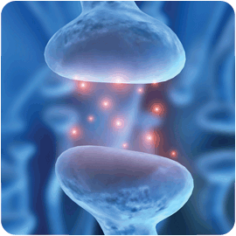
Neurotransmitters
chemicals used to relay, amplify and modulate signals between neurons.
- Characteristics of a neurotransmitter
1. Made in presynaptic neuron
2. Present and available in presynaptic neuron
3. Postsynaptic receptors should be able to bind to it.
4. A biochemical mechanism for inactivation exists.
Notes:
We have previously said that emotion is all chemicals. Emotions are caused by signals and messages related between different parts of the brain by different chemicals. These chemicals are called neurotransmitters.

Slide 7
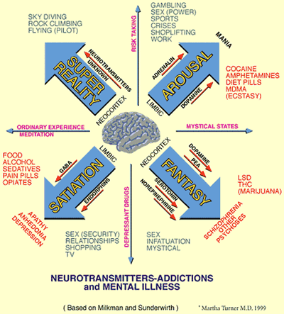
Types and Effects of Neurotransmitters
Some examples of neurotransmitter action:
Acetylcholine - voluntary movement of the muscles
Norepinephrine - wakefulness or arousal
Dopamine - voluntary movement and motivation, "wanting", pleasure, associated with addiction and love
Serotonin - memory, emotions, wakefulness, sleep and temperature regulation
GABA (gamma aminobutyric acid) - inhibition of motor neurons
It is important to appreciate that it is the receptor
that dictates the neurotransmitter's effect.
Notes:
Remember to point out that there’s a common chemical structure. briefly mention that drugs are addictive because they bind more strongly to neurotransmitter receptors than the neurotransmitters themselves. hint that this might be due to a chemical structural similarity.

Slide 8
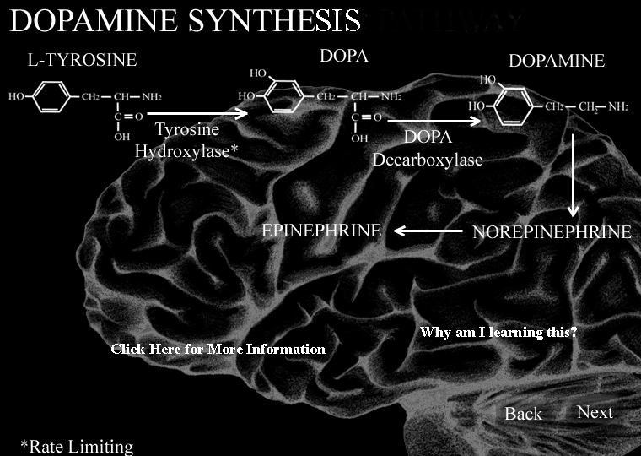
Major systems
The major neurotransmitter systems are:
Noradrenaline
system
2. Dopamine system
3. Serotonin system
4. Cholinergic system.
Notes:
Remember to point out that there’s a common chemical structure. briefly mention that drugs are addictive because they bind more strongly to neurotransmitter receptors than the neurotransmitters themselves. hint that this might be due to a chemical structural similarity.

Slide 9
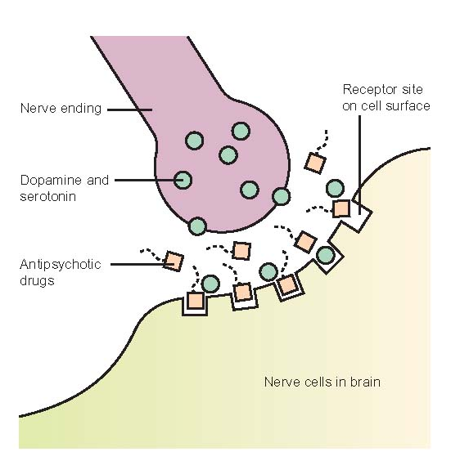
Effect of drugs
Drugs targeting the neurotransmitter affects the whole system:
1. Cocaine blocks dopamine + dopamine receptor binding, leaving dopamine in the synaptic gap longer. ¹
2. Prozac blocks serotonin + serotonin receptor binding, boosting effect of naturally produced serotonin. ¹
1. Neurotransmitters, The Wikipedia

Slide 10

Dopamine
- Is a neurotransmitter.
Associated with the reward system of the brain
- Dopamine pathways are pathologically altered in addicted persons. ¹
1. Neurotransmitters, The Wikipedia
Notes:
Dopamine has the chemical formula C6H3(OH)2-CH2-CH2-NH2. Its chemical name is "4-(2-aminoethyl)benzene-1,2-diol" , providing feelings of enjoyment and reinforcement to motivate a person proactively to perform certain activities by naturally rewarding experiences such as food, sex, some drugs, and neutral stimuli that become associated with them. This theory is often discussed in terms of drugs such as cocaine, nicotine,and amphetamines, which seem to directly or indirectly lead to the increase of dopamine in these areas, and in relation to neurobiological theories of chemical addiction, arguing that these dopamine pathways are pathologically altered in addicted persons.

Slide 11
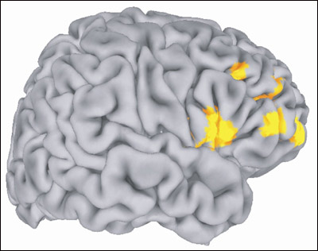
…but not just chemicals!
Neurotransmitters + Neuronal Circuits = Brain Function.
Synapse: a functional connection of two neurons. Electrical/chemical.
Brain: 100 x 10⁹ neurons x 1000 synapses/neuron
= 100 x 10¹² connections in the brain!²
2. The Brain, a very short Introduction. Oxford University Press
Notes:
The functioning of the brain isn’t only dependent on the molecules. Brain function, especially specific behavior and memory, is better studied at a different level of organization: at that of neuronal circuits in the brain.

Slide 12
Electrical Brain Stimulation!
…but not just chemicals!
Olds and Milner (1954) first identified brain sites where direct electrical stimulation is reinforcing.
The potency of this electrical stimulation is most dramatically illustrated in a classic experiment where the subjects suffered self-imposed starvation when forced to make a choice between obtaining food and water or electrical brain stimulation.

Slide 13
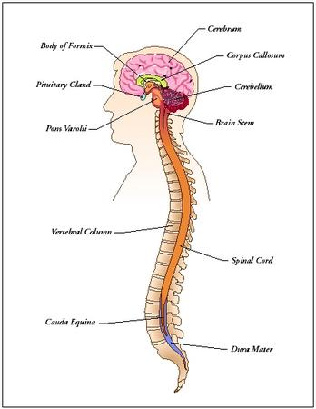
Complex systems
The Brain is possibly the most complex system known
Complexity at several levels: Molecular (neurotransmitter structures and functions)
Cellular: Neuron- neuron interactions. Synaptic complexity.
Tissue level: local area organization and functional complexity.
Organ level: Nervous integration and system-wide synchronization
And beyond? Organism-level complexity? Populations?
Notes:
-- the structure, function and interdependence of parts of a complex system is often most easily understood by studying anomalies of that complex system. Thus, traffic flow can be understood by studying traffic jams. The mechanism of the organelle trafficking in cells can be understood by studying mutants where parts of this mechanism are selectively destroyed, as in this C elegans worm.
The Brain is the most complex system we know of now. Thus, one of the best ways of studying brain function (and so has been the case, historically), is to study exceptions—and this would mean behavioral oddities—like addiction.

Slide 14
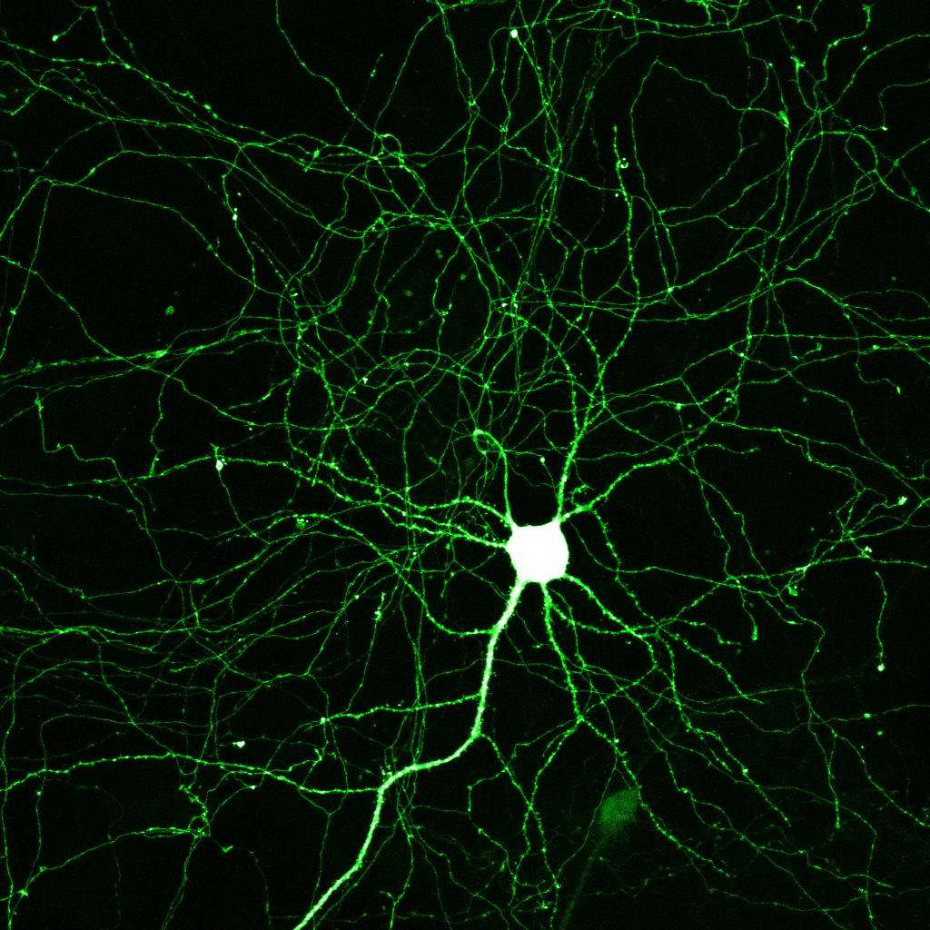
A complex part of a complex Brain: Motivated Behavior
What is Motivated Behavior?
What neural circuits cause Motivated Behavior?
- Look for neural components that attaches importance to different stimuli, i.e. that determine the ‘salience’ of the stimuli, so that the behavior is turned ‘ON’.
- These components must ‘chain-load’ a specific behavioral response when ‘ON’.
Notes:
Let us now look at a small part of this complex system: more specifically, the circuitry controlling goal directed behavior. Let’s define motivated or goal-directed behavior as a sequence of routines activated by the environment, that leads to a directed behavioral output. Our next task is identifying neural circuits or components of the brain responsible for motivated behavior. We do this by two ways: first, we look for parts of the brain that we know are responsible for determining the importance or “salience” of the signals it processes. We then look for neural circuits that initiate the appropriate specific behavioral response. While we do understand how the first mechanism occurs, we still don’t understand how a SPECIFIC behavior is called by the circuits.

Slide 15
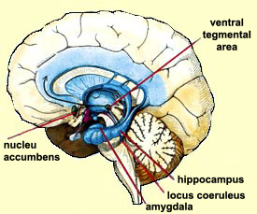
The Activation of Motivated Behavior
Three regions of the brain we
could guess would contribute:
Amygdala : fear.
2. Prefrontal Cortex (PFC) : “measures” intensity of emotion.
3. Nucleus Accumbens : linked to reward motivated behavior.

Slide 16
The actual circuit
³
Ventral Tegmental Area (VTA)
Dopamine released in
response to motivationally
relevant event “X”
Initiate ada
-ptive behavioral
response
Initiate cellular
changes to establish
learned associations
3. The Neural Basis of Addiction:
A Pathology of Motivation and Choice
Peter W. Kalivas,Nora D. Volkow
Notes:
Thus, should the event re occur, the efficiency of eliciting adaptive behavior should increase.

Slide 17

What happens in the VTA in normal motivated behavior?
³
As the causal event ‘X’ becomes
familiar, dopamine release is no
longer induced.
BUT: Behavior elicited is still
goal directed
BUT, since it is well learned,
DOPAMINE INDUCED NEUROPLASTIC CHANGES ARE NOT NECESSARY.
3. The Neural Basis of Addiction: A Pathology of Motivation and Choice
Peter W. Kalivas,Nora D. Volkow

Slide 18
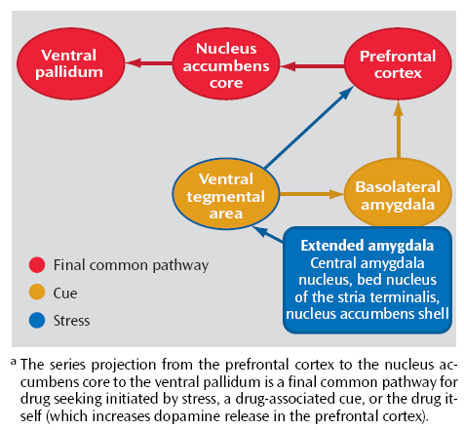
Addiction:
Addiction: a dis-regulation of the motive circuit.
This pathway is associated with repeated drug use
Notes:
-- addiction is one such disruption to study the ultimate complex system, the brain.

Slide 19
certain common pathways emerge from the disrupted circuit
Inactivate PFC
Block AMPA glutamate receptors on nucleus accumbens
Prevent global glutamate release
Reinstatement of drug seeking inactivated
Drug and cue reinstatement inactivated Drug seeking prevented
Glutamatergic projections from PFC to Nucleus accumbens are a final common pathway
Notes:
srinivas

Slide 20
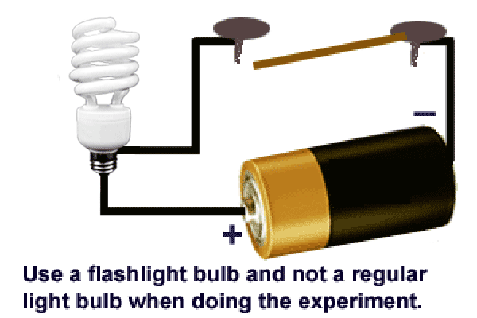
Other parts of circuit are shut down!
- activation of anterior cingulate, OFC in addicts inhibited
- during decisions
- in response to biologically relevant rewards

Slide 21
Other parts of circuit are shut down!

Slide 22
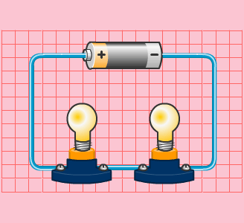
Three features of the modified circuit
The common glutamatergic pathway
2. Modality dependant sub circuits
3. All three modalities require dopamine transmission

Slide 23
1. The common Glutamatergic. pathway

Slide 24

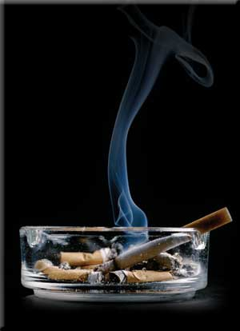
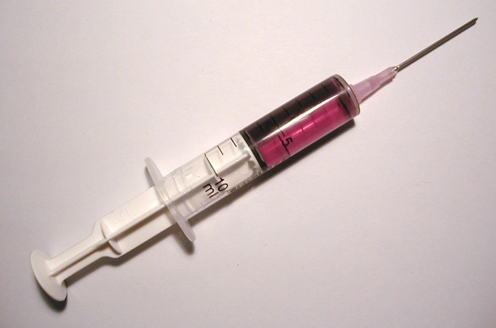
2. Modality Dependant sub-circuits
Each modality (drug/stress/cue) has its own mechanism of action, and is initiated in a different neuronal sub-circuit.
Multiple pathways to reinstatement?

Slide 25
3. All three modalities require dopamine transmission
Drug seeking initiated by inactivating VTA
Reward of acute drug use may be associated with a ‘high’
Drug seeking reinstatement
Mesocorticolimbic dopamine projection ESSENTIAL for reinstatement
Increased dopamine release in nucleus accumbens
Dopamine release in PFC, amygdala, but NOT in nucleus accumbens

Slide 26
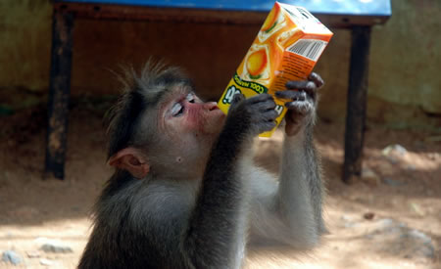
Role of Dopaminergic Pathway in Addiction
Dopaminergic Pathway is now recognised as critical in anticipation and withdrawal as well. ⁴
Phasic burst
of neuron activity
Cue
Food
+
Pause in normal
(basal) neuron firing
No Food
Cue
+
Addiction: A Disease of Learning and Memory: Steven E. Hyman, M.D. (Am J Psychiatry 2005; 162:1414–1422)
Notes:
The role of dopamine in addiction is now
recognised as critical in anticipation and
withdrawal as well. In an elegant series of
experiments, Schultz (2001) found that in
primates trained to associate a cue with a
pleasurable experience (food), increased
dopaminergic activity was seen in response
to the cue and not to the food. If the food
was not then presented, dopaminergic
function dropped. Reduced dopaminergic
function is thought to be associated with
negative affect (e.g. dysphoria). Thus, an
individual with an addiction may see a
‘cue’ (e.g. a public house, mirror or needle)
and if their drug of choice is not available
may feel dysphoric, which is likely to increase
the drive to obtain the drug.

Slide 27
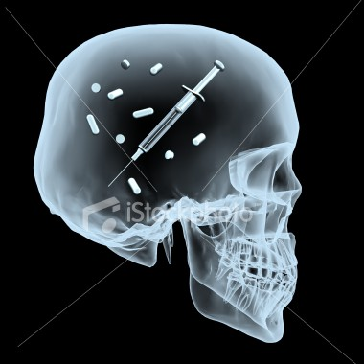
Fighting addiction⁵
Three methods:
1. substitution or a blocking antibody
2. the antagonistic approach
3. pain instead of pleasure
5. Infecting the brain to stop addiction?. David Nutt and Anne Lingford-Hughes. PNAS
Notes:
Drug addiction was once viewed exclusively as a moral problem or character defect. Today we understand it to be a chronic, recurring illness with personal and social underpinnings. Drug addiction produces changes in brain chemistry, but treatment can help restore chemical balance and give patients a chance to regain control of their lives.
Drug abuse is a major public health problem, and, although there are many treatments of proven efficacy, the majority of patients are not permanently cured, with relapse rates on the order of 70% or more in the first years for the treatment of almost all drugs of addiction.
The concept that blocking the actions of a drug of addiction will lead to reduced use and dependence is well established for opiates, where the antagonist naltrexone has a long track record
An antagonist approach to cocaine has been considered by means of drugs that block its access to the dopamine uptake site (6) and block the actions of the dopamine that is released by cocaine to stimulate receptors, e.g., ecopipam

Slide 28
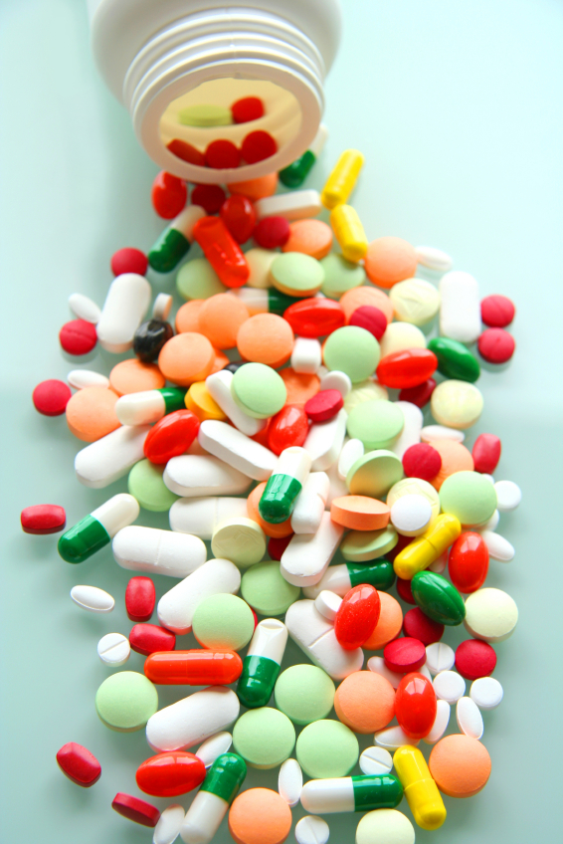
Pharmacotherapy⁶
Blocking vs. Antagonist
Blocking Antibody is “dormant” except when drug is taken
Stops drug effects “at source”, which is easier than stopping drug effects later on
Blocking antibody does not affect normal neurotransmitter functions
4. Antagonists of the various neurotransmitters would lead to unwanted actions on the many aspects of brain function, for instance, in the case of dopamine, mood, attention, and movement.
6 Neurobiology of addiction and implications for treatment
ANNE LINGFORD-HUGHES and DAVID NUTT, BRITISH JOURNAL OF P SYCHIATRY
Notes:
Because of the pre-eminence of the dopaminergic reward system in addiction, this has been a target for pharmacotherapy, but with mixed results. One strategy, for instance, has been to block the binding of cocaine to the dopamine transporter site (Nutt, 1993). In cocaine addiction, the development of dopaminergic partial agonists at the D3 receptor currently holds some promise.
Refer back to fact that we mentioned chemical similarity of addictive drug. Indole ring hypothesis. Now discredited.

Slide 29
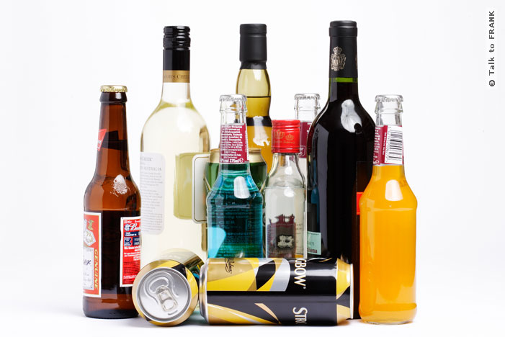
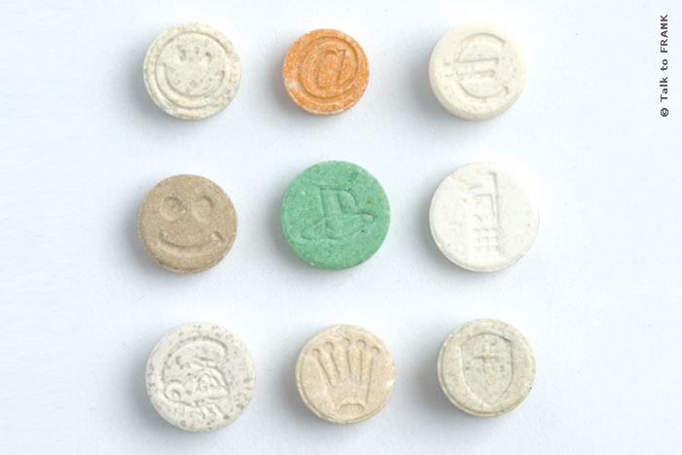
Some common prescription drugs to deal with Substance Abuse
Alcohol -Acamprosate, a taurine derivative
Opiates -methadone and buprenorphine
Ecstasy - fluoxetine (in animals)
Benzodiazepine - Gamma-hydroxybutyrate
(GHB)
Notes:
How
acamprosate achieves its therapeutic effect
has not yet been fully characterised; it
antagonises the NMDA receptor (possibly
through the polyamine site). Acamprosate
also reduces glutamate levels and may be
neuroprotective
Methadone (like
heroin) is a full agonist at the mu receptor,
whereas buprenorphine is a mu partial
agonist. Partial agonists give lower levels
of response at maximal receptor occupancy.
neuroprotective,
apparently by blocking ecstasy uptake into
5-HT neurons
increasing
the action of GABA, and so result in greater
inhibitory activity in the brain

Slide 30


To sum up…
Addiction cannot be fought by willpower.
Reward not equal to pleasure.
Relapse is due to distributed modalities
Cure doesn’t change the circuit

