Slide 1
Design and Fabrication of PZT Micropump-Integrated Silicon Microneedle Array for Transdermal Drug-Delivery
By:
Dr. Anupam Bam (113300011)
Pinaki Dey (113300003)

Slide 2
Contents
Introduction
Transdermal Drug Delivery vs. Conventional Drug Delivery
MEMS-based Microneedle
Desired Properties of Microneedles and Micropump
Design and Working Principle
Microneedles
Micropump
Integrated System Design
Fabrication
Microneedle array
Characterization
Mechanical properties
Flow Analysis
CFD Analysis at Different Inlet Pressures
Results & Analysis
Conclusions
References

Slide 3
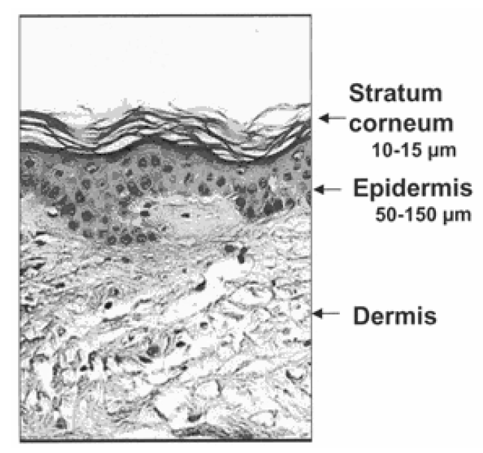
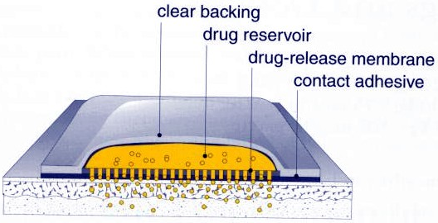
Introduction
Transdermal Drug Delivery vs. Conventional Drug Delivery
Conventional Drug Delivery Methods:
Oral route
Parenteral
IV/IM/SC
Disadvantages:
Gastrointestinal degradation
Lower Bioavailability
GI upset
Pain
Allergic reactions
Need of expertise
Transdermal Drug Delivery Methods:
Transdermal Patches
Microneedles
Advantages:
Painless
Improved Bioavailability
Controlled & automated drug delivery
Negligible side effects
Source: Ma et al, 2006, IEEE
http://www.fda.gov

Slide 4
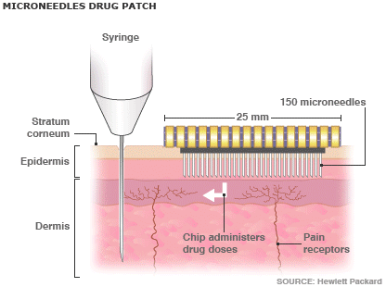
Introduction (Contd.)
MEMS-based Microneedle
Delivery of both Hydrophilic and Lipophilic drugs
Fluid sampling
Integration of Actuator
Precise and Sustained Drug delivery
Painless
Minimally invasive
Less tissue damage
Source: Ma et al, 2006, IEEE

Slide 5
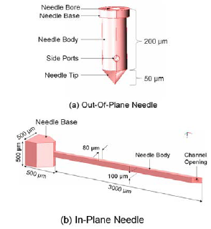
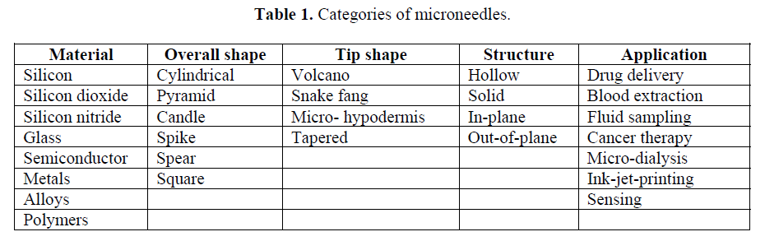
Desired Properties of Microneedles and Micropump
Microneedle
Should withstand skin resistive forces [bending & buckling] (~3.18 MPa).
Needle tip opening should not get clogged while skin penetration.
Out-of-Plane structure for higher needle density.
Suitable needle length (~100 µm for drug delivery and more than 200 µm for fluid sampling) .
Inner diameter ~30-40 µm.
Tip radius should be small (400-500 nm) to provide high insertion force.
Needle wall thickness should be optimum (~30 µm) to provide high fracture force.
Source: Podder et al, 2011
Source: Ashraf et al, 2010
Tapered Tip, Hollow, Cylindrical, Out-of-Plane, Si Microneedle with Side Openings.

Slide 6
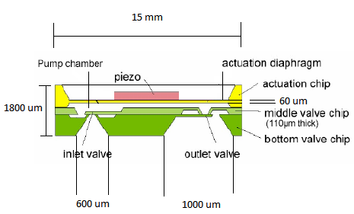
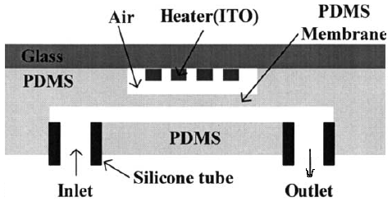
Desired Properties of Microneedles and Micropump (Contd.)
Micropump
Use of bidirectional Piezoelectric displacement-reciprocating micropump.
Active material: Lead-Zirconate-Titanate (PZT-A).
Powered discharge stroke.
Large Actuation force.
Good resonant frequency (~7 kHz) (Fang et al)
Short response time.
Better sensitivity.
Low power requirement (5±0.5 V).
Better control over actuation.
Limitations:
Wear and fatigue of the valves
Valveless micropump would be
a good alternative but would have
less precision and more dead volume.
Source: Richter et al, 2008
Source: Kim et al, 2005

Slide 7
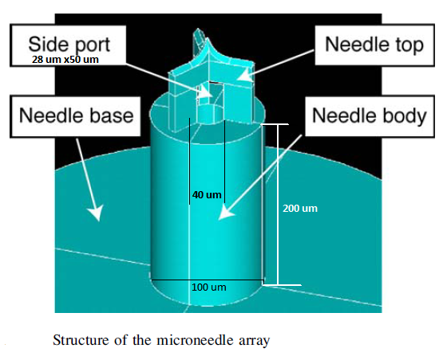
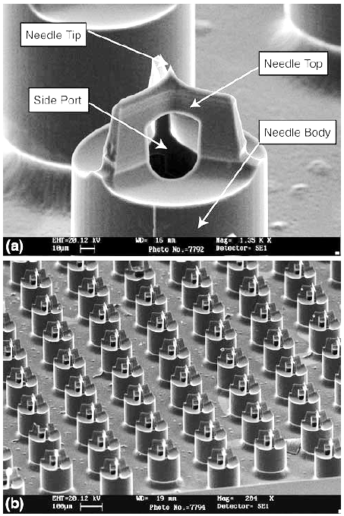
Design and Working Principle
Microneedle
Source: Zhang et al, 2009
Outer Diameter: 100 µm
Inner diameter: 40 µm
Length: 200 µm
Area of side openings: 28x50 µm²
Tip diameter: 450 nm (with knife-like edges)
Structure: Out-of-Plane
Shape of Needle body: Cylindrical (minimize leakage, resist bending and buckling)
Material: Si (monocrystalline) (better mechanical/ electrical properties, integration)
Source: Zhang et al, 2009
a) SEM image of single microneedle
b) SEM image of Needle array; 3x3 mm², containing 110 needles in a 10x11 configuration

Slide 8
Design and Working Principle (Contd.)
Micropump
Volumetric micropump with reciprocating motion.
Voltage change across piezoelectric material causes deformation of membrane.
Inlet valve opens under expansion of pumping chamber.
Outlet valve opens under compression of pumping chamber.
PZT thickness: 180 µm.
Bonded to the membrane with conductive silver epoxy.
Minimal dead volume.
Cone shape--- reduced pipe resistance coefficient.
Source: Richter et al, 2008
Lower 2 wafers bonded via silicon fusion bonding.
Ideally no back pressure.
Avg. Flow rate= 1600 µl/min
Avg. Stroke volume= 260nl
Over pressure at the inlet opens the passive check valve resulting in undesirable free flow.
Ensure ‘free flow stop’ using active valve, prestressing the passive valve or using safety valve.

Slide 9
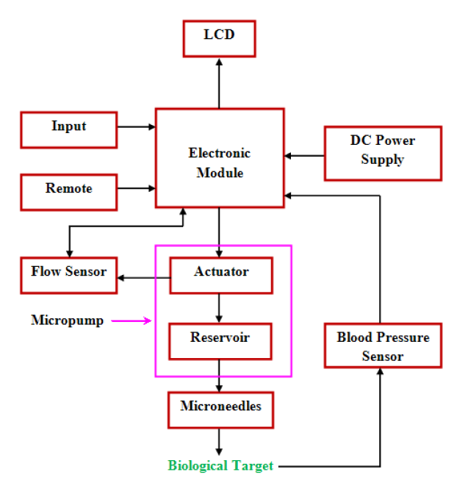
Design and Working Principle (Contd.)
Integrated System Design

Slide 10
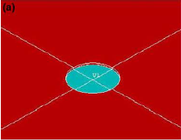
Fabrication
Microneedle array
Surface Preparation
Monocrystalline Si (100) wafer
RCA cleaning, Dehydration
Thermal Growth I
Deposition of SiO₂ layer
Patterning I
6 inch diameter, 500 µm thickness
Dark-field mask
Photolithography
Develop & Etch
Spin coating of PMMA

Slide 11
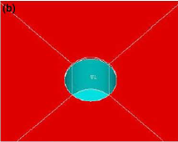
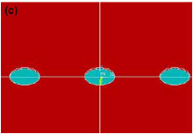
Fabrication (Contd.)
Microneedle array
Anisotropic Etching I
RIE
LPCVD
Deposition of SiO₂ thin-film on the back side of wafer
Patterning II
Dark-field mask
Photolithography
Develop & Etch
Spin coating of PMMA
On Front side
These holes will be etch stop marker for the next etch

Slide 12
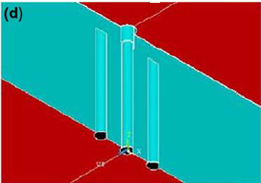
Fabrication (Contd.)
Microneedle array
Anisotropic Etching II
DRIE (2-3 µm/min), higher selectivity
Wet Etching I
On Back side; till marker level is reached
Formation of Micro-channels
HF (fast), BOE (slow)
Removal of SiO₂

Slide 13
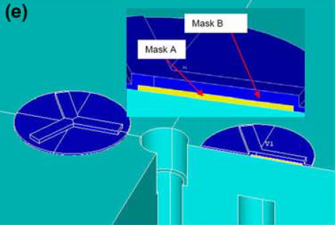
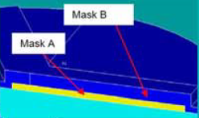
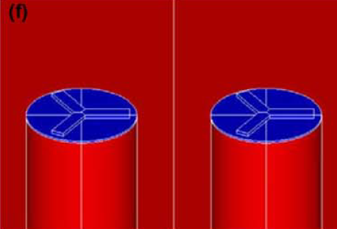
Fabrication (Contd.)
Microneedle array
Alignment
of the
Bi-Mask
Anisotropic Etching III
Thermal Growth II
Deposition of SiO₂
ICP Etch
Forms the Needle body
Bi-mask structure is aligned to the centre of the hole on the front side of the wafer
Passivation layer
Protects both needle body & microchannels

Slide 14
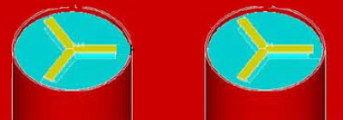
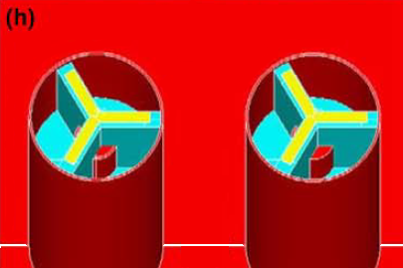
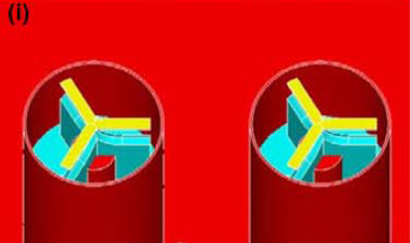
Fabrication (Contd.)
Microneedle array
Upper Mask Removal
Removal of the upper mask (blue)
Anisotropic Etching IV
Isotropic Etching
ICP Etch
RIE
Side ports are formed
Guarantee a sharp needle tip
ICP Etch

Slide 15
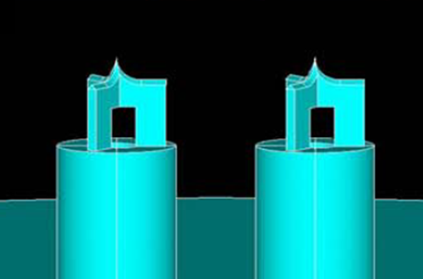
Fabrication (Contd.)
Microneedle array
Wet Etching II
HF
Removal of SiO₂

Slide 16
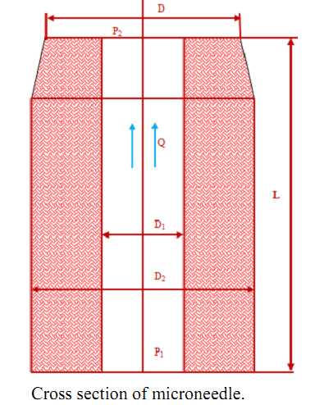
Characterization
Mechanical properties
Bending (shear) and buckling (axial) forces
Axial force experienced at the needle tip.
Effect of bending force maximum at the base.
Maximum axial force the microneedles can withstand without fracture,
F_{axial}=σ_{y}A, where σ_{y:} yield strength, A: cross-sectional area
Minimum pressure required to puncture the skin, P_{min} is given by:
F_{resistance}= P_{min}A where, F_{resistance:} maximum resistive forces offered by the skin
The bending force the microneedles can withsand without breaking,
F_{bending}= σ_{y}I/cL where, I: moment of inertia of the needle, L: length of the needle.
Source: Ashraf et al, 2010
P1: inlet pressure,
P2: outlet pressure,
D: tip diameter,
D1: inner diameter,
D2: external diameter, L: length of microneedle,
Q: flow rate in the lumen

Slide 17

Characterization (Contd.)
Flow analysis
Fluid pressure drop due to needle array geometry, roughness of surface, viscosity and microneedle array density.
Poiseulle’s law:
where, µ: viscosity
Numerical analysis
Structural and fluidic analysis using ANSYS.
Structural analysis
Finite element method (FEM)- single out-of-plane needle, base fixed in all directions, Y=169GPa, ν=0.22
Maximum bending stress at the bottom with applied tip force of 8.8 N- 6.96 GPa (much more than human skin resistance of 3.18 MPa)
Maximum axial stress of 2.96 MPa occurs inside the lumen section of the microneedle at applied pressure of 3.18 MPa with negligible deflection

Slide 18
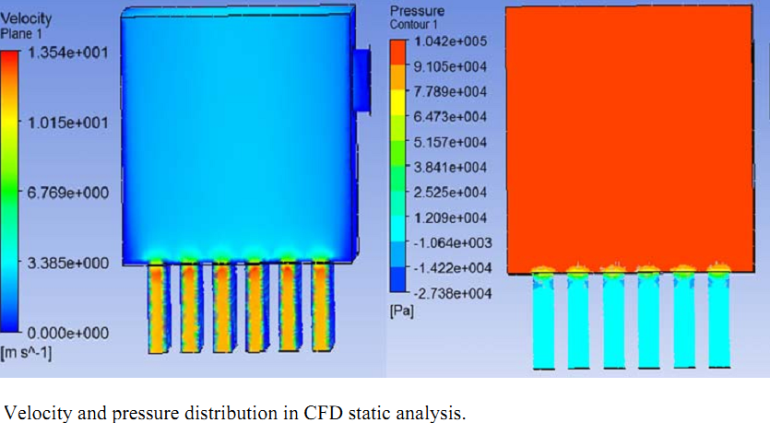
Characterization (Contd.)
CFD Analysis at Different Inlet Pressures
Single row of microneedle array (6 microneedles) was considered for analysis.
Static pressure 20 kPa to 140 kPa applied at the microneedle inlet.
Source: Ashraf et al, 2010

Slide 19
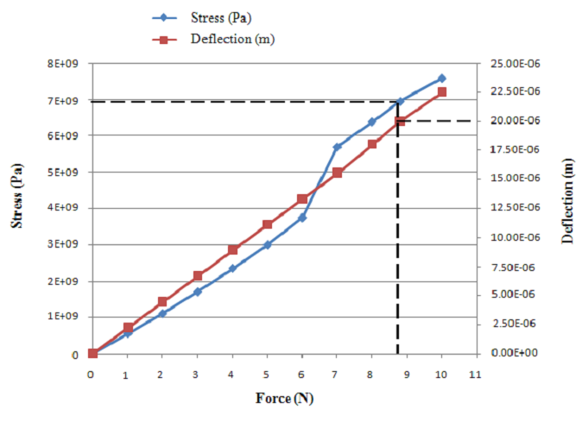
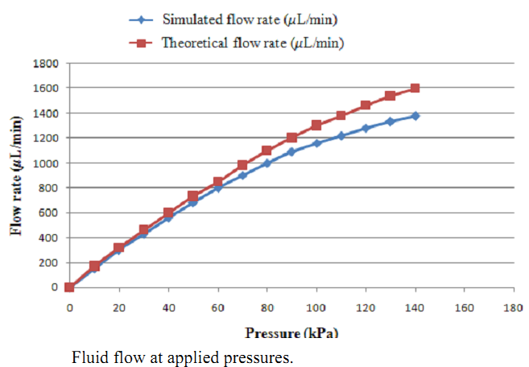
Results & Analysis
Relation between bottom stress and tip deflection.
Results show that maximum stress is less than the yield stress. So, microneedle is strong enough to bear the force up to 8.8 N.
In static CFD analysis, the maximum flow rate 1375 µL/min was observed at 140.
Source: Ashraf et al, 2010

Slide 20
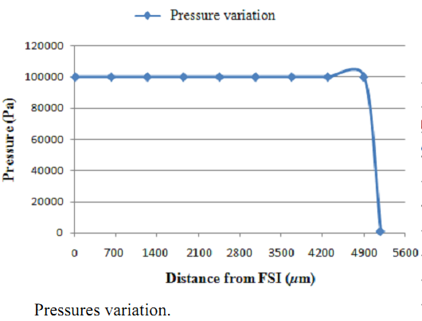
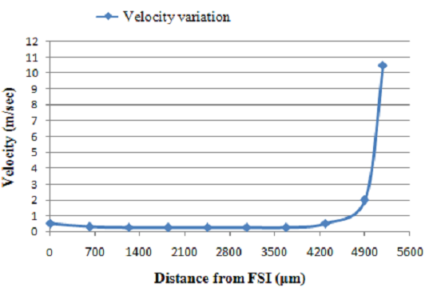
Results & Analysis (Contd.)
Pressure variation in CFD analysis Velocity variation in CFD analysis
Source: Ashraf et al, 2010

Slide 21
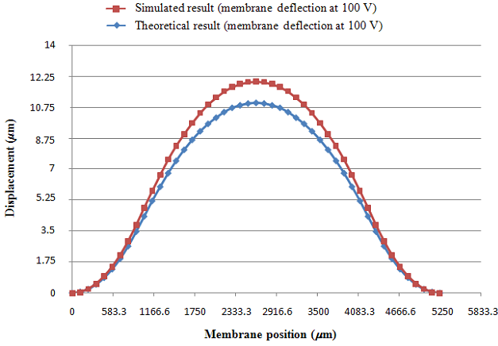
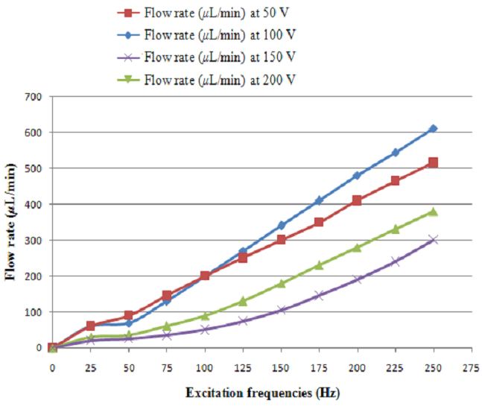
Results & Analysis (Contd.)
FEM analysis the bending of actuator at sinusoidal applied 100 V
The frequency of 250 Hz was considered constant. The deformation is calculated along the length of the actuator. The maximum displacement of 12.24 µm occurs at the centre of the membrane.
The flow rate for excitation frequencies at various applied voltages
When the excitation frequency is increased, fluid flow rate also increases. The highest flow rate(612 µL/min, through the 6×6 microneedle array) is achieved at applied 100 V with membrane deflection of 12.24 µm
Source: Ashraf et al, 2010

Slide 22
Conclusions
Microneedles are a better alternative, for systemic drug delivery, to the conventional methods in terms of absence of pain, ease of use, minimum side effects, etc.
Integration of microneedle array with actuators like PZT micropump and sensors can be used for automated drug delivery.
Improved microneedle design in terms of side ports and fabrication techniques like bi-mask technique can overcome the disadvantages of the existing design and techniques, respectively.
Mechanical and flow analysis showed satisfactory results. This design of microneedles is capable of withstanding pressures required for penetrating skin and an array of microneedles gives a pretty high flow rate suitable for practical purposes.

Slide 23
References
Zhang et al, 2009: Design and fabrication of MEMS-based microneedle arrays for medical applications; Peiyu Zhang, Colin Dalton, Graham A. Jullien; Microsyst Technol (2009) 15:1073–108.
Ashraf et al, 2010: Fabrication and Analysis of Tapered Tip Silicon Microneedles for MEMS based Drug Delivery System; Muhammad Waseem Ashraf, Shahzadi Tayyaba, Nitin Afzulpurkar, Asim Nisar; Sensors & Transducers Journal, Vol. 122, Issue 11, November 2010, pp. 158-172.
Ma et al, 2006: A PZT Insulin Pump Integrated with a Silicon Micro Needle Array for Transdermal Drug Delivery; Bin Ma, Sheng Liu, Zhiyin Gan, Guojun Liu, Xinxia Cai, Honghai Zhang, Zhigang Yang; 2006 Electronic Components and Technology Conference.
Podder et al, 2011: Design, Simulation and Study of MEMS Based Micro-needles and Micro-pump for Biomedical Applications; Pranay Kanti Podder, Dhiman Mallick , Dip Prakash Samajdar, Anirban Bhattacharyya; 2011 COMSOL Conference Bangalore.
Kim et al, 2005: A disposable thermopneumatic-actuated micropump stacked with PDMS layers and ITO-coated glass; Jin-Ho Kim, Kwang-Ho Na, C.J. Kang, Yong-Sang Kim; Sensors and Actuators A: Physical, Volume 120, Issue 2, 17 May 2005, Pages 365–369.
Richter et al, 2008: Design And Development Of The Double Normally Closed Microvalve; M. Richter, J. Kruckow, G. Neumayer, M. Wackerle, K. Heinrich; Workshop microdosing systems, 2008, Fraunhofer Institute for Reliability and Microintegration (IZM), Munich, Germany.
Fang et al, 2006: Self-Assembly of PZT Actuators for Micropumps With High Process Repeatability; Jiandong Fang, Kerwin Wang, and Karl F. Böhringe; Journal Of Microelectromechanical Systems, Vol. 15, No. 4, August 2006.

Slide 24
Thank You!

