Slide 1
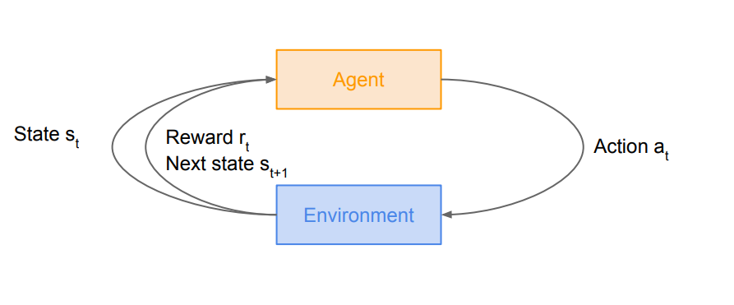
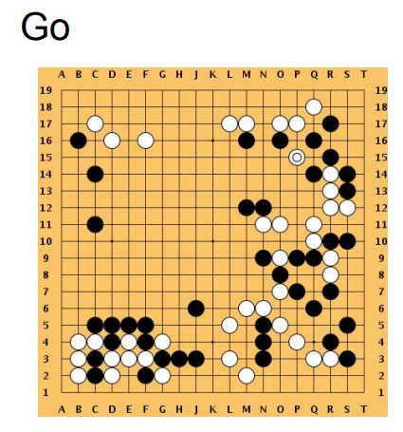
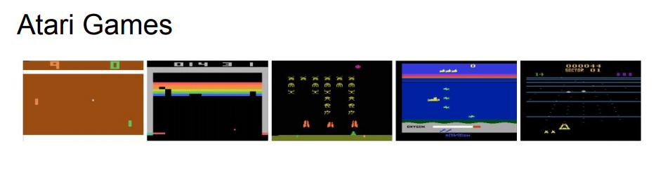
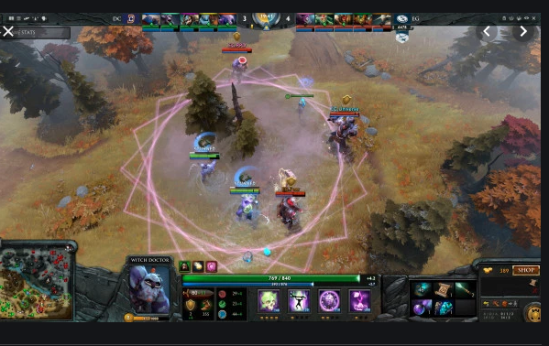
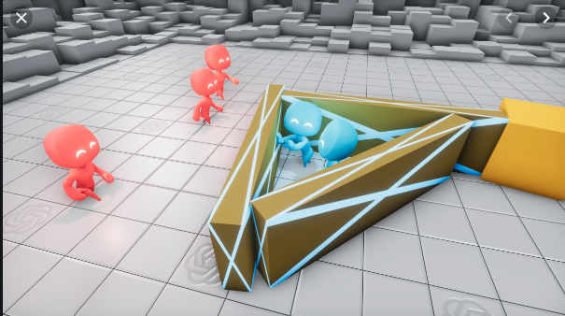
Reinforcement Learning
DOTA 5
HIDE &
SEEK

Slide 2
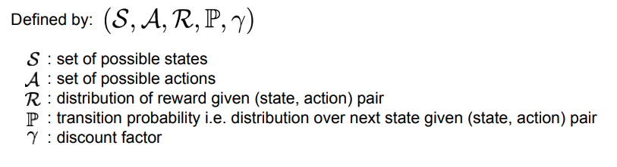
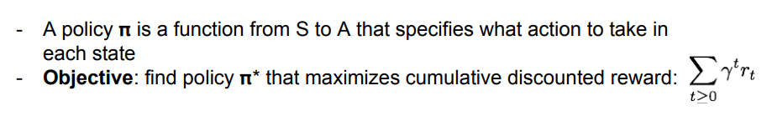
Markov Decision Process
- Mathematical formulation of the RL problem
Markov property: Current state completely characterises the state of the world

Slide 3
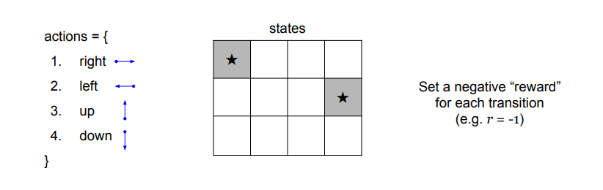
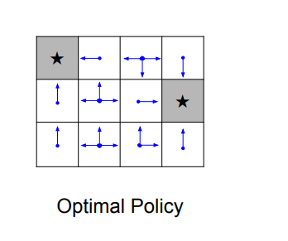
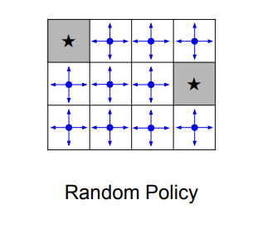
A simple MDP: Grid World

Slide 4
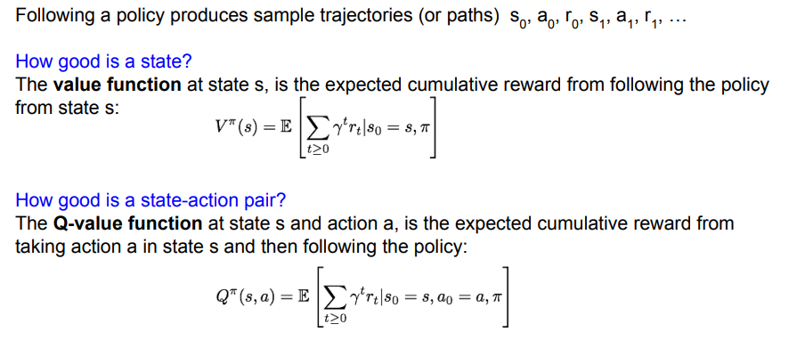
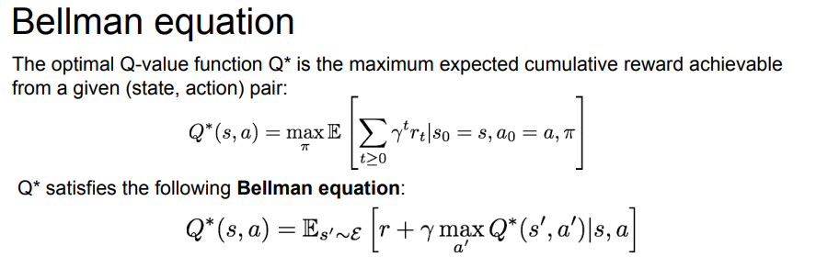
Definitions: Value function and Q-value function

Slide 5
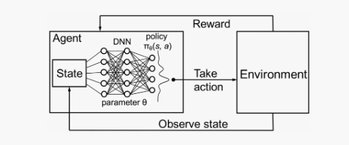
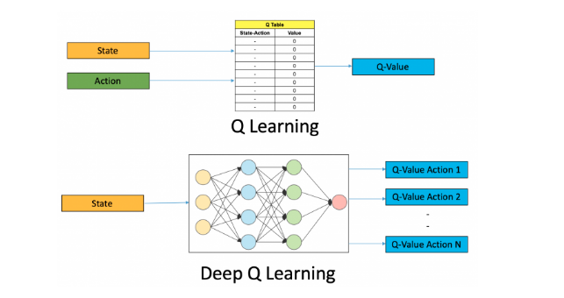
Deep RL

Slide 6
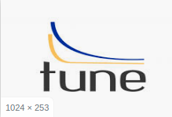
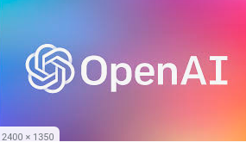

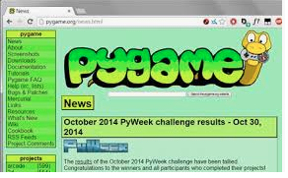

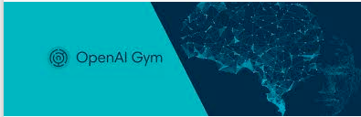
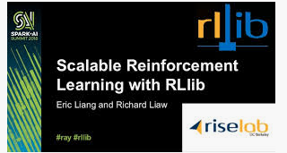
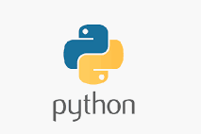



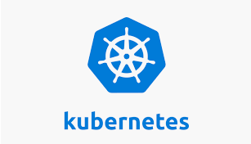



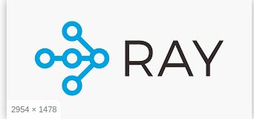

Neural Network
Auto ML- Tuning hyperparmeters
Environment Wrapper
Custom Network
RL Agent Algorithm
Custom RL
Simulation Environment
Cloud
Compute
Platform
Software container
Parallel communication
Putting all together

Slide 7
Choice of algorithm
RL Algoritms
Model free
Algos
RL Algos
Policy based
Value based
Learn Model
Knows Model
Actor-Critic
On
Policy
On
Policy
Off
Policy
I2A
AlphaZero
Uses
MCTS
DQN
MBMF
A2C
REINFORCE
SARSA
DDQN
MBVE
A3C
PPO
DDPG
RAINBOW
TRPO
IMPALA

Slide 8

Work Progress
Use auto-curriculam learning to help training,
Train Agents in parallel environments on cloud
Create low fidelity POC environments (pygame)
Train Agents in single environment
Train Agents in parallel environments
Enrich simulation environment with remote vehicles using HV policies (previously trained)
Train Agent on multiple environments parallely to achieve better generalization
(Auto) Tune Agent hyper-parameters
Train Agents in parallel environments on cloud cluster
Train in high-fidelity simulation environments (Carla, LG-Sim)
Encapsulate with safety Behavior with online prediction
Demo in vehicle
Train in simulation environments with self-play

Slide 9
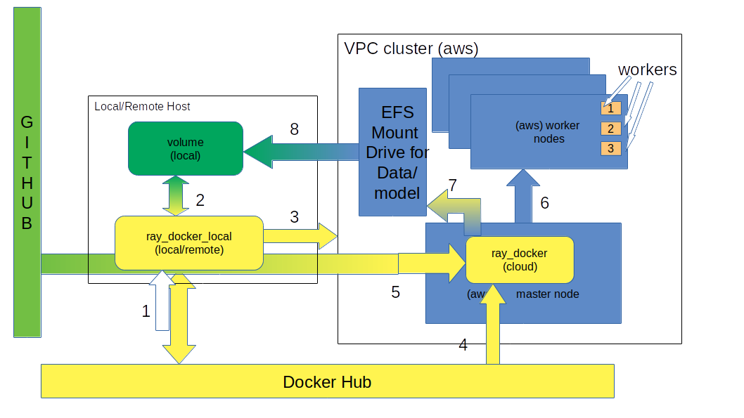
Distributed RL using Ray in containerized cloud cluster

Slide 10
AV Behavior Planning RL architecture
Road and Lane Info from map
Object info from perception
Road and Lane Info from map
Road Rules as constraints (virtual objects)
Object info from perception
Road Rules as constraints (virtual objects)
Lane and object info in frenet form
Obs space: objects and virtual objects(constraints)
Obs space: objects and virtual objects(constraints)
RL Policy
RL Policy
Actions:
{Accel, Steering}
Actions(discrete decisions) :
Lane-Keep
Lane change
Plant Model
PID Control
Accel
Steering
Un Structured Environment
Plant Model
Semi Structured Environment

Slide 11
Results
Single Agent. Two-way sub-division environment.
Multi Agent two-way subdivision environment. Agents have not been trained in this environment (self-play) yet.

