Slide 1
RL Tasks | Task Objective | Status | Comments
Train with state of the art algorithms from open-ai, deepmind, rise lab (rllib) etc. | obvious | Achieved and ongoing | Used Ray/Rllib and open AI baseline so far. PPO, DDPG, IMPALA, A2C/A3C, DQN etc. standard algorithms have been tried so far.
MultiEnv training | To get more generalized agents which don’t overfit to one env. | Achieved and ongoing | Agent is simultaneously trained on multiple (should be similar envs at this point). Trained on two way and highway env at the same time. Closer to general intelligence. This is more of a research area (alpha zero)
Multi agent training – Intelligent Agents simulation for other vehicles | To enrich the env, to have the simulation closer to real life. Remote vehicle behavior is simulated using previously obtained policies for Ego | Started and ongoing | This could be solving for policies concurrently or using a previous policy for the other actors (alpha go)
Multi agent training – Self play | Ego and remote policies evolve simultaneously given rules of the road. | Not Started | For AD this may be more research/exploration area. (alpha go zero)
Auto ML/Hyper parameter tuning | To improve RL agent performance. (not reward tuning) | Achieved and ongoing | Developed the infrastructure for this using ray tune and demonstrated on a PBT based algorithm. This should be revisited once an algorithm is fixed.
Curriculam learning | Aid the agent training process by progressively making the environment tougher. | Achieved | Using rllib APIs.
Inverse RL | Shaping the RL rewards using expert knowledge | Not Started
Architecture and implementation to bring RL mainstream |  | Concept phase only
Create low fidelity proof of concept level environments | For fast training. Proof of concept model comparison. | Achieved and ongoing | in pygame so far. Need to keep developing new environments. Env is and need to be open AI gym compatible.
Create High fidelity simulation environments (ex: Carla, LG sim) | For deploying on car this is an important intermediate step. | Investigation phase only | Bonus if they are open AI gym compatible, otherwise more work needed to make it such.AI team is working on Carla.
Not specific to RL but containerization of code is important for scalability and deployability across many different compute platforms. | containerize the code | achieved | Done in docker. Containerization helps with deploying in cloud cluster as well (see below)
Parallel multi processing capabilities (even on a single compute node) on top of the algorithms | Speed up RL training | achieved | We have shown this on both baselines(using MPI) and rllib(using redis/ray APIs) on both local machines and on aws.
Distributed computing on cloud cluster. | Speed up RL training even more | achieved | We have shown this on both rllib using ray cluster APIs

Slide 2
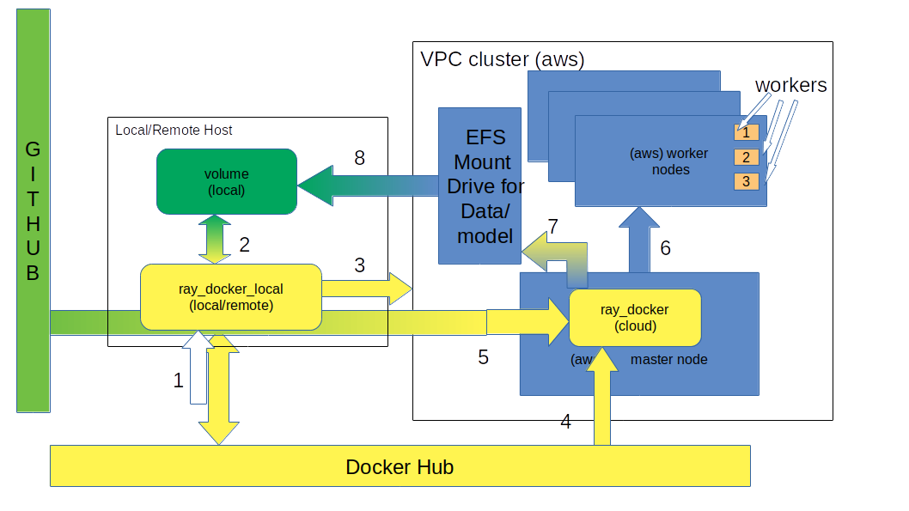
(Ray/AWS) Cloud cluster setup
We are using a local-host/ remote-server based docker-container controlled cluster management process for the Ray based RL training. The manager
a) initiates cloud(aws) compute clusters (master/worker nodes) based on defined config
b) auto updated docker image/SW on cloud from dockerhub and github.
c)Another docker container from master node parallelizes worker processes among worker nodes and can auto scale up/down
d)Once complete data/model is retrieved from the cloud.
e)Cloud cluster is terminated

Slide 3
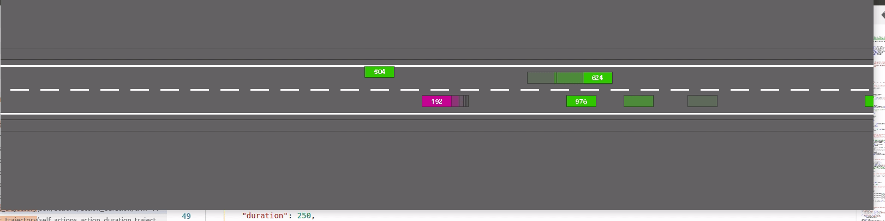
Some results
PPO trained HV (magenta) with hand coded RV in a two way environment

