Slide 1
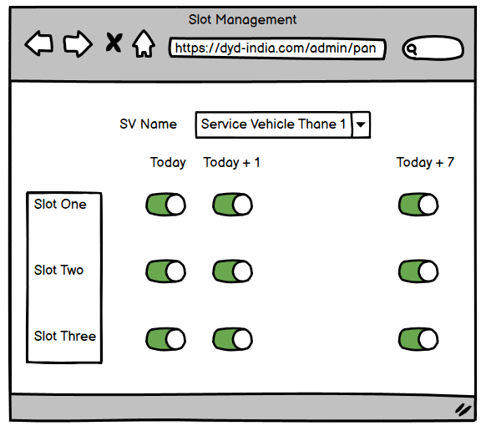
Slot Management
Display the button as active when available, otherwise don’t show provision to change(ON/OFF non-editable)

Slide 2
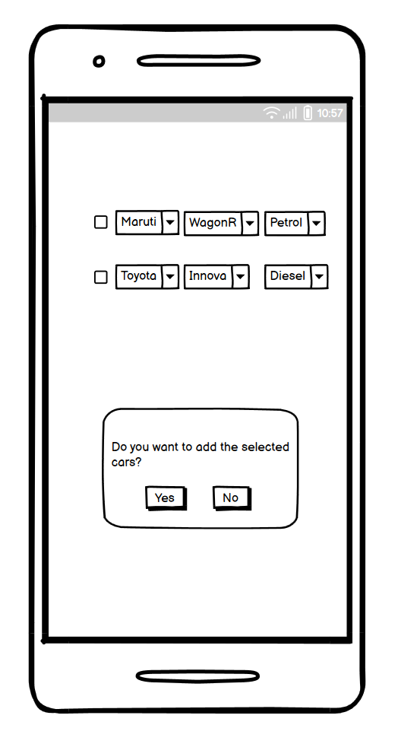
Auto Selection of Vehicle During Registration
Pick up from Vahaan & Display the available vehicles registered using this No. By default selected checkbox with provision to change car(If same brand, model, fuel is present in DYD DB, else normal flow)
If user clicks Yes after selecting any car/cars : he is redirected to User Profile Screen
If user clicks No, then he is taken to the Brand Selection page.

Slide 3
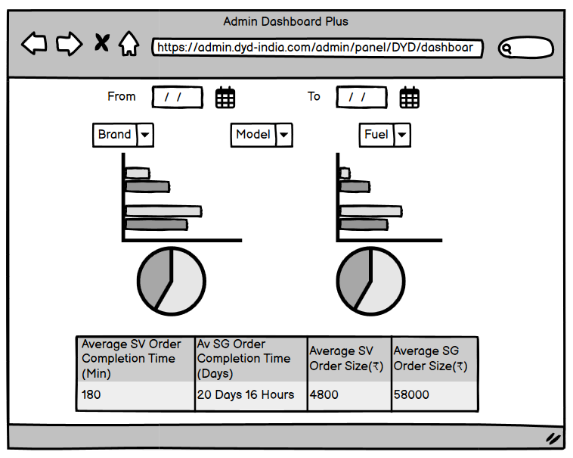
Admin Dashboard Plus
# Services Completed :
# Services Cancelled :
# Services Rescheduled :
# Services Pending :
# Services Ongoing :
# Slots Utilized :
# Customers Ordered More than One Order & Completed :
Package Wise Revenue Contribution
SV Vs SG Revenue
SV Wise Revenue Contribution

