Slide 1
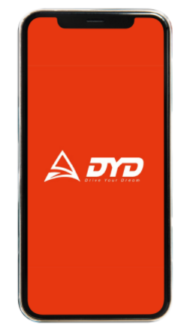
KPI – Metrics
info@dyd-india.com
PEACE AT YOUR
DOORSTEP
From dyd-india.com

Slide 2
Assumption : - The App will have the option to signup using mobile no post download.
- Services listed on the App(MVP Version) will be same as listed in DYD-India website.
Acquisition | Activation | Engagement | Retention | Monetization
# of downloads | # of signups using mobile no | # of Profile completeness(e.g. Address etc) # of users that checked: Periodic Maintenance Car Grooming Denting & Painting Wheels Care Batteries | # of users in terms of return to App : 1 Day 7 Days 30 Days 90 Days 180 Days 1 Year | Average Revenue Per User Average Revenue Per Paying User Average Revenue Per Daily Active User Life Time Value Conversion Rate

Slide 3
Few Additional Metrics
CPI/CAC | ARPPU | Stickiness Ratio | Average Session Length | Churn Rate & Goal Completion Time
Total Marketing Cost/ # of Installs | Lifetime Revenue / # of paying users | # DAU / # MAU | Total duration of all sessions (in seconds) during a specified time frame / total number of sessions during that same time frame | Churn rate = (1 – Retention Rate) Goal Completion Time(3~4 Secs for low priority goals) Higher priority goals should be at par with competitors.

Slide 4

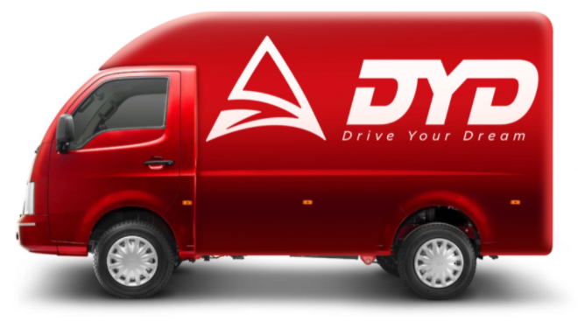
www.dyd-india.com
PEACE AT YOUR
DOORSTEP
THANK YOU

