Slide 1
healthiO
Pinak Saha
Abdul Goffar

Slide 2
Purpose/Problem
Simple app to keep track of common health statistics
Track blood pressure, blood sugar, heart rate, weight
Input values, generate graph
Users: Anyone between the age of 18+

Slide 3
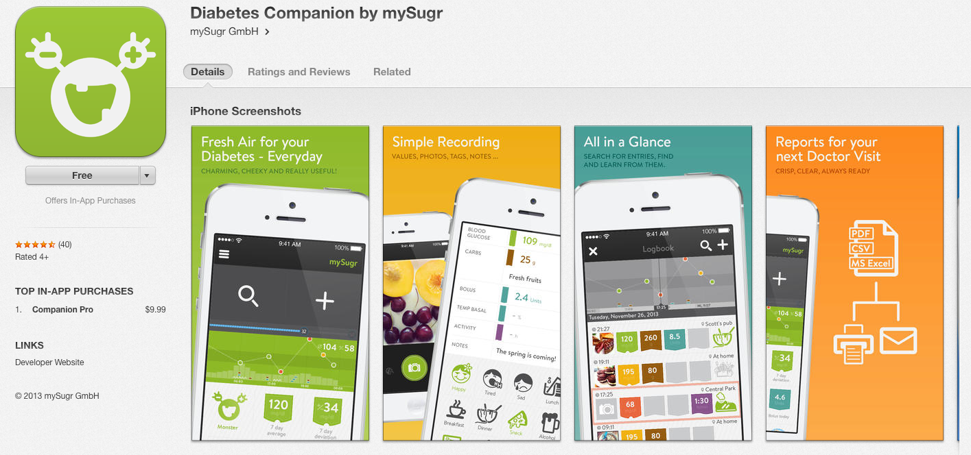
Apps that already exists …
MySugr

Slide 4
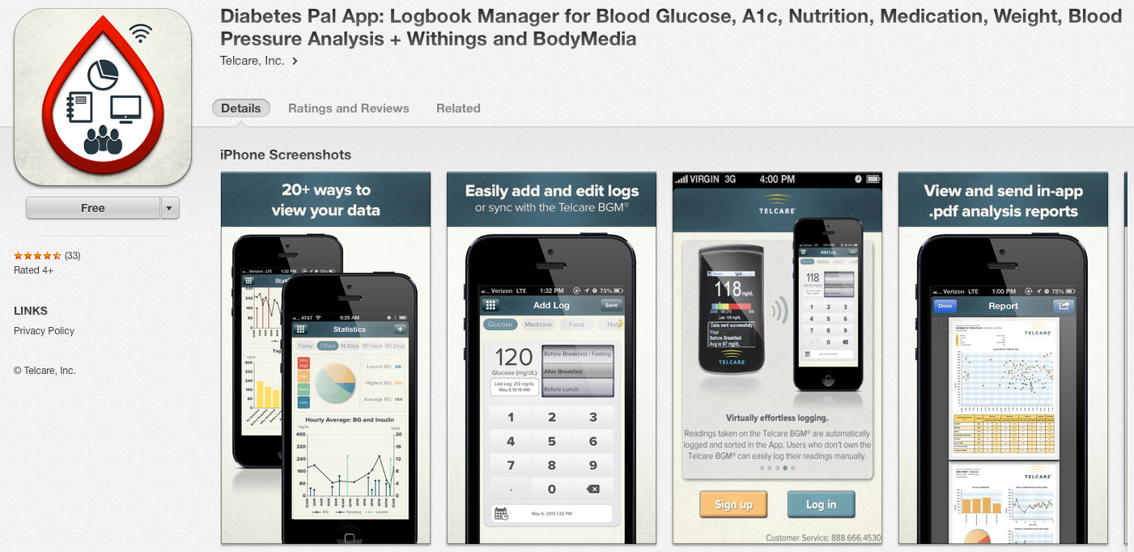
Apps that already exists …
Diabetes Pal App

Slide 5
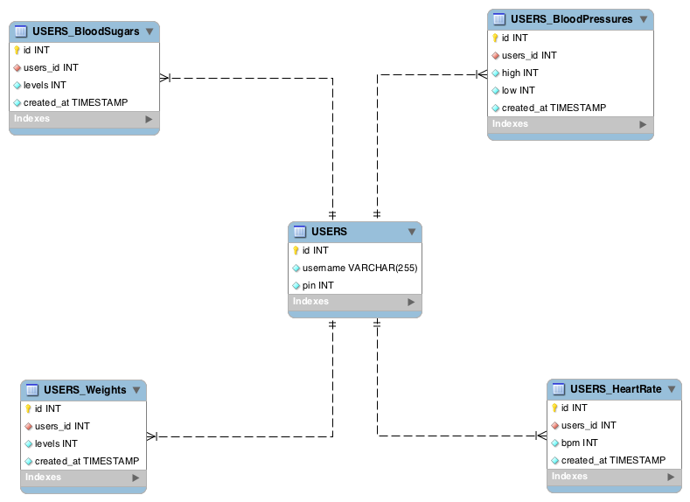
Data Model

Slide 6
Libraries
Open source graph library
SHLineGraph Library by Shan Haq

Slide 7
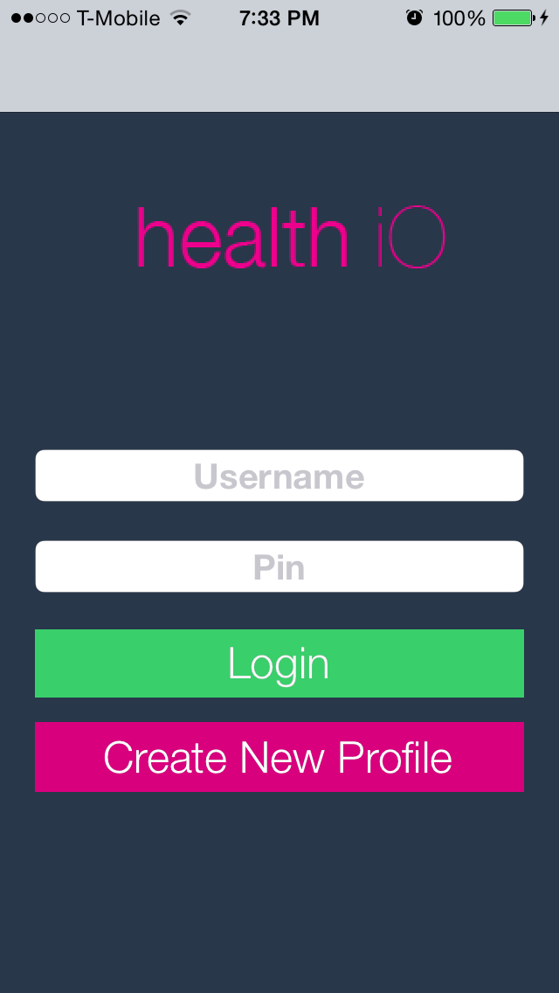
Log In

Slide 8
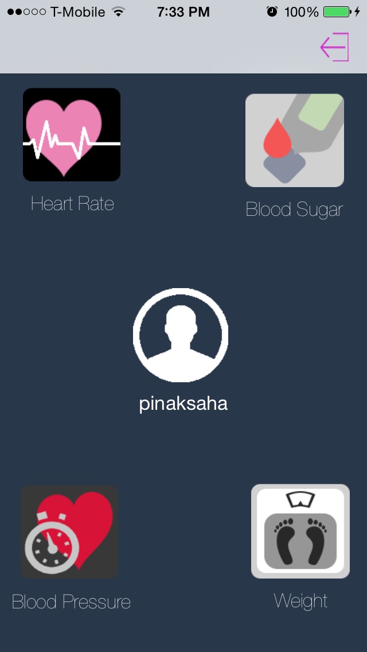
User Dashboard

Slide 9
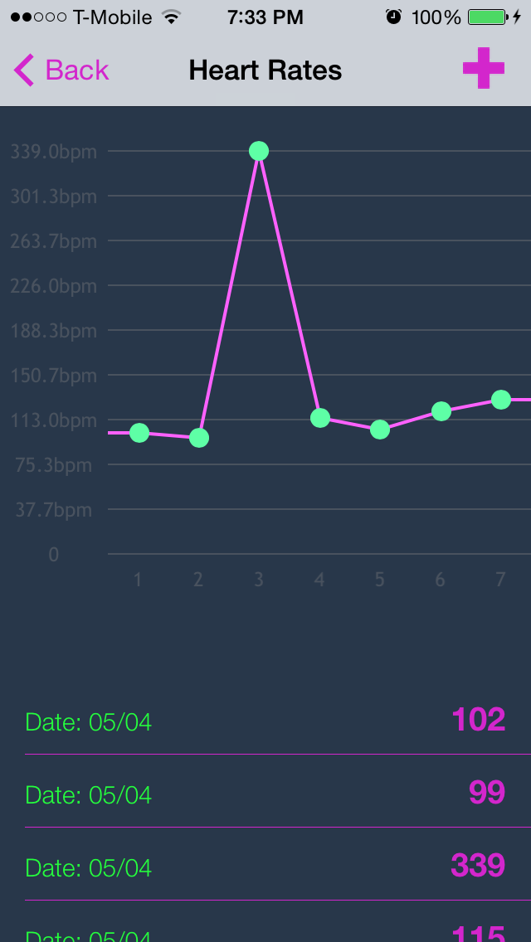
Heart Rate

Slide 10
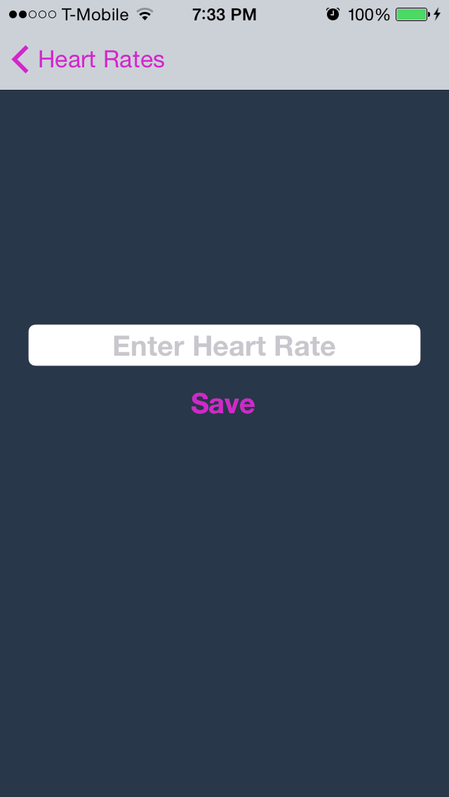
Heart Rate Cont’d

Slide 11
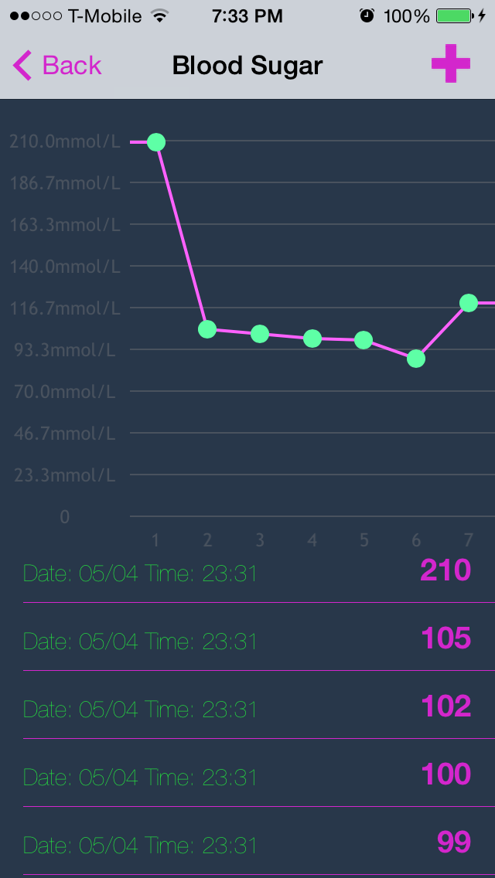
Blood Sugar

Slide 12
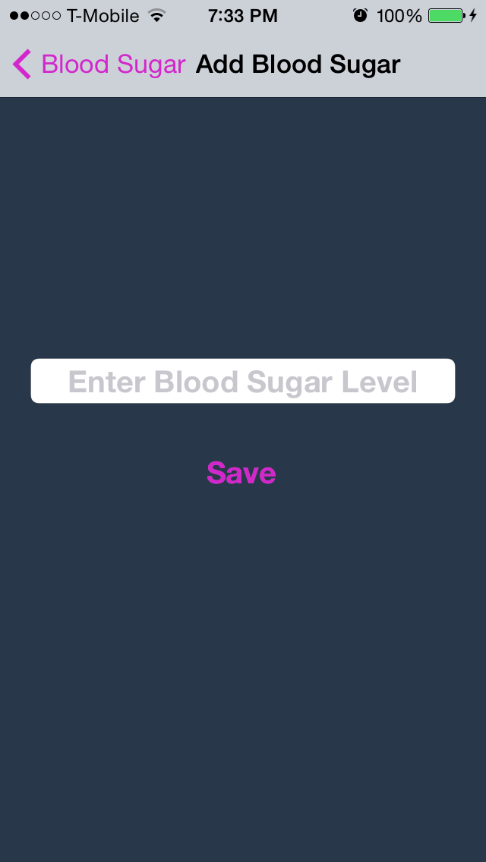
Blood Sugar Cont’d

Slide 13
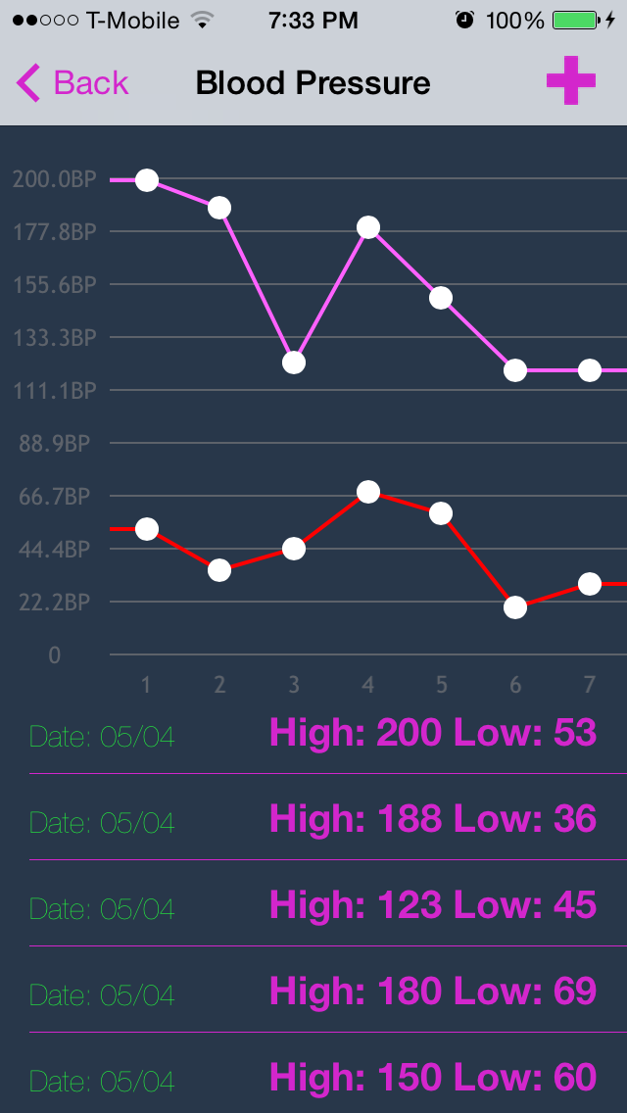
Blood Pressure

Slide 14
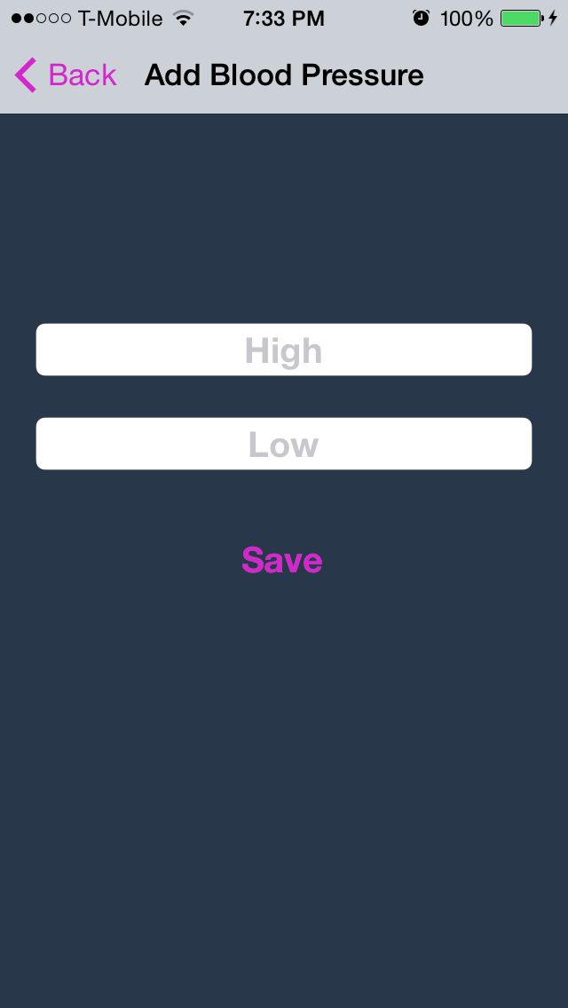
Blood Pressure Cont’d

Slide 15
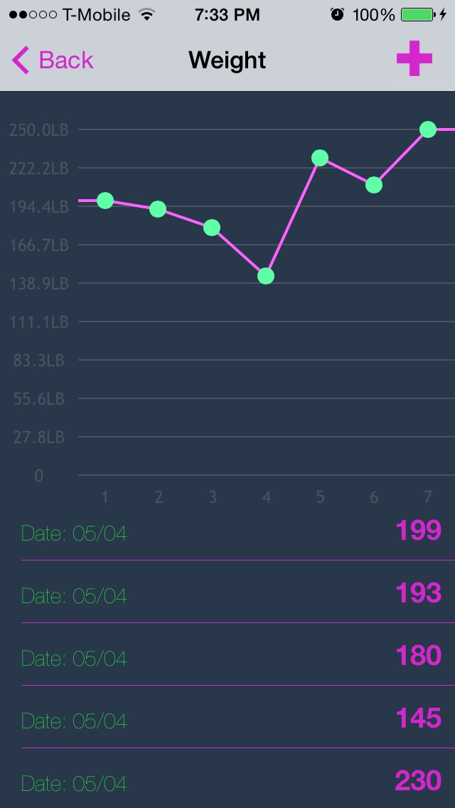
Weight

Slide 16
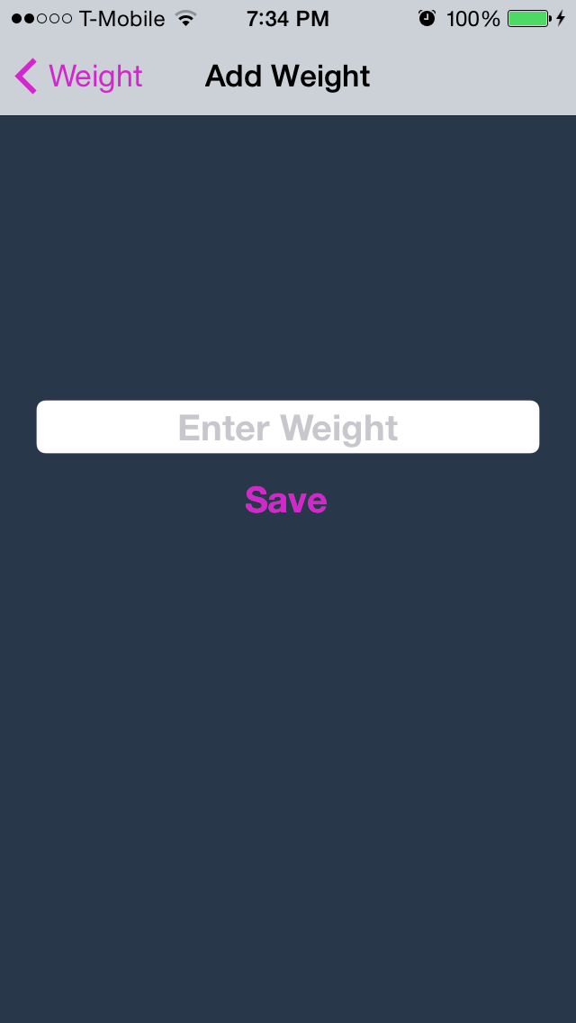
Weight Cont’d

Slide 17

Demo

