Slide 1

Data Analysis Essentials
Cornerstone Project —Third Review
Library Management Data Analysis System
Presented by
P. Krishna Kumari – [25B11AI863]
P. Madhu Shalini – [25B11AI957]
S. Tejaswini – [25B11AIB52]
T. Devi Phanitha – [25B11AIB84]
Department
Department of Artificial Intelligence & Machine Learning

Slide 2

Abstract
The Library Management Data Analysis System aims to analyze library records using Python. The dataset contains information about books, authors, categories, issue dates, return dates, and fines. The project involves data collection, data cleaning, exploratory data analysis (EDA), and visualization to identify useful patterns in library operations. A classification model is also used to predict whether a book is likely to become overdue. Model performance is evaluated using accuracy, precision, recall, and F1-score. The results help in understanding library records, borrowing patterns, and overdue book trends.
Technologies Used : Python ,Google Colab ,Pandas ,NumPy ,Matplotlib Seaborn

Slide 3
Problem Statement
Library records may contain missing values, duplicate records, and information that is difficult to interpret manually. Analyzing these records is necessary to understand book availability, borrowing patterns, overdue books, and fine amounts. The project addresses these challenges through data cleaning, exploratory data analysis, and visualization. It also uses a classification model to predict overdue status and evaluates the model's performance using appropriate metrics.

Slide 4
Objectives
To load and inspect the library dataset using Python.
To identify and handle missing values and duplicate records.
To perform exploratory data analysis (EDA).
To visualize book status, categories, authors, and borrowing patterns.
To develop a classification model for predicting overdue status.
To evaluate model performance using accuracy, precision, recall, and F1-score.
To interpret the results and identify useful insights from library records.

Slide 5
Limitations of Existing System
It needs a lot of paper work.
Most work is done by hand.
Finding a book takes time.
Records can be lost or damaged.
Mistakes can happen while writing details.
It is hard to know if a book is available.
Fine calculation can have mistakes.
Making reports takes more time.
Some records may be missing or repeated.

Slide 6
Proposed System
Add and store book details.
Add and store student details.
Search for books easily.
Check book availability.
Issue books to students.
Record returned books.
Advantages
Faster library work.
Less paperwork.
Fewer mistakes in records.
Easy book searching.
Quick checking of book availability.

Slide 7
Dataset Description
Feature | Description
Book_ID | Unique ID for each book
Book_Name | Name of the book
Author_Name | Name of the author
Book_Category | Type of book
Publisher_Name | Name of the publisher
Total_Copies | Total copies of the book
Student_ID | Unique ID of the student
Student_Name | Name of the student
Issue_Date | Date when the book is issued
Due_Date | Last date to return the book
Return_Date | Date when the book is returned
Fine_Amount | Fine for late return

Slide 8
DATASET BEFORE & AFTER CLEANING
Google Colab - Library Management System
Check | Before | After
Rows | 200 | 197
Columns | 9 | 9
Missing values | 49 | 0
Duplicate rows | 3 | 0
Status distribution | 100 Returned, 50 Overdue, 50 Issued | 98 Returned, 49 Overdue, 50 Issued
from google.colab import files
uploaded = files.upload()
import pandas as pd
df = pd.read_csv("library_management_200.csv")
print(df.head())
print("Before Cleaning")
print("Rows:", df.shape[0])
print("Columns:", df.shape[1])
print("Missing Values:", df.isnull().sum().sum())
print("Duplicate Rows:", df.duplicated().sum())
df = df.drop_duplicates()
df["Return_Date"] = df["Return_Date"].fillna("Not Returned")
print("After Cleaning")
print("Rows:", df.shape[0])
print("Columns:", df.shape[1])
print("Missing Values:", df.isnull().sum().sum())
print("Duplicate Rows:", df.duplicated().sum())

Slide 9
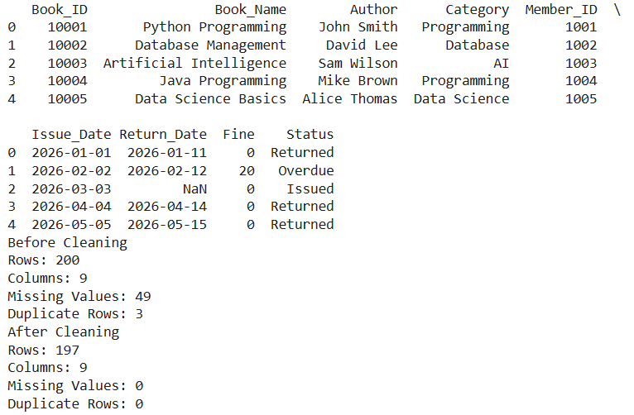
IMPLEMENTATION — CODE EXECUTION
Execution Output – Data Cleaning
Step 1 — Duplicates
Detected and removed duplicate library records..
Step 2 — Missing Values
Handled missing values using suitable data-cleaning methods.
Step 3 — Final Check
Re-checked null values and duplicate records.
Result
Clean dataset ready for EDA and visualization.

Slide 10
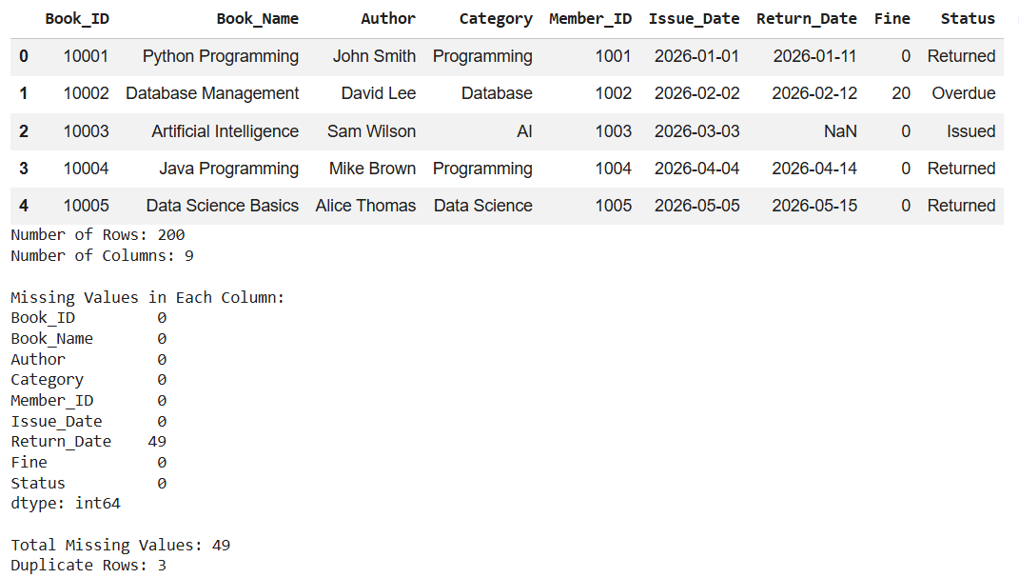
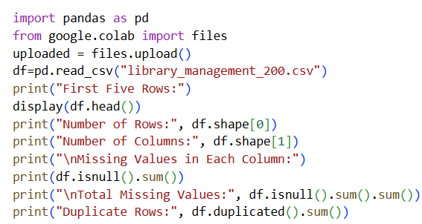
Dataset Loading and Inspection
Output

Slide 11
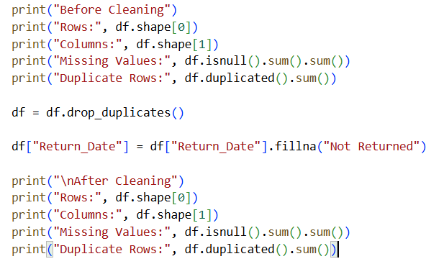
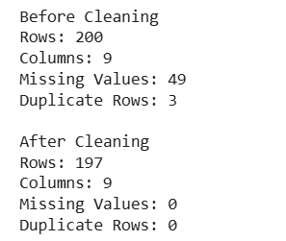
Data Cleaning and Preprocessing
Output

Slide 12
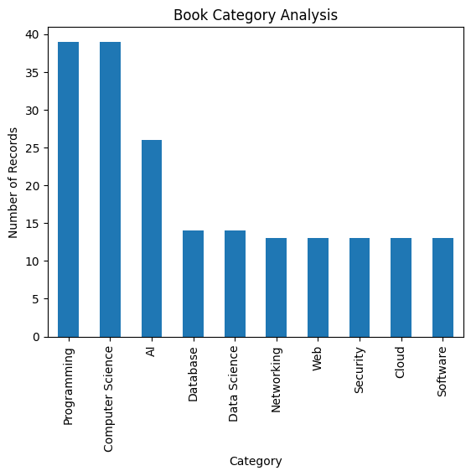
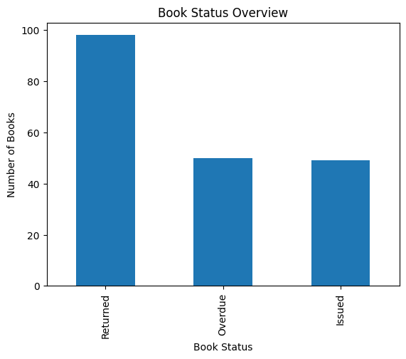
Exploratory Data Analysis and Visualization

Slide 13
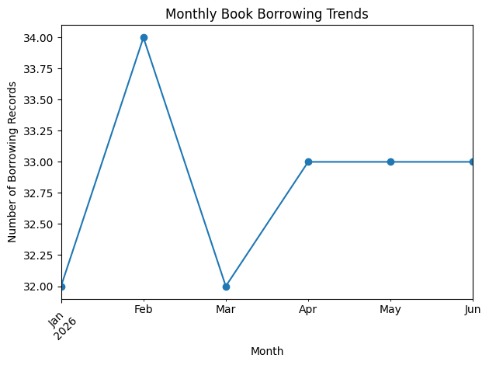
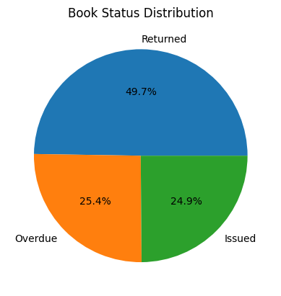
Data Analysis and Visualization

Slide 14
PROJECT IMPLEMENTATION — PREDICTION MODEL
Model Implementation
Load Dataset
Load the library dataset into Google Colab.
Preprocess Data
Clean missing values and convert categorical data into numerical form.
Split Dataset
Divide the data into 80% training and 20% testing.
Train Model
Apply Logistic Regression using the training data.
Make Prediction
Predict whether a book will be Overdue or Not Overdue.
Evaluate Model
Check the model using Accuracy, Precision, Recall, and F1-Score
Model
Logistic Regression
Classification model used to predict whether a book is likely to be overdue.
Preprocessing Pipeline
Missing values are handled and categorical variables are encoded before training the model.
Split
80% training / 20% testing, stratified by the target variable.
Execution
Model is trained on historical library records and generates Overdue / Not Overdue predictions.

Slide 15
VISUALIZATION & INTERPRETATION
Book Status Overview
Shows the distribution of returned, overdue, and issued books, helping understand the current status of library books.
Author-wise Distribution
Compares the number of books available for different authors and identifies authors with higher or lower representation.
Book Category Analysis
Shows the distribution of books across different categories, helping identify the major subject areas available in the library.
Borrowing Analysis
Examines book borrowing patterns to identify frequently borrowed books and understand user demand.
Why this matters
Visualizations make library data easier to understand for better library management.
Example Interpretation
Most books are returned, while a smaller number are overdue or currently issued, indicating the overall status of book circulation.
Author-wise analysis shows that most authors have a similar number of books, with some authors having relatively higher or lower representation.
These visual findings support the project objective by providing useful insights into library operations and helping in the prediction and management stages.

Slide 16
RESULTS & KEY INSIGHTS
Finding 1
Book Status: Most books in the library are returned, while the remaining books are either issued or overdue.
Finding 2
Author Distribution: Most authors have a similar number of books, while a few authors have comparatively higher or lower representation.
Finding 3
Book Availability: The analysis shows the current distribution of available and issued books, helping understand library resource availability.
Borrowing Insight
The analysis identifies frequently borrowed books and categories, providing useful information about user demand.
Overdue Insight
A noticeable number of books are overdue, highlighting the importance of monitoring return dates.
Prediction Model
The classification model can use historical borrowing information to predict whether a book is likely to become overdue or not overdue.
The completed pipeline moves from library records → data cleaning → preprocessing → exploratory analysis → visualization → prediction → evaluation.
The analysis provides useful insights into book status, availability, authors, borrowing patterns, and overdue books.
The prediction model provides a baseline for identifying potential overdue books and can be improved with additional features and models in future work.

Slide 17
CONCLUSION
The Library Management System project demonstrates a complete data-analysis and prediction workflow.
The library dataset was inspected, cleaned, preprocessed, and analyzed to understand book-related information.
EDA and visualizations were used to identify meaningful patterns in book status, author distribution, book categories, availability, and borrowing activity.
A classification model was implemented to predict whether a book is likely to become overdue or not overdue.
The project combines data analysis, visualization, prediction, and evaluation to provide useful insights for library management.

Slide 18
THANK YOU
Questions & Viva

