Slide 1
Holmusk Challenge: Chronic Kidney Disease Dataset
Pinar Bilgin

Slide 2
Outline
What is CKD?
Understanding the Data
Demographic
Clinical markers of CKD
Medication
Stage Progression
Determining the Classifier
Model comparison and Considerations
Methodology
Results
Discussion

Slide 3
What is CKD?
Chronic kidney disease (CKD) is a disease caused by damaged kidneys that are unable to filter blood the way they should. The reason it is called ”chronic” is due to damage happening slowly to the kidneys over a long period of time.
It is important to monitor all patients with CKD as the progression differs from patient to patient.
*https://www.niddk.nih.gov/health-information/kidney-disease/chronic-kidney-disease-ckd/what-is-chronic-kidney-disease

Slide 4
Understanding the Data
The CKD dataset comes with 9 files that can be separated into 4 classes:
T_demo.csv -> Patient demographic (id, race, gender, age)
T_creatinine.csv, T_DBP.csv, T_SBP.csv, T_HGB.csv, T_glucose.csv, T_ldl.csv -> Clinical markers for CKD (id, value, time)
T_meds.csv -> Medications prescribed (id, drug, daily dosage, start, end)
T_stage.csv -> Patient’s CKD Stage Progress (id, Stage_Progress)

Slide 5
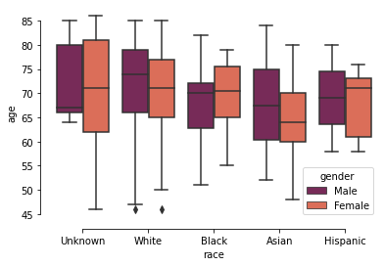
Patient Demographic
To visually explain the demographic, the box plot below indicates the races, genders and ages of the patients.

Slide 6
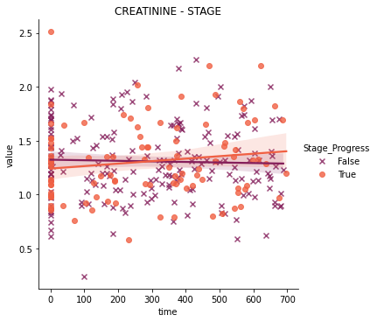
Clinical Markers of CKD
Below are 2D scatterplots with an overlaid linear regression line for all the given markers using Stage Progress as scatter points, time value given as x axis and the observed marker value as the y axis.
The plots don’t show a significant lean for stage progress in the different values of markers by themselves.
The clinical markers are respectively;
Creatinine value
Diastolic Blood Pressure
Systolic Blood Pressure
Hemoglobin level
Glucose level
Low-density lipoprotein (LDL-c)

Slide 7
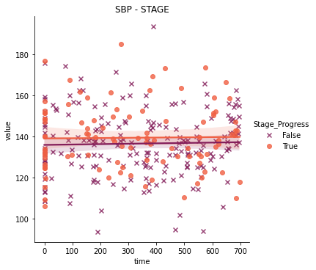
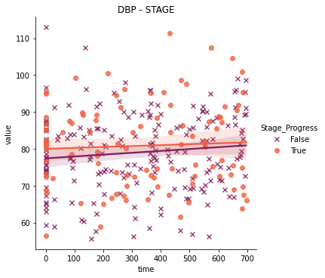

Slide 8
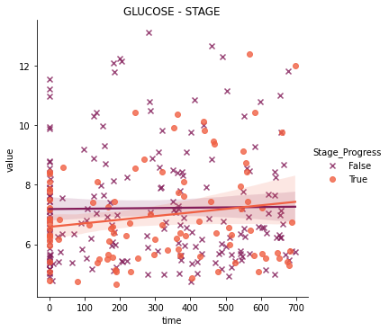
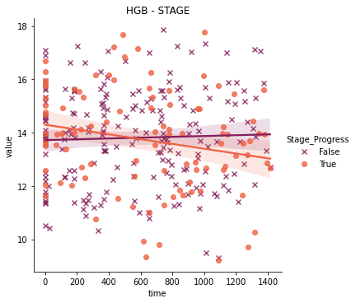

Slide 9
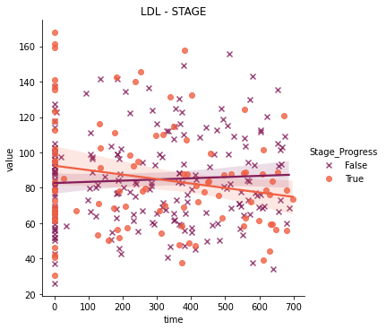

Slide 10
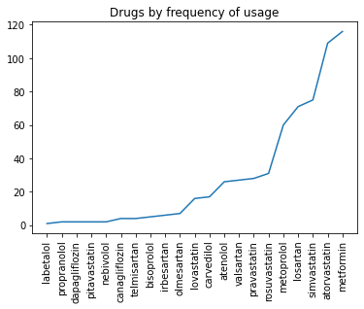
Medication Prescribed
From the data provided, we are able to see which medications are used the most for CKD patients. The plot shows the order and frequency of medications used.
The number of patients taking medicine is 272 out of 300.
Most used medications:
Metformin – 116
Atorvastatin – 109
Simvastatin – 75
Losartan – 71

Slide 11
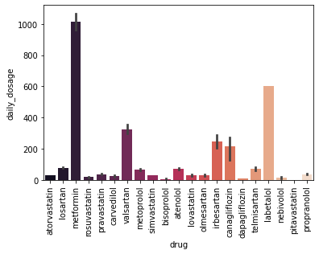
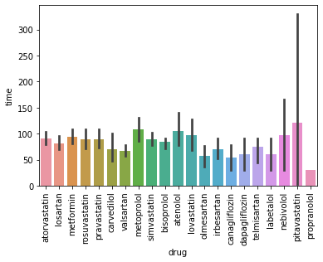
Theses plots show the daily prescribed dosage of each drug, and the amount of time that the drug was taken for, respectively.

Slide 12
Stage Progression
Stage Progression is what we are aiming to predict for the patients in the classification. So, in the classification model, this would be our label.
According to the data:
Stage Progress Information: False 200 True 100
Percentage of Progression: False 0.666667 True 0.333333
Shown on the next slide are plots of Stage Progress in the patient demographic that was given in the data according to race, gender and age.

Slide 13
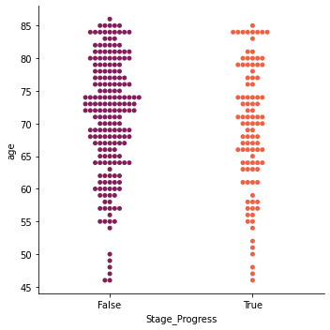
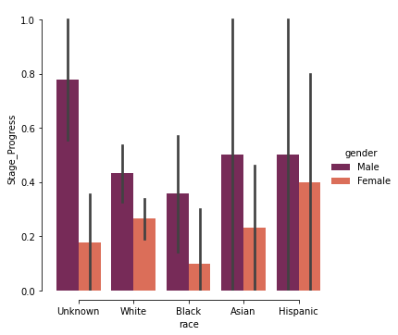

Slide 14
Determining the Classifier
As this is a binary classification problem, I decided a simple approach such as Random Forest Classification would work best. Although I considered using Logistic Regression as well, with this type of data with many explanatory variables and little to no noise, Random Forest will give better results than Logistic Regression.
However, if this was a larger industry dataset, Logistic Regression would have worked better.

Slide 15
Methodology
I merged the all of the data points provided using id to determine the shape of data, which became a matrix of size (300,34).
The data labels were then separated to True (100,34) and False (200,34).
I trained two Random Forest Classifiers, first one with balanced dataset using 15 patients for each label, and second one with an unbalanced dataset using the class weights of 0.75 for class 0 and 1.5 for class 1. Both datasets were separated 90:10.
After the split, train_set was (270,34) and test_set was (30,34) for both models.

Slide 16
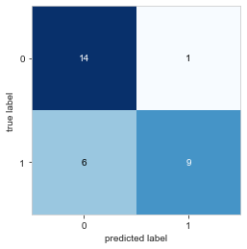
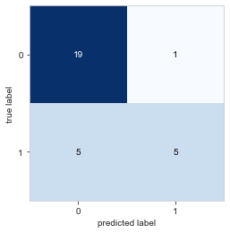
Results
Random Forest Classification (balanced data)
precision recall f1-score support
False 0.70 0.93 0.80 15
True 0.90 0.60 0.72 15
accuracy. 0.77 30
macro avg 0.80 0.77 0.76 30
weighted avg 0.80 0.77 0.76 30
Random Forest Classification (unbalanced data)
precision recall f1-score support
False 0.79 0.95 0.86 20
True 0.83 0.50 0.62 10
accuracy. 0.80 30
macro avg 0.81 0.72 0.74 30
weighted avg 0.81 0.80 0.78 30

Slide 17
Discussion
The results using Random Forest Classifier are promising.
If the data is extended, we will be able to explore deep learning options such as RNN-LSTM for analysis.
Using Random Forest algorithm, we may be able to slightly increase accuracy if we play with the class weights for the unbalanced dataset.

Slide 18

Thank You!

