Slide 1

Citizen Portal Platform
Team Members: Mustafa Pınarcı, Ege İzmir, Bartu Özen, Ahmet Tokgöz, Onat Keser, Emir Can Tokalakoğlu

Slide 2

Introduction
Project Objective: Develop a Citizen Portal Platform to facilitate citizen engagement through voting on proposals, topic submission, and feedback mechanisms.
Importance: Enhances civic participation and improves public services through active citizen feedback.

Slide 3

Team Members' Roles and Responsibilities
Emir Can Tokalakoğlu: Project Manager
Onat Keser: Business Analyst
Ege İzmir: Tester
Ahmet Tokgöz: UI/UX Designer
Bartu Özen: Frontend Developer
Mustafa Pınarcı: Backend Developer

Slide 4

Chosen Software Development Methodology
Methodology: Agile
Rationale
Iterative Development
Feedback Loops
Flexibility
Collaboration

Slide 5

Key Features and Functional Requirements
Voting on Proposals: Users can vote on community proposals.
Topic Submission: Citizens can submit new topics for discussion.
Feedback Mechanism: Allows users to provide feedback on various topics.
Profile Management: Users can manage their profiles.

Slide 6
Non-Functional Requirements
Performance
Security
Usability
Reliability

Slide 7

Performance Requirements
User Interaction Response Time
Voting and Feedback Processing Time
Concurrent Users Handling
Scalability
Availability
Traffic Spikes Management

Slide 8

Safety Requirements
Data Protection Compliance
User Consent and Data Deletion
Unauthorized Modifications Prevention
Security Audits
Disaster Recovery Plan
Regular Data Backups

Slide 9

Security Requirements
Strong Authentication
Secure Password Storage
Role-Based Access Control
Data Encryption
Code Review and Security Testing
Audit Logs

Slide 10
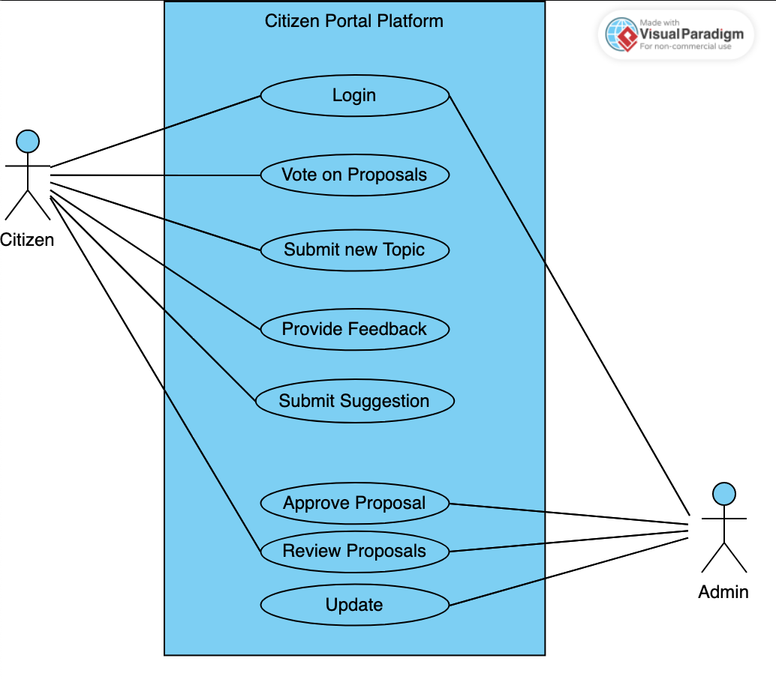
Use-Case Diagram

Slide 11
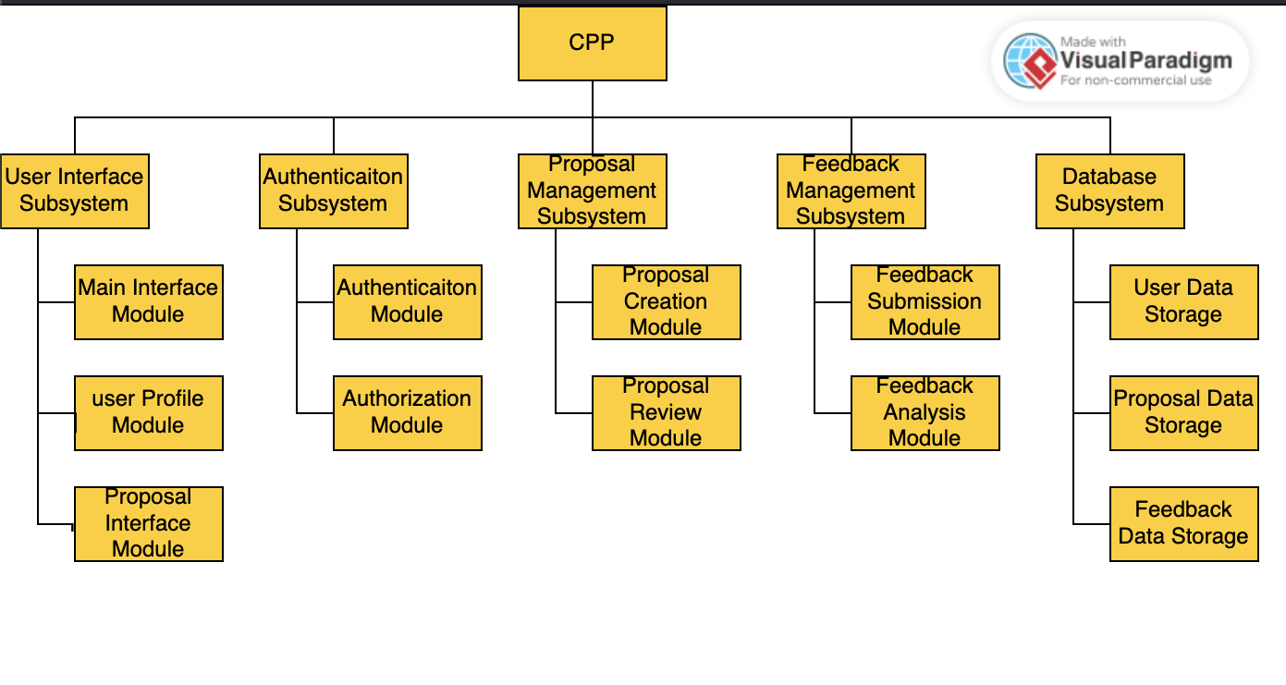
Structural Decomposition Diagram

Slide 12
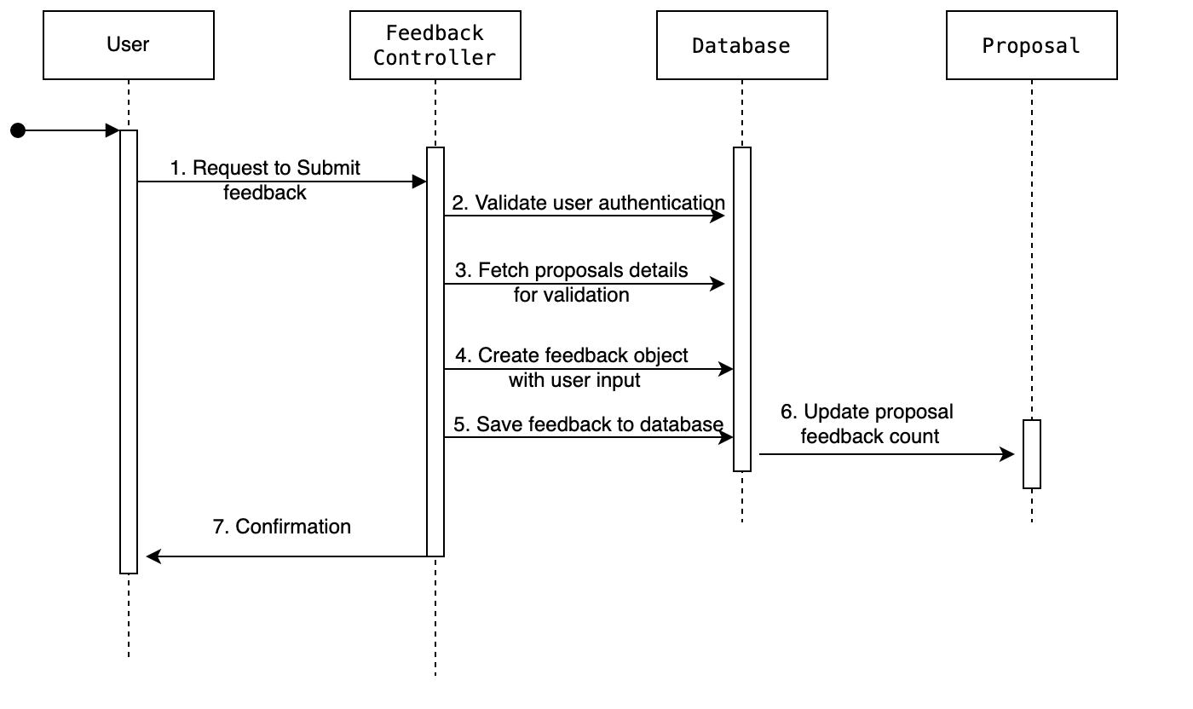
Sequence Diagram

Slide 13
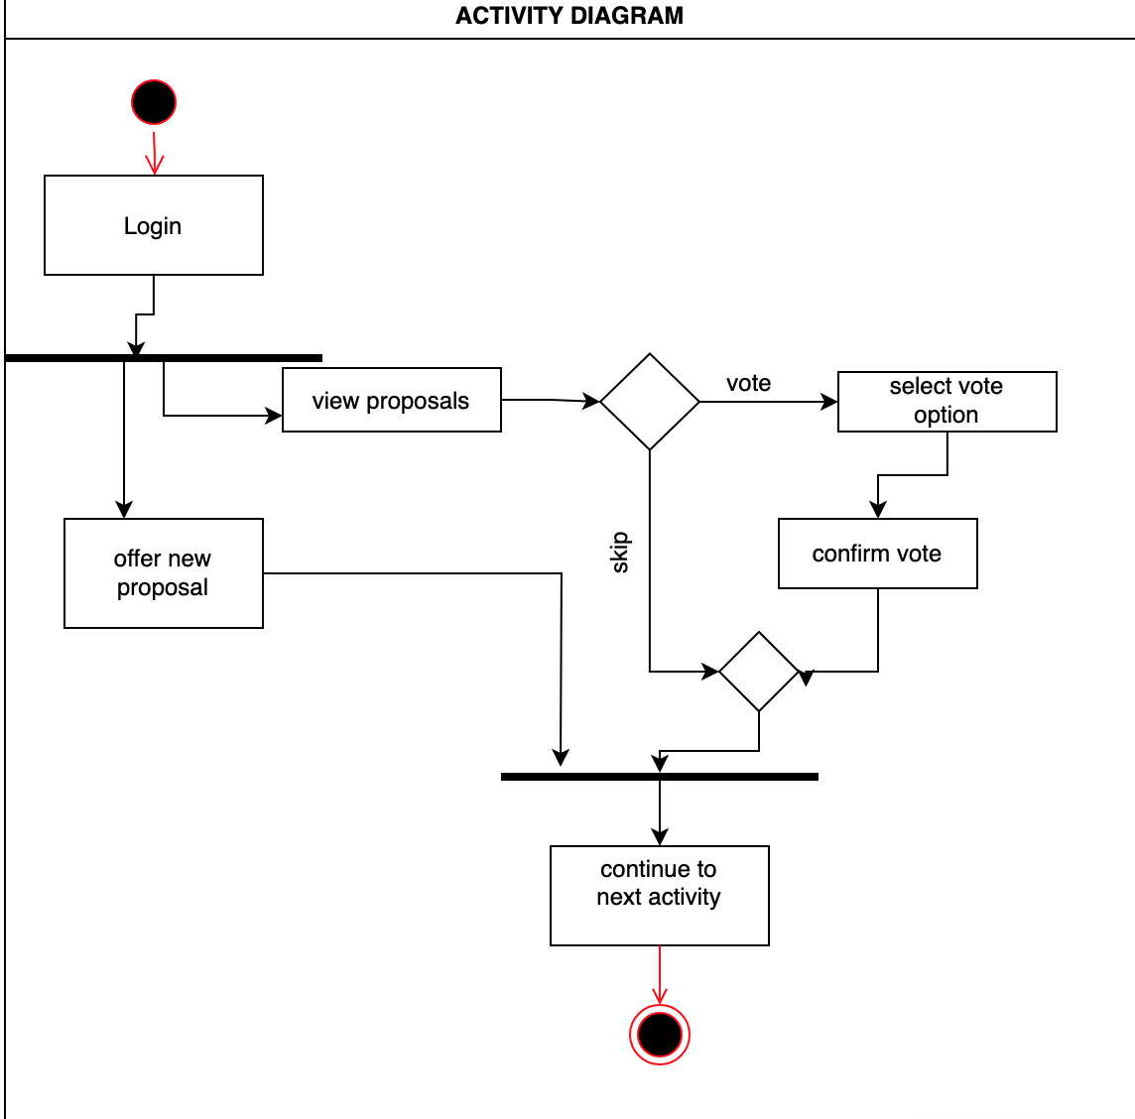
Activity Diagram

Slide 14
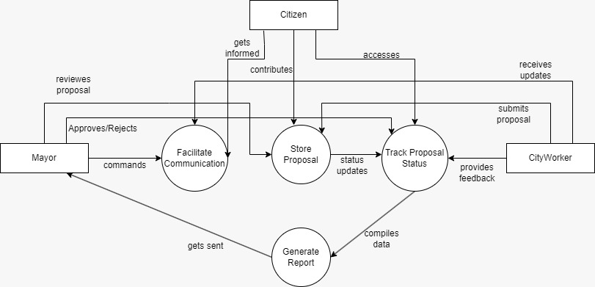
Data Flow Diagram

Slide 15
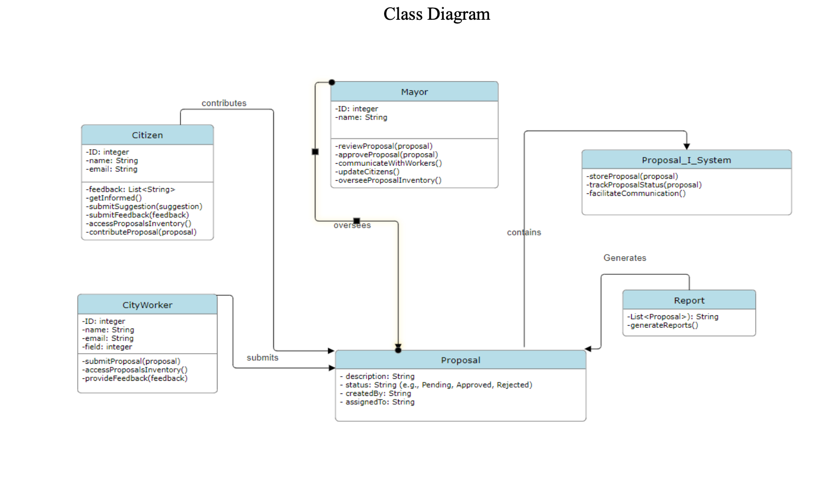
Class Diagram

Slide 16
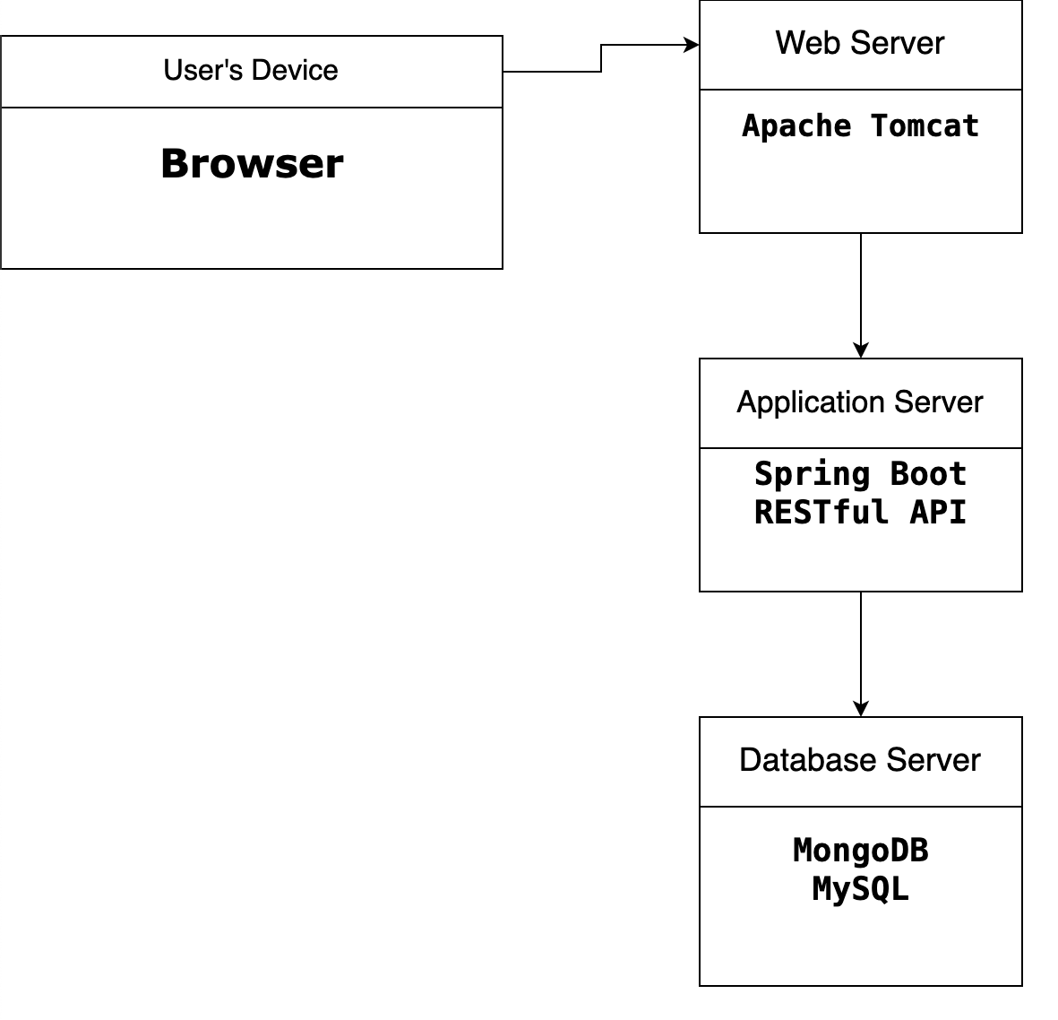
Deployment Diagram

Slide 17

Software Architecture
Subsystems
User Interface: Web-based interface designed for ease of use and accessibility.
Authentication: Secure login system managing user credentials and access levels.
Proposal Management: Handles the creation, submission, and voting on proposals.
Feedback Management: Manages user feedback on various topics and proposals.
Database: Central repository for storing all user data, proposals, and feedback.

Slide 18

User Acceptance Criteria
User can successfully vote on a proposal.
User can submit a new topic for discussion.
User can provide feedback on existing topics.
User can manage and update their profile information.

Slide 19
Test Scenarios
Voting Validation: Ensure votes are correctly recorded and updated in the database.
Topic Submission: Verify that new topics are correctly submitted and displayed.
Feedback Submission: Check that feedback is stored accurately and visible to other users.
Error Handling: Test how the system handles errors and edge cases, ensuring stability.

Slide 20

Conclusion
Summary
The Citizen Portal Platform effectively supports civic engagement through well-defined features and a robust architecture.
The platform’s design and functionalities align with the specified requirements, ensuring a user-friendly and secure experience.
Future Work
We plan to iteratively improve the platform based on user feedback.
Future enhancements may include real-time analytics and additional features to further engage citizens.

Slide 21

Q&A Session:
We welcome any questions from the audience regarding the presentation and the Citizen Portal Platform.

