Slide 1
From TE-CCL to Graph Neural Policy Learning for Adaptive Collective Communication
Problem: Optimizing collective communication over heterogeneous accelerator topologies — especially in multi-chassis or cross-region-like settings— is computationally expensive.
Current solution: TE-CCL uses MILP optimization to generate high-quality schedules, but solving can be computationally expensive.
Our goal: Learn this optimization behavior with graph neural networks in a using a "Teacher-Student" framework
, so that high-quality communication decisions can be produced much faster

Slide 2
Pipeline Overview
Step 1 — Teacher data extraction
TE-CCL outputs are parsed into:
topology graphs
policy matrices
collective finish times
Step 2 — Agent
Input: topology graph
Output: edge-level communication policy
Step 3 — SimNet
Input: topology graph + policy
Output: predicted collective completion time
End-to-end goal Topology → Agent → Policy → SimNet → Time

Slide 3
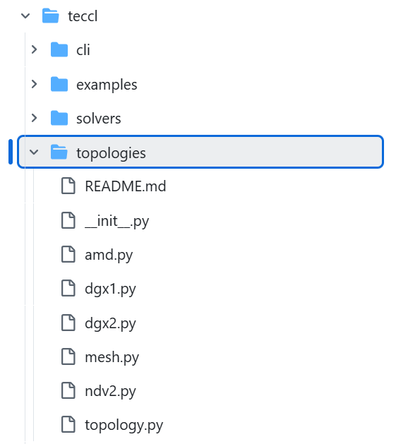
TE-CCL Repository as Teacher and Data Source
2 components of the TE-CCL repository were used:
1. Topologies : To construct communication graphs
NDv2 and DGX2 were the two topology families used in the final dataset, since they are experiments with them provided with the TE-CCL expert outputs.
Topologies were defined with :
Capacity → link bandwidth
Alpha → link latency
Switch indices → switch node identities
Chassis → multi-chassis structure
Nodes per chassis → local topology size

Slide 4
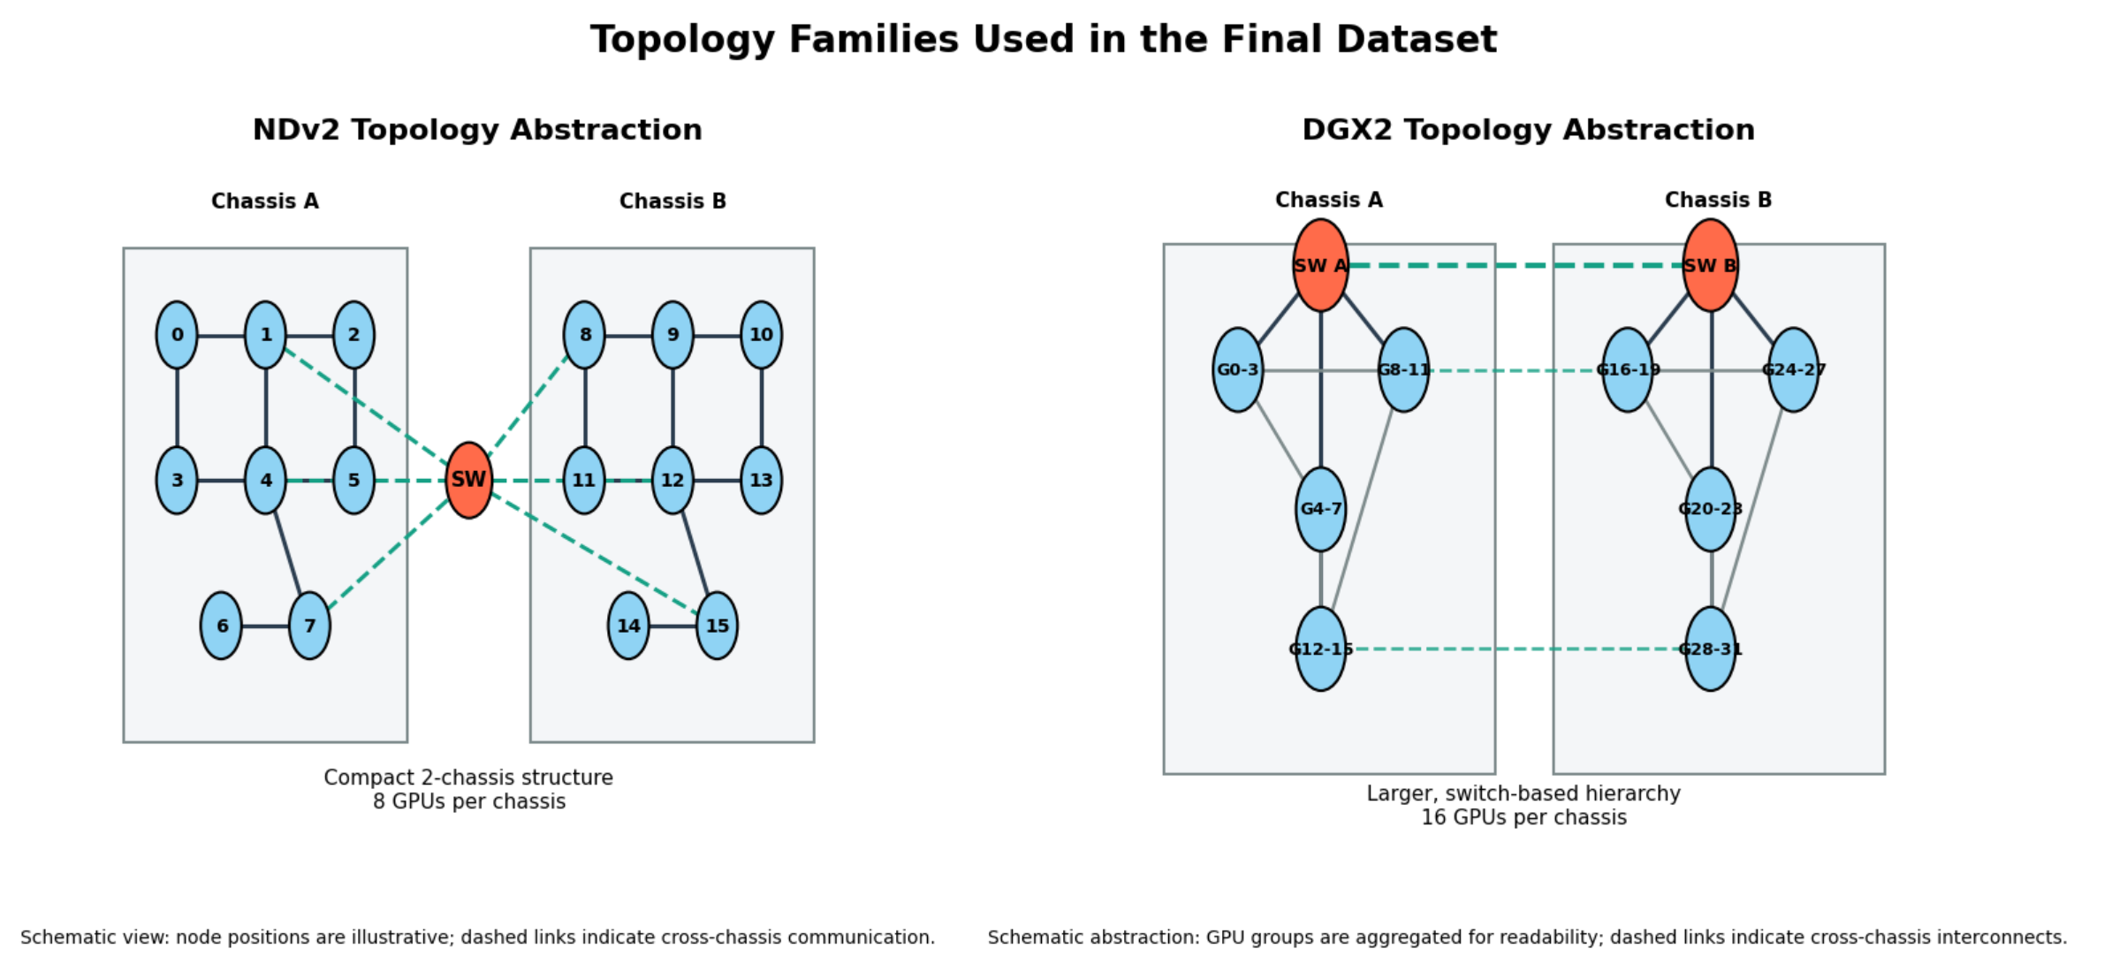
Topologies Used in Final Dataset

Slide 5
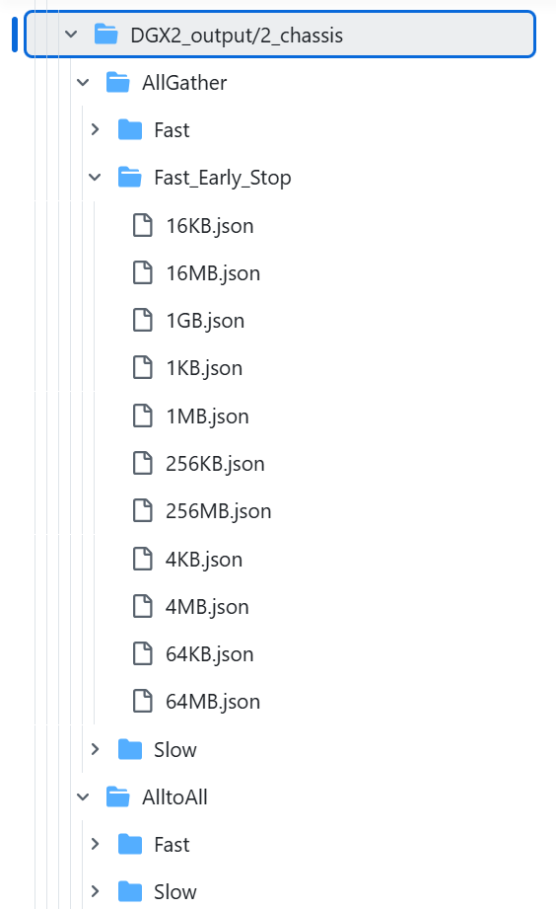
TE-CCL Repository as Teacher and Data Source
2. Experiments with Provided outputs : To extract expert schedules and collective completion times as supervision targets
Each output file represents a combination of configurations:
Component | Final Dataset
Topologies | NDv2, DGX2
Chassis | 2, 4 (4-chassis mainly from NDv2)
Collectives | AllGather, AlltoAll
Modes | Fast, Slow, Fast_Early_Stop
Message sizes | 1KB – 1GB
Total samples | 154

Slide 6
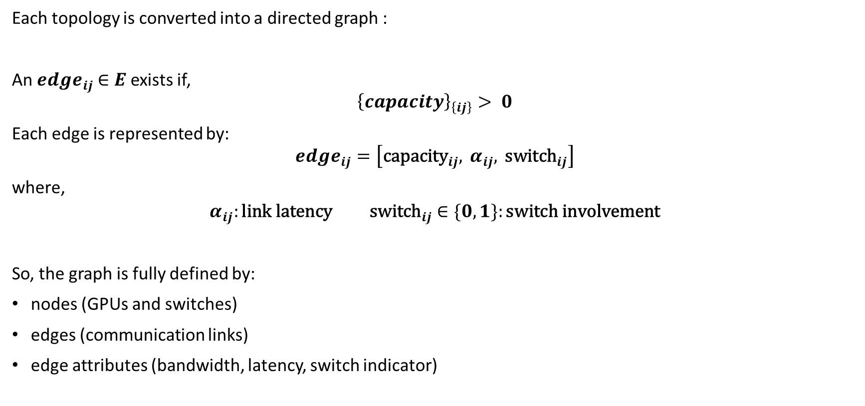
Graph Construction from Topology
Each topology is converted into a directed graph :
An ${edge}_{ij}$ $∈E$ exists if,
$${\left\{capacity\right\}}_{\left\{ij\right\}}> 0$$
Each edge is represented by:
$${edge}_{ij}=\left[{\text{capacity}}_{ij}, α_{ij}, {\text{switch}}_{ij}\right]$$
where,
$$α_{ij}:\text{link} \text{latency} {\text{switch}}_{ij}∈\{0,1\}:\text{switch} \text{involvement}$$
So, the graph is fully defined by:
nodes (GPUs and switches)
edges (communication links)
edge attributes (bandwidth, latency, switch indicator)

Slide 7

Policy Matrix Extraction from TE-CCL Flows
Each TE-CCL output provides a set of communication flows of the form:
$$\text{Chunk} c \text{traveled} \text{over} i→j$$
The policy matrix $P∈R^{N×N}$constructed as :
$$P_{ij}=\sum_{\text{flows}}{1}\{\text{edge} i→j \text{is} \text{used}\}$$
Then normalized,
$$\hat{P_{ij}}=\frac{P_{ij}}{\max_{a,b}{P_{ab}}} \hat{P_{ij}}∈\left[0,1\right]$$

Slide 8
The Agent GNN
Input: Graph
3 layer GNN Encoder (GATv2) The GNN encoder updates each node by looking at its neighbors and the quality of connections.
Node Embeddings This produces node embeddings that capture the structure of the network.
Edge Scoring (MLP)
Then, for each edge, we combine the two endpoint embeddings and edge features to compute a score.
Output: Policy Matrix Finally, we obtain a policy score for every communication link.
GATv2 is preffered as an attention mechanism and it allows the model to weight neighbors differently based on the varying edge attributes.

Slide 9
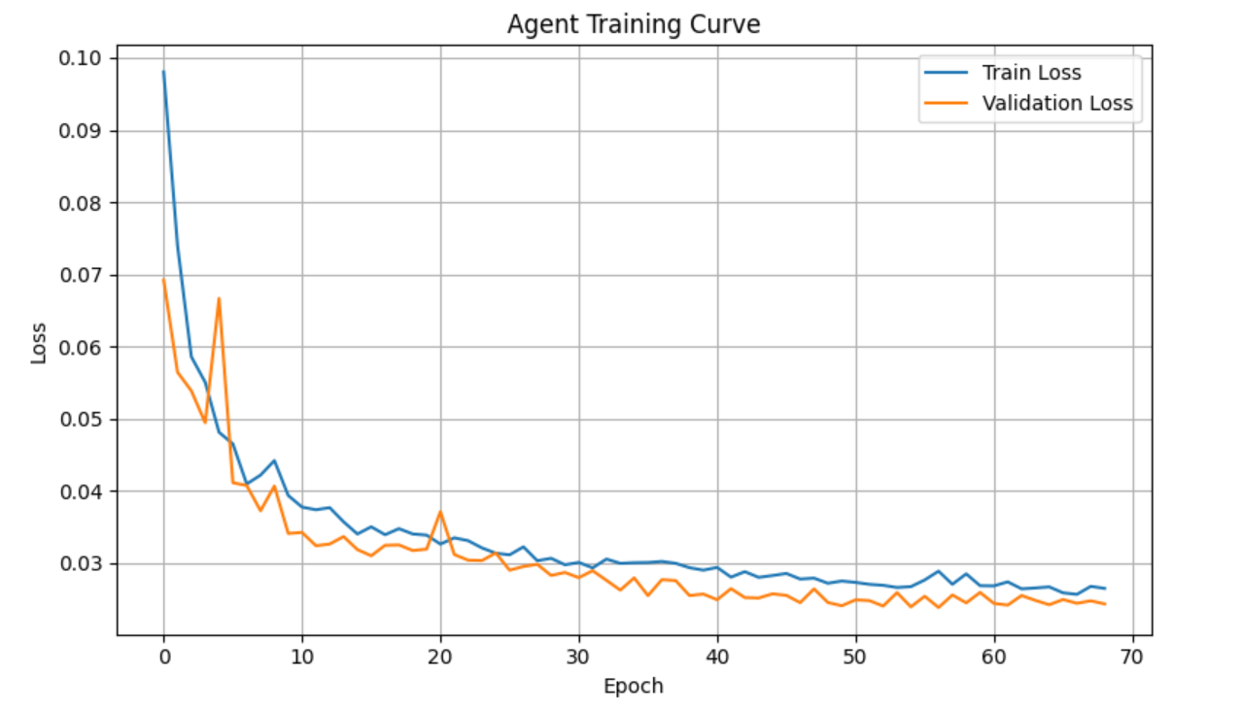
Agent Training Results
Early stopping applied.
The training and validation losses decrease consistently, indicating stable learning.
The gap between them remains small, suggesting good generalization.
The model alone successfully learns to approximate the expert communication policies.
Best validation loss: 0.0237
Test loss: 0.0228

Slide 10
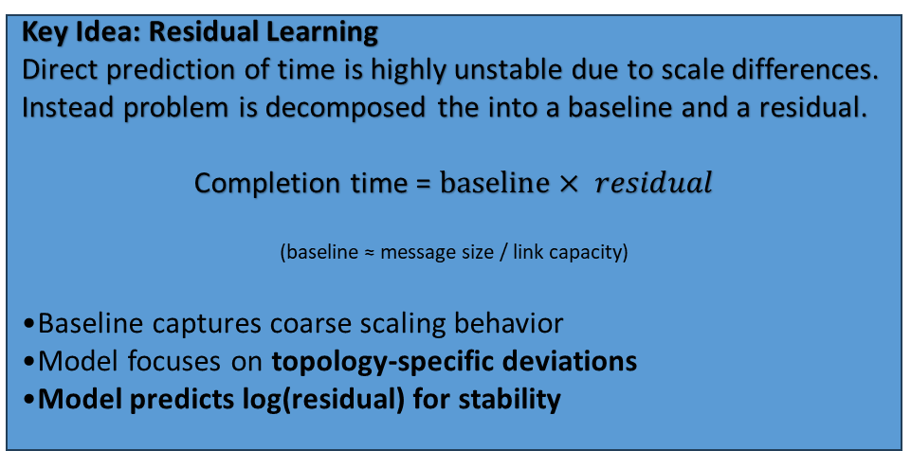
SimNet GNN: The Proxy Model
Goal: Learn a differentiable surrogate model of collective communication time and approximate expensive simulator calls during optimization.
Input:
Graph topology (nodes + edges)
Edge features (latency, bandwidth, policy)
Global Metadata:
Message size (log-scale)
Collective type (AllGather / AlltoAll)
Output:
Predicted completion time
(via residual reconstruction)
Key Idea: Residual Learning
Direct prediction of time is highly unstable due to scale differences. Instead problem is decomposed the into a baseline and a residual.
Completion time = $baseline× residual$
(baseline ≈ message size / link capacity)
Baseline captures coarse scaling behavior
Model focuses on topology-specific deviations
Model predicts log(residual) for stability
3-layer GNN Encoder (GATv2)
Global Pooling
Input
Node Embeddings
MLP
Output
+
Global Metadata

Slide 11
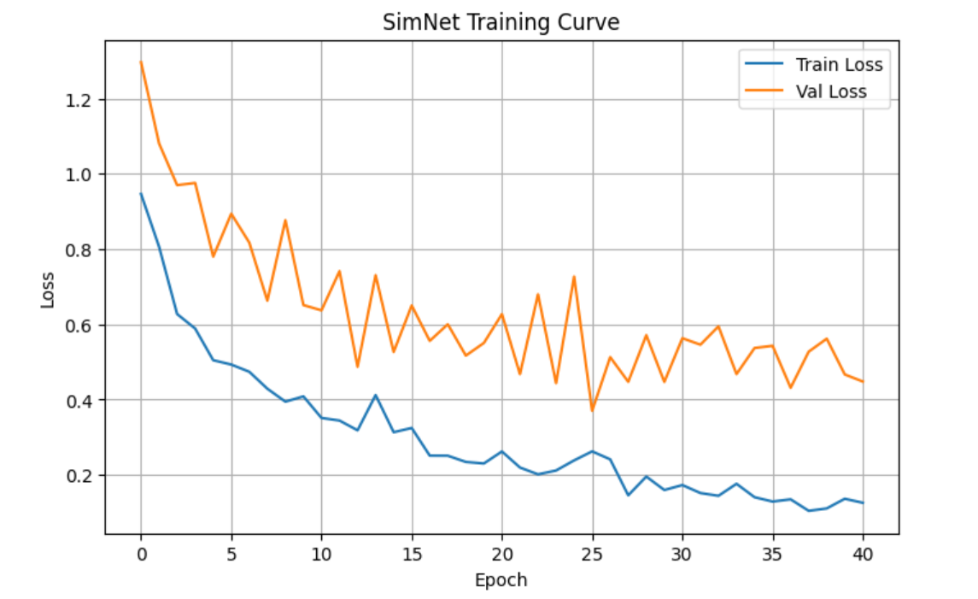
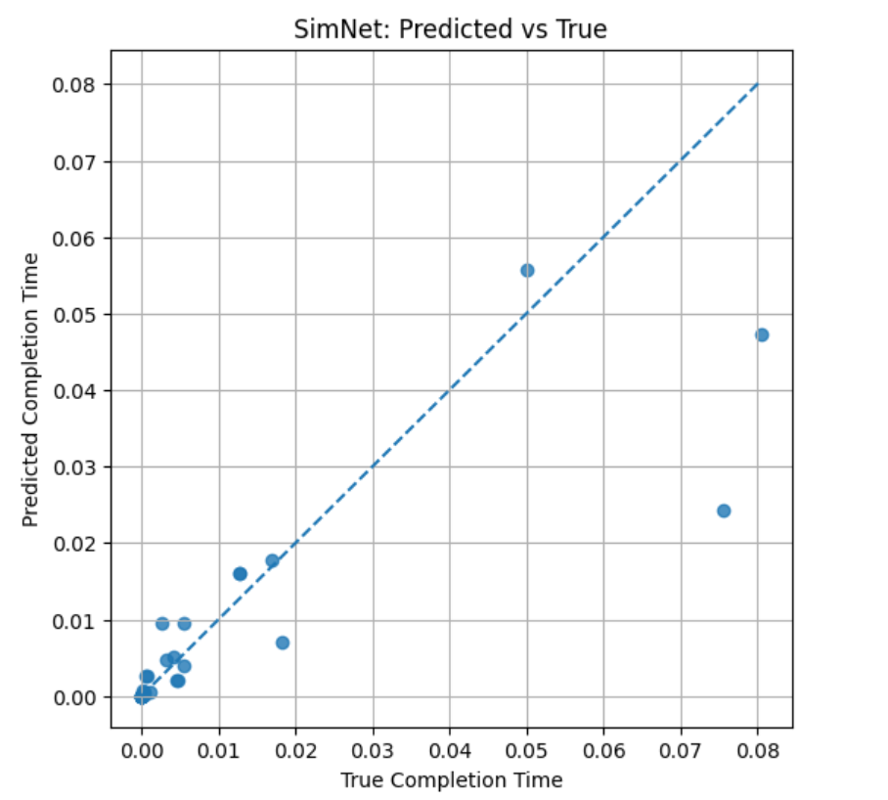
SimNet Training Results
Model achieves nearly stable convergence during training, validation loss fluctuates.
Good alignment between predicted and true completion times at small scale.
Higher variance observed for larger message sizes , likely due to increased complexity and limited training samples in that regime.
Performance degrades slightly in high-latency / large-scale regimes
Limited training data restricts full generalization

