Slide 1
Final Project Title
Delivering an ML/AI Strategy, AI for Business Leaders, Udacity
Student Name, Month - Year
© 2024 Udacity.

Slide 2
Executive Summary
Purpose of Project
Project origination -- e.g., taking the course itself
Need and/or impending doom of not running a data-driven business
Methodology
Analysis conducted over _________ weeks
Over ___ potential use cases underwent thorough assessment for feasibility and impact
Incorporated both technical knowledge and user feedback
Path Forward
___ use cases identified for implementation
Needs and requirements to be successful
Next steps

Slide 3
I Began with Four Use Case Ideas
Use Case 1 Title
Description of Use Case 1
------------------------------------------
Use Case 4 Title
Description of Use Case 4
------------------------------------------
Use Case 2 Title
Description of Use Case 2
------------------------------------------
Use Case 3 Title
Description of Use Case 3
------------------------------------------

Slide 4
I Assessed Feasibility vs. Impact for All Cases
UC 1
UC1: <Enter Name 1 Here>
UC 2
UC2: <Enter Name 2 Here>
UC 3
UC3: <Enter Name 3 Here>
Impact
UC 4
UC4: <Enter Name 4 Here>
low
low
Feasibility
high

Slide 5
Transforming Our Business Using ML/A with These Top Two Use Cases
Use Case Title
Description of Use Case ----------------------------------------------------------------------------------------------------------------------------------------
Use Case Title
Description of Use Case ----------------------------------------------------------------------------------------------------------------------------------------
By executing on these two projects I believe we can drive ___________ for our business by _______ and become a(n) _______ business.

Slide 6
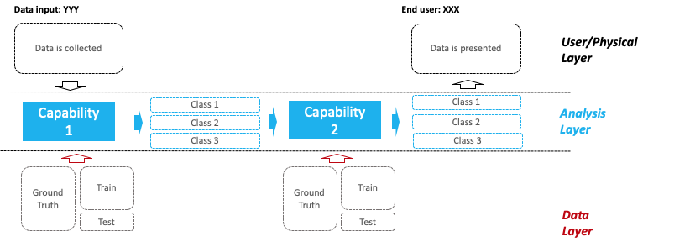
Use Case 1 __________ Deep Dive
Process Today
Storyboard point 1
Storyboard point 2
Storyboard point 3
Storyboard point 4
Example Architecture
Process Tomorrow
Storyboard point 1
Storyboard point 2
Storyboard point 3
Storyboard point 4
The impact of ___ will be ____ thanks to ____!

Slide 7
Use Case 2 __________ Deep Dive
Process Today
Storyboard point 1
Storyboard point 2
Storyboard point 3
Storyboard point 4
Example Architecture
Process Tomorrow
Storyboard point 1
Storyboard point 2
Storyboard point 3
Storyboard point 4
The impact of ___ will be ____ thanks to ____!

Slide 8
Risks / Mitigations
 | Use Case | Use Case
Accuracy Definition | Concerns: Plan: | Concerns: Plan:
Underfitting/Overfitting Definition | Concerns: Plan: | Concerns: Plan:
Ethical Concerns Definition | Concerns: Plan: | Concerns: Plan:

