Slide 1
Robot Learning and Interaction
Spring 2023
LAB#1 - Particle Filter Localization Tutorial
TA email : jason27146913@gmail.com

Slide 2
Base Code Tutorial - ParticleFilter
Several Important Attributes For ParticleFilter
self.map -> OccupancyGrid
# the information of map
self.num_particles -> int
# the number of particles used in the particle filter
self.particle_cloud -> list of Particle
# the particle clouds array
self.robot_estimate - Pose
# the estimated robot pose
# should be updated in update_estimated_robot_pose()
self.odom_pose - PoseStamped
# the current poses of robot
self.odom_pose_last_motion_update - PoseStamped
# the previous poses of robot

Slide 3
Base Code Tutorial - ParticleFilter
Several Important Implemented Functions For ParticleFilter
self.robot_scan_received(data)
# receive LaserScan’s data, then
# update the particles if the robot have moved far enough
self.initialize_particle_cloud()
# initialize particles to random positions, normalized their weights and then publish particle cloud
self.normalize_particles()
# make all the particle weights sum to 1.0
self.get_map()
# get real map information
get_yaw_from_pose(pose) -> Float
# return Euler angle of yaw

Slide 4
Base Code Tutorial - ParticleFilter
Several Functions To Be Implemented For ParticleFilter
self.update_particles_with_motion_model()
# based on the how the robot has moved (calculated from its odometry),
# we'll move all of the particles correspondingly
self.update_particle_weights_with_measurement_model(data: LaserScan)
# update particle weights with measurement information,
# you can use self.likelihood_field to help you implement this function
self.resample_particles()
# resample particles using the updated weights
self.update_estimated_robot_pose()
# update the robot pose estimate based on the particles

Slide 5
Base Code Tutorial - Functions To Be Implemented
class ParticleFilter:
def update_particles_with_motion_model(self):
#TODO
def update_particle_weights_with_measurement_model(self, data):
#TODO
def resample_particles(self):
#TODO
def update_estimated_robot_pose(self):
#TODO

Slide 6
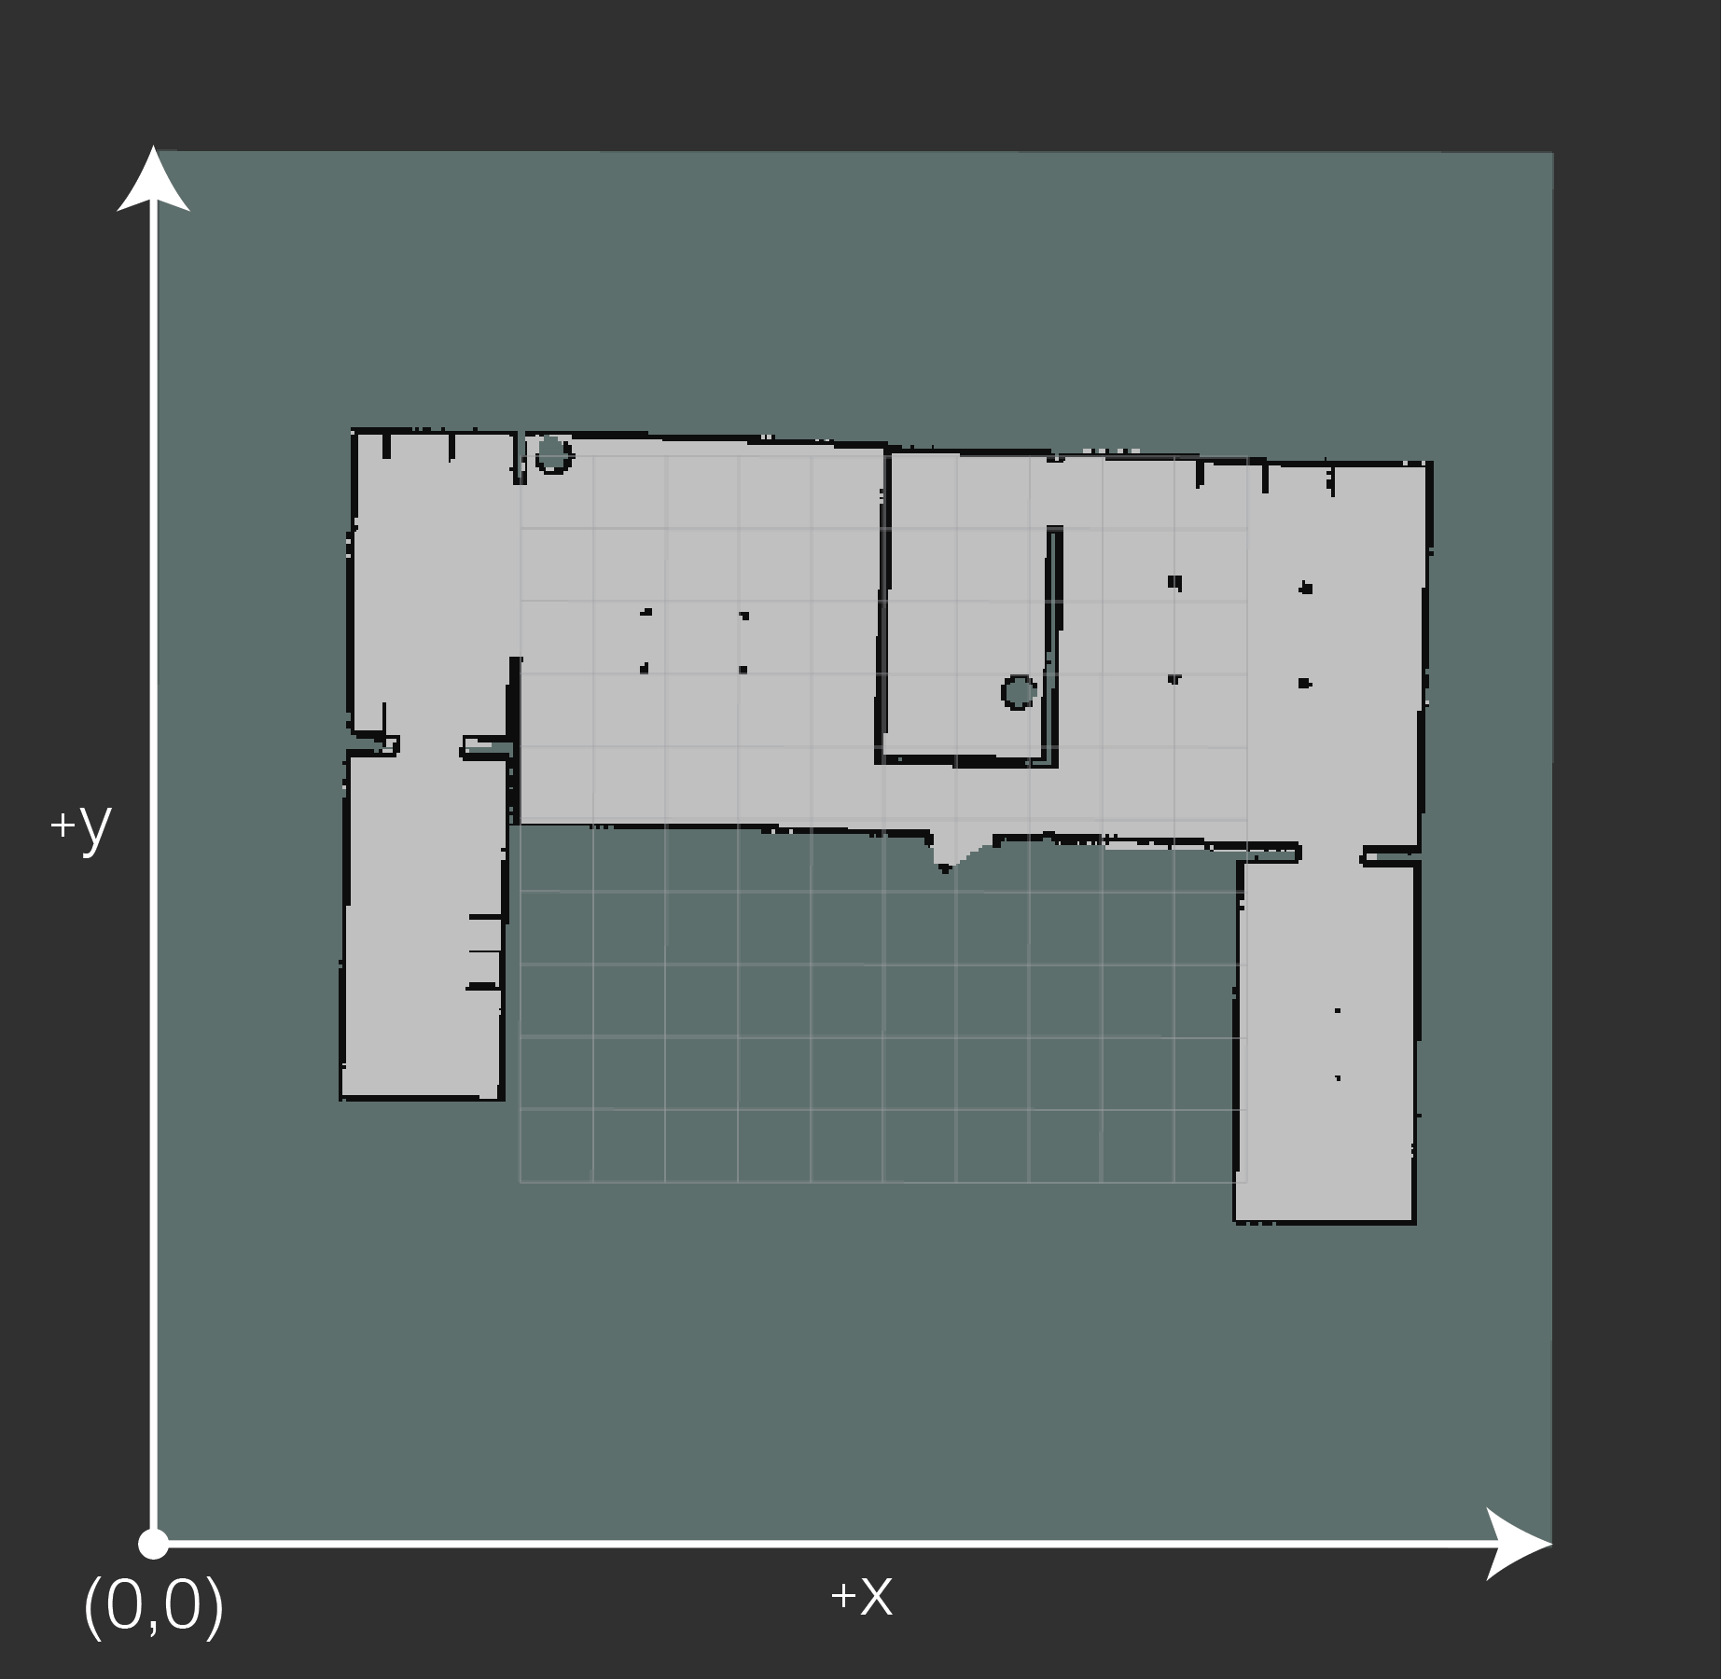
Base Code Tutorial - OccupancyGrid
Several Important Information For OccupancyGrid (self.map)
self.map.info -> MapMetaData
resolution -> float # The map resolution [m/cell]
width -> uint # Map width [cells]
height -> uint # Map height [cells]
origin -> Pose # The origin of the map .
This is the real-world pose of the cell (0,0) in the map.
position -> Point(x, y, z)
orientation -> Quaternion(x, y, z, w)
self.map.data -> int[]
# The map data, in row-major order, starting with (0,0).
# Occupancy probabilities are in the range [0,100].
# Empty (white): 0,
# Obstacle (gray): 1-100,
# Unknown (Outside the map): -1.

