Slide 1
CSCI 578 Software Architecture Assignment 3
March 4th, 2016
Tatsuhiko Tomita
USCID:5699305385

Slide 2
Files
readme.pptx
this file
analysis/*.xml
Results of COVERT analysis
soup.py
For parsing the App description XML files
For finding connections between applications.
index.html
visualization code
createUrlWithJsonFile.sh
create url for each json files
(output/*.json)
Json files for visualization. They will be created by executing soup.py
(d3/)
d3 scripts (used by index.html for visualization)

Slide 3
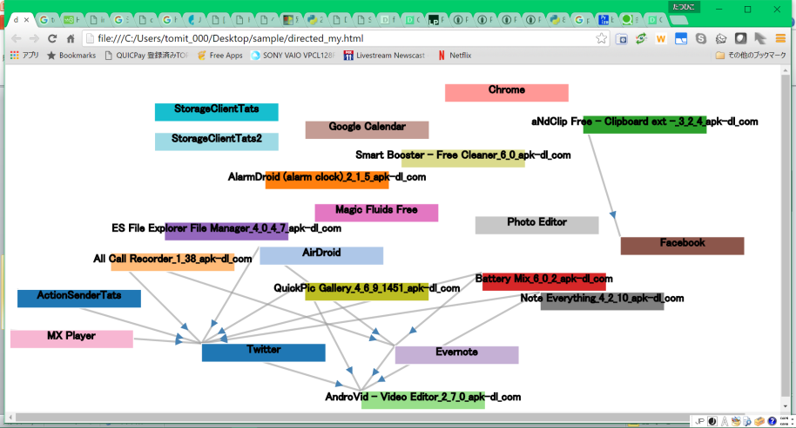
Toolchain
Legend
Data
External Tool
My Output
analyze/*.xml
output/*.json
APK files
soup.py
COVERT
index.html
Beautiful Soup
d3
createUrlWithJsonFile.sh
file:///home/***/index.html?file=???.json

Slide 4
Development Environment
Python 2.7.6
Beautiful Soup 4.4.1
https://www.crummy.com/software/BeautifulSoup/
apt-get install python-pip
pip install beautifulsoup4
D3 3.5.16
https://d3js.org/

Slide 5
How to use
open Linux terminal
$ cd $TOP/
$ python soup.py analysis output
analysis : xml files are in this directory
output : json files will be in this directory
$ ./createUrlWithJsonFile.sh output file:///./index.html?file=./output/merge.json file:///./index.html?file=./output/MX Player.json …
Open the above link in WEB browsers (e.g. Chrome)
merge.json : For visualization of all applications (w/o component level)
***.json : For visualization of each application (w/ component level)

Slide 6
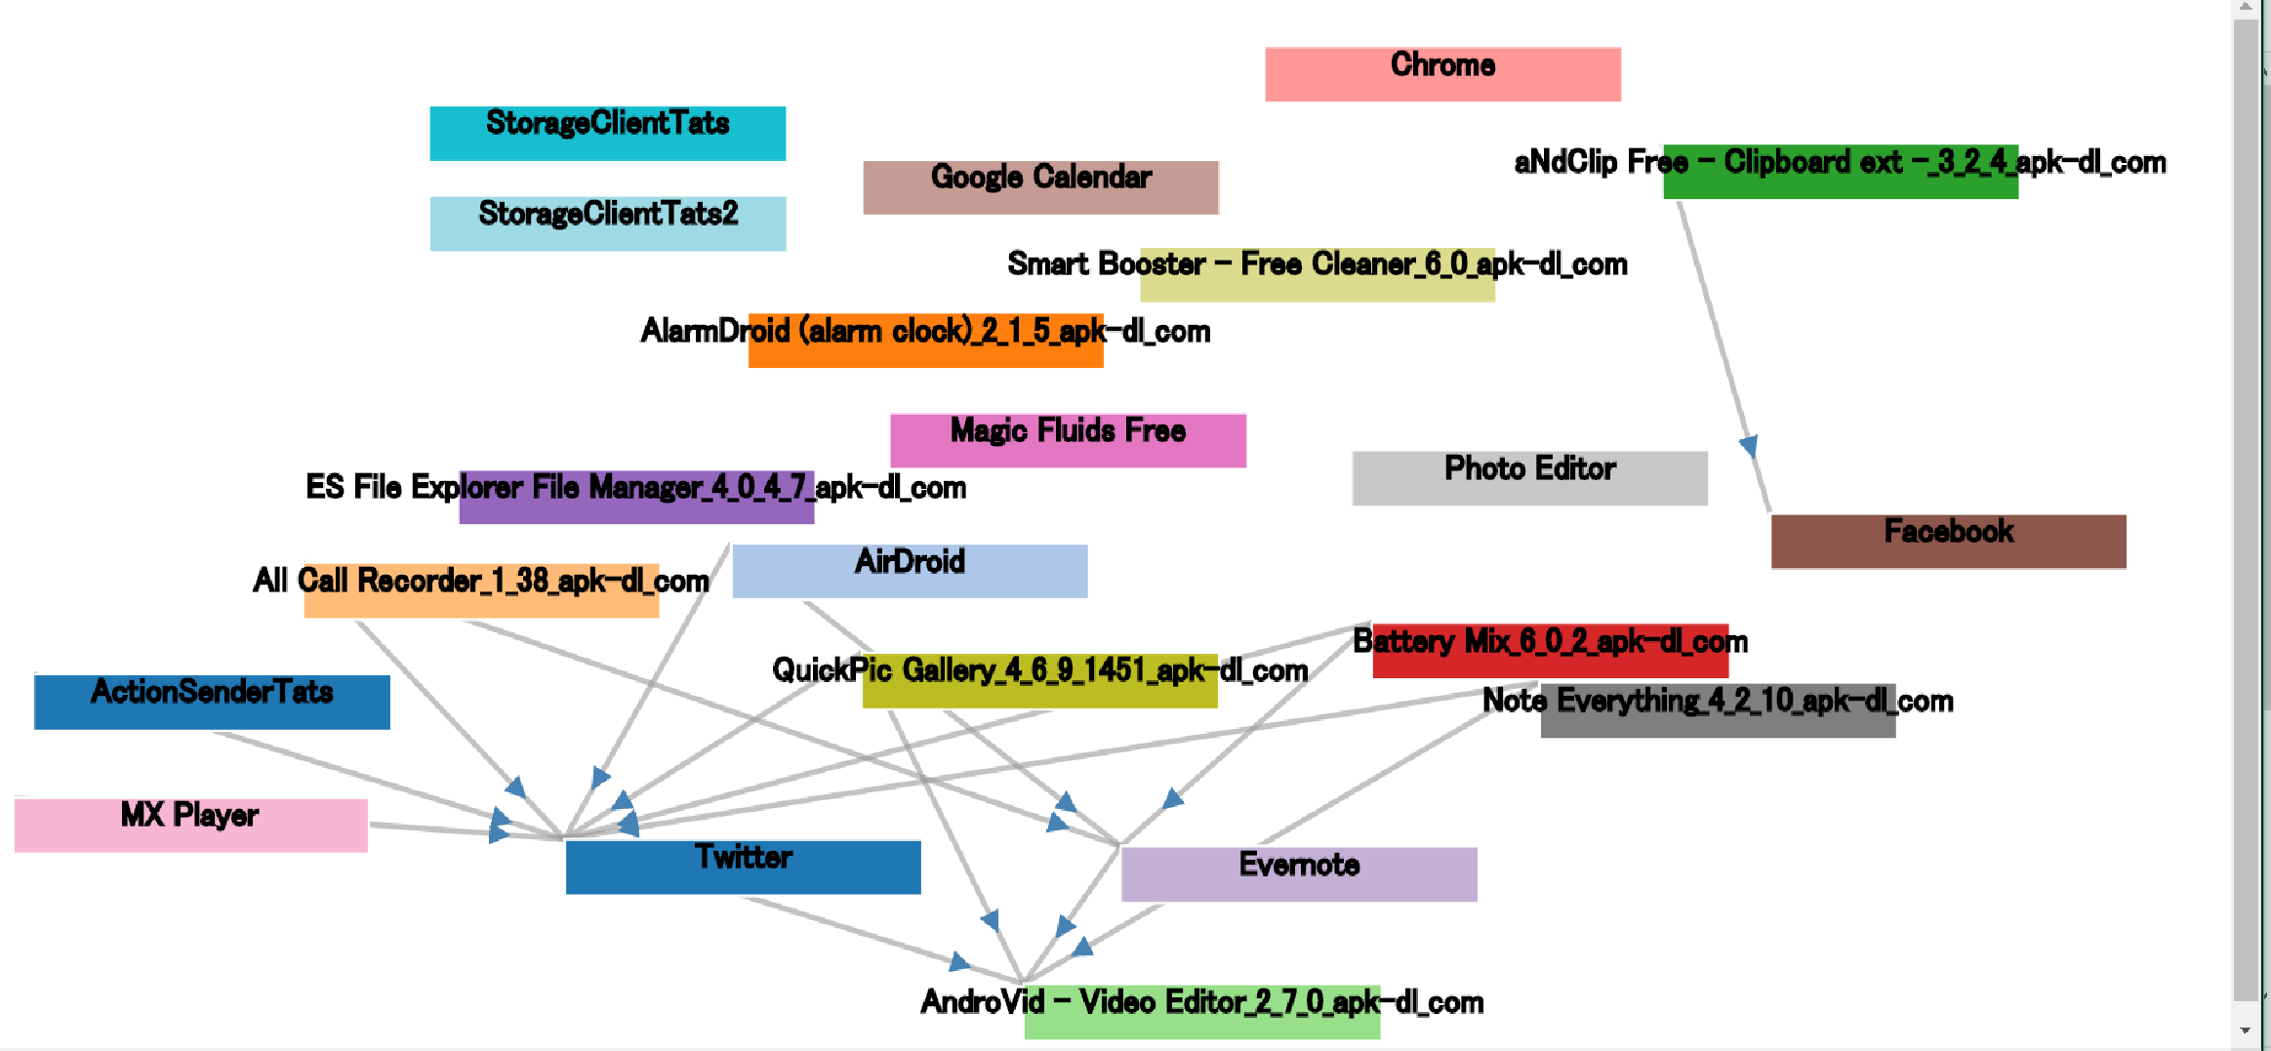
Output Image
index.html?file=merge.json

Slide 7
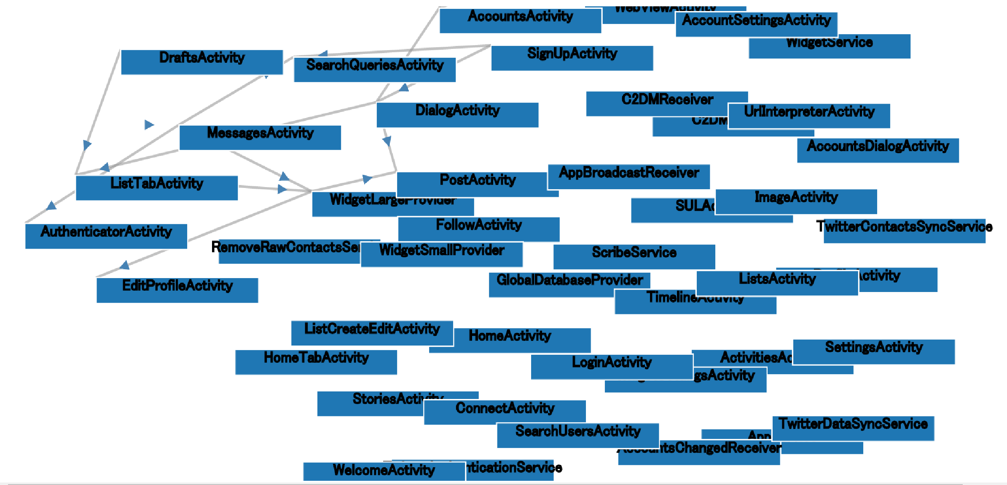
Output Image
index.html?file=Twitter.json

Slide 8
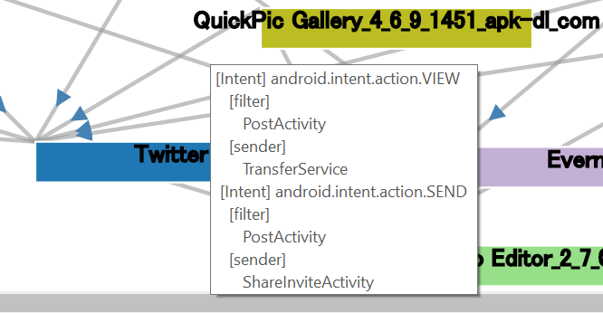
Output Image
Show the link’s detail when the mouse moves over the link element.
Even if the link has more than one Intent, show all of the relationships
Here, an example for link between “QuickPic” and “Twitter”
[filter] means components that declare Intent Filter in receiver app (here, Twitter).
[sender] means components that send the Intent in sender app. (here, QuickPick)

Slide 9
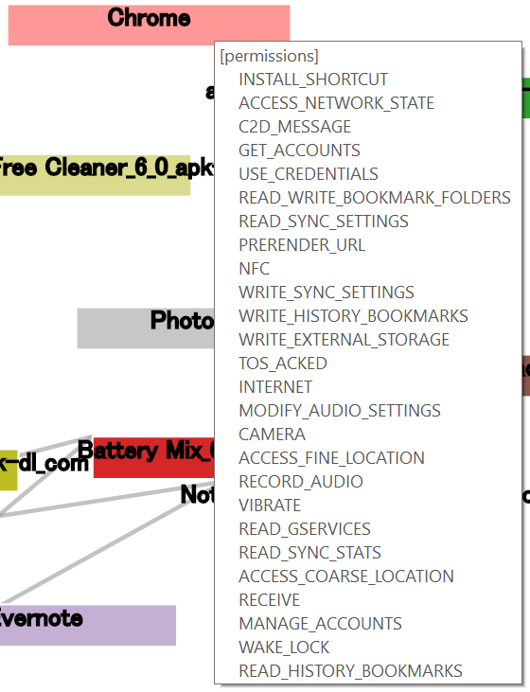
Output Image
Show the application’s permissions when the mouse moves over the App element.
Here, an example for “Chrome”

Slide 10
Observations
Only 4 apps out of 20 apps might be attacked because they have Intent Filter and the others might send Implicit Intent to them
My ICC application, ActionSenderTats, uses action.SEND and it can only affect “Twitter” application (“PostActivity” component in detail) among 20 apps I chose

Slide 11
End

