Slide 1
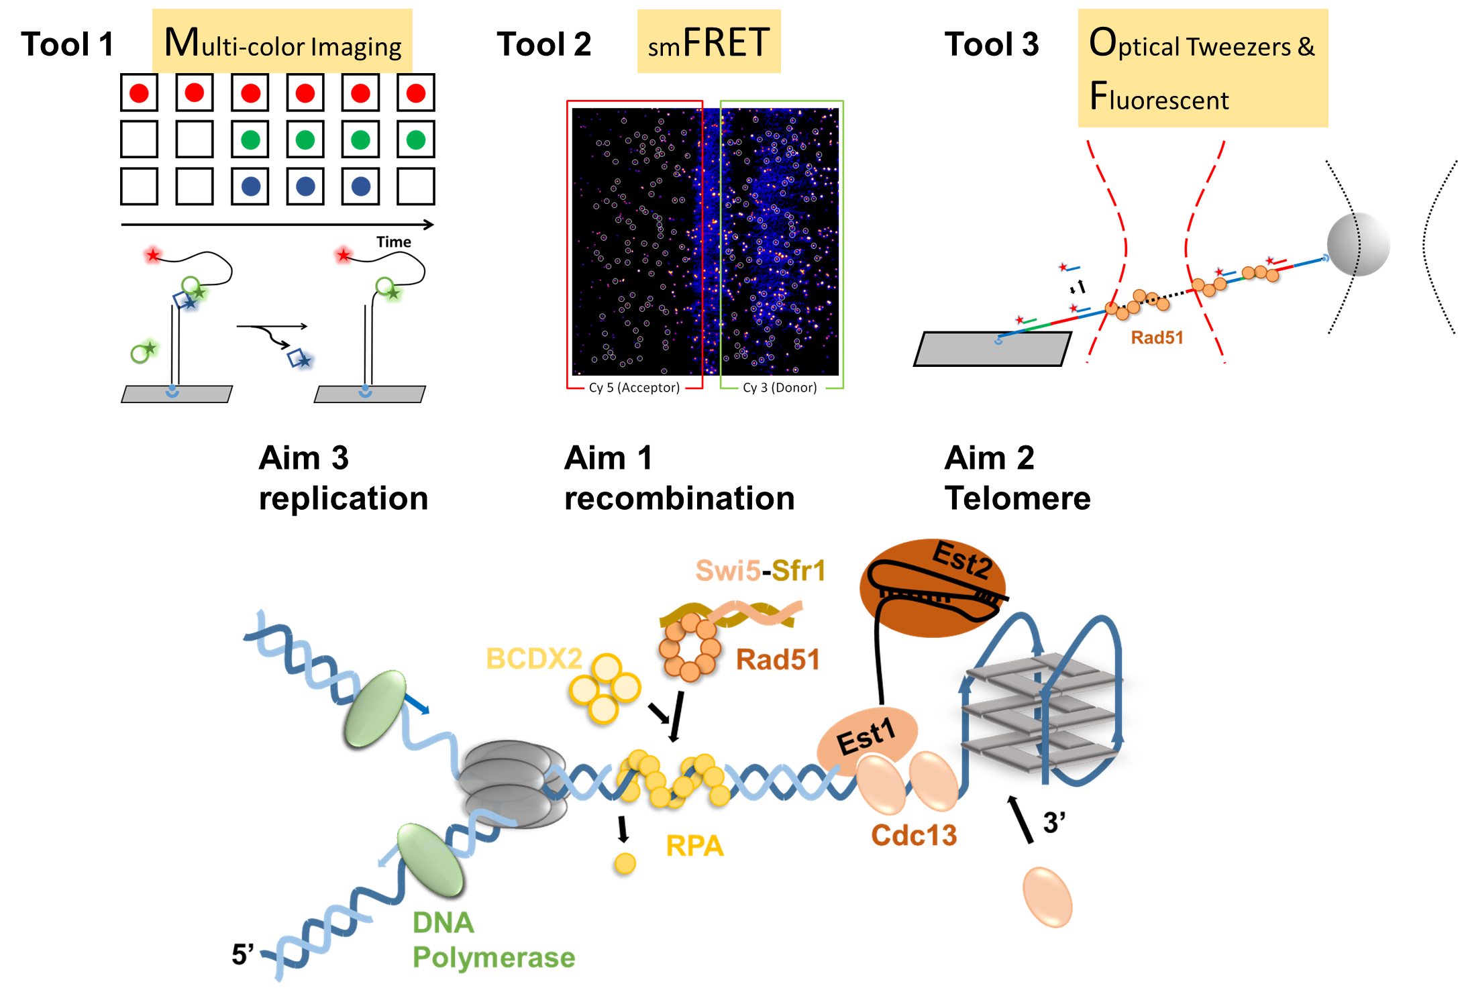
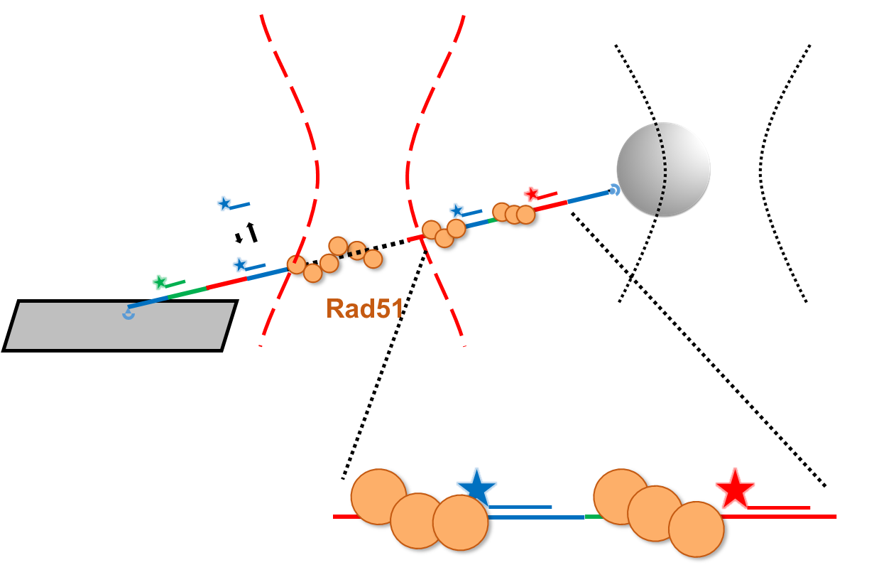
Single Molecule
The Li Lab
(B)

Slide 2

The Li Lab
Single Molecule
Techniques

