Slide 1
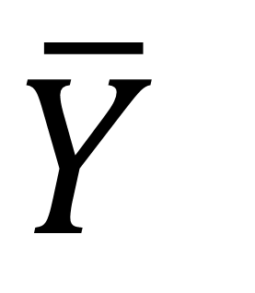

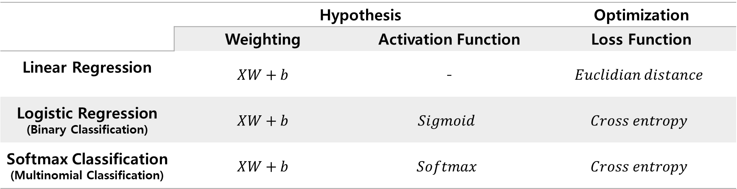

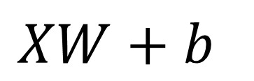
1.
2.
$$X$$
$$\overline{Y}$$
$$XW+b$$
$$f(XW+b)$$
Activation Function
 | Hypothesis |  | Optimization
 | Weighting | Activation Function | Loss Function
Linear Regression | $$XW+b$$ | - | $$Euclidian distance$$
Logistic Regression (Binary Classification) | $$XW+b$$ | $$Sigmoid$$ | $$Cross entropy$$
Softmax Classification (Multinomial Classification) | $$XW+b$$ | $$Softmax$$ | $$Cross entropy$$

Slide 2
1.
2.
$$X$$
$$\overline{Y}$$
$$XW+b$$
$$f(XW+b)$$
Activation Function
Sigmoid
ReLU
tanh

